Slide 1
Kaos
Lounge
& Restaurant

Slide 2
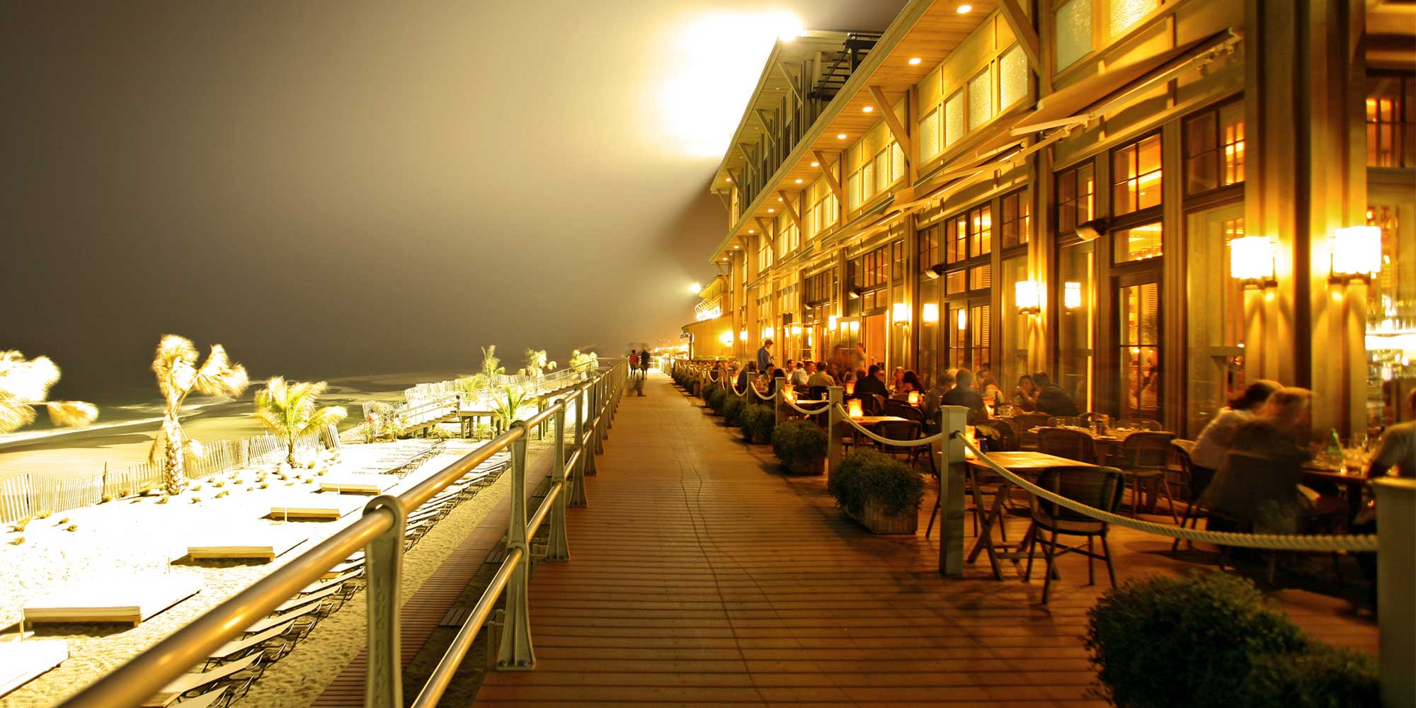
Marketing Review
Market Overview
Fine dining restaurant
Market Segment
Political
Economical
Target market
Diverse clientele ages 25-60
Located in long branch, new jersey
Cozy dining and elegant
Menu variety
Social
Technological
The business man
Happy couples
The family
High-ends singles
Tourists
60 seat fine Dining, 20 Seat Lounge
New American-Swedish with Asian Influence

Slide 3
Competitive Review
Rooneys's Oceanfront Restaurant
Open 6 days a week
Charley's Ocean Grill
Upscale lounge/food bar
Sirena Ristorante
Upscale Contemporary American restaurant at the Ocean.
Serves lunch and dinner
Located uptown on Broadway
Their price range is $7-$15 for lunch and $12-$29 for dinner entrees.
Small menu
Located in the West End district two blocks away from the ocean
Only open for dinner
Their menu range from $8-$15 and a mixed drink is $8-$10.
Open 7 days a week
Dinner for two without wine averages $100.

Slide 4
SWOT ANALYSIS
The area lacks a warm and friendly place with exceptional food.
A large population and the rapidly expanding area of Long Branch, New Jersey.
OPPORTUNITIES
THREATS
WEAKNESSES
Well educated kitchen staff.
Open on major holidays besides Thanksgiving, Christmas, and New Year’s Day.
Efficient and friendly loans.
Forms Available for catering.
Varying of entertainment.
Outdoor patio.
Open 7 days a week.
Competitive restaurants.
Appeals to a diverse clientele.
Cozy dining room and elegant lounge with comfortable furnishings.
STRENGTHS
25% of wines are only available exclusively in glass
Catering team was established before the beginning of this restaurant, therefore kaos cannot screen catering staff.
This type of restaurant not having previously been tested on clientele.
Beginning on a loan.
Ever-changing menu.
Possibility of different “theme nights”; not being successful.
Hiring a large enough and qualified staff.
Other upscale restaurants in the area.

Slide 5
Goals and Objectives
Sales Objectives
Marketing Objectives
Monthly restaurant gross sales are to average $68,186.
for dinner spending approximately $25 per person.
Catering will average $10,471/month or three parties of $3,490 each.
for lunch spending approximately $15 per person,
Foodie photos
Show off our staff
Offer coupons and discounts
fish bowl business card giveaways
share positive
website

Slide 6
Marketing Strategies
Price and Product
Appetizers and small lunches
Vegetable dumpling $7
Fresh squid salad $9
Swedish shrimp salad $11
Salads
Small mixed green salad $6
Thai chicken salad $11
Gravlax salad $12
Asian noodles $8
Sandwiches
shrimp (open face)$7
turkey wrap $6
egg salad and tuna salad$6
Fish
Fish soup $9
sea bass wit cous cous risotto $13
roasted coad with spinach and mushrooms $14

Slide 7
Price and Product
Pasta
Linda's Pad Thai $12
Garlic and fresh basil $12
Vegetarian Lasagna $12
Meat
Swedish Meatballs $13
Chicken Thai $13
Mango Chutney Filet Tenderloin $15
Desserts $6
Swedish Pancakes
Chocolate Pudding
Cocktails
La vie en rose $12
Madame Alexander $14
The Brazilian $14

Slide 8
Marketing Strategies
DISTRIBUTON
Catering for special occasions
PROMOTION SCHEDULE BUDGET
Is about $51,625.
Online and call reservations
Direct sales as dining experience.
Catering Delivery
Increase customers
Help to cover the expenses of the promotional advertisements.
New out comers going to the restaurant.

Slide 9
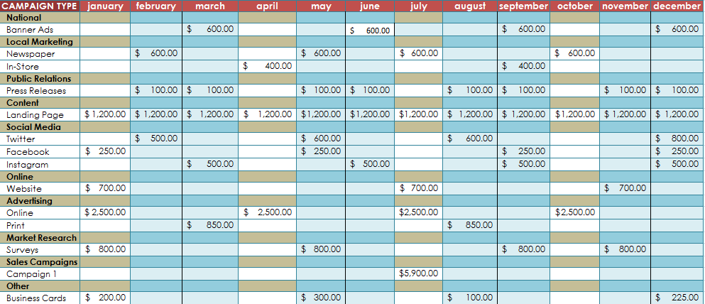

Slide 10
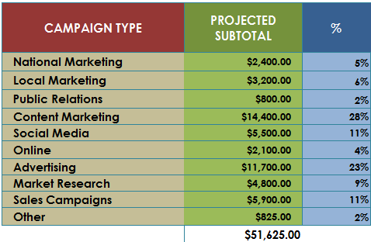

Slide 11
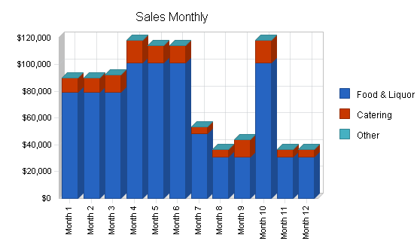
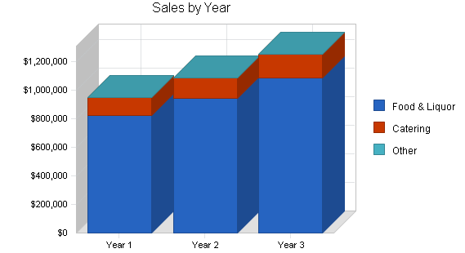
Short and long-term Projections

Slide 12
Break Even Analysis
ASSUMPTIONS
Average Percent Variable Cost: 33%
Estimated Monthly Fixed Cost: $31,125
Monthly Revenue Break-even: $46,455

