Slide 1

Human Resource Management
Fifteenth Edition
Chapter 9
Direct Financial Compensation (Core Compensation)
Copyright © 2019, 2016, 2014 Pearson Education, Inc. All Rights Reserved
Notes:
If this PowerPoint presentation contains mathematical equations, you may need to check that your computer has the following installed:
1) MathType Plugin
2) Math Player (free versions available)
3) NVDA Reader (free versions available)

Slide 2
Learning Objectives (1 of 2)
9.1 Summarize the usual components of a total compensation plan and the environment of compensation practice.
9.2 Explain the direct financial compensation practices.
9.3 Discuss job structures and how they are established.
9.4 Summarize competitive pay policies: pay level and pay mix.

Slide 3
Learning Objectives (2 of 2)
9.5 Explain what pay structures are and how they are created.
9.6 Review exceptions to the rules: compensation for sales representatives, contingent workers, and executives.

Slide 4
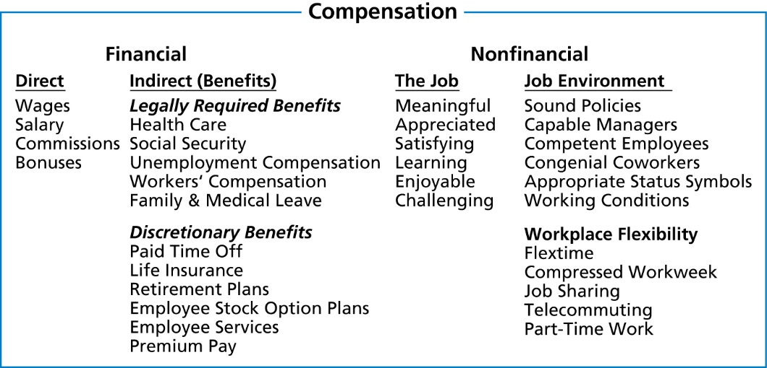
Total Compensation Components
Notes:
Compensation is an important HR practice that helps firms address the challenge of recruiting and retaining top talent and other challenges. At the broadest level, total compensation represents both the intrinsic and extrinsic rewards employees receive for performing their jobs. These components of a total compensation program are the building blocks embedded within a system of three structural elements: job structure, competitive compensation practices, and pay structures.
Compensation is the total of all rewards provided to employees in return for their services. The overall purposes of providing compensation are to attract, retain, and motivate employees. Direct financial compensation (core compensation) consists of the pay that an employee receives in the form of wages, salaries, commissions, and bonuses. Indirect financial compensation (or employee benefits) consists of all financial rewards that are not included in direct financial compensation, such as health care insurance. Nonfinancial compensation consists of the satisfaction that an employee receives from the job itself or from the environment in which he or she works. Employers may choose to award nonfinancial compensation to complement an employee’s paycheck, especially when financial compensation budgets make it difficult to award higher pay.

Slide 5
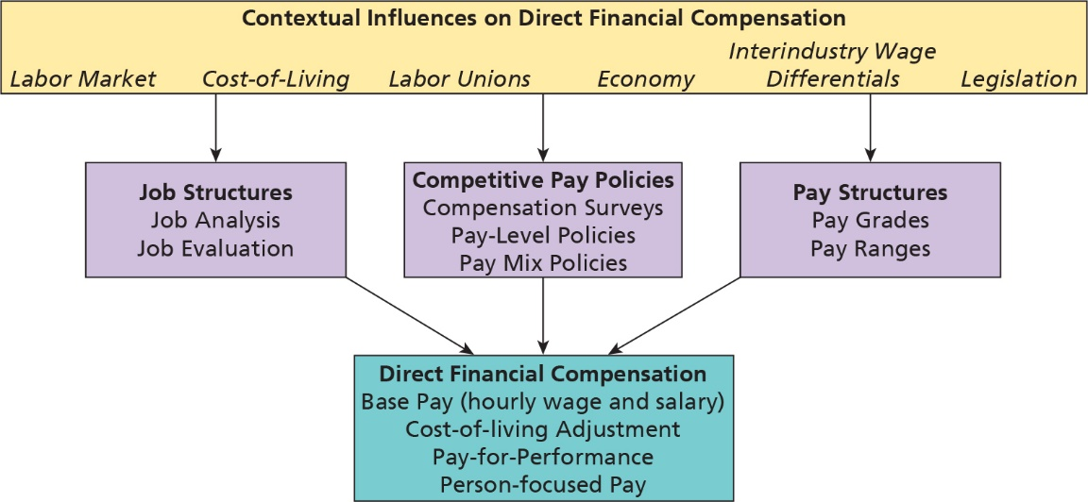
Determinants of Direct Financial Compensation
Notes:
It is important to consider how companies determine what its direct financial compensation should be. There are many factors to consider, starting with consideration of contextual factors. But, first, we briefly summarize the three structural elements of compensation plans. These elements include job structures, competitive compensation policies, and pay structures.
Management techniques used for determining a job’s relative worth include job analysis, job descriptions, and job evaluation, and together, these lead to the creation of job structures. An organization must first define and describe job content. HR professionals use job analysis for this purpose. The primary by-product of job analysis is the job description. Job descriptions serve many different purposes, including data for evaluating jobs. With job descriptions, HR professionals can use job evaluation to judge the relative worth of all jobs. The primary basis for making value judgments is consideration of skill, knowledge, ability, and working conditions.
After companies have clearly written job descriptions and they have specified job structures that show the relative worth of jobs, they move on to the next step, which is to decide on competitive compensation policies. HR professionals must give careful consideration to the compensation policies that it will pursue, and these focus on pay level (for example, paying higher, on average, than the market for similar jobs) and pay mix (percentage of direct financial compensation that goes toward salary, employee benefits.
Coupled closely with these choices is job pricing, which leads to the construction of pay structures. HR professionals conduct compensation surveys to identify what and how the competition is paying its employees. Once armed with information about market pay rates, HR professionals develop pay structure features that facilitate administration of pay policies. These include pay range and pay grades.

Slide 6
Contextual Influences on Direct Financial Compensation
Labor market
Cost-of-living differences
Labor unions
Economy
Inter-industry wage differentials
Legislation
Notes:
HR professionals build the compensation system in a dynamic environment. Among the most prominent considerations are the labor market, cost-of-living differences, labor unions, the economy, inter-industry wage differentials and legislation. Potential employees located within the geographic area from which employees are recruited constitute the labor market. Labor markets for some jobs extend far beyond the location of a firm’s operations..As global economics increasingly sets the cost of labor, the global labor market grows in importance as a determinant of financial compensation for individuals. Cos-of-living differences between geographic locations may account for variations in compensation for similar jobs. Oftentimes, the cost-of-living is higher in large, urban communities and the competition for the best employees is higher in large, urban areas where there are more companies competing for the best. Compensation managers must be aware of these differences to compete successfully for employees.
The National Labor Relations Act declared legislative support, on a broad scale, for the right of employees to organize and engage in collective bargaining. Unions normally prefer to determine compensation through the process of collective bargaining, which describes the negotiations between the labor union that represents employee interests and company management. An excerpt from the National Labor Relations Act prescribes the areas of mandatory collective bargaining between management and unions as “wages, hours, and other terms and conditions of employment.” These broad bargaining areas obviously have great potential to impact compensation decisions. Unions’ gains also influenced nonunion companies’ compensation practices. Many nonunion companies offered similar compensation to their employees. This phenomenon is known as a spillover effect.
The economy definitely affects financial compensation decisions. For example, a depressed economy generally increases the labor supply, and this serves to lower the market rate. In addition, companies often choose not to award pay raises to contribute to cost containment objectives in a slow economic environment where business activity is likely to suffer. A booming economy, on the other hand, results in greater competition for workers and the price of labor is driven upward.
In competitive labor markets, companies attempt to attract and retain the best individuals for employment partly by offering lucrative wage and benefits packages. Some companies unfortunately were unable to compete on the basis of wage and benefits. Indeed, there are differences in wages across industries. These differences are known as inter-industry wage or compensation differentials. Inter-industry differentials can be attributed to a number of factors, including the industry’s product market, the degree of capital intensity, the profitability of the industry, unionization, and gender mix of the workforce.
Federal and state laws can also affect the amount of compensation a person receives and how that amount is determined. For example, prevailing wage laws specify how pay rates should be calculated. The Equal Pay Act prohibits an employer from paying an employee of one gender less money than an employee of the opposite gender, if both employees do work that is substantially the same. Equal employment legislation, including the Civil Rights Act, the Age Discrimination in Employment Act, and the Americans with Disabilities Act, prohibits discrimination against specified groups in employment matters, including compensation. The same is true for federal government contractors or subcontractors covered by Executive Order 11246 and the Rehabilitation Act. States and municipal governments also have laws that affect compensation practices.

Slide 7
Legislation
Davis-Bacon Act of 1931
Walsh-Healy Act of 1936
Fair Labor Standards Act of 1938
Equal Pay Act of 1963
Wall Street Reform and Consumer Protection Act of 2010 (Dodd-Frank Act)
Notes:
The Davis–Bacon Act of 1931 was the first national law to deal with minimum wages. It mandates a prevailing wage for all federally financed or assisted construction projects exceeding $2,000. Contractors must pay wages at least equal to the prevailing wage in the local area.
The Walsh-Healy Act covers contractors and manufacturers who sell supplies, materials, and equipment to the federal government. Its coverage is more extensive than is the Davis–Bacon Act. This act applies to both construction and non-construction activities.
The most significant law affecting compensation is the Fair Labor Standards Act (FLSA) of 1938. The purpose of the FLSA is to establish minimum labor standards on a national basis and to eliminate low wages and long working hours. The FLSA attempts to eliminate low wages by setting a minimum wage and to make long hours expensive by requiring a higher overtime pay rate for excessive hours. It also requires record keeping and provides standards for child labor. The FLSA distinguishes between exempt and non-exempt jobs for the purposes of determining which employees are required to be paid an overtime of one-and-one-half times the regular rate after 40 hours of work in a consecutive 7 day period.
The Equal Pay Act of 1963 is based on a simple principle: Men and women should receive equal pay for performing equal work. The Equal Pay Act of 1963 pertains explicitly to jobs of equal worth.
The Dodd-Frank Act has provisions relating to executive compensation and corporate governance.

Slide 8
Direct Financial Compensation (1 of 2)
Base pay: recurring pay for performing work
Cost-of-living adjustments: increase to compensate for rises in the average cost of goods and services
Seniority pay: pay increases automatically as years of service increase
Notes:
There are two kinds of extrinsic compensation. Direct financial compensation (monetary compensation) consists of the pay that a person receives in the form of wages, salaries, commissions and bonuses. The second, indirect financial compensation (employee benefits), refers to extrinsic compensation other than hourly wages or annual salary.
There are five types of direct financial compensation. These include employee base pay, cost-of-living adjustments, seniority pay, pay-for-performance, and person-focused pay. An employee’s direct financial compensation rarely consists of all five components. Most employees receive base pay, and companies choose which of the remaining four types of financial compensation to include. Companies choose one additional or combination of direct financial compensation components for employee groups based on how best to direct employee job performance (for example, sales employees versus clerical employees). Also, factors such as labor unions influence how direct employee compensation is structured.
Employees receive base pay, or money, for performing their jobs. Base pay is recurring; that is, employees continue to receive base pay as long as they remain in their jobs. Companies disburse base pay to employees in one of two forms: hourly pay or wage or as salary.
Cost-of-living adjustments (COLAs) represent periodic base pay increases that are founded on changes in prices as recorded by the consumer price index (CPI). In recent years, the typical COLA equaled approximately 2–3 percent annually. COLAs enable workers to maintain their purchasing power and standard of living by adjusting base pay for inflation.
Seniority is the length of time an employee has been associated with the company, division, department, or job. Seniority pay systems reward employees with periodic additions to base pay according to employees’ length of service in performing their jobs. These pay plans assume that employees become more valuable to companies with time and that valued employees will leave if they do not have a clear idea that their salaries will progress over time.

Slide 9
Direct Financial Compensation (2 of 2)
Performance-based pay
  Merit pay
  Incentive pay
  Group incentive plans
  Company-wide incentive plans
Person-focused pay
Notes:
Performance-based pay is governed by how well one performs the job. To maximize company objectives of the firm, it is important to link employee compensation to performance. This basic rule applies to all within the organization, ranging from the company president to hourly employee. It recognizes that some workers are just better than other workers in performing the same job. The objective of performance-based pay is to improve productivity by rewarding those who best assist in achieving this goal
Merit pay is a pay increase added to employees’ base pay based on their level of performance. It assumes that employees’ compensation over time should be determined, at least in part, by differences in job performance. Employees earn permanent merit increases based on their performance. The increases reward excellent effort or results, motivate future performance, and help employers retain valued employees.
Companies are increasingly placing a higher percentage of their compensation budget in merit bonuses, which is a one-time annual financial award, based on productivity that is not added to base pay. This approach better enables companies to control the cost of direct compensation by not adding pay increases to base pay on a permanent basis, which is the case for seniority and merit pay.
Incentive pay rewards employees for partially or completely attaining a predetermined work objective. Incentive or variable pay is defined as compensation—other than base wages or salaries—that fluctuates according to employees’ attainment of some standard, such as a pre-established formula, individual or group goals, or company earnings. Much like seniority and merit pay approaches, incentive pay augments employees’ base pay, but incentive pay appears as one-time payments. Employees usually receive a combination of recurring base pay and incentive pay, with base pay representing the greater portion of direct financial compensation.
There are many kinds of incentive pay plan options. Companies can use incentive pay to reward individual employees, groups of employees, or whole companies based on their performance.

Slide 10
Types of Individual Incentive Plans
Piecework plans: reward workers for every item produced over a designated production standard
Management incentive plans: award bonuses to managers when they meet or exceed objectives based on sales, profit, production, or other measures for their division
Behavior encouragement plans: employees receive payments for specific behavioral accomplishments
Referral plans: employees receive bonuses for recruitment of highly qualified employees
Notes:
Piecework is an incentive pay plan in which employees are paid for each unit they produce.
Management incentive plans award bonuses to managers when they meet or exceed objectives based on sales, profit, production, or other measures for their division.
Behavior encouragement plans provide employees with payments for specific behavioral accomplishments.
Referral plans refer to the bonuses employees receive for the recruitment of highly qualified employees.

Slide 11
Calculation of a Piecework Award for a Garment Worker (1 of 2)
Piecework standard: 15 stitched garments per hour
Hourly base rate awarded to employees when the standard is not met: $4.50 per hour
That is, workers receive $4.50 per hour worked regardless of whether they meet the piecework standard of 15 stitched garments per hour.
Piecework incentive award: $0.75 per garment stitched per hour above the piecework standard
Notes:
This is an example of a calculation of a piecework award for a garment worker. The worker receives $4.50 per hour worked. The worker receives $0.75 per garment per hour above the piecework standard. In this example, 10 garments were stitched, so 10 X $0.75 = $7.50 is a piecework award on top of guaranteed hourly base. For the first hour, the worker receives $12 in total.

Slide 12
Calculation of a Piecework Award for a Garment Worker (2 of 2)
Blank | Guaranteed Hourly Base Pay ($) | Piecework Award (No. of Garments Stitched Above the Piecework Standard × Piecework Incentive Award) | Total Hourly Earnings ($)
First Hour | 4.50 | 10 garments times $0.75 per garment = $7.50 | 12.00
Second Hour | 4.50 | Fewer than 15 stitched garments, thus piecework award equals 0 | 4.50
Notes:
This is an example of a calculation of a piecework award for a garment worker. The worker receives $4.50 per hour worked. The worker receives $0.75 per garment per hour above the piecework standard. In this example, 10 garments were stitched, so 10 X $0.75 = $7.50 is a piecework award on top of guaranteed hourly base. For the first hour, the worker receives $12 in total.

Slide 13
Group Incentives
Gain-sharing: binds employees to firm’s productivity and provides incentive payment based on improved company performance
Scanlon plan: reward to employees for savings in labor costs resulting from employees’ suggestions
Notes:
Team-based or group incentives are determined by how well the team performs in the accomplishment of the job. Because team performance consists of individual efforts, individual employees should be recognized and rewarded for their contributions. However, if a team is to function effectively, firms should also provide a reward based on the overall team performance as well. Changing a firm’s compensation structure from an individual-based system to one that involves team-based pay can have powerful results. By so doing, a firm can improve efficiency, productivity, and profitability.
Gain-sharing plans are designed to bind employees to the firm’s productivity and to provide an incentive payment based on improved company performance. The goal of gainsharing is improving efficiency, reducing costs, and improving profitability. Gainsharing helps align employees with the organization’s strategy.
The Scanlon plan provides a financial reward to employees for savings in labor costs resulting from their suggestions. Employee-management committees evaluate these suggestions. If the company is able to reduce payroll costs through increased operating efficiency, it shares the savings with its employees. Scanlon plans are not only financial incentive systems, but also systems for participative management that encourage cooperation between management and employees.

Slide 14
Company Wide Incentive Plans
Profit sharing: Distribution of predetermined percentage of firm’s profits to employees
Employee stock plans: Companies grant employees right to purchase share of company
  Company stock (a unit of company equity)
  Company stock shares (shares of company equity)
  Stock options (right to purchase stock)
Notes:
Profit sharing is a compensation plan that results in the distribution of a predetermined percentage of the firm’s profits to employees. Many firms use this type of plan to integrate employees’ interests with those of the company.
Companies grant employees right to purchase share of company with employee stock plans. This may include company stock (a unit of company equity), company stock shares (shares of company equity), and stock options (right to purchase stock).

Slide 15
Person-Focused Pay
Rewards employees for acquiring new skills, competencies, and knowledge necessary to perform work
On the other hand, job-based pay rewards employees for performance on the job being currently performed
Skill-based pay
Competency-based pay
Notes:
Thus far, we have examined job-based pay practices. Job-based pay compensates employees for jobs they currently perform. HR professionals establish a minimum and maximum acceptable amount of pay for each job. In the case of merit pay, managers evaluate employees based on how well they fulfilled their designated roles as specified by their job descriptions and periodic objectives. Managers then award a permanent merit addition to base pay, based on employee performance. With incentive pay, managers award one-time additions to base pay. Pay raise amounts are based on the attainment of work goals, which managers communicate to employees in advance.
In contrast, person-focused pay compensates employees for developing the flexibility and skills to perform a number of jobs effectively. Moreover, these programs reward employees on their potential to make positive contributions to the workplace based on their successful acquisition of work-related skills or knowledge. Job-based pay plans reward employees for the work they have done as specified in their job descriptions or periodic goals (i.e., how well they have fulfilled their potential to make positive contributions in the workplace).
Skill-based pay is a system that compensates employees for their job-related skills and knowledge, rather than how well he or she performs on the present job. Skill-based pay is a method of recruiting and retaining highly skilled employees that enables employers to offer compensation based on the knowledge, skills, and abilities that employees bring to the company and that they develop over the course of their employment, rather than based solely on the duties associated with a position.
Competency-based pay plans generally reward employees for acquiring job-related competencies, knowledge, or skills rather than for demonstrating successful job performance.

Slide 16
Building Job Structures
Job structure: An ordered set of jobs represents the job structure or hierarchy. That is, jobs that require higher qualifications, more responsibilities, and more complex job duties should be paid more
Job evaluation: Systematically recognizes differences in the relative worth among a set of jobs and to establish pay differentials accordingly
Notes:
A job structure is an ordered set of jobs that represents the job structure or hierarchy. That is, jobs that require higher qualifications, more responsibilities, and more complex job duties should be paid more than jobs that require lower qualifications, fewer responsibilities, and less-complex job duties. Internally consistent job structures formally recognize differences in job characteristics that enable compensation managers to set pay accordingly. HR professionals use job evaluation systematically to recognize differences in the relative worth among a set of jobs and to establish pay differentials accordingly. When done properly, job evaluation helps to eliminate internal pay inequities that exist because of illogical pay structures.

Slide 17
Job Evaluation Methods
Ranking method
Classification method
Factor comparison method
Point method
Notes:
The four traditional job evaluation methods are the ranking, classification, factor comparison, and point. There are innumerable versions of these methods, and a firm may choose one and modify it to fit its particular purposes. Another option is to purchase a proprietary method such as the Hay Plan. The ranking and classification methods are non-quantitative, whereas the factor comparison and point methods are quantitative approaches.
In the job evaluation ranking method, the raters examine the description of each job being evaluated and arrange the jobs in order according to their value to the company. The procedure is essentially the same as the ranking method for evaluating employee performance. The only difference is that you evaluate jobs, not people.
The classification method involves defining a number of classes or grades to describe a group of jobs. In evaluating jobs by this method, the raters compare the job description with the class description. Class descriptions reflect the differences between groups of jobs at various difficulty levels.
The factor comparison method of job evaluation assumes that there are five universal factors consisting of mental requirements, skills, physical requirements, responsibilities, and working conditions; the evaluator makes decisions on these factors independently.
In the point method, raters assign numerical values to specific job factors, such as knowledge required, and the sum of these values provides a quantitative assessment of a job’s relative worth.

Slide 18
Establishing Competitive Compensation Policies
Compensation policy: Choices that compensation professionals make to promote competitive advantage
Pay level compensation policies
  Market lead
  Market match
  Market lag
Pay mix policies
Notes:
A compensation policy refers to choices that compensation professionals make to promote competitive advantage. Broadly, policy choices are made about pay level and pay mix. Pay level compensation policies determine whether the company will be a pay leader, be a pay follower, or strive for an average position in the labor market. Pay level policies have the greatest impact on attracting and retaining employees.
Pay mix policies refer to the combination of direct and indirect financial compensation and employee benefits components that make up an employee’s compensation package. Pay mix policies have the greatest impact on motivating employees.
Companies that pursue a market lead policy are organizations that pay higher wages and salaries than competing firms. Using this strategy, they feel that they will be able to attract high-quality, productive employees and thus achieve lower per-unit labor costs. The market match policy is usually the median pay that most employers provide for a similar job in an area or industry. Companies may choose to pay below the market rate (market lag policy) because of poor financial conditions or because they are hiring employees whose skills and expected impact on the company’s success are relatively lower than employees whose skills and expected impact are much greater.

Slide 19
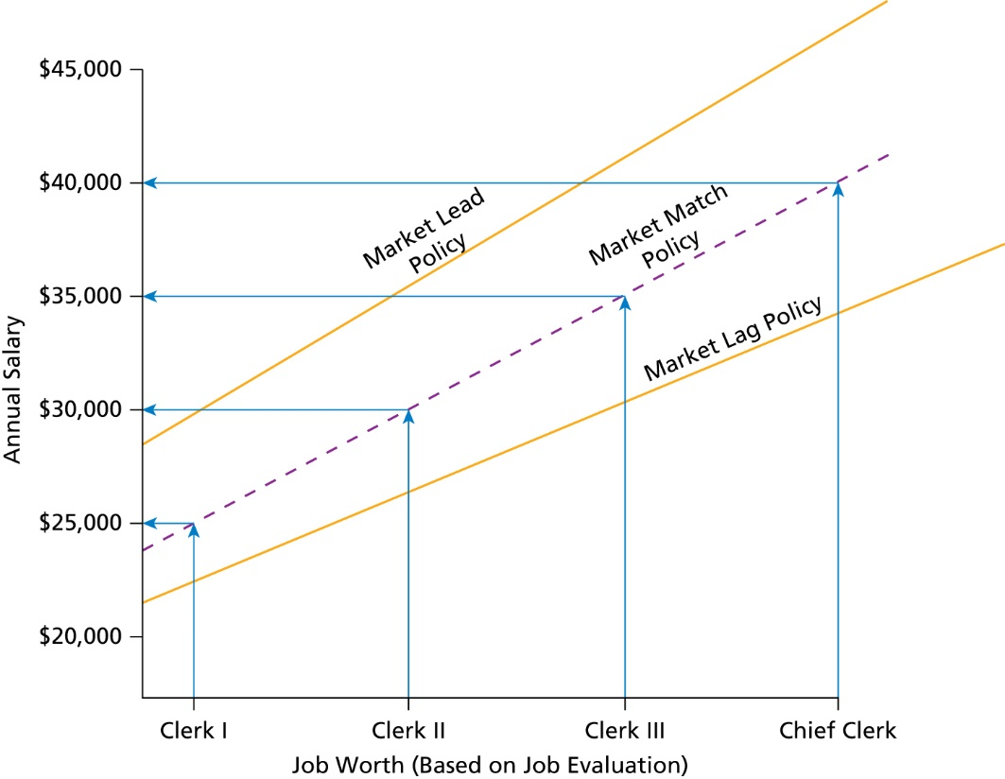
Pay Level Policy
Notes:
A wage curve is the fitting of plotted points to create a smooth progression between pay grades. The line drawn minimizes the distance between all dots and the line. Although the line of best fit may be straight or curved, a straight line is often the result when the point system is used.

Slide 20
Building Pay Structures (1 of 2)
Pay structures represent pay rate differences for jobs of unequal worth and the framework for recognizing differences in employee contributions. These structures result from an analysis based on compensation survey work.
Compensation surveys involve the collection and subsequent analysis of competitors’ compensation data.
Notes:
Pay structures represent pay rate differences for jobs of unequal worth and the framework for recognizing differences in employee contributions. These structures result from an analysis based on compensation survey work.
Compensation surveys involve the collection and subsequent analysis of competitors’ compensation data. Compensation surveys traditionally focused on competitors’ wage and salary practices. Employee benefits have more recently also become a target of surveys because benefits are a key element of market-competitive pay systems. Compensation surveys are important because they enable compensation professionals to obtain realistic views of competitors’ pay practices. Companies recognize these differences by paying individuals according to their credentials, knowledge, or job performance. When completed, pay structures should define the boundaries for recognizing employee contributions. Well-designed structures should promote the retention of valued employees. Pay grades and pay ranges are structural features of pay structures.

Slide 21
Building Pay Structures (2 of 2)
Pay grades
Pay ranges
  Points along the pay range
  Topping out (pay range max.)
  Rate ranges at higher levels
Notes:
Pay grades and pay ranges are structural features of pay structures. A pay grade is the grouping of similar jobs to simplify pricing jobs. For example, it is much more convenient for organizations to price 15 pay grades than 200 separate jobs.
After pay grades have been determined, the next decision is whether all individuals performing the same job will receive equal pay or whether pay ranges should be used. A pay range includes a minimum and maximum pay rate with enough variance between the two to allow for a significant pay difference.
A wage curve (or pay curve) is the fitting of plotted points to create a smooth progression between pay grades. The curve often equates to the market match policy. The line drawn minimizes the distance between all dots and the line; a line of best fit may be straight or curved. However, when the point system is used, a straight line is often the result. The use of statistical methods to determine the line is essential given the sheer number of data points (pay rates) collected during the compensation survey process.
The minimum rate may be the hiring-in rate that a person receives when joining the firm, although in practice, new employees often receive pay that starts above this level. The maximum pay rate represents the maximum that an employee can receive for that job regardless of how well he or she performs the job.
Topping Out: A person at the top of a pay grade will have to be promoted to a job in a higher pay grade to receive a pay increase unless (1) an across-the-board adjustment is made or (2) the job is re-evaluated and placed in a higher pay grade. This situation has caused numerous managers some anguish as they attempt to explain the pay system to an employee who is doing a tremendous job but is at the top of a pay grade.
Rate ranges at higher levels: The rate ranges established should be large enough to provide an incentive to do a better job. At higher levels, pay differentials may need to be greater to be meaningful. There may be logic in having the rate range become increasingly wide at each consecutive level.

Slide 22
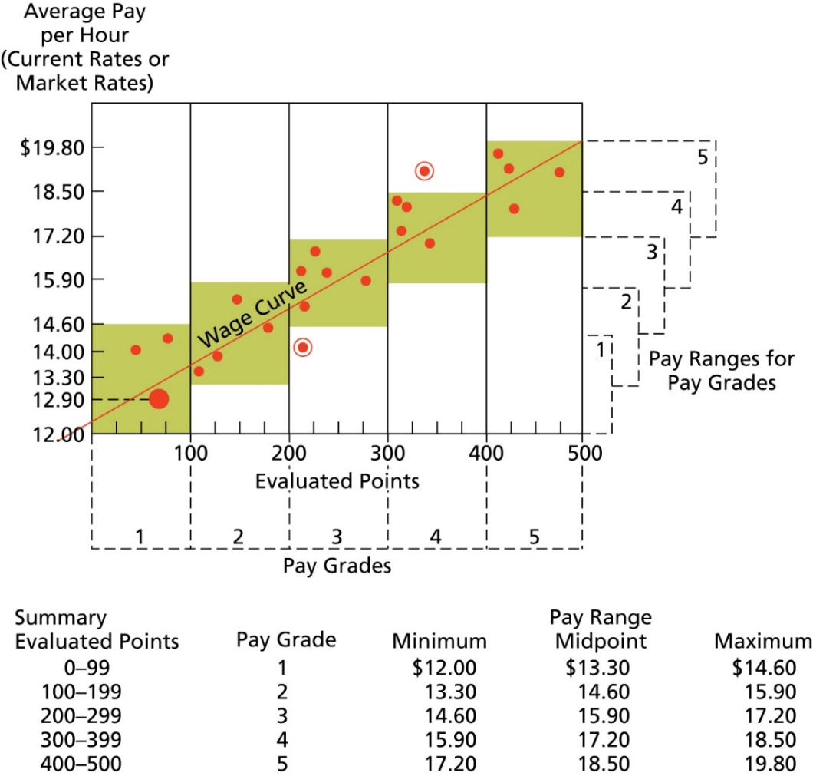
Scatter Diagram of Evaluated Jobs Illustrating Wage Curve, Pay Grades, and Pay Ranges
Notes:
Plotting jobs on a scatter diagram is often useful to managers in determining the appropriate number of pay grades for a company. Each dot on the scatter diagram represents one job. The location of the dot reflects the job’s relationship to pay and evaluated points, which reflects its worth.

Slide 23
Building Pay Structures
Broadbanding: Technique that collapses many pay grades (salary grades) into a few wide bands to improve organizational effectiveness
Two-tiered wage system: New employees paid less
Adjusting pay rates: Overpaid and underpaid jobs
Pay compression: Occurs when less-experienced employees are paid as much as or more than employees who have been with the organization
Notes:
Broadbanding is a technique that collapses many pay or salary grades into a few wide bands to improve organizational effectiveness. Broadbanding creates the basis for a simpler compensation system that de-emphasizes structure and places greater importance on flexible decision making. Bands may also promote lateral development of employees and reduce demand for scarce vertical promotions.
Two-tiered pay structures reward new hires less than established employees on either a temporary or permanent basis. It is mainly used in unionized companies such as in the commercial airline industry and automobile manufacturing industry. The lower pay scale for new hires may restrict a company’s ability to recruit and retain quality employees and can lower employees' morale.
Good management practice is to correct pay inequities for underpaid employees as rapidly as possible. Overpaid jobs present a different problem. Promotion is a possibility if the employee is qualified for a higher-rated job and a job opening is available. Another possibility is to freeze the rate until across-the-board pay increases bring the job into line. Finally, the employee’s pay could be cut, but this is generally not a good idea because it punishes the employee for a situation he or she did not create.
Pay compression occurs whenever a company’s pay spread between newly hired or less qualified employees and more qualified job incumbents is small. In extreme cases, less experienced employees are paid as much as or more than employees who have been with the organization a long time because of a gradual increase in starting salaries and limited salary adjustments for long-term employees.

Slide 24
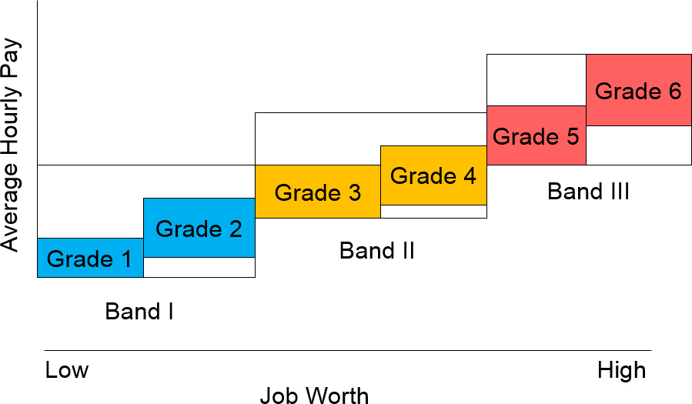
Broad-banding and Its Relationship to Traditional Pay Grades and Ranges
Notes:
The decreased emphasis on job levels should encourage employees to make cross-functional moves to jobs that are on the same or an even lower level because their pay rate would remain unchanged. Broadbanding allows for more flexibility within ranges, allows more movement of employees within the ranges, and can reduce the need for promotions. The use of broad-banding has declined in recent years because each band consists of a broad range of jobs and the market value of these jobs may vary considerably. Unless carefully monitored, employees in jobs at the lower end of the band could progress to the top of the range and become overpaid.

Slide 25
Exceptions to the Rules (1 of 2)
Sales Representative Compensation
  Salary
  Commission
  Part-Salary, Part-Commission
Contingent worker compensation
  In most cases, contingent workers earn less pay than permanent counterparts
  Far less likely to receive health or retirement benefits
Notes:
Designing compensation programs for sales employees involves unique considerations.
The straight salary approach is one extreme in sales compensation. In this method, salespersons receive a fixed salary regardless of their sales levels. Organizations use straight salary primarily to emphasize product support after the sale. For instance, sales representatives who deal largely with the federal government on a continuous basis often receive this form of compensation.
At the other extreme is straight commission, in which the person’s pay is totally determined as a percentage of sales. If the salesperson makes no sales, the individual receives no pay. On the other hand, highly productive sales representatives can earn a great deal of money under this plan.
Between these extremes are the endless varieties of part-salary, part-commission combinations. The possibilities increase when a firm adds various types of bonuses to the basic compensation package. The emphasis given to either commission or salary depends on several factors, including the organization’s philosophy toward service, the nature of the product, and the amount of time required to close a sale.

Slide 26
Exceptions to the Rules (2 of 2)
Executive Compensation
  Compensation programs need to be developed that motivate these executives to strive to achieve long-term success for firm
  Types of executive compensation
    Base salary
    Bonuses and performance-based pay
    Stock option plans
    Perquisites (perks)
    Severance packages
Notes:
The pay gap between the most affluent executives and the average worker has become enormous. It is difficult for workers who make $12 to $18 an hour to appreciate why these executives are making such outrageous salaries. On the other hand, the skills possessed by executives largely determine whether a firm will survive or fail. Thus, a company’s program for compensating executives is a critical factor in attracting and retaining the best available talent. Organizations typically tie salary growth for executives to market rates and overall corporate performance, including the firm’s market value.
Although it may not represent the largest portion of the executive’s compensation package, the base salary provided is obviously important. It is a factor in determining the executive’s standard of living and may also determine the amount of bonuses and certain benefits.
As shareholders become increasingly disenchanted with the high levels of executive compensation for less-than-stellar accomplishments, performance-based pay is gaining in popularity. While the Dodd–Frank Act has influenced executive pay, it appears that the greater influence has been the initiative to link pay to performance. If pay for performance is appropriate for lower-level employees, should top executives be exempt from the same practice? The true superstars can still have huge earnings if their targets are met.
Stock option plans give executives the option to buy a specified amount of stock in the future at or below the current market price. The stock option is a long-term incentive designed to integrate the interests of management with those of the organization. Stock options have lost some of their appeal because of accounting rule changes that require companies to expense these options as they are granted.
Perquisites (perks) are any special benefits provided by a firm to a small group of key executives and designed to give the executives “something extra.” Possible executive’s perks might include a company-provided car, limousine service, and the use of the company plane and yacht.
What most people may not understand is that massive severance payments are not set up by a board of directors after a CEO has quit or been fired. These payments were negotiated prior to being hired.
The Securities and Exchange Commission has adopted far-reaching executive compensation disclosure rules that apply to publicly traded companies. The new rules require companies to list all the agreements for each executive, to disclose the payment triggers, and, most importantly, to give an estimated dollar value of potential payments and benefits and the specific factors used to determine them. For the first time, investors will see the estimated total dollar value of the exit packages. No longer will these agreements become exposed only at the time of a merger and acquisition deal or when the board removes a CEO.
The Frank-Dodd Act has increased the transparency of how executives are compensated. The Dodd-Frank Act contains several additional provisions. The first, say on pay, gives shareholders in all but the smallest companies an advisory vote on executive pay. The second provision requires that companies report the ration of CEO compensation to the median compensation of its employees in SEC filings.

Slide 27

Copyright

