Slide 1
Chapter 18
Management of Waiting Lines
Copyright © 2015 McGraw-Hill Education. All rights reserved. No reproduction or distribution without the prior written consent of McGraw-Hill Education.

Slide 2
Chapter 18: Learning Objectives
You should be able to:
  LO 18.1 What imbalance does the existence of a waiting line reveal?
  LO 18.2 What causes waiting lines to form, and why is it impossible to eliminate them completely?
  LO 18.3 What metrics are used to help managers analyze waiting lines?
  LO 18.4 What very important lesson does the constant service time model provide for managers?
  LO 18.4 What are some psychological approaches to managing lines, and why might a manager want to use them?

Slide 3

Waiting Lines
Waiting lines occur in all sorts of service systems
Wait time is non-value added
  Wait time ranges from the acceptable to the emergent
    Short waits in a drive-thru
    Sitting in an airport waiting for a delayed flight
    Waiting for emergency service personnel
  Waiting time costs
    Lower productivity
    Reduced competitiveness
    Wasted resources
    Diminished quality of life
LO 18.1

Slide 4
Queuing Theory
Queuing theory
  Mathematical approach to the analysis of waiting lines
  Applicable to many environments
    Call centers
    Banks
    Post offices
    Restaurants
    Theme parks
    Telecommunications systems
    Traffic management
LO 18.1

Slide 5

Why Is There Waiting?
Waiting lines tend to form even when a system is not fully loaded
  Variability
    Arrival and service rates are variable
  Services cannot be completed ahead of time and stored for later use
LO 18.2

Slide 6
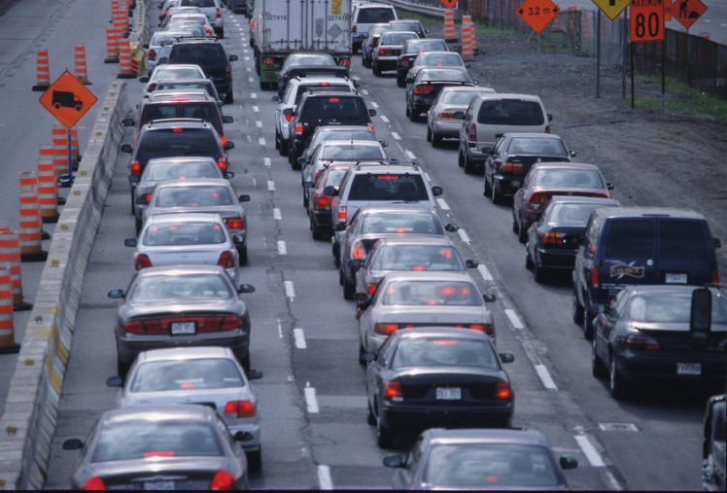
Waiting Lines:
Managerial Implications
Why waiting lines cause concern:
  The cost to provide waiting space
  A possible loss of business when customers leave the line before being served or refuse to wait at all
  A possible loss of goodwill
  A possible reduction in customer satisfaction
  Resulting congestion may disrupt other business operations and/or customers

Slide 7
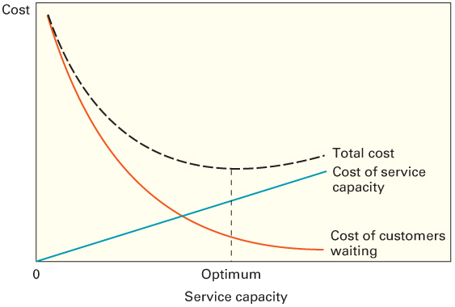
Waiting Line Management
The goal of waiting line management is to minimize total costs:
  Costs associated with customers waiting for service
  Capacity cost

Slide 8
Waiting Line Characteristics
The basic characteristics of waiting lines
  Population source
  Number of servers (channels)
  Arrival and service patterns
  Queue discipline

Slide 9
Simple Queuing System
System
Calling population
Processing Order
Arrivals
Waiting
line
Service
Exit

Slide 10
Population Source
Infinite source
  Customer arrivals are unrestricted
  The number of potential customers greatly exceeds system capacity
Finite source
  The number of potential customers is limited

Slide 11
Channels and Phases
Channel
  A server in a service system
  It is assumed that each channel can handle one customer at a time
Phases
  The number of steps in a queuing system

Slide 12
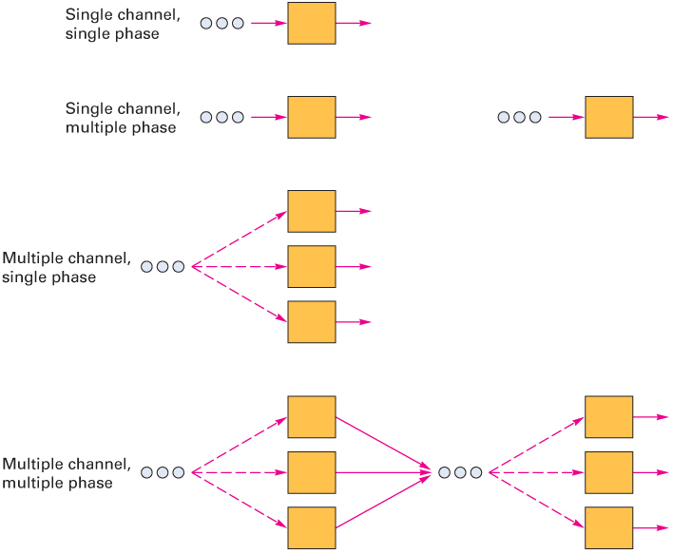
Common Queuing Systems

Slide 13
Arrival and Service Patterns
Arrival pattern
  Most commonly used models assume the arrival rate can be described by the Poisson distribution
    Arrivals per unit of time
  Equivalently, interarrival times are assumed to follow the negative exponential distribution
    The time between arrivals
Service pattern
  Service times are frequently assumed to follow a negative exponential distribution

Slide 14
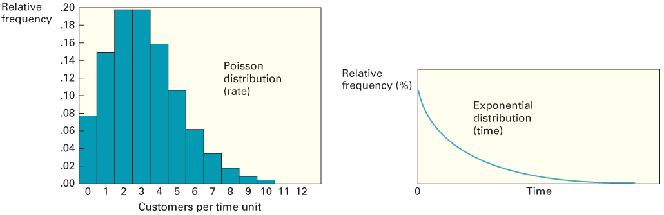
Poisson and Negative Exponential

Slide 15
Queue Discipline
Queue discipline
  The order in which customers are processed
    Most commonly encountered rule is that service is provided on a first-come, first-served (FCFS) basis
    Non FCFS applications do not treat all customer waiting costs as the same

Slide 16
Waiting Line Metrics
Managers typically consider five measures when evaluating waiting line performance:
  The average number of customers waiting (in line or in the system)
  The average time customers wait (in line or in the system)
  System utilization
  The implied cost of a given level of capacity and its related waiting line
  The probability that an arrival will have to wait for service
LO 18.3

Slide 17
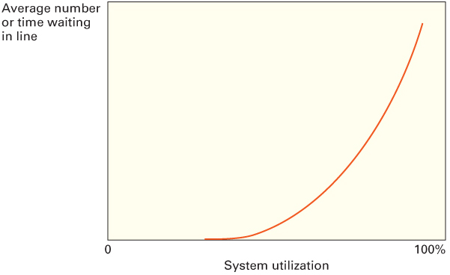
Waiting Line Performance
The average number waiting in line and the average time customers wait in line increase exponentially as the system utilization increases
LO 18.3

Slide 18
Queuing Models: Infinite Source
Four basic infinite source models
  All assume a Poisson arrival rate
    Single server, exponential service time
    Single server, constant service time
    Multiple servers, exponential service time
    Multiple priority service, exponential service time

Slide 19
Infinite-Source Symbols

Slide 20
Basic Relationships
System Utilization
Average number of customers being served

Slide 21
Basic Relationships
Little’s Law
  For a stable system the average number of customers in line or in the system is equal to the average customer arrival rate multiplied by the average time in the line or system

Slide 22
Basic Relationships
The average number of customers
  Waiting in line for service:
  In the system:
The average time customers are
  Waiting in line for service
  In the system

Slide 23
Single Server, Exponential Service Time
M/M/1

Slide 24
Single Server, Constant Service Time
M/D/1
  If a system can reduce variability, it can shorten waiting lines noticeably
  For, example, by making service time constant, the average number of customers waiting in line can be cut in half
  Average time customers spend waiting in line is also cut by half.
  Similar improvements can be made by smoothing arrival rates (such as by use of appointments)
LO 18.4

Slide 25
Multiple Servers (M/M/S)
Assumptions:
  A Poisson arrival rate and exponential service time
  Servers all work at the same average rate
  Customers form a single waiting line (in order to maintain FCFS processing)

Slide 26
M/M/S

Slide 27
Cost Analysis
Service system design reflects the desire of management to balance the cost of capacity with the expected cost of customers waiting in the system
Optimal capacity is one that minimizes the sum of customer waiting costs and capacity or server costs

Slide 28
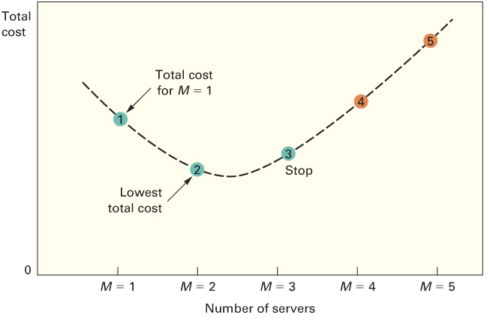
Total Cost Curve

Slide 29
Maximum Line Length
An issue that often arises in service system design is how much space should be allocated for waiting lines
The approximate line length, L_{max}, that will not be exceeded a specified percentage of the time can be determined using the following:

Slide 30
Multiple Priorities
Multiple priority model
  Customers are processed according to some measure of importance
  Customers are assigned to one of several priority classes according to some predetermined assignment method
    Customers are then processed by class, highest class first
    Within a class, customers are processed by FCFS
    Exceptions occur only if a higher-priority customer arrives
      That customer will be processed after the customer currently being processed

Slide 31
Multiple – Server Priority Model

Slide 32
Finite-Source Model
Appropriate for cases in which the calling population is limited to a relatively small number of potential calls
Arrival rates are required to be Poisson
  Unlike the infinite-source models, the arrival rate is affected by the length of the waiting line
    The arrival rate of customers decreases as the length of the line increases because there is a decreasing proportion of the population left to generate calls for service
Service times are required to be exponential

Slide 33
Finite-Source Model
Procedure:
  Identify the values for
    N, population size
    M, the number of servers/channels
    T, average service time
    U, average time between calls for service
  Compute the service factor, X=T/(T + U)
  Locate the section of the finite-queuing tables for N
  Using the value of X as the point of entry, find the values of D and F that correspond to M
  Use the values of N, M, X, D, and F as needed to determine the values of the desired measures of system performance

Slide 34
Finite-Source Model

Slide 35
Constraint Management
Managers may be able to reduce waiting lines by actively managing one or more system constraints:
  Fixed short-term constraints
    Facility size
    Number of servers
  Short-term capacity options
    Use temporary workers
    Shift demand
    Standardize the service
    Look for a bottleneck

Slide 36
Psychology of Waiting
If those waiting in line have nothing else to occupy their thoughts, they often tend to focus on the fact they are waiting in line
  They will usually perceive the waiting time to be longer than the actual waiting time
  Steps can be taken to make waiting more acceptable to customers
    Occupy them while they wait
      In-flight snack
      Have them fill out forms while they wait
    Make the waiting environment more comfortable
    Provide customers information concerning their wait
LO 18.5

Slide 37

Operations Strategy
Managers must carefully weigh the costs and benefits of service system capacity alternatives
Options for reducing wait times:
  Work to increase processing rates, instead of increasing the number of servers
  Use new processing equipment and/or methods
  Reduce processing time variability through standardization
  Shift demand

