Slide 1
Chapter 13
Inventory Management
Copyright © 2015 McGraw-Hill Education. All rights reserved. No reproduction or distribution without the prior written consent of McGraw-Hill Education.

Slide 2
Chapter 13: Learning Objectives
You should be able to:
LO 13.1 Define the term inventory
LO 13.2 List the different types of inventory
LO 13.3 Describe the main functions of inventory
LO 13.4 Discuss the main requirements for effective management
LO 13.5 Explain periodic and perpetual review systems
LO 13.6 Describe the costs that are relevant for inventory management
LO 13.7 Describe the A-B-C approach and explain how it is useful
LO 13.8 Describe the basic EOQ model and its assumptions and solve typical problems
LO 13.9 Describe the economic production quantity model and solve typical problems
LO 13.10 Describe the quantity discount model and solve typical problems
LO 13.11 Describe reorder point models and solve typical problems
LO 13.12 Describe situations in which the fixed-order interval model is appropriate and solve typical problems
LO 13.12 Describe situations in which the single-period model is appropriate, and solve typical problems

Slide 3
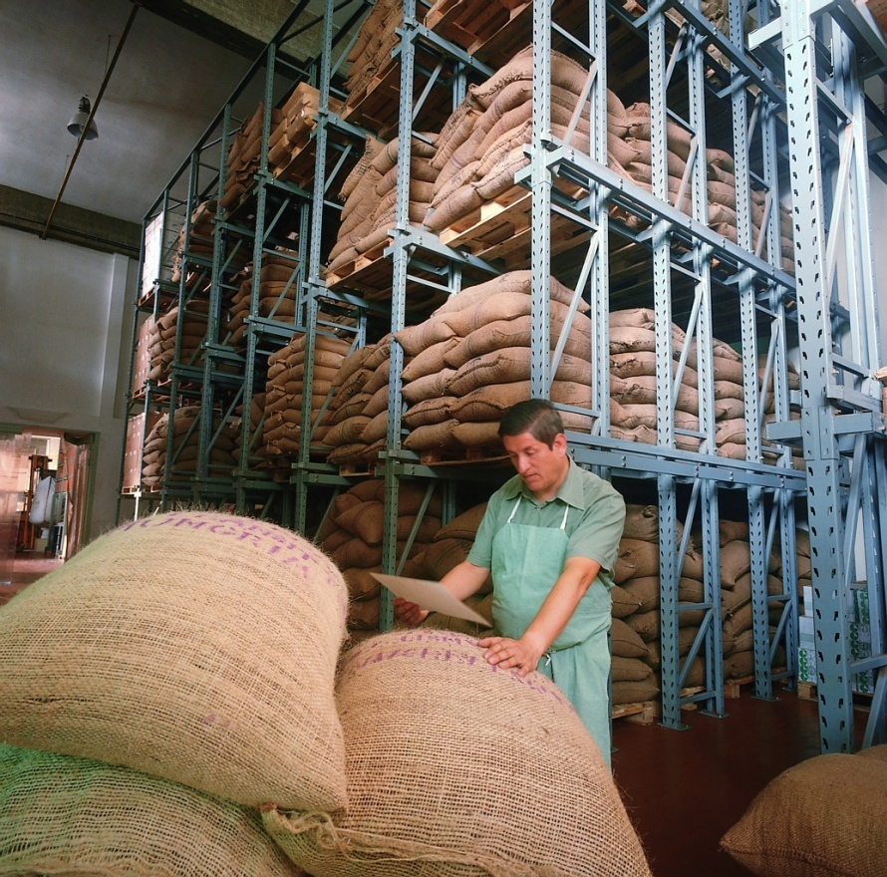
Inventory
Inventory
A stock or store of goods
Independent demand items
Items that are ready to be sold or used
Inventories are a vital part of business: (1) necessary for operations and (2) contribute to customer satisfaction
A “typical” firm has roughly 30% of its current assets and as much as 90% of its working capital invested in inventory
LO 13.1

Slide 4
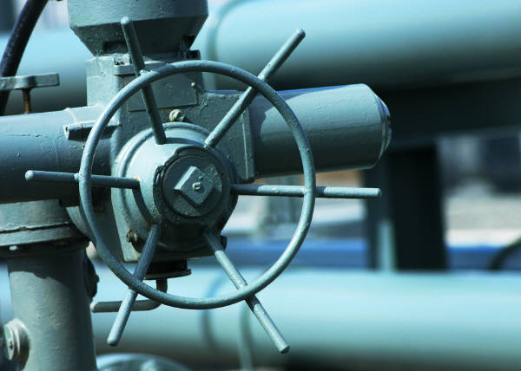
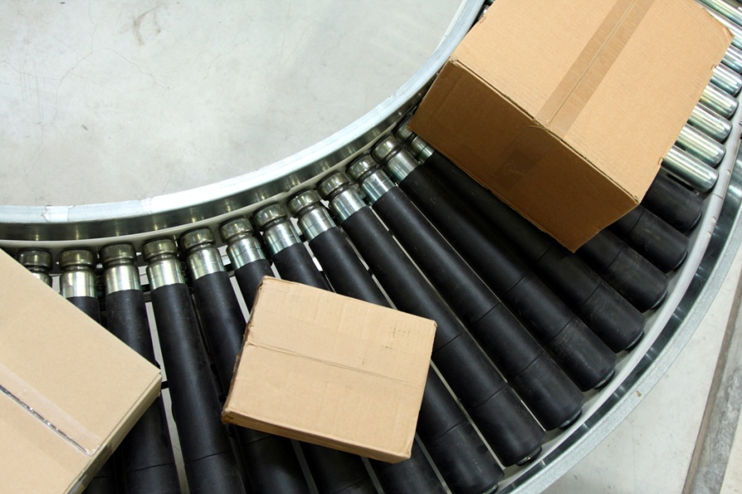
Types of Inventory
Raw materials and purchased parts
Work-in-process (WIP)
Finished goods inventories or merchandise
Tools and supplies
Maintenance and repairs (MRO) inventory
Goods-in-transit to warehouses or customers (pipeline inventory)
LO 13.2

Slide 5
Inventory Functions
Inventories serve a number of functions such as:
To meet anticipated customer demand
To smooth production requirements
To decouple operations
To protect against stockouts
To take advantage of order cycles
To hedge against price increases
To permit operations
To take advantage of quantity discounts
LO 13.3

Slide 6
Objectives of Inventory Control
Inventory management has two main concerns:
Level of customer service
Having the right goods available in the right quantity in the right place at the right time
Costs of ordering and carrying inventories
The overall objective of inventory management is to achieve satisfactory levels of customer service while keeping inventory costs within reasonable bounds
Measures of performance
Customer satisfaction
Number and quantity of backorders
Customer complaints
Inventory turnover
LO 13.3

Slide 7
Effective Inventory Management
Requires:
A system keep track of inventory
A reliable forecast of demand
Knowledge of lead time and lead time variability
Reasonable estimates of
holding costs
ordering costs
shortage costs
A classification system for inventory items
LO 13.4

Slide 8
Inventory Counting Systems
Periodic System
Physical count of items in inventory made at periodic intervals
Perpetual Inventory System
System that keeps track of removals from inventory continuously, thus monitoring current levels of each item
An order is placed when inventory drops to a predetermined minimum level
Two-bin system
Two containers of inventory; reorder
when the first is empty
LO 13.5

Slide 9
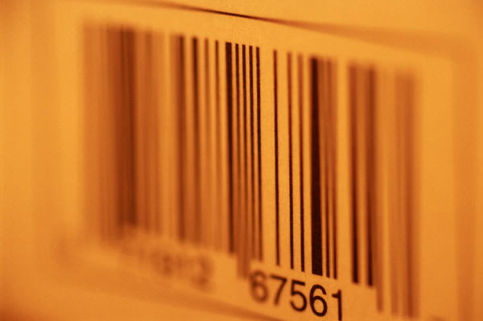
Inventory Counting Technologies
Universal product code (UPC)
Bar code printed on a label that has information about the item to which it is attached
Radio frequency identification (RFID) tags
A technology that uses radio waves to identify objects, such as goods, in supply chains
LO 13.5

Slide 10
Inventory Costs
Purchase cost
The amount paid to buy the inventory
Holding (carrying) costs
Cost to carry an item in inventory for a length of time, usually a year
Ordering costs
Costs of ordering and receiving inventory
Setup costs
The costs involved in preparing equipment for a job
Analogous to ordering costs
Shortage costs
Costs resulting when demand exceeds the supply of inventory; often unrealized profit per unit
LO 13.6

Slide 11
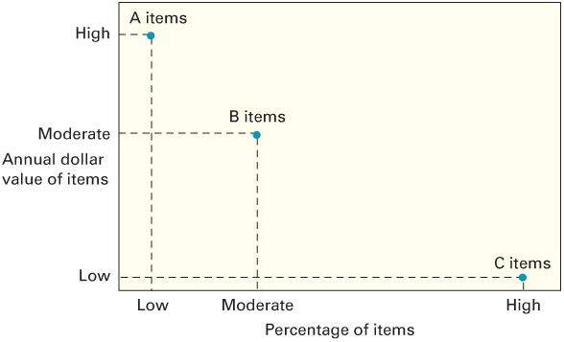
ABC Classification System
A-B-C approach
Classifying inventory according to some measure of importance, and allocating control efforts accordingly
A items (very important)
10 to 20 percent of the number of items in inventory and about 60 to 70 percent of the annual dollar value
B items (moderately important)
C items (least important)
50 to 60 percent of the number
of items in inventory but only
about 10 to 15 percent of the
annual dollar value
LO 13.7

Slide 12
Cycle Counting
Cycle counting
A physical count of items in inventory
Cycle counting management
How much accuracy is needed?
A items: ± 0.2 percent
B items: ± 1 percent
C items: ± 5 percent
When should cycle counting be performed?
Who should do it?
LO 13.7

Slide 13
How Much to Order: EOQ Models
Economic order quantity models identify the optimal order quantity by minimizing the sum of annual costs that vary with order size and frequency
The basic economic order quantity model
The economic production quantity model
The quantity discount model
LO 13.8

Slide 14
Basic EOQ Model
The basic EOQ model is used to find a fixed order quantity that will minimize total annual inventory costs
Assumptions:
Only one product is involved
Annual demand requirements are known
Demand is even throughout the year
Lead time does not vary
Each order is received in a single delivery
There are no quantity discounts
LO 13.8

Slide 15
The Inventory Cycle
Profile of Inventory Level Over Time
Q
Usage
rate
Quantity
on hand
Reorder
point
Time
Receive
order
Place
order
Receive
order
Place
order
Receive
order
Lead time
LO 13.8

Slide 19
Economic Production Quantity (EPQ)
The batch mode is widely used in production. In certain instances, the capacity to produce a part exceeds its usage (demand rate)
Assumptions
Only one item is involved
Annual demand requirements are known
Usage rate is constant
Usage occurs continually, but production occurs periodically
The production rate is constant
Lead time does not vary
There are no quantity discounts
LO 13.9

Slide 20
EPQ: Inventory Profile
Q
Production
and usage
Usage
only
Production
and usage
Usage
only
Production
and usage
Q_{p}
Cumulative
production
I_{max}
Amount
on hand
Time
LO 13.9

Slide 24
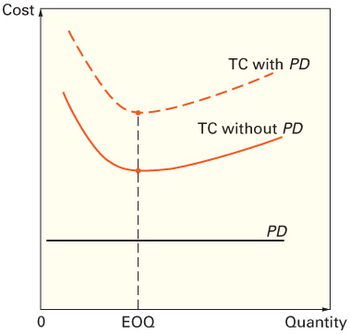
Quantity Discounts
Adding PD does not change EOQ
LO 13.10

Slide 25
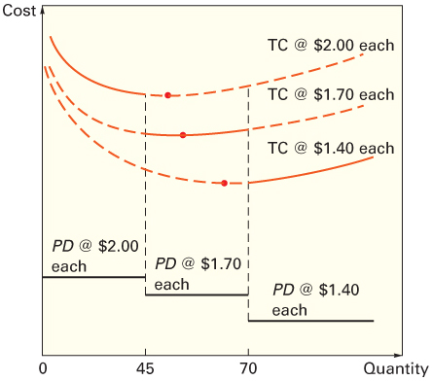
Quantity Discounts
The total-cost curve with quantity discounts is composed of a portion of the total-cost curve for each price
LO 13.10

Slide 26
When to Reorder
Reorder point
When the quantity on hand of an item drops to this amount, the item is reordered.
Determinants of the reorder point
The rate of demand
The lead time
The extent of demand and/or lead time variability
The degree of stockout risk acceptable to management
LO 13.11

Slide 29
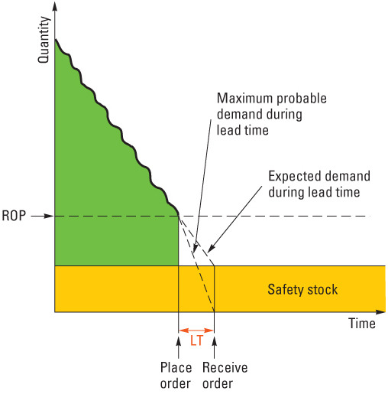
Safety Stock
LO 13.11

Slide 30
Safety Stock?
As the amount of safety stock carried increases, the risk of stockout decreases.
This improves customer service level
Service level
The probability that demand will not exceed supply during lead time
Service level = 100% - Stockout risk
LO 13.11

Slide 32
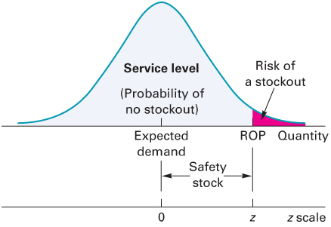
Reorder Point
The ROP based on a normal
Distribution of lead time demand
LO 13.11

Slide 35
How Much to Order: FOI
Fixed-order-interval (FOI) model
Orders are placed at fixed time intervals
Reasons for using the FOI model
Supplier’s policy may encourage its use
Grouping orders from the same supplier can produce savings in shipping costs
Some circumstances do not lend themselves to continuously monitoring inventory position
LO 13.12

Slide 36
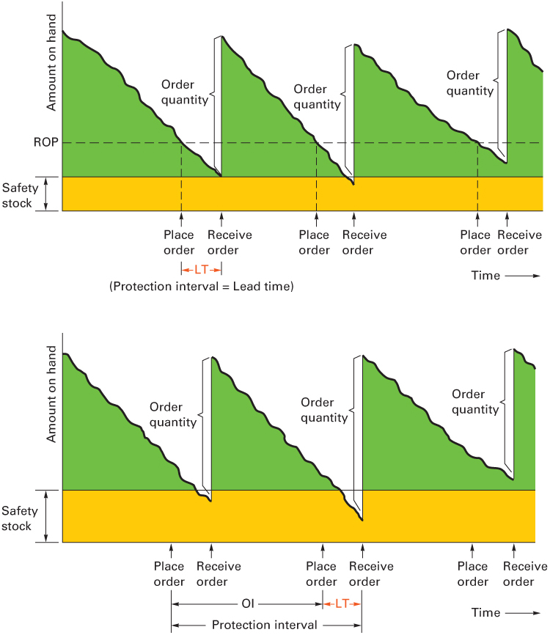
Fixed-Quantity vs. Fixed-Interval Ordering
Fixed Quantity
Fixed Interval
LO 13.12

Slide 38
Single-Period Model
Single-period model
Model for ordering of perishables and other items with limited useful lives
Shortage cost
Generally, the unrealized profit per unit
C_{shortage} = C_{s} = Revenue per unit – Cost per unit
Excess cost
Different between purchase cost and salvage value of items left over at the end of the period
C_{excess} = C_{e} = Cost per unit – Salvage value per unit
LO 13.13

Slide 39
Single-Period Model
The goal of the single-period model is to identify the order quantity that will minimize the long-run excess and shortage costs
Two categories of problem:
Demand can be characterized by a continuous distribution
Demand can be characterized by a discrete distribution
LO 13.13

