Slide 1
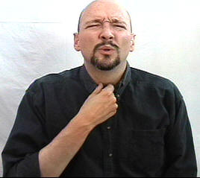
Case Study: Sore Throat

Slide 2
Case Study
B.W. is a 44-year-old man who presents to the family practice with complaints of sore throat, hoarseness, and a dry cough that worsens at night. He states that the cough started 6 days ago, and the sore throat and hoarseness began 3 days ago and appear to be getting worse The patient has a history of prediabetes, which is controlled through diet and exercise. Vital signs are T 99.5, P 58, R 16, and BP 110/55.

Slide 3
Questions
1. What subjective information should the nurse obtain?
2. The nurse is assessing the structures of the oral cavity. What are the physical features?
3. The nurse notes that the patient’s teeth are stained yellow and asks the patient about tobacco use. The patient states that he chews one bag of tobacco every other day. What health promotion concepts should the nurse include in the teaching plan?
4. What is the most likely cause of this patient’s cough, sore throat, and hoarseness?

