Slide 1
Chapter 4
Product and Service Design
Copyright © 2015 McGraw-Hill Education. All rights reserved. No reproduction or distribution without the prior written consent of McGraw-Hill Education.

Slide 2
Chapter 4: Learning Objectives
You should be able to:
  LO 4.1 Explain the strategic importance of product and service design
  LO4.2 Describe what product and service design does
  LO4.3 Name the key questions of product and service design
  LO4.4 Identify some reasons for design or redesign
  LO4.5 List some of the main sources of design ideas
  LO4.6 Discuss the importance of legal, ethical, and sustainability considerations in product and service design
  LO4.7 Explain the purpose and goal of life cycle assessment
  LO4.8 Explain the phrase “the 3 Rs”
  LO4.9 Discuss several key issues in product or service design
  LO4.10 Discuss the two key issues in service design
  LO4.11 Name the phases in service design
  LO4.12 List the characteristics of well-designed service systems
  LO4.13 List some guidelines for successful service design

Slide 3
Strategic Product and Service Design
The essence of an organization is the goods and services it offers
  Every aspect of the organization is structured around them
Product and service design – or redesign – should be closely tied to an organization’s strategy
LO 4.1

Slide 4
What Does Product & Service Design Do?
Translate customer wants and needs into product and service requirements
Refine existing products and services
Develop new products and services
Formulate quality goals
Formulate cost targets
Construct and test prototypes
Document specifications
Translate product and service specifications into process specifications
Involve Inter-functional Collaboration
LO 4.2

Slide 5
Key Questions
Is there a demand for it?
  Market size
  Demand profile
Can we do it?
  Manufacturability - the capability of an organization to produce an item at an acceptable profit
  Serviceability - the capability of an organization to provide a service at an acceptable cost or profit
LO 4.3

Slide 6
Key Questions (contd.)
What level of quality is appropriate?
  Customer expectations
  Competitor quality
  Fit with current offering
Does it make sense from an economic standpoint?
  Liability issues, ethical considerations, sustainability issues, costs and profits
LO 4.3

Slide 7
Reasons to Design or Re-Design
The driving forces for product and service design or redesign are market opportunities or threats:
  Economic
  Social and Demographic
  Political, Liability, or Legal
  Competitive
  Cost or Availability
  Technological
LO 4.4

Slide 8
Idea Generation
Supply-chain based
Competitor based
Research based
LO 4.5

Slide 9
Supply-Chain Based
Ideas can come from anywhere in the supply chain:
  Customers
  Suppliers
  Distributors
  Employees
  Maintenance and repair personnel
LO 4.5

Slide 10
Competitor-Based
By studying how a competitor operates and its products and services, many useful ideas can be generated
Reverse engineering
  Dismantling and inspecting a competitor’s product to discover product improvements
LO 4.5

Slide 11
Research Based
Research and Development (R&D)
  Organized efforts to increase scientific knowledge or product innovation
  Basic research
    Has the objective of advancing the state of knowledge about a subject without any near-term expectation of commercial applications
  Applied research
    Has the objective of achieving commercial applications
  Development
    Converts the results of applied research into useful commercial applications.
LO 4.5

Slide 12
Legal Considerations
Legal Considerations
  Product liability
    The responsibility a manufacturer has for any injuries or damages caused by as faulty product
    Some of the concomitant costs
      Litigation
      Legal and insurance costs
      Settlement costs
      Costly product recalls
      Reputation effects
  Uniform Commercial Code
    Under the UCC, products carry an implication of merchantability and fitness
LO 4.6

Slide 13
Ethical Considerations
Designers are often under pressure to
  Speed up the design process
  Cut costs
These pressures force trade-off decisions
  What if a product has bugs?
    Release the product and risk damage to your reputation
    Work out the bugs and forego revenue
LO 4.6

Slide 14
Sustainability
Sustainability
  Using resources in ways that do not harm ecological systems that support human existence
Key aspects of designing for sustainability
  Cradle-to-grave assessment (Life-Cycle assessment)
  End-of-life programs
  The 3-Rs
    Reduction of costs and materials used
    Re-using parts of returned products
    Recycling
LO 4.6

Slide 15
Cradle-to-Grave Assessment
Cradle-to-Grave Assessment
  aka Life-Cycle Assessment (LCA)
  The assessment of the environmental impact of a product or service throughout its useful life
    Focuses on such factors as
      Global warming
      Smog formation
      Oxygen depletion
      Solid waste generation
    LCA procedures are part of the ISO 14000 environmental management procedures
LO 4.7

Slide 16
Reduce: Costs and Materials
Value analysis
  Examination of the function of parts and materials in an effort to reduce the cost and/or improve the performance of a product
  Common questions used in value analysis
    Is the item necessary; does it have value; could it be eliminated?
    Are there alternative sources for the item?
    Could another material, part, or service be used instead?
    Can two or more parts be combined?
    Can specifications be less stringent to save time or money?
    Do suppliers/providers have suggestions for improvements?
    Can packaging be improved or made less costly?
LO 4.8

Slide 17
Re-Use: Remanufacturing
Remanufacturing
  Refurbishing used products by replacing worn-out or defective components
    Can be performed by the original manufacturer or another company
  Reasons to remanufacture:
    Remanufactured products can be sold for about 50% of the cost of a new product
    The process requires mostly unskilled and semi-skilled workers
    In the global market, European lawmakers are increasingly requiring manufacturers to take back used products
  Design for disassembly (DFD)
    Designing a product to that used products can be easily taken apart
LO 4.8

Slide 18

Recycle
Recycling
  Recovering materials for future use
    Applies to manufactured parts
    Also applies to materials used during production
  Why recycle?
    Cost savings
    Environmental concerns
    Environmental regulations
  Companies doing business in the EU must show that a specified proportion of their products are recyclable
  Design for recycling (DFR)
    Product design that takes into account the ability to disassemble a used product to recover the recyclable parts
LO 4.8

Slide 19
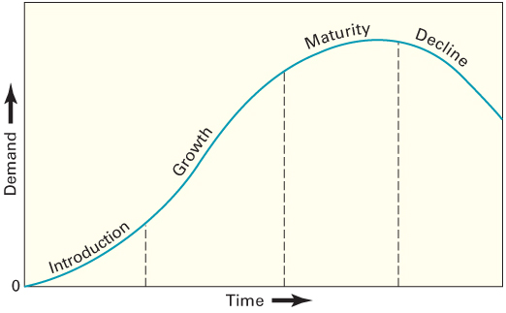
Product or service life stages
LO 4.9

Slide 20
Standardization
Standardization
  Extent to which there is an absence of variety in a product, service, or process
    Products are made in large quantities of identical items
    Every customer or item processed receives essentially the same service
LO 4.10

Slide 21
Designing for Mass Customization
Mass customization
  A strategy of producing basically standardized goods or services, but incorporating some degree of customization in the final product or service
  Facilitating Techniques
    Delayed differentiation
    Modular design
LO 4.10

Slide 22
Delayed Differentiation
Delayed Differentiation
  The process of producing, but not quite completing, a product or service until customer preferences are known
  It is a postponement tactic
    Produce a piece of furniture, but do not stain it; the customer chooses the stain
LO 4.10

Slide 23
Modular Design
Modular Design
  A form of standardization in which component parts are grouped into modules that are easily replaced or interchanged
    Advantages
      easier diagnosis and remedy of failures
      easier repair and replacement
      simplification of manufacturing and assembly
      training costs are relatively low
    Disadvantages
      Limited number of possible product configurations
      Limited ability to repair a faulty module; the entire module must often be scrapped
LO 4.10

Slide 24
Reliability
Reliability
  The ability of a product, part, or system to perform its intended function under a prescribed set of conditions
  Failure
    Situation in which a product, part, or system does not perform as intended
  Reliabilities are always specified with respect to certain conditions
    Normal operating conditions
      The set of conditions under which an item’s reliability is specified
LO 4.10

Slide 25
Robust Design
Robust design
  A design that results in products or services that can function over a broad range of conditions
    The more robust a product or service, the less likely it will fail due to a change in the environment in which it is used or in which it is performed
  Pertains to product as well as process design
    Consider the following automobiles:
      Ferrari Enzo
      Toyota Avalon
        Which is design is more robust?
LO 4.10

Slide 26
Degree of Newness
Product or service design changes:
  Modification of an existing product or service
  Expansion of an existing product line or service offering
  Clone of a competitor’s product or service
  New product or service
The degree of change affects the newness of the product or service to the market and to the organization
  Risks and benefits?
LO 4.10

Slide 27
Quality Function Deployment
Quality Function Deployment (QFD)
  An approach that integrates the “voice of the customer” into both product and service development
    The purpose is to ensure that customer requirements are factored into every aspect of the process
    Listening to and understanding the customer is the central feature of QFD
LO 4.10

Slide 28
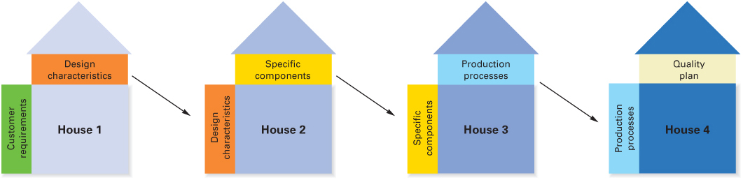
The House of Quality Sequence
LO 4.10

Slide 29
Kano Model
Basic quality
  Refers to customer requirements that have only limited effect on customer satisfaction if present, but lead to dissatisfaction if absent
Performance quality
  Refers to customer requirements that generate satisfaction or dissatisfaction in proportion to their level of functionality and appeal
Excitement quality
  Refers to a feature or attribute that was unexpected by the customer and causes excitement
LO 4.10

Slide 30
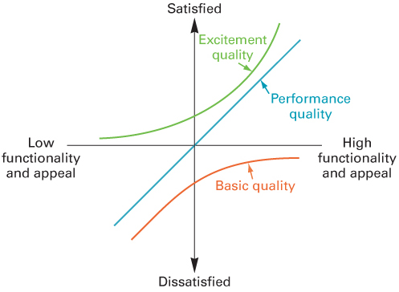
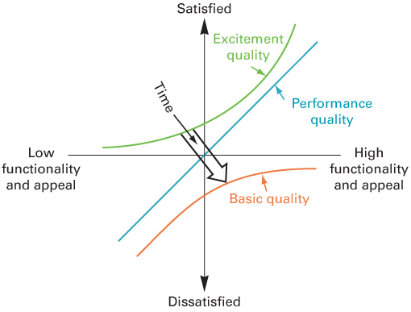
The Kano Model – As Time Passes
LO 4.10

Slide 31
Concurrent Engineering
Concurrent engineering
  Bringing engineering design and manufacturing personnel together early in the design phase
    Also may involve manufacturing, marketing and purchasing personnel in loosely integrated cross-functional teams
    Views of suppliers and customers may also be sought
  The purpose is to achieve product designs that reflect customer wants as well as manufacturing capabilities
LO 4.10

Slide 32
Computer-Aided Design (CAD)
CAD
  Product design using computer graphics
  Advantages
    increases productivity of designers, 3 to 10 times
    creates a database for manufacturing information and product specifications
    provides possibility of engineering and cost analysis on proposed designs
  CAD that includes finite element analysis (FEA) can significantly reduce time to market
    Enables developers to perform simulations that aid in the design, analysis, and commercialization of new products
LO 4.10

Slide 33
Production Requirements
Designers must take into account production capabilities
  Equipment
  Skills
  Types of materials
  Schedules
  Technologies
  Special abilities
LO 4.10

Slide 34
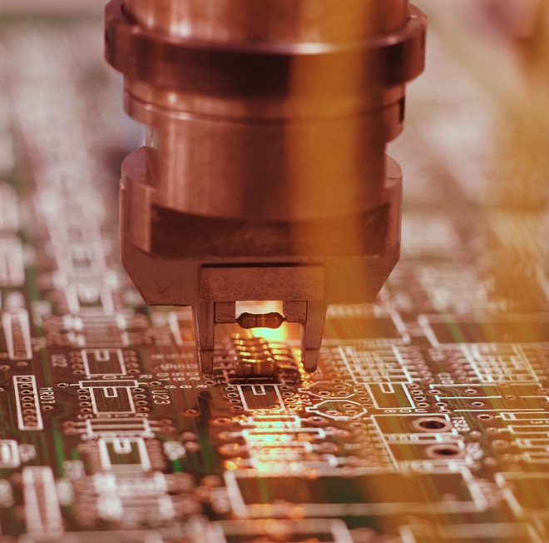
Manufacturability
Manufacturability
  Ease of fabrication and/or assembly
  It has important implications for
    Cost
    Productivity
    Quality
LO 4.10

Slide 35
Component Commonality
When products have a high degree of similarity in features and components, a part can be used in multiple products
Benefits:
  Savings in design time
  Standard training for assembly and installation
  Opportunities to buy in bulk from suppliers
  Commonality of parts for repair
  Fewer inventory items must be handled
LO 4.10

Slide 36
Service Design
Begins with a choice of service strategy, which determines the nature and focus of the service, and the target market
  Key issues in service design
    Degree of variation in service requirements
    Degree of customer contact and involvement
LO 4.11

Slide 37
Differences between Service and Product Design
Products are generally tangible, services intangible
Services are created and delivered at the same time
Services cannot be inventoried
Services are highly visible to consumers
Some services have low barriers to entry and exit
Location is often important to service design, with convenience as a major factor
Service systems range from those with little or no customer contact to those that have a very high degree of customer contact
Demand variability alternately creates waiting lines or idle service resources
LO 4.11

Slide 38
The Well-Designed Service System
Characteristics
  Being consistent with the organization mission
  Being user-friendly
  Being robust if variability is a factor
  Being easy to sustain
  Being cost-effective
  Having value that is obvious to the customer
  Having effective linkages between back- and front-of-the-house operations
  Having a single, unifying theme
  Having design features and checks that will ensure service that is reliable and of high quality
LO 4.12

Slide 39
Successful Service Design
Define the service package in detail
Focus on the operation from the customer’s perspective
Consider the image that the service package will present both to customers and to prospective customers
Recognize that designers’ familiarity with the system may give them a quite different perspective than that of the customer, and take steps to overcome this
Make sure that managers are involved and will support the design once it is implemented
Define quality for both tangibles and intangibles
Make sure that recruitment, training, and reward policies are consistent with service expectations
Establish procedures to handle both predictable and unpredictable events
Establish system to monitor, maintain, and improve service
LO 4.13

Slide 40

Operations Strategy
Effective product and service design can help the organization achieve competitive advantage:
  Packaging products and ancillary services to increase sales
  Using multiple-use platforms
  Implementing tactics that will achieve the benefits of high volume while satisfying customer needs for variety
  Continually monitoring products and services for small improvement opportunities
  Reducing the time it takes to get a new or redesigned product or service to the market

