Slide 1
Notes:
Eric: Hello everyone, we are Ultimate Sports View, where you can experience sports your way.

Slide 2
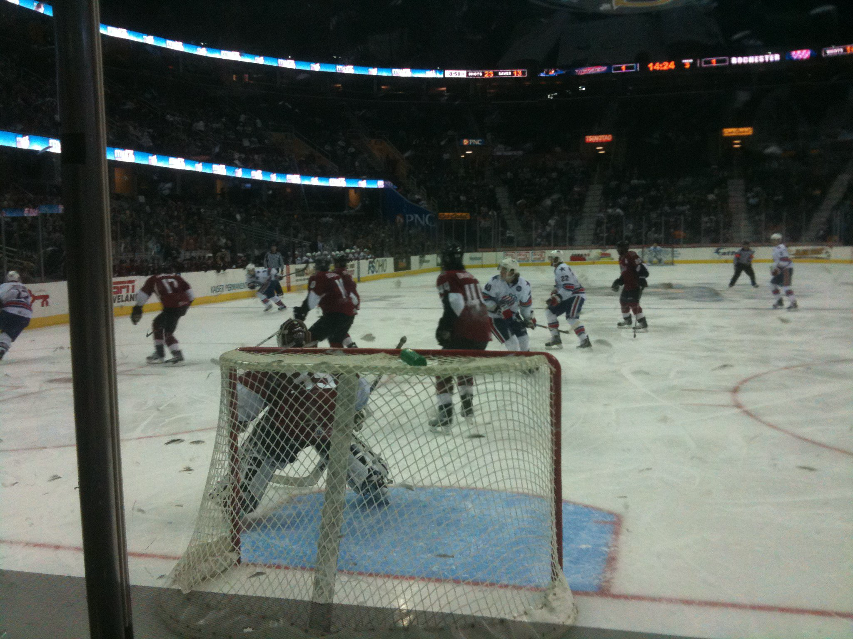
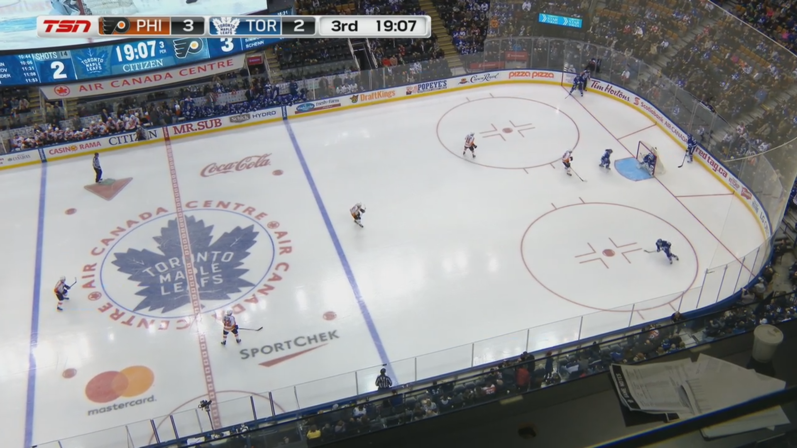
Some of our Views
Notes:
Eric: We made Ultimate Sports View to provide a unique viewing experience for our customers through placing cameras throughout select seating area sections within hockey arenas. Our cameras will be placed in predetermined sections of the arenas. Our goal has always been to provide our customers with the opportunity to experience sports from different viewpoints and safely watch events as if they were there. We can see our cameras being used not only throughout the pandemic, but well into the digital future. Here are just two of our different camera views. The one on the left shows our behind goal view so our customers can see their favorite goals in the eyes of the goalie. The second picture shows our most popular view which is our overhead view. This view lets our avid hockey fans see every play develop in real-time.

Slide 3
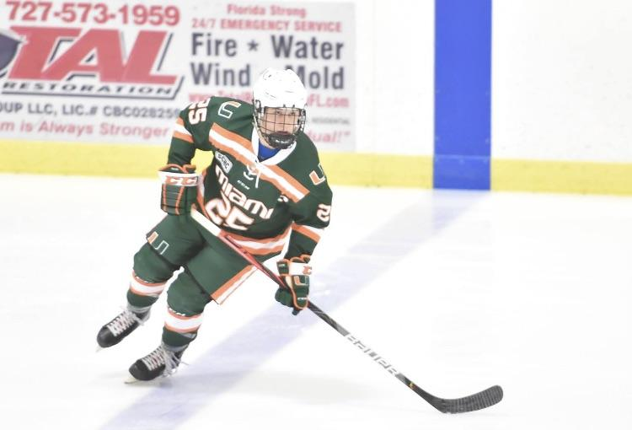
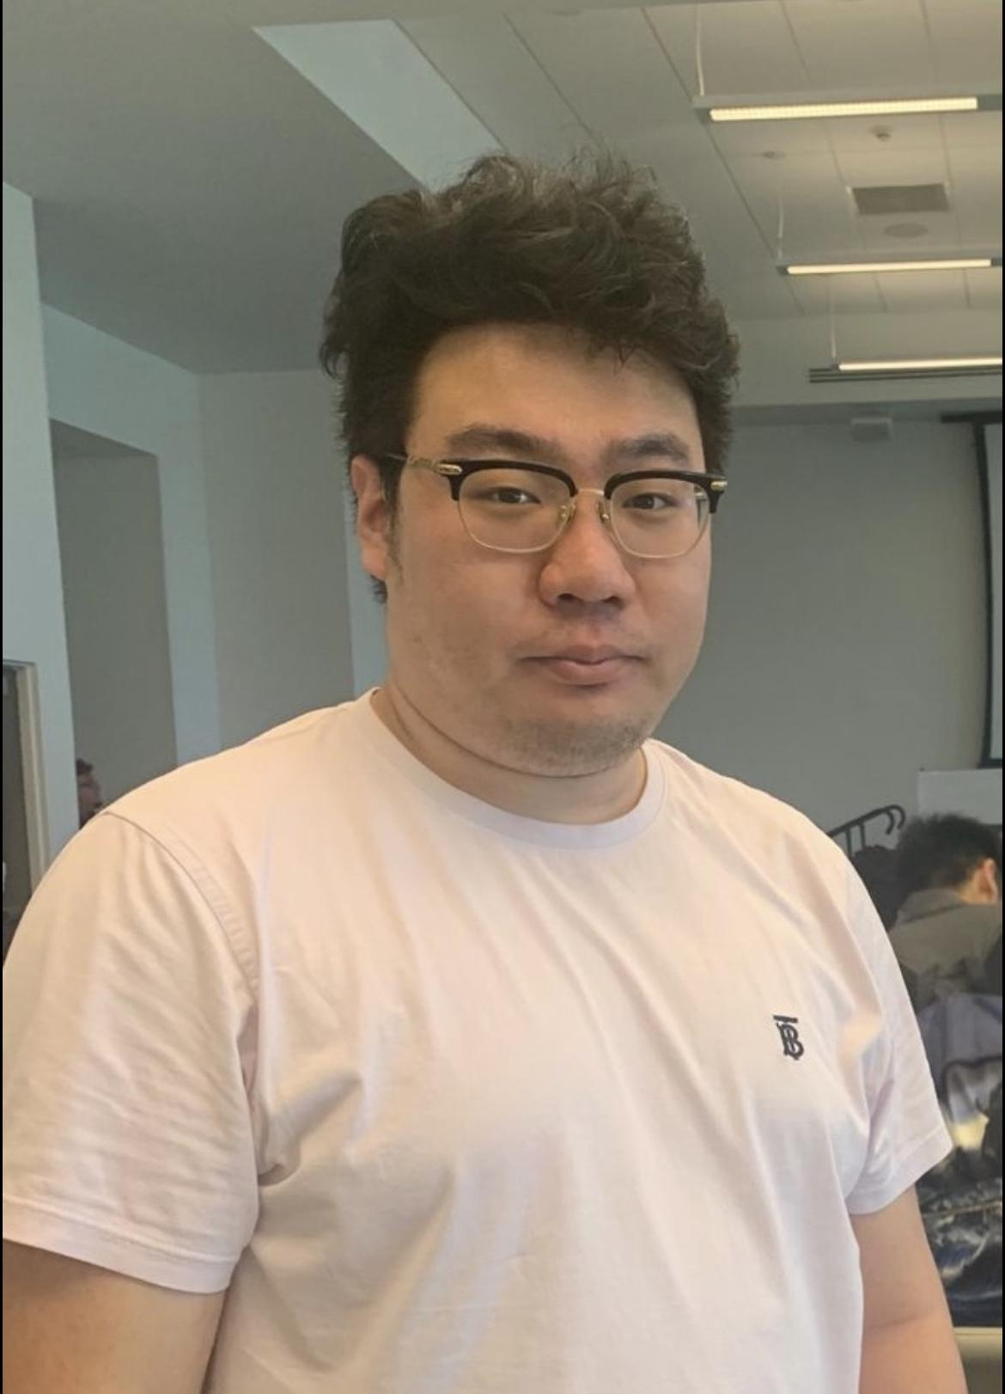
Our Team
Eric Tolep, CEO Keith Asplundh, CFO Zhuoting Liu, COO
Notes:
Eric: My name is Eric Tolep and I am the CEO of Ultimate Sports View. I am double majoring in business technology and management and these two foundations will help our company grow in the crowded technology field. My experience working in the Information Technology field will aide in setting up and maintaining our company’s Information Systems.
Keith: My name is Keith Asplundh and I am the CFO of Ultimate Sports View. I am a Sport Administration Major and have extensive knowledge of the professional sports industry. I played a big role in creating the financial statements for our company. Playing hockey for most of my childhood has fueled my passion for getting involved in the business side of sports.
Zhuoting: My name is Zhuoting Liu and I am the COO of Ultimate Sports View. I am an Economics major and a Sports Administration minor. I have always had a passion for the sports management field. I have prior experience with business operations and feel that I can bring an informed point of view to our company.

Slide 4
What We Know
“78% of people who self-report as “intense” sports fans would pay more for online streaming than for traditional TV channels.”
Notes:
Zhuoting: According to Center for the Digital Future at USC Annenberg, 78% of people who self-report as “intense” sports fans would pay more for online streaming than for traditional TV channels. We believe that this really plays in our favor. Many skeptics out there might say, “Why would I pay to use a service when I can just watch the game for free?” Our answer to this question is simple. First, not all games for your hockey team will be broadcasted on tv. Second, your only other option is an expensive sports package from NHL.TV. Now I will send it over to our CFO, Keith, to talk more about our market opportunity.

Slide 5
Market Opportunity
Sports Streaming Market was estimated to be valued at almost $11.32 billion (2018)
Millennials, ages 23-36, prefer to watch TV online and on streaming services
Stream more online TV than any other generation—mainly on streaming services such as Netflix, Amazon Prime Video, Hulu, and Disney Plus.
Notes:
Keith: Thanks Zhuoting. In 2018, the Sports Streaming Market was valued at over 11 billion dollars. Our target customers are millennials, which tend to be people born between 1984 and 1997. This age group prefers to consume their television programs online and through the use of streaming services. What’s unique to millennials is that they stream more online TV than ANY other generation. Some of these streaming services include Netflix, Amazon Prime Video, Hulu, and Disney Plus. Since our target market spends most of their time online, we feel they will gravitate towards watching sports through OUR streaming service. Now I will send it over to our CEO, Eric, to discuss how Ultimate Sports View came to fruition.

Slide 6
Problem
Started out with two Freshman friends and a Problem
“Why can’t we watch NHL hockey games from different vantage points?”
COVID-19
Notes:
Eric: Thanks Keith. So this all started when two Freshman friends who lived on the same floor at University of Miami, Keith and I, had a realization. You see, Keith and I were big hockey fans. Therefore, we played a lot of the video game NHL during a free time. We always had the door open and it became normal for people on our floor to walk in and play a game of hockey. During games, we realized that after anyone scored a goal, they would want to watch a replay of it in many different angles and views. Luckily, the video game included this playback feature. After several games with friends, Keith and I wondered, why can we not watch REAL hockey games from different perspectives? We put the idea down for awhile, until COVID-19 reached our shores. With COVID-19, many teams and leagues began to not allow fans into their arenas, stadiums, and ballparks, NHL being one of those leagues. Keith and I missed going to hockey games and feeling like we were there. Immediately, we started thinking back to our Freshman year and how this idea might actually work, especially with COVID jump-starting it. We believe that Ultimate Sports View will help avid hockey fans cope with not physically being at their team’s games anymore. Even after COVID-19, we believe USV will digitally expand the number of seats in any arena.

Slide 7
Our Service
https://youtu.be/2TUV5_kpD4E
Notes:
Eric: Now we wanted to show you some of the angles and viewpoints that would be included in our service. Hopefully this video will help you see the difference between what a normal broadcast looks like and what Ultimate Sports View provides. Now back to Keith.

Slide 8
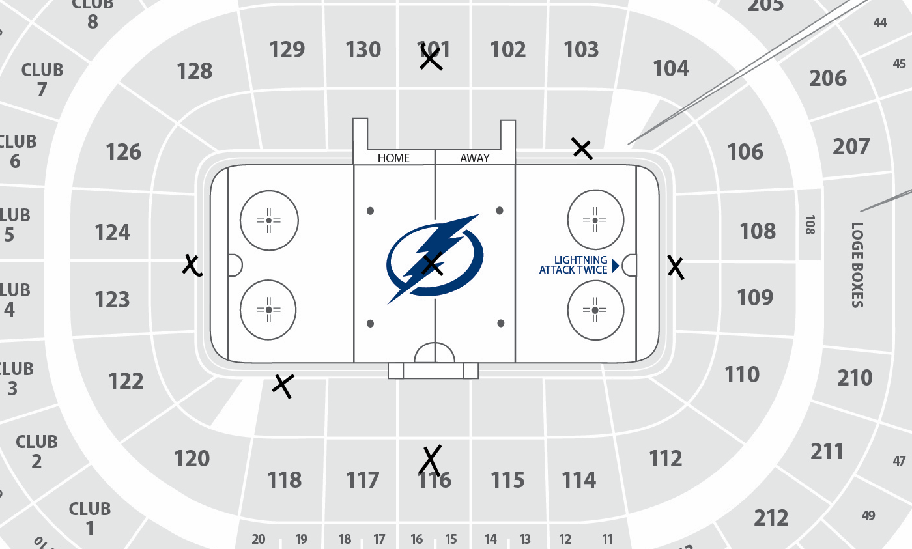
Business Model: Key Revenue Stream
$150 for single team pass
Watch every single game your team plays during regular season
Includes all camera angles
Notes:
Keith: Thanks Eric. Our key revenue stream is our yearly subscription fees. Ultimate Sports View will cost only $150 dollars for you to watch every regular season game your team plays. This fee includes access to all camera angles. We will offer 7 different camera angles in each NHL arena. These will include one behind each net, one overhead view, one in the middle level of the arena behind the benches, one in the middle level of the arena behind the penalty boxes, one first row lower level in one offensive zone, and one first row lower level in the other offensive zone. As you can see on our rink map, the cameras will be selectively placed to give fans all the views they desire.

Slide 9
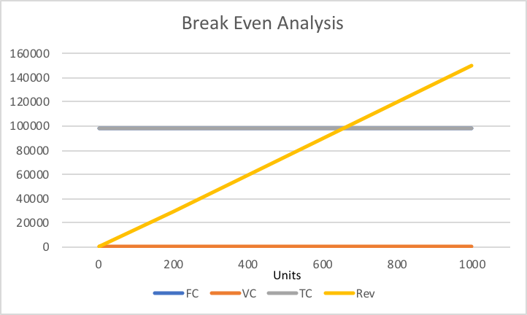
Financials
Projected 2021 Net Sales = $2.4 million (500 subscribers per team)
Break-even Point = 657 subscribers per team
Notes:
Keith: We have a projected sales of $2.4 million dollars in 2021. This sales number was created with a projected 500 subscribers per team. As per the graph, our break even point is achieved by adding only 157 more subscribers to each team, which adds up to a total of 657 subscribers per team. Having 500 subscribers per team was an extremely cautious estimate. Therefore, we believe that reaching this break-even point and surpassing it will be achievable.
The median amount of attendance per team during the 2019-2020 NHL season was around 17,500 fans. With live attendance not being available as of now, we feel that 500 fans per team would be easily attained. Having 500 subscribers is only 2.9% of the total median in person attendance.
500/17,500=2.9%
http://www.espn.com/nhl/attendance

Slide 10
Market Approach & Strategy
Notes:
Eric: Thanks Keith. So our market approach and strategy is pretty simple. Our plan is to start solely on the NHL. The reason we want to start with just one league is so we can measure the demand and reaction from our customers in a relatively small environment. As demand increases, we plan to add additional leagues to our platform such as MLS Soccer, NBA Basketball, NFL Football, and finally MLB Baseball. We want to proceed with caution though to ensure we are able to scale successfully.

Slide 11
Competition
Notes:
Eric: Now our only competitor in the hockey space is NHL.TV. Similar to us, they offer a single team package for $116 per year. Ultimate Sports View is only 30% more expensive at $150 dollars per year. And for this additional 34 dollars, you get access to all seven of our camera angles across all your favorite devices. Why would you watch your favorite hockey team the way everyone else does when you can watch it the way you want to see it? Now back to Keith.

Slide 12
Investment
$451,000 for 49% of company
Money used to purchase equipment and enable growth
Notes:
Keith: Thanks Eric. We are looking for an investment of $451,000 for a 49% stake in our company. We will use this money to purchase our necessary equipment, such as cameras, microphones, and computers. While we know that 49% is a high number, we wanted to be accurate with our evaluation. Our evaluation is around $920,000. We understand that the online streaming market is crowded and competitive, therefore we wanted to be fair to you, our potential investor, and grow the company with your help.

Slide 13
Questions?
Feel free to send us an email to questions@usv.com or DM us on Facebook, Instagram, or Twitter
Thank you!
Notes:
Zhuoting: Thanks Keith. If you have any questions, feel free to send us an email to questions@usv.com or DM us on Facebook, Instagram, or Twitter. Thank you!

