Slide 1
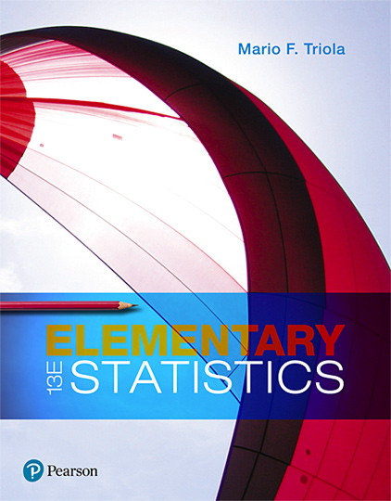
Elementary Statistics
Thirteenth Edition
Chapter 13
Nonparametric Tests
Copyright © 2018, 2014, 2012 Pearson Education, Inc. All Rights Reserved

Slide 2
Nonparametric Tests
13-1 Basics of Nonparametric Tests
13-2 Sign Test
13-3 Wilcoxon Signed-Ranks Test for Matched Pairs
13-4 Wilcoxon Rank-Sum Test for Two Independent Samples
13-5 Kruskal-Wallis Test for Three or More Samples
13-6 Rank Correlation
13-7 Runs Test for Randomness

Slide 3
Key Concept
This section describes the runs test for randomness, which is used to determine whether a sequence of sample data has a random order. This test requires a criterion for categorizing each data value into one of two separate categories, and it analyzes runs of those two categories to determine whether the runs appear to result from a random process, or whether the runs suggest that the order of the data is not random.

Slide 4
Run
Run
After characterizing each data value as one of two separate categories, a run is a sequence of data having the same characteristic; the sequence is preceded and followed by data with a different characteristic or by no data at all.

Slide 5
Runs Test
Runs Test
The runs test uses the number of runs in a sequence of sample data to test for randomness in the order of the data.

Slide 6
Run Test for Randomness: Objective
Apply the runs test for randomness to a sequence of sample data to test for randomness in the order of the data. Use the following null and alternative hypotheses:
H₀: The data are in a random order.
H₁: The data are in an order that is not random.

Slide 7
Run Test for Randomness: Notation
n₁ = number of elements in the sequence that have one particular characteristic. (The characteristic chosen for n₁ is arbitrary.)
n₂ = number of elements in the sequence that have the other characteristic
G = number of runs

Slide 8
Run Test for Randomness: Requirements
The sample data are arranged according to some ordering scheme, such as the order in which the sample values were obtained.
Each data value can be categorized into one of two separate categories (such as male/female).

Slide 9
Run Test for Randomness: Test Statistic and Critical Values (1 of 3)
For Small Samples and α = 0.05: If n₁ ≤ 20 and n₂ ≤ 20 and the significance level is α = 0.05, the test statistic, critical values, and decision criteria are as follows:
Test statistic: number of runs G
Critical values of G: Use Table A-10.
Decision criteria: Reject randomness if the number of runs G is such that
G ≤ smaller critical value found in Table A-10.
or G ≥ larger critical value found in Table A-10.

Slide 10
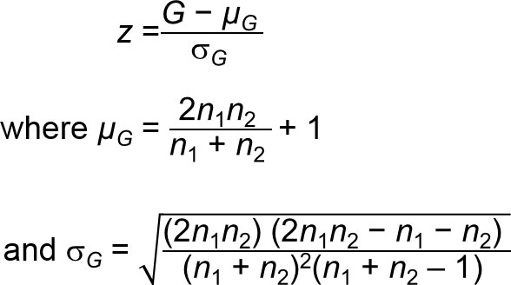
Run Test for Randomness: Test Statistic and Critical Values (2 of 3)
For Large Samples or α ≠ 0.05: If n₁ > 20 or n₂ > 20 or α ≠ 0.05, the test statistic, critical values, and decision criteria are as follows:
Test statistic:

Slide 11
Run Test for Randomness: Test Statistic and Critical Values (3 of 3)
For Large Samples or α ≠ 0.05: If n₁ > 20 or n₂ > 20 or α ≠ 0.05, the test statistic, critical values, and decision criteria are as follows:
Critical values of z: Use Table A-2.
Decision criteria: Reject randomness if the test statistic z is such that
z ≤ negative critical z score (such as −1.96)
or z ≥ positive critical z score (such as 1.96).

Slide 12
Caution
The runs test for randomness is based on the order in which the data occur; it is not based on the frequency of the data. For example, a sequence of 3 men and 20 women might appear to be random, but the issue of whether 3 men and 20 women constitute a biased sample (with disproportionately more women) is not addressed by the runs test.

Slide 13
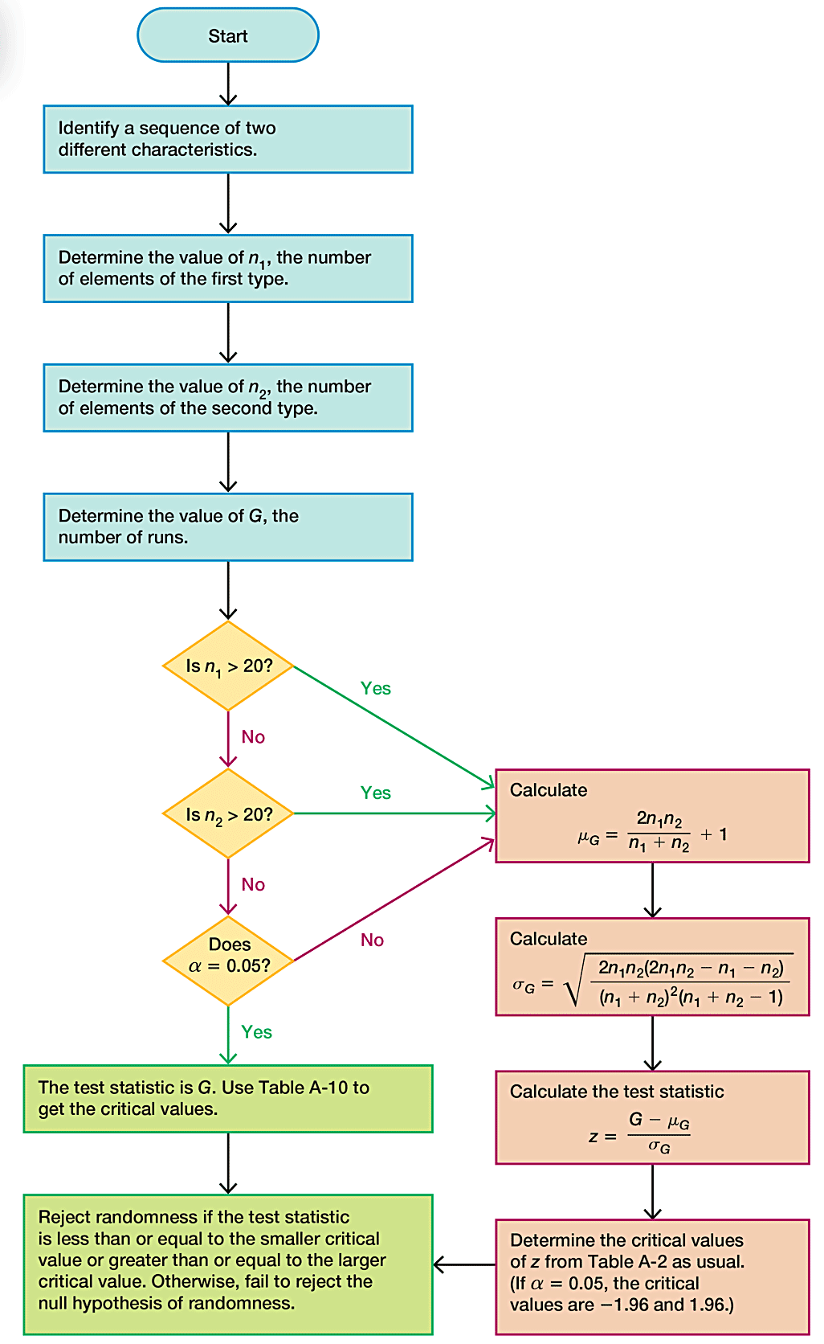
Procedure for Runs Test for Randomness

Slide 14
Fundamental Principle of the Runs Test
Here is the key idea underlying the runs test:
Reject randomness if the number of runs is very low or very high.
Example: The sequence of genders FFFFFMMMMM is not random because it has only 2 runs, so the number of runs is very low.
Example: The sequence of genders FMFMFMFMFM is not random because there are 10 runs, which is very high.

Slide 15
Example: Small Sample – Political Parties of Presidents (1 of 5)
Listed below are the recent political parties of presidents of the United States. The letter R represents a Republican president and the letter D represents a Democratic president. Use a 0.05 significance level to test for randomness in the sequence.
R R D D R D D R R D R R D R D

Slide 16
Example: Small Sample – Political Parties of Presidents (2 of 5)
Solution
Requirement Check (1) The data are arranged in order. (2) Each data value is categorized into one of two separate categories (Republican/Democrat). The requirements are satisfied.

Slide 17
Example: Small Sample – Political Parties of Presidents (3 of 5)
Solution
We will follow the procedure. The sequence of two characteristics (Republican/Democrat) has been identified. We must now find the values of n₁, n₂, and the number of runs G. The sequence is shown below with spacing adjusted to better identify the different runs.

Slide 18
Example: Small Sample – Political Parties of Presidents (4 of 5)
Solution
The above display shows that there are 8 Republican presidents and 7 Democratic presidents, and the number of runs is 10. We represent those results with the following notation.
n₁ = number of Republican presidents = 8
n₂ = number of Democratic presidents = 7
G = number of runs = 10

Slide 19
Example: Small Sample – Political Parties of Presidents (5 of 5)
Solution
Because n₁ ≤ 20 and n₂ ≤ 20 and the significance level is α = 0.05, the test statistic is G = 10 (the number of runs), and we refer to Table A-10 to find the critical values of 4 and 13. Because G = 10 is neither less than or equal to the critical value of 4, nor is it greater than or equal to the critical value of 13, we do not reject randomness. There is not sufficient evidence to reject randomness in the sequence of political parties of recent presidents.

Slide 20
Example: Large Sample – Randomness of Births (1 of 8)
Data Set 4 “Births” in Appendix B lists genders from 100 births at Bellevue Hospital Center. Let’s consider the sequence of the listed genders indicated below, where 1 = boy and 0 = girl. (The complete list of 100 genders can be seen in Data Set 4.) Use a 0.05 significance level to test the claim that the sequence is random.
1 0 1 0 0 0 0 1…1 0 1

Slide 21
Example: Large Sample – Randomness of Births (2 of 8)
Solution
Requirement Check (1) The data are arranged in order. (2) Each data value is categorized into one of two separate categories (boy/girl). The requirements are satisfied. The null and alternative hypotheses are as follows:
H₀: The sequence is random.
H₁: The sequence is not random.

Slide 22
Example: Large Sample – Randomness of Births (3 of 8)
Solution
Examination of the sequence of 100 genders results in these values:
n₁ = number of boys = 51
n₂ = number of girls = 49
G = number of runs = 59

Slide 23
Example: Large Sample – Randomness of Births (4 of 8)
Solution
Since n₁ > 20, we need to calculate the test statistic z, so we must first evaluate µ_{G} and s_{G} as follows:

Slide 24
Example: Large Sample – Randomness of Births (5 of 8)
Solution

Slide 25
Example: Large Sample – Randomness of Births (6 of 8)
Solution
We now find the test statistic:
We can use the test statistic z = 1.61 to find the P-value of 0.1074, which is greater than the significance level of α = 0.05, so we fail to reject the null hypothesis of randomness.

Slide 26
Example: Large Sample – Randomness of Births (7 of 8)
Solution
Also, because the significance level is α = 0.05 and we have a two-tailed test, the critical values are z = −1.96 and z = 1.96. The test statistic of z = 1.61 does not fall within the critical region, so we again fail to reject the null hypothesis of randomness.

Slide 27
Example: Large Sample – Randomness of Births (8 of 8)
Interpretation
We do not have sufficient evidence to reject randomness of the sequence of 100 births at Bellevue Hospital Center (from Data Set 4 “Births” in Appendix B).

