Slide 1
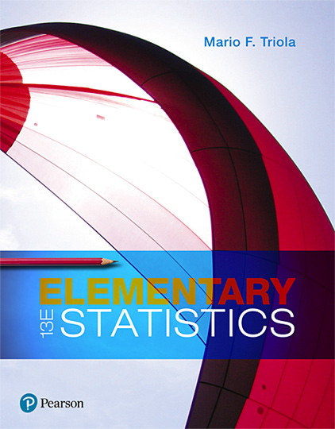
Elementary Statistics
Thirteenth Edition
Chapter 13
Nonparametric Tests
Copyright © 2018, 2014, 2012 Pearson Education, Inc. All Rights Reserved

Slide 2
Nonparametric Tests
13-1 Basics of Nonparametric Tests
13-2 Sign Test
13-3 Wilcoxon Signed-Ranks Test for Matched Pairs
13-4 Wilcoxon Rank-Sum Test for Two Independent Samples
13-5 Kruskal-Wallis Test for Three or More Samples
13-6 Rank Correlation
13-7 Runs Test for Randomness

Slide 3
Key Concept
This section describes the nonparametric method of the rank correlation test, which uses ranks of paired data to test for an association between two variables.

Slide 4
Rank Correlation Test
Rank Correlation Test
The rank correlation test (or Spearman’s rank correlation test) is a nonparametric test that uses ranks of sample data consisting of matched pairs. It is used to test for an association between two variables.

Slide 5
Rank Correlation: Objective
Compute the rank correlation coefficient r_{s} and use it to test for an association between two variables. The null and alternative hypotheses are as follows:

Slide 6
Rank Correlation: Notation
r_{s} = rank correlation coefficient for sample paired data (r_{s} is a sample statistic)
n = number of pairs of sample data
d = difference between ranks for the two values within an individual pair

Slide 7
Rank Correlation: Requirements
The paired data are a simple random sample.
The data are ranks or can be converted to ranks.

Slide 8
Rank Correlation: Test Statistic (1 of 2)
Within each sample, first convert the data to ranks, then find the exact value of the rank correlation coefficient r_{s} by using this formula:

Slide 9
Rank Correlation: Test Statistic (2 of 2)
Simpler Test Statistic if There Are No Ties: After converting the data in each sample to ranks, if there are no ties among ranks for the first variable and there are no ties among ranks for the second variable, the exact value of the test statistic can be calculated using the formula on the previous slide or with the following relatively simple formula, but it is probably easier to use the formula on the previous slide with technology:

Slide 10
Rank Correlation: P-Values
P-values are sometimes provided by technology, but use them only if they result from Spearman’s rank correlation. (Do not use P-values resulting from tests of linear correlation.)

Slide 11
Rank Correlation: Critical Values
If n ≤ 30, critical values are found in Table A-9.
If n > 30, critical values of r_{s} are found using the following formula.
where the value of z corresponds to the significance level.

Slide 12
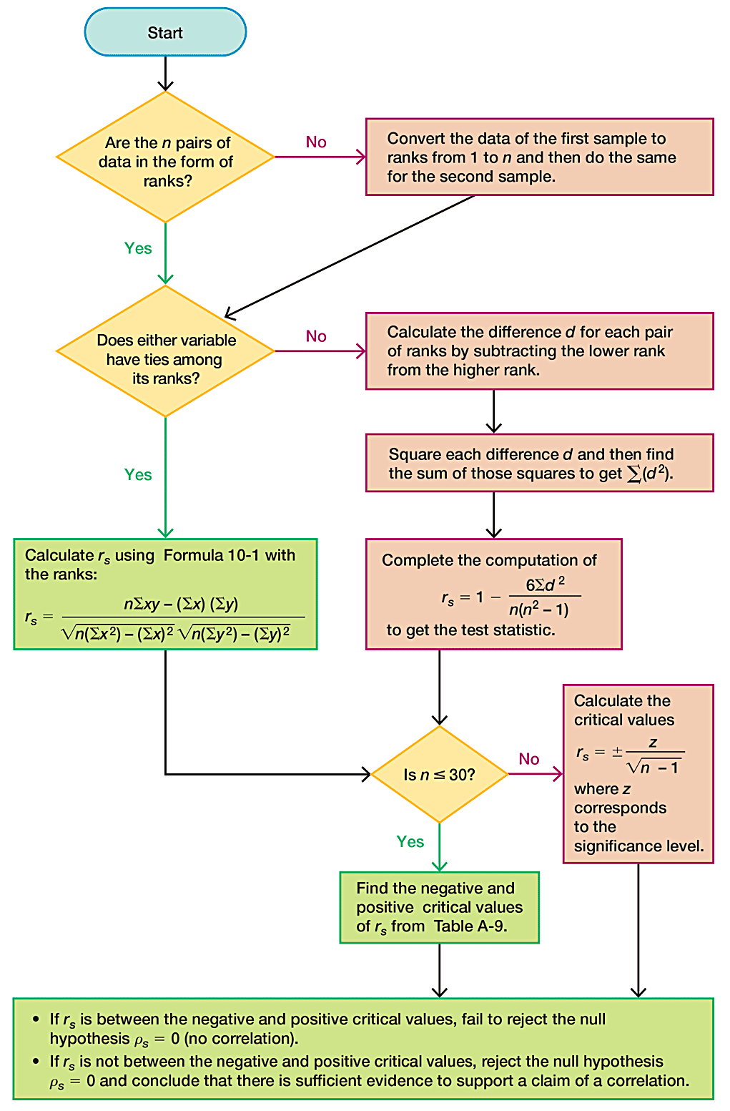
Rank Correlation Procedure for Testing H₀: ρ_{s} = 0

Slide 13
Advantages of Rank Correlation
Rank correlation has these advantages over the parametric methods:
Rank correlation can be used with paired data that are ranks or can be converted to ranks. Unlike the parametric methods, the method of rank correlation does not require a normal distribution for any population.
Rank correlation can be used to detect some (not all) relationships that are not linear.

Slide 14
Disadvantage of Rank Correlation: Efficiency
A minor disadvantage of rank correlation is its efficiency rating of 0.91. This efficiency rating shows that with all other circumstances being equal, the nonparametric approach of rank correlation requires 100 pairs of sample data to achieve the same results as only 91 pairs of sample observations analyzed through the parametric approach, assuming that the stricter requirements of the parametric approach are met.

Slide 15
Example: Do Better Televisions Cost More? (1 of 8)
The table below lists ranks and costs (hundreds of dollars) of LCD televisions with screens of at least 60 inches (based on data from Consumer Reports). Find the value of the rank correlation coefficient and use it to determine whether there is sufficient evidence to support the claim of a correlation between quality and price. Use a 0.05 significance level. Based on the result, does it appear that you can get better quality by spending more?
Quality Rank | 1 | 2 | 3 | 4 | 5 | 6 | 7 | 8 | 9 | 10
Cost (hundreds of dollars) | 23 | 50 | 23 | 20 | 32 | 25 | 14 | 16 | 40 | 22

Slide 16
Example: Do Better Televisions Cost More? (2 of 8)
Solution
Requirement Check The sample data are a simple random sample from the televisions that were tested. The data are ranks or can be converted to ranks.
The quality ranks are consecutive integers and are not from a population that is normally distributed, so we use the rank correlation coefficient to test for a relationship between quality and price.

Slide 17
Example: Do Better Televisions Cost More? (3 of 8)

Slide 18
Example: Do Better Televisions Cost More? (4 of 8)
Solution
Following the procedure, we begin by converting the costs in the table below into their corresponding ranks shown in the table on the next slide.
Quality Rank | 1 | 2 | 3 | 4 | 5 | 6 | 7 | 8 | 9 | 10
Cost (hundreds of dollars) | 23 | 50 | 23 | 20 | 32 | 25 | 14 | 16 | 40 | 22

Slide 19
Example: Do Better Televisions Cost More? (5 of 8)
Solution
The lowest cost of $1400 is assigned a rank of 1. Because the fifth and sixth costs are tied at $2300, we assign the rank of 5.5 to each of them (where 5.5 is the mean of ranks 5 and 6). The ranks corresponding to the costs are shown in the second row.
Quality Rank | 1 | 2 | 3 | 4 | 5 | 6 | 7 | 8 | 9 | 10
Cost Rank | 5.5 | 10 | 5.5 | 3 | 8 | 7 | 1 | 2 | 9 | 4

Slide 20
Example: Do Better Televisions Cost More? (6 of 8)
Solution
Because there are ties among ranks, we must use the first test statistic formula to find that the rank correlation coefficient r_{s} is equal to −0.274.
Quality Rank | 1 | 2 | 3 | 4 | 5 | 6 | 7 | 8 | 9 | 10
Cost Rank | 5.5 | 10 | 5.5 | 3 | 8 | 7 | 1 | 2 | 9 | 4

Slide 21
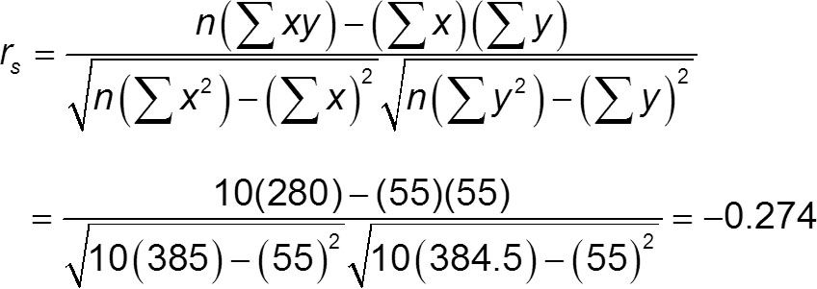
Example: Do Better Televisions Cost More? (7 of 8)
Solution

Slide 22
Example: Do Better Televisions Cost More? (8 of 8)
Solution
Now we refer to Table A-9 to find the critical values of ±0.648 (based on α = 0.05 and n = 10). Because the test statistic r_{s} = −0.274 is between the critical values of −0.648 and 0.648, we fail to reject the null hypothesis. There is not sufficient evidence to support a claim of a correlation between quality and cost. Based on the given sample data, it appears that you don’t necessarily get better quality by paying more.

Slide 23
Example: Large Sample Case (1 of 4)
Refer to the measured systolic and diastolic blood pressure measurements of 147 randomly selected females in Data Set 1 “Body Data” in Appendix B and use a 0.05 significance level to test the claim that among women, there is a correlation between systolic blood pressure and diastolic blood pressure.

Slide 24
Example: Large Sample Case (2 of 4)
Solution
Requirement Check The data are a simple random sample and can be converted to ranks.
Test Statistic The value of the rank correlation coefficient is r_{s} = 0.354, which can be found by using technology.

Slide 25
Example: Large Sample Case (3 of 4)
Solution
Critical Values Because there are 147 pairs of data, we have n = 147. Because n exceeds 30, we find the critical values from the formula below instead of Table A-9. With α = 0.05 in two tails, we let z = 1.96 to get the critical values of −0.162 and 0.162, as shown below.

Slide 26
Example: Large Sample Case (4 of 4)
Solution
The test statistic of r_{s} = 0.354 is not between the critical values of −0.162 and 0.162, so we reject the null hypothesis of r_{s} = 0. There is sufficient evidence to support the claim that among women, there is a correlation between systolic blood pressure and diastolic blood pressure.

