Slide 1
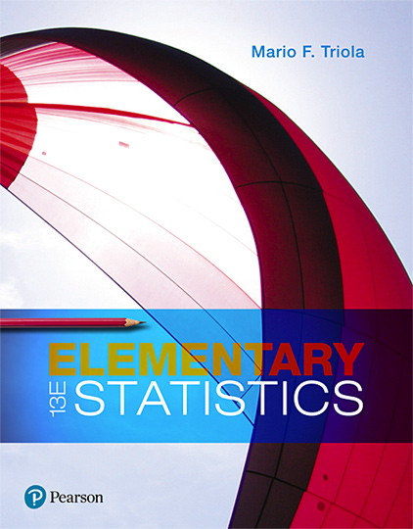
Elementary Statistics
Thirteenth Edition
Chapter 13
Nonparametric Tests
Copyright © 2018, 2014, 2012 Pearson Education, Inc. All Rights Reserved

Slide 2
Nonparametric Tests
13-1 Basics of Nonparametric Tests
13-2 Sign Test
13-3 Wilcoxon Signed-Ranks Test for Matched Pairs
13-4 Wilcoxon Rank-Sum Test for Two Independent Samples
13-5 Kruskal-Wallis Test for Three or More Samples
13-6 Rank Correlation
13-7 Runs Test for Randomness

Slide 3
Key Concept
This section describes the Wilcoxon rank-sum test, which uses ranks of values from two independent samples to test the null hypothesis that the samples are from populations having equal medians.

Slide 4
Caution
Don’t confuse the Wilcoxon rank-sum test for two independent samples with the Wilcoxon signed-ranks test for matched pairs.

Slide 5
Wilcoxon Rank-Sum Test
Wilcoxon Rank-Sum Test
The Wilcoxon rank-sum test is a nonparametric test that uses ranks of sample data from two independent populations to test this null hypothesis:
H₀: Two independent samples come from populations with equal medians.
The alternative hypothesis H₁ can be any one of the following three possibilities:
The two populations have different medians.
The first population has a median greater than the median of the second population.
The first population has a median less than the median of the second population.

Slide 6
Wilcoxon Rank-Sum Test: Objective
Use the Wilcoxon rank-sum test with samples from two independent populations for the following null and alternative hypotheses:
H₀: The two samples come from populations with equal medians.
H₁: The median of the first population is different from (or greater than, or less than) the median from the second population.

Slide 7
Wilcoxon Rank-Sum Test: Notation
n₁ = size of Sample 1
n₂ = size of Sample 2
R₁ = sum of ranks for Sample 1
R₂ = sum of ranks for Sample 2
R = same as R₁ (sum of ranks for Sample 1)
µ_{R} = mean of the sample R values that is expected when the two populations have equal medians
σ_{R} = standard deviation of the sample R values that is expected with two populations having equal medians

Slide 8
Wilcoxon Rank-Sum Test: Requirements
There are two independent simple random samples.
Each of the two samples has more than 10 values.

Slide 9
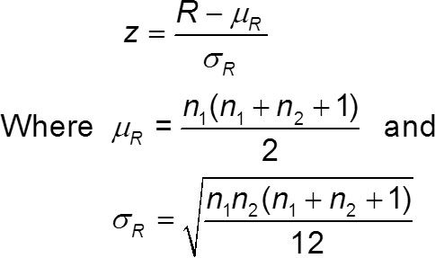
Wilcoxon Rank-Sum Test: Test Statistic
n₁ = size of the sample from which the rank sum R is found
n₂ = size of the other sample
R = sum of ranks of the sample with size n₁

Slide 10
Wilcoxon Rank-Sum Test: P-Values
P-Values
P-values can be found from technology or by using the z test statistic and Table A-2.

Slide 11
Wilcoxon Rank-Sum Test: Critical Values
Critical Values
Critical values can be found in Table A-2 (because the test statistic is based on the normal distribution).

Slide 12
Procedure for Finding the Value of the Test Statistic (1 of 4)
Step 1: Temporarily combine the two samples into one big sample, then replace each sample value with its rank. (The lowest value gets a rank of 1, the next lowest value gets a rank of 2, and so on. If values are tied, assign to them the mean of the ranks involved in the tie. See Section 13-1 for a description of ranks and the procedure for handling ties.)

Slide 13
Procedure for Finding the Value of the Test Statistic (2 of 4)
Female Professor | Male Professor
4.3 (20.5) | 4.5 (25.5)
4.3 (20.5) | 3.7 (8)
4.4 (23.5) | 4.2 (17.5)
4.0 (13.5) | 3.9 (11)
3.4 (5.5) | 3.1 (2)
4.7 (27) | 4.0 (13.5)
2.9 (1) | 3.8 (9.5)
4.0 (13.5) | 3.4 (5.5)
4.3 (20.5) | 3.4 (25.5)
3.4 (5.5) | 3.8 (9.5)
3.4 (5.5) | 4.3 (20.5)
3.3 (3) | 4.4 (23.5)
Blank | 4.1 (16)
Blank | 4.2 (17.5)
Blank | 4.0 (13.5)
n₁ = 12 | n₂ = 15
R₁ = 159.5 | R₂ = 218.5
Step 1:
EXAMPLE: In the table, the ranks of the 27 student course evaluations are shown in parentheses. The rank of 1 is assigned to the lowest sample value of 2.9, the rank of 2 is assigned to the next lowest value of 3.1, and the rank of 3 is assigned to the next lowest value of 3.3. The next lowest value is 3.4, which occurs four times, so we find the mean of the ranks of 4, 5, 6, 7, which is 5.5, and we assign the rank of 5.5 to each of those four tied values.

Slide 14
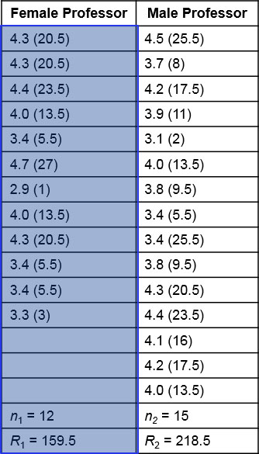
Procedure for Finding the Value of the Test Statistic (3 of 4)
Step 2:
Find the sum of the ranks for either one of the two samples.
EXAMPLE: In the table, the sum of the ranks from the first sample is 159.5.
R₁ = 20.5 + 20.5 + 23.5 + … + 3 = 159.5

Slide 15
Procedure for Finding the Value of the Test Statistic (4 of 4)
Step 3: Calculate the value of the z test statistic as shown previously, where either sample can be used as “Sample 1.” (If both sample sizes are greater than 10, then the sampling distribution of R is approximately normal with mean µ_{R} and standard deviation σ_{R}, and the test statistic is as shown previously.)
EXAMPLE: Calculations of µ_{R} and σ_{R} and z are shown in the example which follows.

Slide 16
Example: Course Evaluation Ratings for Female and Male Professors (1 of 11)
Female Professor | Male Professor
4.3 (20.5) | 4.5 (25.5)
4.3 (20.5) | 3.7 (8)
4.4 (23.5) | 4.2 (17.5)
4.0 (13.5) | 3.9 (11)
3.4 (5.5) | 3.1 (2)
4.7 (27) | 4.0 (13.5)
2.9 (1) | 3.8 (9.5)
4.0 (13.5) | 3.4 (5.5)
4.3 (20.5) | 3.4 (25.5)
3.4 (5.5) | 3.8 (9.5)
3.4 (5.5) | 4.3 (20.5)
3.3 (3) | 4.4 (23.5)
Blank | 4.1 (16)
Blank | 4.2 (17.5)
Blank | 4.0 (13.5)
n₁ = 12 | n₂ = 15
R₁ = 159.5 | R₂ = 218.5
The table lists course evaluation ratings for courses taught by female and male professors. Use a 0.05 significance level to test the claim that female and male professors have the same median course evaluation rating.

Slide 17
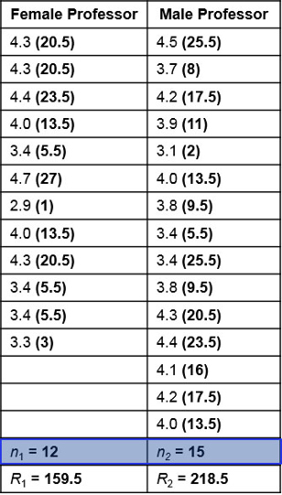
Example: Course Evaluation Ratings for Female and Male Professors (2 of 11)
Solution
Requirement Check (1) The sample data are two independent simple random samples. (2) The sample sizes are 12 and 15, so both sample sizes are greater than 10. The requirements are satisfied.

Slide 18
Example: Course Evaluation Ratings for Female and Male Professors (3 of 11)
Solution
The null and alternative hypotheses are as follows:
H₀: The median of the course evaluation ratings for courses taught by female professors is equal to the median of the course evaluation ratings for courses taught by male professors.
H₁: The median course evaluation rating for courses taught by female professors is different from the median course evaluation rating for courses taught by male professors.

Slide 19
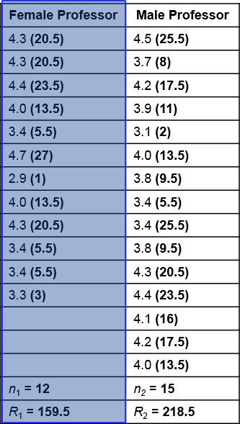
Example: Course Evaluation Ratings for Female and Male Professors (4 of 11)
Solution
Rank the combined list of all 27 course ratings, beginning with a rank of 1 (assigned to the lowest value of 2.9). The ranks corresponding to the individual sample values are shown in parentheses in the table. R denotes the sum of the ranks for the sample we choose as Sample 1. If we choose the course evaluations of female professors as Sample 1, we get
R = 20.5 + 20.5 + 23.5 + ... + 3 = 159.5

Slide 20
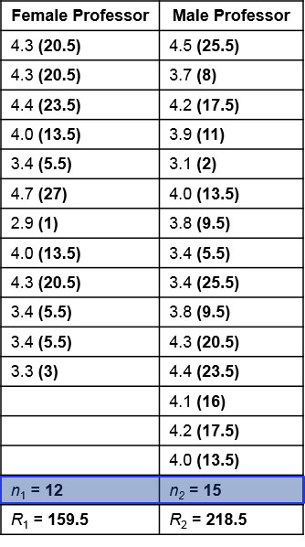
Example: Course Evaluation Ratings for Female and Male Professors (5 of 11)
Solution
Because there are course evaluation ratings for 12 female professors, we have n₁ = 12. Also, n₂ = 15 because there are course evaluation ratings of 15 male professors. The values of µ_{R} and σ_{R} and the test statistic z can now be found as follows.

Slide 21
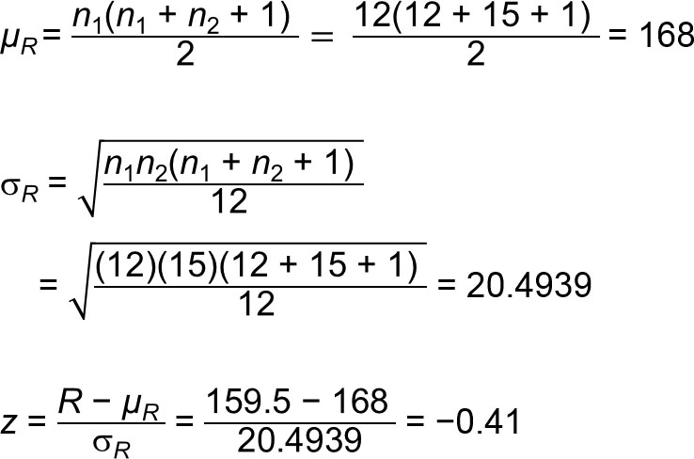
Example: Course Evaluation Ratings for Female and Male Professors (6 of 11)
Solution

Slide 22
Example: Course Evaluation Ratings for Female and Male Professors (7 of 11)
Solution
The test is two-tailed because a large positive value of z would indicate that disproportionately more higher ranks are found in Sample 1, and a large negative value of z would indicate that disproportionately more lower ranks are found in Sample 1. In either case, we would have strong evidence against the claim that the two samples come from populations with equal medians.

Slide 23
Example: Course Evaluation Ratings for Female and Male Professors (8 of 11)
Solution
The significance of the test statistic z can be treated as in previous chapters. We are testing (with α = 0.05) the hypothesis that the two populations have equal medians, so we have a two-tailed test.

Slide 24
Example: Course Evaluation Ratings for Female and Male Professors (9 of 11)
Solution
P-Value Using the unrounded z score, the P-value is 0.678, so we fail to reject the null hypothesis that the populations of female professors and male professors have the same median course evaluation rating.

Slide 25
Example: Course Evaluation Ratings for Female and Male Professors (10 of 11)
Solution
Critical Values If we use the critical values of z = ±1.96, we see that the test statistic of z = −0.41 does not fall within the critical region, so we fail to reject the null hypothesis that the populations of female professors and male professors have the same median course evaluation rating.

Slide 26
Example: Course Evaluation Ratings for Female and Male Professors (11 of 11)
Interpretation
There is not sufficient evidence to warrant rejection of the claim that female professors and male professors have the same median course evaluation rating. Based on the available sample data, it appears that female professors and male professors teach courses that are rated about the same.

