Slide 1
Introduction: The Four Threats
Energy sources
Civil War
Climate change
Poor health of entire populations
Notes:
Energy sources
The poor utilization of energy sources poses the greatest threat on the basis that it worsens global warming. The continued use of fossil fuel continues to emit enormous greenhouse gases to the atmosphere, an outcome that threatens all living organisms. For instance, in 2018, 6,677 million Metric tons of CO₂ were emitted to the atmosphere in the US (US EPA, 2018). Such amounts are unsustainable.
Civil War
Civil wars are also a threat as the number of countries engaged in civil wars is high. Some of the most common civil wars are in the Middle East which includes the Iraqi civil war, the Yemeni civil war and many other insurgencies that can easily turn into civil wars. Such wars are a threat to global peace and stability.
Climate change
Climate change is one of the most existential threats human beings face. Sea levels are rising, desertification is increasing and forest fires are multiplying. For instance, sea levels have risen by between 0.18 and 0.2m (Carbon Brief, 2019). Such issues can make Earth inhabitable.
Poor health of entire populations
Poor health among entire populations is another threat to human society. WHO (2017) assert that half of the world population lack access to health services. The Lancet (2015) adds that 2.3 billion people suffer at least five ailments.

Slide 2
The Greatest Threat: Global Warming
The history of global warming can be traced to 1800 where the theory then was that carbon (IV) oxide was driving global warning.
By 1950, the connection between carbon IV oxide and global warming had been confirmed (History, 2017).
By 1980s, there was a sharp increase in global temperatures.
The illustration in slide 6 shows that global warning has worsened.

Slide 3
Most affected Countries and How
Cambodia is facing a high risk of flooding due to climate change.
Cameroon is already facing violent winds, high temperatures, and heavy rainfall due to global warning (Global water Partnership, 2018).
Australia is also affected as it is facing heat-waves and devastating fires (Goodman, 2020)
Notes:
The United Nations should prioritize these countries by one, offering financial support and secondly, offering technical assistance.

Slide 4
Effect on World Population
Famine will also increase because of desertification. Diseases such as malnutrition will rise
Global warming will disturb ecosystems and drive some species to extinction
Global warming will compound the instances of civil war and ethnic clashes as people clash over scarce resources.
Extreme temperatures will also make the world unbearable (Contributor & Contributor, 2017).
Many will deny due to heat waves and flooding.

Slide 5
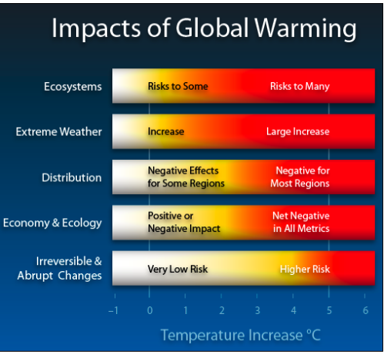
Impact Of Global Warming

Slide 6
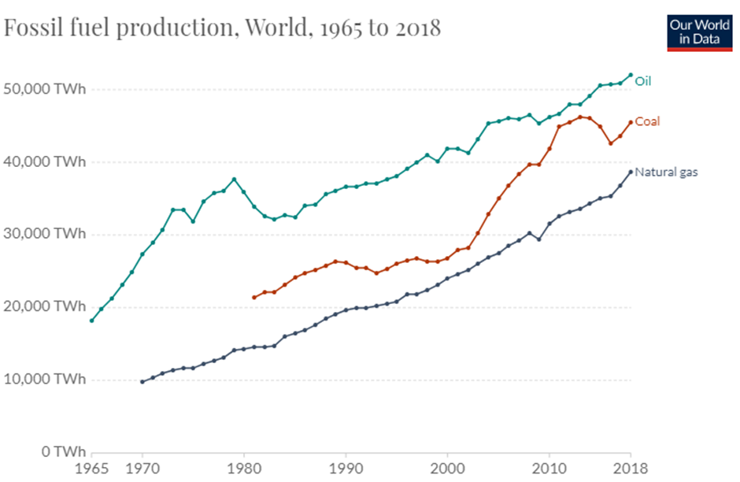
The Second Threat: Energy Sources
Fossil fuels have been in use for decades particularly in industrial activities and transport.
The illustration above shows that the production of fossil fuels has increased exponentially over the years.
Notes:
However, the extensive use of fossil fuels has precipitated serious socio-environmental challenges.
Pollution is high and so is global warming. That is, the current sources of energy are tied to the rising threat of climate change.
Sea levels are rising, desertification is increasing and forest fires are multiplying.
These are serious threats because they can catalyze human extinction.

Slide 7
Most affected Countries and How
China: It accounts for 28% of all global greenhouse emissions as shown in slide 10.
India: India accounts for 7% of all global greenhouse emissions. The
United States: The US is responsible for 14% of all global greenhouse emissions.
Temperatures will continue rising particularly in warm climates.
Notes:
The resulting effect is that China’s air is highly polluted which can cause respiratory diseases (Each Country's Share of CO2 Emissions, 2008).
Similarly, India’s air pollution is high, an issue that can expose citizens to respiratory diseases.
The information indicates that the UN should work closely with these states to help them suppress the emission of greenhouses within their jurisdictions.
More resources should be directed particularly towards China and India.

Slide 8
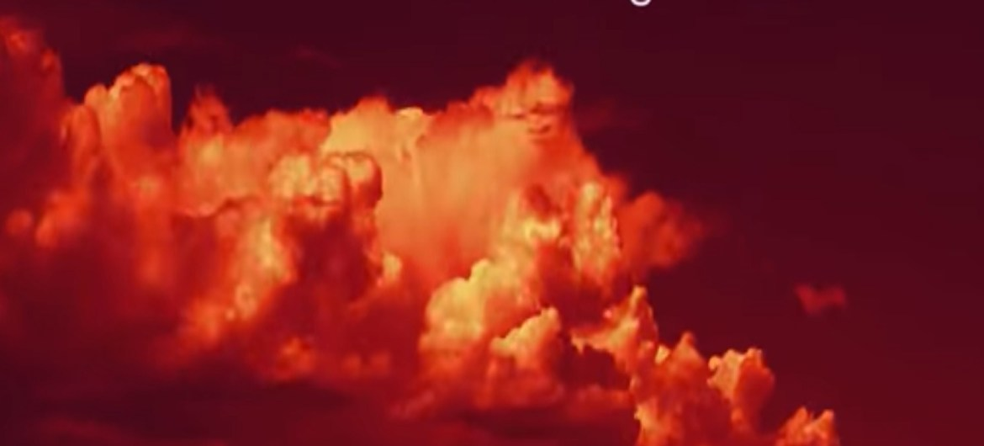
Effect on World Population
The world population will continue experiencing high temperatures.
quality of air will also decline
desertification will rise

Slide 9
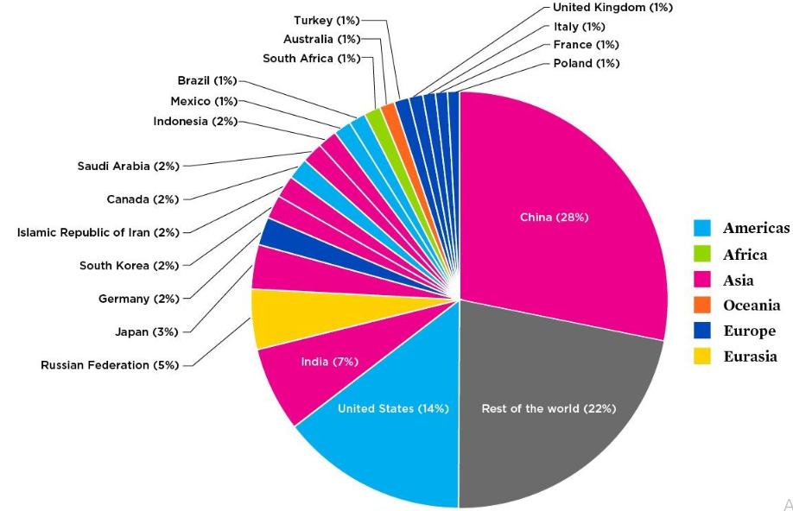
Greenhouse Emissions

Slide 10
Third Threat: Poor Health of Entire Populations
Historically, diseases and ailments have been part and parcel of the human race.
However, as the world population continues to grow, this challenge will be magnified.
WHO (2017) assert that half of the world population lack access to health services.
The Lancet (2015) adds that 2.3 billion people suffer at least five ailments.
Notes:
Poor health among entire populations is another threat to human society.
As more people fail to access sufficient healthcare, suffering will increase. As a result, the number of deaths will rise and the quality of living will decline.

Slide 11
Most affected Countries and How
Some of the most affected countries include Chad, Central African Republic, Guinea, Liberia, Benin, Mozambique, Ivory Coast and Nigeria (Werft, 2017).
These countries have the worst health performance. The prevalence of diseases and ailments such as Malaria, malaria, lower respiratory infections, HIV/AIDS and diarrheal is quite high.
For instance, 1.9 million Nigerians live with HIV/AIDS as shown in slide 14 (Avert, 2019).
Malaria-related deaths are also high in Chad. In 2013, the number of malaria-related deaths stood at 2,057 (The New Humanitarian, 2019).
Notes:
The United Nations can prioritize these countries by providing more funds to establish hospitals and hire healthcare workers.
Additionally, the UN can promote research to find vaccines for these diseases.

Slide 12
Effect on World Population
The presence of these diseases in one part of the globe will easily be transferred to other regions.
That is, more people can get infected over time. For instance, the number of new HIV infections stood at 1.7 million (World Health Organization, 2018).
Additionally, poor health leads to death and affects standards of living.
Poor health also affects productivity and can increase poverty

Slide 13
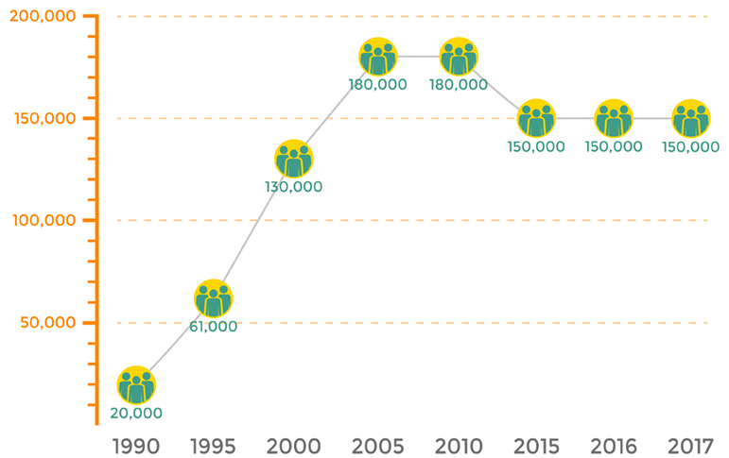
HIV Deaths in Nigeria

Slide 14
The Fourth Threat: Civil War
Civil wars have a long history as different communities have always attempted to control or enslave others.
Roman civil wars are an example of ancient and medieval civil wars.
Others include Revolt of 1173–74, (England), German Peasants' War, 1524–1525, and Count's Feud (Denmark), 1534–1536
Current civil wars include; First Libyan Civil War (2011), Syrian Civil War (2011 - present) and Iraqi Civil War (2014 - 2017)
Notes:
These civil wars have been very destructive and deadly.
In particular, the Syrian war has led to the displacement of 6.2 million people.
More than 200,000 people have so far been killed (CNN, 2020).
Therefore, the ongoing civil wars will kill and displace more.

Slide 15
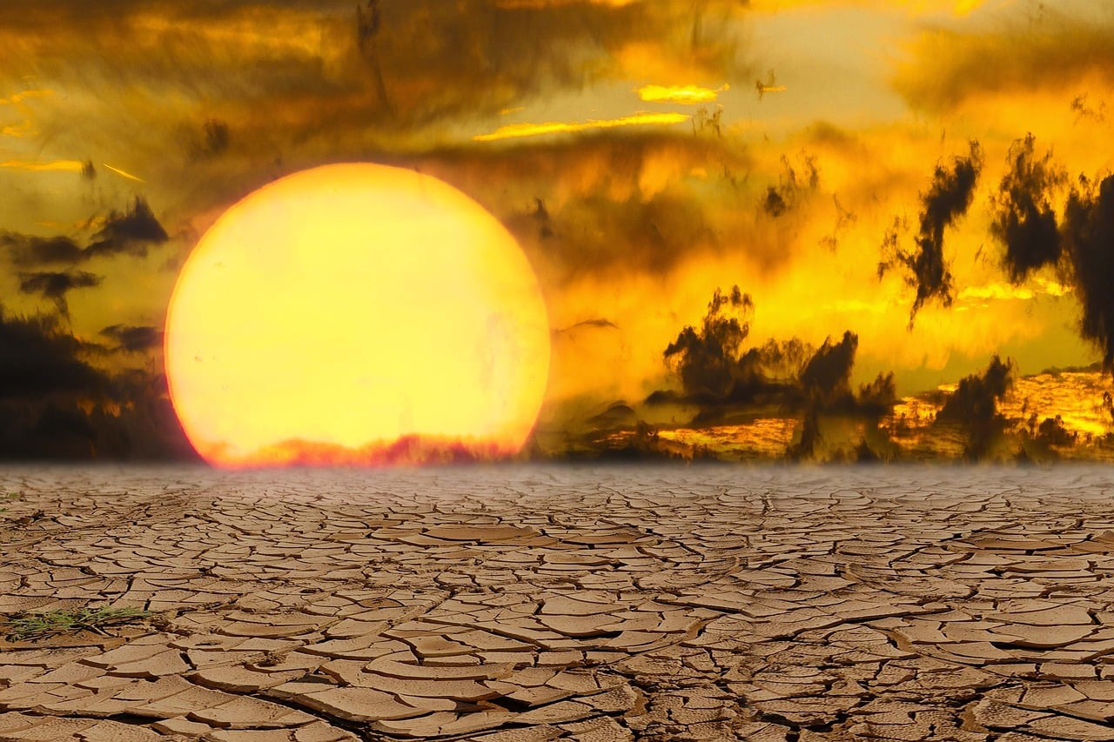
Most affected Countries and How
Some of the most affected are Syria, Iraq, Libyan and Yemen.
Death toll is high
The infrastructure in these countries has also been destroyed.
Notes:
For instance, the Syrian war has displaced more than 6.2 million people and killed over 200,000 people.
As of 2019, the death toll in the Syrian Civil war reached over 100,000 (Beaumont, 2019)
Iraq now needs $88.2 billion to rebuild after the Islamic State war (CNBC, 2018)

Slide 16
Effect on World Population
This threat affects the world population as it can increase the risk of terrorism.
Civil wars create a perfect environment for terrorism activities to thrive
Civil wars also help the proliferation of small arms that make the world less secure
Notes:
The UN can prioritize these countries by facilitating peace negotiations
Additionally, the UN should work with member states to place more sanctions on the involved parties. The aim is to reduce the flow of weapons to risky areas.

Slide 17
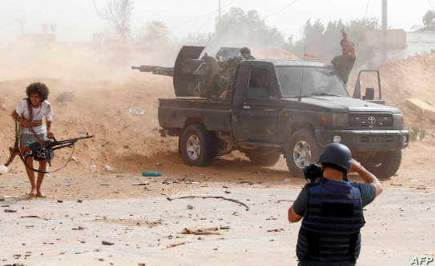
Terrorists Fighting in Libya

Slide 18
Conclusion
This project discussed four threats, namely; Energy sources, civil War, climate change and Poor health of entire populations
These threats have been shown to affect certain countries strongly more than others
In general, the threats affect the sustainability of the human race

Slide 19
References
Cameroon: Preparing National Adaptation Plan for Climate Change (NAPCC) and its Investment Strategy (#492) - GWP. (2018). Retrieved 6 June 2020, from https://www.gwp.org/en/learn/KNOWLEDGE_RESOURCES/Case_Studies/Africa/cameroon-preparing-national-adaptation-plan-for-climate-change-napcc-and-its-investment-strategy-492/#:~:text=Cameroon%20is%20already%20facing%20consequences,and%20the%20services%20they%20provide.
NASA. (2020). Climate Change Evidence: How Do We Know? Retrieved 6 June 2020, from https://climate.nasa.gov/evidence/
Climate Change History. (2017). Retrieved 6 June 2020, from https://www.history.com/topics/natural-disasters-and-environment/history-of-climate-change
Contributor, A., & Contributor, S. (2017). Effects of Global Warming. Retrieved 6 June 2020, from https://www.livescience.com/37057-global-warming-effects.html
Each Country's Share of CO2 Emissions. (2008). Retrieved 6 June 2020, from https://www.ucsusa.org/resources/each-countrys-share-co2-emissions
Carbon brie. (2019). Explainer: How climate change is accelerating sea level rise. Retrieved 6 June 2020, from https://www.carbonbrief.org/explainer-how-climate-change-is-accelerating-sea-level-rise
Goodman, J. (2020). What is Australia doing to tackle climate change?. Retrieved 6 June 2020, from https://www.bbc.com/news/world-australia-50869565
Avert. (2019). HIV and AIDS in Nigeria. (2019). Retrieved 7 June 2020, from https://www.avert.org/professionals/hiv-around-world/sub-saharan-africa/nigeria
WHO. (2018). HIV/AIDS. Retrieved 7 June 2020, from https://www.who.int/gho/hiv/en/

Slide 20
References
The New Humanitarian. (2013). Malaria deaths nearly double in Chad. Retrieved 7 June 2020, from https://www.thenewhumanitarian.org/news/2013/10/25/malaria-deaths-nearly-double-chad
The Lancet. (2015). Over 95% of the world’s population has health problems, with over a third having more than five ailments. Retrieved 6 June 2020, from https://www.sciencedaily.com/releases/2015/06/150608081753.htm
US EPA. (2018). Overview of Greenhouse Gases | US EPA. Retrieved 6 June 2020, from https://www.epa.gov/ghgemissions/overview-greenhouse-gases#:~:text=Carbon%20dioxide%20(CO2)%20is,gas%20emitted%20through%20human%20activities.&text=Larger%20image%20to%20save%20or%20printThe%20main%20human%20activity,changes%20also%20emit%20CO2.
Ritchie, H., & Roser, M. (2018). Fossil Fuels. Retrieved 6 June 2020, from https://ourworldindata.org/fossil-fuels#all-charts-preview
Werft, M. (2017). The 10 Most & Least Healthy Countries In The World In 2016. Retrieved 7 June 2020, from https://www.globalcitizen.org/en/content/best-worst-countries-list-health-2016-legatum-inde/
World Bank and WHO: Half the world lacks access to essential health services, 100 million still pushed into extreme poverty because of health expenses. (2017). Retrieved 6 June 2020, from https://www.who.int/news-room/detail/13-12-2017-world-bank-and-who-half-the-world-lacks-access-to-essential-health-services-100-million-still-pushed-into-extreme-poverty-because-of-health-expenses
CNBC. (2018). $88.2 billion price tag for rebuilding Iraq after Islamic State war. (2018). Retrieved 7 June 2020, from https://www.cnbc.com/2018/02/12/88-point-2-billion-us-dollar-price-tag-for-rebuilding-iraq-after-islamic-state-war.html
Beaumont, P. (2019). Death toll in Yemen war reaches 100,000. Retrieved 7 June 2020, from https://www.theguardian.com/world/2019/oct/31/death-toll-in-yemen-war-reaches-100000
CNN. (2020). Syrian Civil War Fast Facts. Retrieved 7 June 2020, from https://edition.cnn.com/2013/08/27/world/meast/syria-civil-war-fast-facts/index.html

