Slide 1
School of Computer & Information Sciences
ITS-532 Cloud Computing
Chapter 2 – Software as a Service
Notes:
Content from:
Primary Textbook: Jamsa, K. A. (2013). Cloud computing: SaaS, PaaS, IaaS, virtualization, business models, mobile, security and more. Burlington, MA: Jones & Bartlett Learning.
Secondary Textbook: Erl, T., Mahmood, Z., & Puttini, R. (2014). Cloud computing: concepts, technology, & architecture. Upper Saddle River, NJ: Prentice Hall.

Slide 2
Learning Objectives
Define and describe SaaS.
List the advantages and disadvantages of SaaS solutions.
Define and describe OpenSaaS.
Define and describe mashups.
Discuss the wide range of SaaS solutions and their providers.

Slide 3
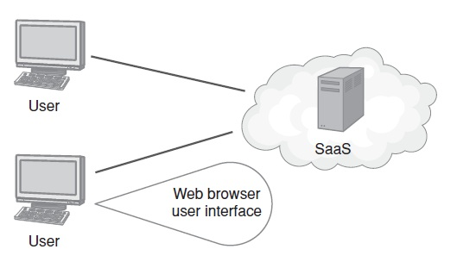
Software as a Service Defined
A solution model in which users use a web browser to access software that resides, along with the programs and user data, in the cloud.

Slide 4
Characteristics
The following six specific characteristics are common to the majority of cloud environments:
on-demand usage
ubiquitous access
multitenancy
elasticity
measured usage
resiliency
(Erl, 2014)

Slide 5
SaaS Advantages
Eliminate the need for an on-site data center.
Eliminate the need for application administration.
Allow customers to pay on demand for software use, normally on a per-user basis.
Offer application, processor, and data storage scalability.
Offer device-independent access to applications.
Increase disaster recovery and business continuity.

Slide 6
SaaS Disadvantages
The biggest concern, or potential disadvantage, is that the data, like the applications, reside in the cloud. Many companies are concerned about letting go of their data.
Also, because the company does not own the solution, it can be challenging or expensive to customize the application.

Slide 7
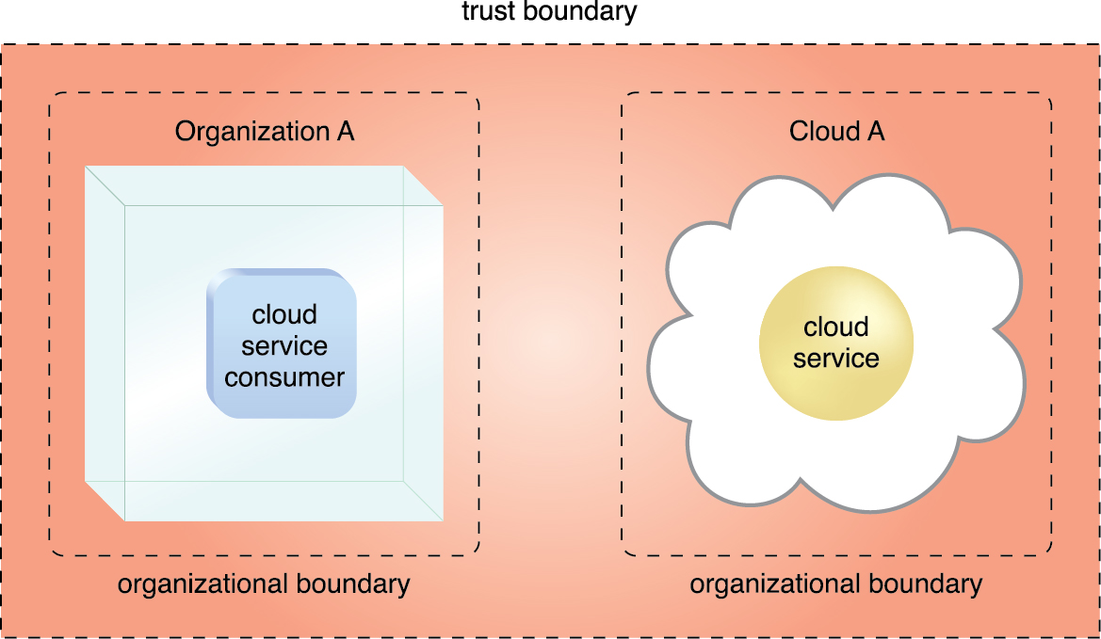
Boundaries
Organizational Boundary
Represents the physical perimeter that surrounds a set of IT resources that are owned and governed by an organization. The organizational boundary does not represent the boundary of an actual organization, only an organizational set of IT assets and IT resources.
Trust Boundary
A logical perimeter that typically spans beyond physical boundaries to represent the extent to which IT resources are trusted
Figure 4.7 An extended trust boundary encompasses the organizational boundaries of the cloud provider and the cloud consumer.
(Erl, 2014)

Slide 8
Real World: Salesforce.com
Cloud-based customer relationship management (CRM) solutions.
Companies accomplish the following:
Manage sales contacts and leads
Centralize contact information, presentations, and project details
Access sales information and reports from anyplace, at any time, with any device
Manage project quotes and project work flow
Sync sales contacts and meetings with existing tools, such as Microsoft Outlook

Slide 9
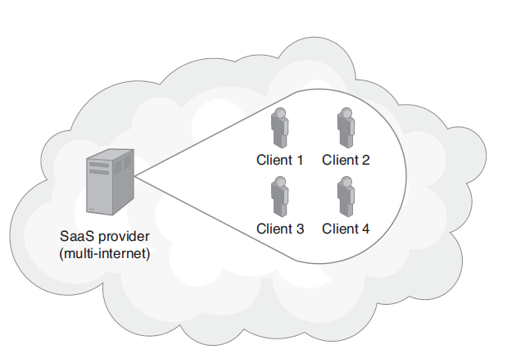
Multitenant SaaS Solutions
SaaS applications are often multitenant solutions; that is, within the cloud, two or more companies may share the same server resources.

Slide 10
Real World: Taleo Human-Resources SaaS
To achieve wide-scale use, an SaaS solution must have large market potential.
Every business must recruit, hire, train, and compensate employees.
The Taleo cloud-based talent management system provides applications and services to meet company human resources demands.

Slide 11
OpenSaaS Solutions
An OpenSaaS solution is an SaaS application created using an open-source programming language and designed to run on an open-source operating system and database.
Many customers believe that if a solution is open source, it will be easier for them to move the data to a different application in the future if the current solution fails to meet their needs.
Because customers do not own the SaaS software, they will not be able to move the application itself.

Slide 12
Real World: ADP SaaS-based Payroll Processing
One of the first companies to leverage the power of the cloud was ADP—a payroll processing company.
Reaching far beyond payroll today, ADP offers cloud-based solutions for time management, employee benefits processing, workers compensation, human resources issues, and more.
Further, ADP has extended many of its services to mobile users, allowing payroll processing to occur any time, from any place.

Slide 13
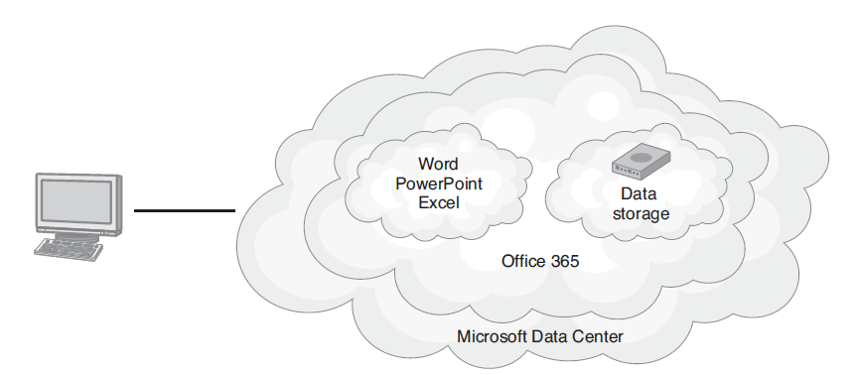
Real World: Office365 SaaS-Based Document Creation
Office 365 provides cloud-based subscription access to the Office suite of applications.

Slide 14
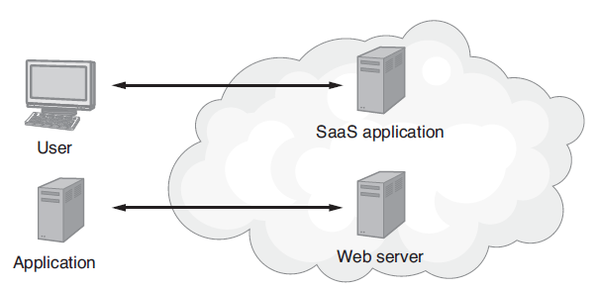
Introducing Service-Oriented Architecture (SOA)
Service-oriented architecture (SOA) is an application development methodology with which developers create solutions by integrating one or more web services.

Slide 15
Web Service
A function or subroutine a program can call to accomplish a specific task.
When a program running on one computer calls a web service, a message, possibly containing parameter values, is sent across the network (or Internet) to the computer housing the web service.
That computer, in turn, performs its processing and normally returns a result to the caller.
Some developers refer to web services as remote-procedure calls.

Slide 16
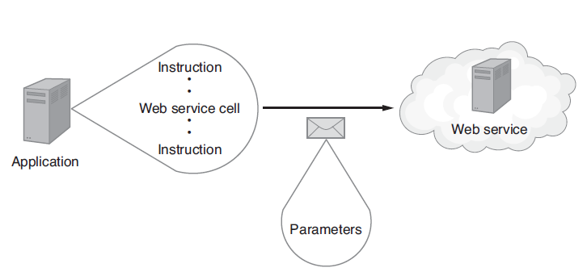
Web Service Message Passing

Slide 17
Web Services Continued
Developers refer to a set of web services as an application program interface (API).
Amazon and eBay, for example, provide APIs that programmers can use to purchase products from across the web using the programs they create.

Slide 18
Facebook: Is It a SaaS?
If you ask 10 cloud experts if Facebook is an SaaS social media site, you will likely get 10 uncommitted “maybe” answers. Facebook definitely has a variety of SaaS characteristics:
Ability to scale with respect to processor demands and data storage needs
No user software to purchase or install
Redundant server hardware and data storage
Accessibility through a myriad of devices

Slide 19
Key Terms

Slide 20
References
Primary:
Jamsa, K. A. (2013). Cloud computing: SaaS, PaaS, IaaS, virtualization, business models, mobile, security and more. Burlington, MA: Jones & Bartlett Learning.
Secondary:
Erl, T., Mahmood, Z., & Puttini, R. (2014). Cloud computing: concepts, technology, & architecture. Upper Saddle River, NJ: Prentice Hall.

