Slide 1
School of Computer & Information Sciences
ITS-532 Cloud Computing
Chapter 1 - Introduction to Cloud Computing
Notes:
Content from:
Primary Textbook: Jamsa, K. A. (2013). Cloud computing: SaaS, PaaS, IaaS, virtualization, business models, mobile, security and more. Burlington, MA: Jones & Bartlett Learning.
Secondary Textbook: Erl, T., Mahmood, Z., & Puttini, R. (2014). Cloud computing: concepts, technology, & architecture. Upper Saddle River, NJ: Prentice Hall.

Slide 2
Learning Objectives
Understand the abstract nature of cloud computing.
Describe evolutionary factors of computing that led to the cloud.
Describe virtualization at both the desktop and the server level.
Describe and identify common cloud types, which include software as a service, platform as a service, and infrastructure as a service.
Know how businesses and individuals use the cloud.
Describe the benefits and disadvantages of cloud computing.
Understand common security considerations with respect to the cloud.
Describe ways cloud computing can improve system fault tolerance.
Describe Web 2.0 and its relationship to cloud computing.

Slide 3
Cloud Computing Defined
Cloud computing describes the abstraction of web-based computers, resources, and services that system developers can utilize to implement complex web-based systems - Jamsa (2013)
Add Erl pg 27/28 to difinietions

Slide 4
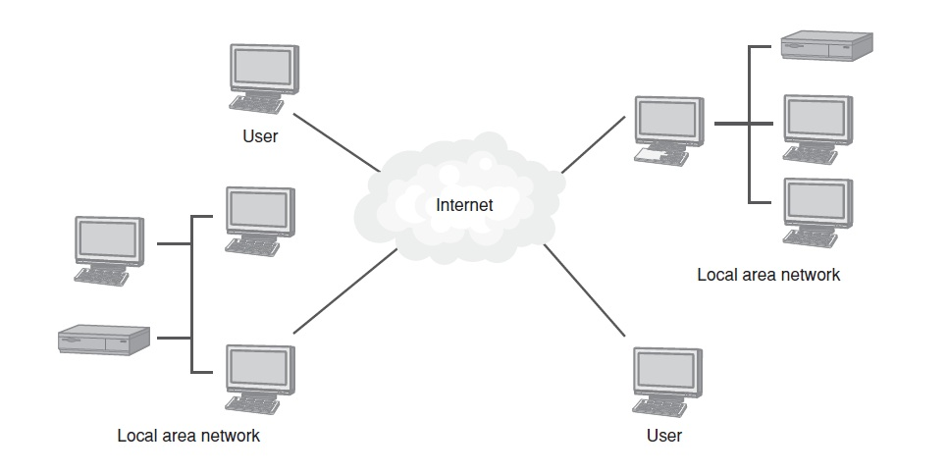
Why Use the Term “Cloud”
For years developers and network administrators have represented the Internet as a cloud.

Slide 5
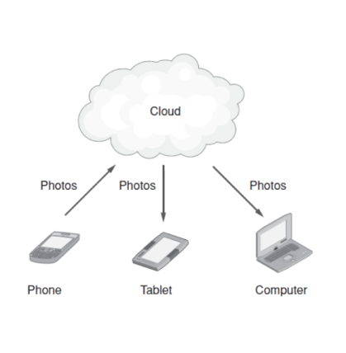
Real World: Apple iCloud
Using iCloud, users can synchronize their content to a variety of devices.

Slide 6
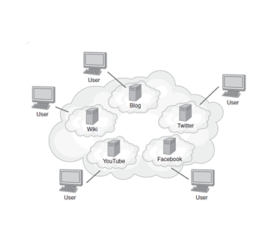
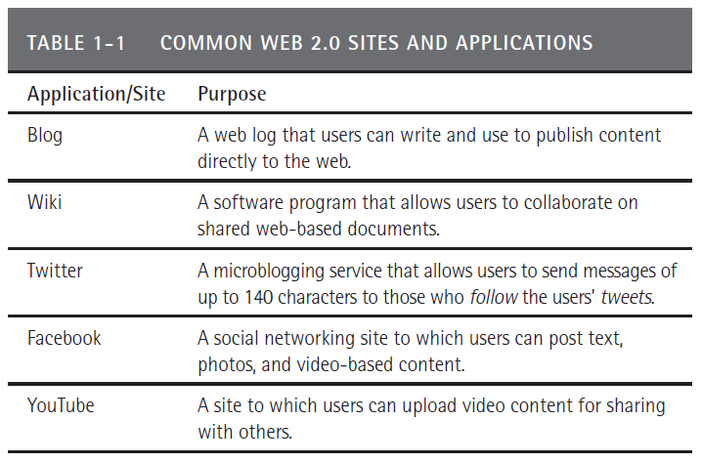
Web 2.0
Web 2.0 tools and sites, users essentially publish content directly to the cloud for access by other users.

Slide 7
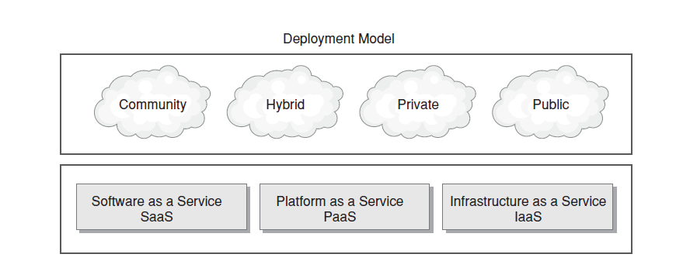
Understanding Cloud Types
To analyze and describe cloud-based systems, people refer to a cloud solution in terms of its deployment model and services model.
These two terms originated from the National Institute of Standards and Technology (NIST)

Slide 8
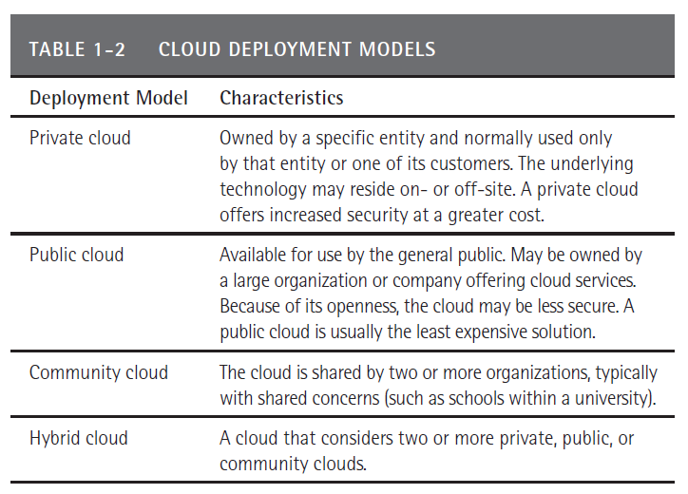
Cloud Deployment Models

Slide 9
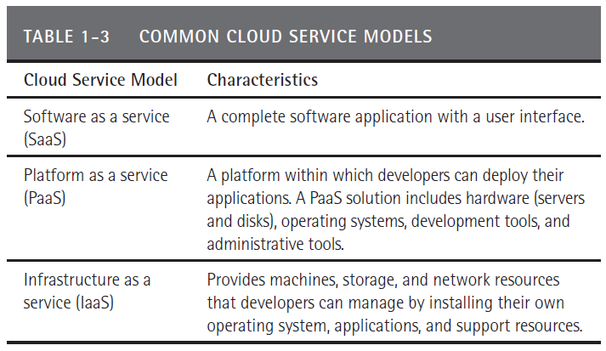
Cloud Service Models

Slide 10
Real World: Windows Azure
Windows Azure is a Microsoft platform developers can use to move applications to the cloud.
Windows Azure provides operating-system support for .NET applications and a cloud-based SQL server (SQL Azure).
Windows Azure platform maintains servers, operating systems, database software, and other supporting applications.
Windows Azure can scale to meet the developer’s needs.

Slide 11
Features of Cloud-Based Platforms
Scalability. On demand resource scaling.
Redundancy. Servers, storage, and networks.
Cost benefits from resource pooling. Shares IT resources across a very large number of companies, which provides cost savings to each.
Outsourced server management. Provides an IT staff who maintain operating systems and underlying support software.
Low cost of entry. Companies do not need to invest in their own IT data center.

Slide 12
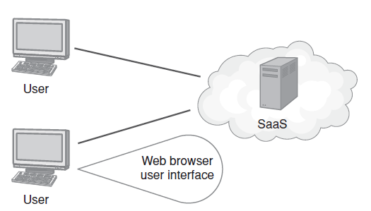
Software as a Service (SaaS)
SaaS provides a cloud-based foundation for software on demand.
Web-delivered content that users access via a web browser.
The software can reside within any of the deployment-model clouds.

Slide 13
SaaS Advantages and Disadvantages
The advantages of SaaS solutions are simplicity of integration (users need only a browser), cost (the data center resides within the cloud), and scalability (customers can add user licenses or seats as needed).
The disadvantage of SaaS solutions is the perception of security issues.

Slide 14
Real World: Salesforce.com
One of the first companies to launch a large-scale SaaS.
Leveraged the fact that as much as three-fourths of a salesperson’s day was spent on nonsales tasks.
Recognized that regardless of the items a company sold, the selling process was similar across companies and even industries.
Automated these tasks and put the underlying data storage in the cloud—the sales cloud.

Slide 15
Platform as a Service
PaaS provides the underlying hardware technology, such as one or more servers (or virtual servers), operating systems, database solutions, developer tools, and network support, for developers to deploy their own solutions.
The hardware and software within a PaaS solution is managed by the platform provider.
Developers need not worry about performing hardware or operating system upgrades. Instead, developers can focus on their own applications.

Slide 16
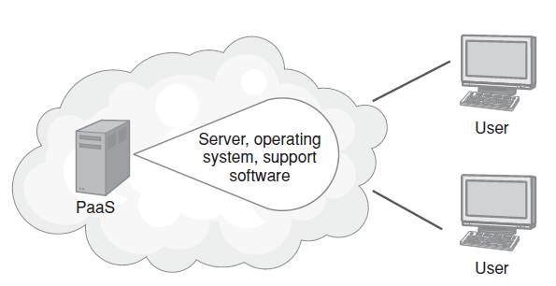
PaaS Advantages and Disadvantages
Developers can focus on application solutions, not hardware or the platform.
Some developers want more control over the underlying systems (patches, versions, …)

Slide 17
Infrastructure as a Service
IaaS provides a virtual data center within the cloud.
IaaS provides servers (physical and virtualized), cloud-based data storage, and more.
Developers must install their own operating system, database management software, and support software.
Then the developers (or the company’s system administrators) must manage both the hardware and the software.

Slide 18
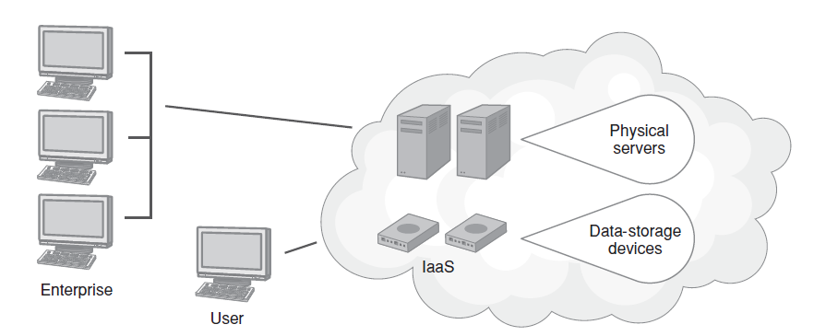
IaaS Advantages and Disadvantages
Companies no longer require a data center
Some developers/administrators want to physically touch their equipment to reduce security concerns

Slide 19
Real World: Amazon AWS
Companies can use Amazon Web Services (AWS) to host their own systems.
Today, AWS process hundreds of thousands of web-based requests for companies every second!

Slide 20
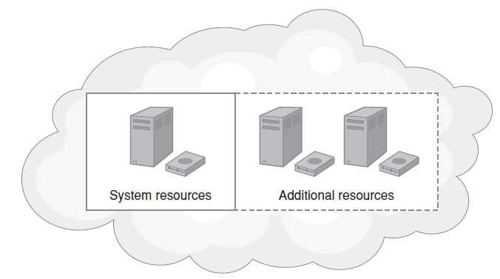
Scalability
A site or application’s ability to use additional resources on demand.
The site or application may scale up to utilize additional resources when the system is experiencing high user demand and later scale down resources when the demand declines.

Slide 21
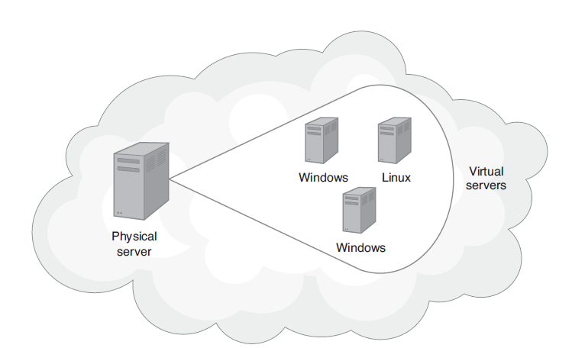
Virtualization
The use of hardware and/or software to create the perception of something.
Using special software, the server can be made to appear as if it has multiple CPUs running the same or different operating systems.

Slide 22
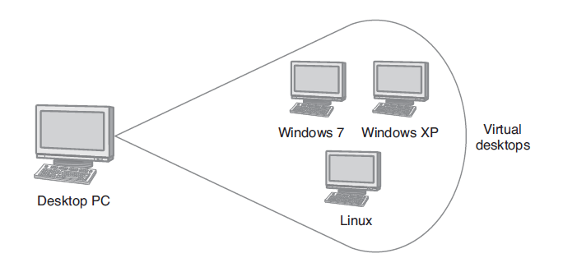
Desktop Virtualization
Allows a desktop PC to run multiple operating systems.
Ideal for testers or support personnel.

Slide 23
Technology Innovations
Clustering – Redundancy and Failover
A group of independent IT resources working as a single system
Identical hardware and software
Synchronization between resources
Grid Computing – High Performance “virtual super computer”
A group of computing resources working together as a logical resource pool
Hardware and software for each resource can vary
Loose coupling of distributed systems
Virtualization
Physical computer resources provided multiple “virtual” instances of themselves
(Erl, 2014)

Slide 24
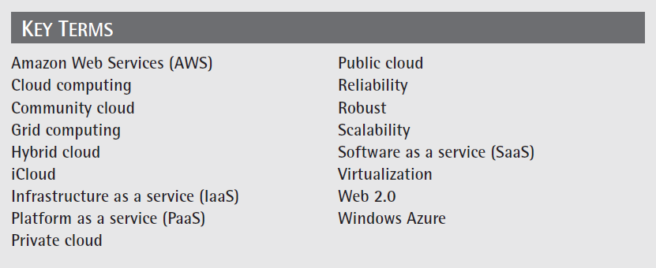
Key Terms

Slide 25
References
Primary:
Jamsa, K. A. (2013). Cloud computing: SaaS, PaaS, IaaS, virtualization, business models, mobile, security and more. Burlington, MA: Jones & Bartlett Learning.
Secondary:
Erl, T., Mahmood, Z., & Puttini, R. (2014). Cloud computing: concepts, technology, & architecture. Upper Saddle River, NJ: Prentice Hall.

