Slide 1
Elementary Statistics
Thirteenth Edition
Chapter 13
Nonparametric Tests
Copyright © 2018, 2014, 2012 Pearson Education, Inc. All Rights Reserved

Slide 2
Nonparametric Tests
13-1 Basics of Nonparametric Tests
13-2 Sign Test
13-3 Wilcoxon Signed-Ranks Test for Matched Pairs
13-4 Wilcoxon Rank-Sum Test for Two Independent Samples
13-5 Kruskal-Wallis Test for Three or More Samples
13-6 Rank Correlation
13-7 Runs Test for Randomness

Slide 3
Key Concept
This section describes the Kruskal-Wallis test, which uses ranks of data from three or more independent simple random samples to test the null hypothesis that the samples come from populations with the same median.

Slide 4
Kruskal-Wallis test
Kruskal-Wallis test
The Kruskal-Wallis test (also called the H test) is a nonparametric test that uses ranks of combined simple random samples from three or more independent populations to test the null hypothesis that the populations have the same median.

Slide 5
Kruskal-Wallis Test: Objective
Use the Kruskal-Wallis test with simple random samples from three or more independent populations for the following null and alternative hypotheses:
H₀: The samples come from populations with the same median.
H₁: The samples come from populations with medians that are not all equal.

Slide 6
Kruskal-Wallis Test: Notation
N = total number of observations in all samples combined
k = number of different samples
R₁ = sum of ranks for Sample 1
n₁ = number of observations in Sample 1
For Sample 2, the sum of ranks is R₂ and the number of observations is n₂, and similar notation is used for the other samples.

Slide 7
Kruskal-Wallis Test: Requirements
We have at least three independent simple random samples.
Each sample has at least five observations.

Slide 8
Kruskal-Wallis Test: Test Statistic

Slide 9
Kruskal-Wallis Test: P-Values
P-values are often provided by technology. By using the test statistic H and the number of degrees of freedom (k − 1), Table A-4 can be used to find a range of values for the P-value.

Slide 10
Kruskal-Wallis Test: Critical Values
The test is right-tailed and critical values can be found from technology or from the chi-square distribution in Table A-4.
df = k − 1 (where df is the number of degrees of freedom and k is the number of different samples)

Slide 11
Procedure for Finding the Value of the H Test Statistic (1 of 4)
Step 1: Temporarily combine all samples into one big sample and assign a rank to each sample value. (Sort the values from lowest to highest, and in cases of ties, assign to each observation the mean of the ranks involved.)
EXAMPLE: In the table on the next slide, the numbers in parentheses are the ranks of the combined data set. The rank of 1 is assigned to the lowest value of 64, the rank of 2 is assigned to the next lowest value of 78, and so on. In the case of ties, each of the tied values is assigned the mean of the ranks involved in the tie.

Slide 12
Procedure for Finding the Value of the H Test Statistic (2 of 4)
Performance IQ Scores (Ranks in parentheses)
Low Blood Lead Level | Medium Blood Lead Level | High Blood Lead Level
80 (6.5) | 78 (2) | 93 (10)
90 (8.5) | 97 (12.5) | 100 (15.5)
107 (18.5) | 107 (18.5) | 97 (12.5)
85 (6.5) | 80 (4) | 79 (3)
100 (15.5) | 90 (8.5) | 97 (12.5)
97 (12.5) | 83 (5) | Blank
101 (17) | Blank | Blank
64 (1) | Blank | Blank
n₁ = 8 | n₂ = 6 | n₃ = 5
R₁ = 86 | R₂ = 50.5 | R₃ = 53.5

Slide 13
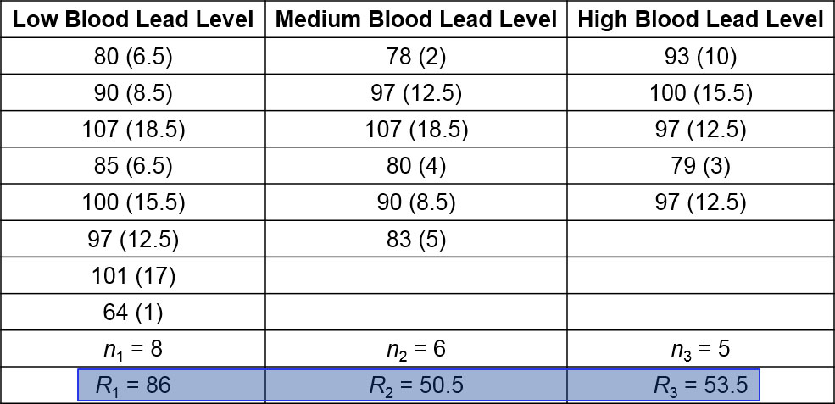
Procedure for Finding the Value of the H Test Statistic (3 of 4)
Step 2: For each sample, find the sum of the ranks and find the sample size.
EXAMPLE: In the table, the sum of the ranks from the first sample is 86, the sum of the ranks for the second sample is 50.5, and the sum of the ranks for the third sample is 53.5.

Slide 14
Procedure for Finding the Value of the H Test Statistic (4 of 4)
Step 3: Calculate H using the results of Step 2 and the notation and test statistic given.
EXAMPLE: The test statistic is computed in the next example.

Slide 15
Example: Effect of Lead on IQ Scores (1 of 11)
The table on the next slide lists performance (non-verbal) IQ scores from samples of subjects with low blood lead level, medium blood lead level, and high blood lead level. Use a 0.05 significance level to test the claim that the three samples of performance IQ scores come from populations with medians that are all equal.

Slide 16
Example: Effect of Lead on IQ Scores (2 of 11)
Low Blood Lead Level | Medium Blood Lead Level | High Blood Lead Level
80 (6.5) | 78 (2) | 93 (10)
90 (8.5) | 97 (12.5) | 100 (15.5)
107 (18.5) | 107 (18.5) | 97 (12.5)
85 (6.5) | 80 (4) | 79 (3)
100 (15.5) | 90 (8.5) | 97 (12.5)
97 (12.5) | 83 (5) | Blank
101 (17) | Blank | Blank
64 (1) | Blank | Blank
n₁ = 8 | n₂ = 6 | n₃ = 5
R₁ = 86 | R₂ = 50.5 | R₃ = 53.5

Slide 17
Example: Effect of Lead on IQ Scores (3 of 11)
Solution
Requirement Check (1) Each of the three samples is a simple random independent sample. (2) Each sample size is at least 5. The requirements are satisfied.

Slide 18
Example: Effect of Lead on IQ Scores (4 of 11)
Solution
The null and alternative hypotheses are as follows:
H₀: The population of subjects with low lead exposure, the population with medium lead exposure, and the population with high lead exposure all have performance IQ scores with the same median.
H₁: The three populations of performance IQ scores have three medians that are not all the same.

Slide 19
Example: Effect of Lead on IQ Scores (5 of 11)
Solution
Test Statistic First combine all of the sample data and rank them, then find the sum of the ranks for each category. In the table, ranks are shown in parentheses next to the original sample values. Next, find the sample size (n) and sum of ranks (R) for each sample. Those values are shown at the bottom of the table. Because the total number of observations is 19, we have N = 19.

Slide 20
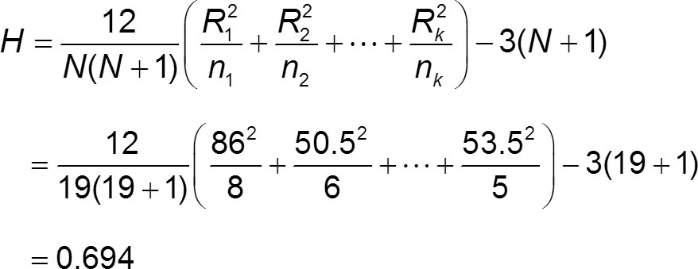
Example: Effect of Lead on IQ Scores (6 of 11)
Solution
We can now evaluate the test statistic as follows:

Slide 21
Example: Effect of Lead on IQ Scores (7 of 11)
Solution
Because each sample has at least five observations, the distribution of H is approximately a chi-square distribution with k − 1 degrees of freedom. The number of samples is k = 3, so we have 3 − 1 = 2 degrees of freedom.

Slide 22
Example: Effect of Lead on IQ Scores (8 of 11)
Solution
P-Value With H = 0.694 and df = 2, Table A-4 shows that the P-value is greater than 0.10. Using technology, we get P-value = 0.707. Because the P-value is greater than the significance level of 0.05, we fail to reject the null hypothesis of equal population medians.

Slide 23
Example: Effect of Lead on IQ Scores (9 of 11)
Solution
Critical Value Refer to Table A-4 to find the critical value of 5.991, which corresponds to 2 degrees of freedom and a 0.05 significance level (with an area of 0.05 in the right tail). The figure on the next slide shows that the test statistic H = 0.694 does not fall within the critical region bounded by 5.991, so we fail to reject the null hypothesis of equal population medians.

Slide 24
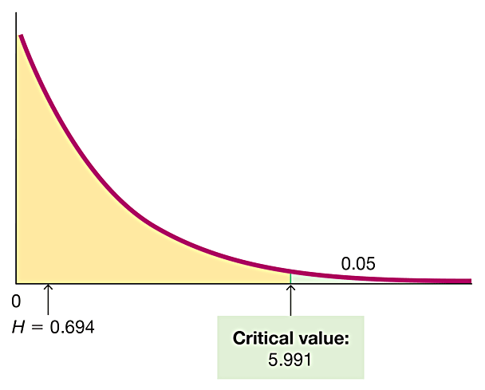
Example: Effect of Lead on IQ Scores (10 of 11)
Solution
The figure shows the test statistic of H = 0.694 and the critical value of χ² = 5.991. The test statistic does not fall in the critical region, so we fail to reject the null hypothesis of equal medians.

Slide 25
Example: Effect of Lead on IQ Scores (11 of 11)
Interpretation
There is not sufficient evidence to reject the claim that the three samples of performance IQ scores come from populations with medians that are all equal. The population medians do not appear to be significantly different.

