Slide 1
Standardized Assessment

Slide 2
Learning Objectives
Define standardized testing and identify their use.
Describe issues concerning standardized testing.
Describe how standardized tests are interpreted in an educational setting.

Slide 3
What Are Standardized Tests and How Are They Used?
The term standardized describes tests that are uniform in:
      content
      administration
      scoring
Standardized tests allow for the comparison of results across classrooms, schools, and school districts.

Slide 4
Selection and Placement
Standardized tests are often used to select students for entry or placement in specific programs:
    college entrance
    special programs for students who are gifted and talented
    special-education programs
High schools may use standardized tests in deciding which students to counsel into:
    college preparatory
    general
    vocational programs.

Slide 5
Diagnosis
Standardized tests are often used to diagnose individual students’ learning problems or strengths:
    For example, a student who is performing poorly in school might be given a battery of tests to determine whether he or she has a learning disability or mental retardation.
Sophisticated assessments can help you determine students’ cognitive styles and the depth of their understanding of complex concepts.

Slide 6
Evaluation and Accountability
A common application of standardized testing is to evaluate students’ progress and teachers’ and schools’ effectiveness.
      For example, districts and states use tests to hold educators accountable for the achievement of their students by evaluating the gains that schools make in overall student performance.
      Parents often want to know how their children are doing in comparison with the typical achievement of children at their grade level.

Slide 7
School Improvement
Standardized tests can contribute to improving the schooling process.
The results of some standardized tests provide information about appropriate student placement and diagnostic information that is important in remediation.
In addition, achievement tests can guide curriculum development and revision when areas of weakness appear.
Standardized tests can play a role in guidance and counseling as well.

Slide 8
What Types of Standardized Tests Are Given?
Aptitude tests, such as tests of general intelligence (IQ) and multifactor batteries, predict students’ general abilities and preparation to learn.
    IQ tests administered to individuals or groups attempt to measure individual aptitude in the cognitive domain.
Achievement tests assess student proficiency in various subject areas.
Diagnostic tests focus on specific subject matter to discover strengths or weaknesses in mastery.

Slide 9
Aptitude Tests
Aptitude tests focus on general learning potential and knowledge acquired both in school and out.
Aptitudes are usually measured by evaluating achievement over a very broadly defined domain.
School learning can affect students’ aptitude test scores, and a student who scores well on one type of test will usually score well on another.
The most common aptitude tests given in school are tests of intelligence, or general aptitude for school learning.

Slide 10
Norm-Referenced Achievement Tests
Achievement tests focus on skills or abilities that are traditionally taught in schools and generally fall into one of four categories:
achievement batteries
diagnostic tests
single-subject achievement measures
criterion-referenced achievement measures

Slide 11
Criterion-Referenced Achievement Tests
Criterion-referenced tests differ from norm-referenced standardized tests in several ways.
Such tests can take the form of:
    a survey battery
    a diagnostic test
    a single subject test
In contrast to norm-referenced tests, which are designed for schools with varying curricula, criterion-referenced tests are most meaningful when constructed around a well-defined set of objectives.

Slide 12
Standard Setting
When tests are used for making decisions about mastery of a subject or topic, a procedure is employed to determine the test cutoff scores indicating various proficiency levels.
Most methods of establishing a cutoff score rely on the professional judgment of teachers and other educators.
Qualified professionals might examine each item in a test and judge the probability that a student with a given level of proficiency would get the item correct.
They then base the cutoff score for mastery or proficiency on these probabilities.

Slide 13
How Are Standardized Tests Interpreted?
After students take a standardized test, the tests are usually sent for computer scoring. The students’ raw scores are translated into one or more derived scores such as:
    percentiles-the percentage of scores in the norming group that fall below a particular score
    grade equivalents-the grade and month at which a particular score is thought to represent typical performance
    standard scores-the students’ performance in relation to the normal distribution of scores

Slide 14
Percentile Scores
A percentile score, or percentile rank (sometimes abbreviated as % ILE), indicates the percentage of students in the norming group who scored lower than a particular score.
For example: If you ranked a group of 30 students from bottom to top on test scores, the 25th student from the bottom would score in the 83rd percentile (25/30 3 100 83.3).

Slide 15
Grade-Equivalent Scores
Grade-equivalent scores relate students’ scores to the average scores obtained by students at a particular grade level.
The advantage of grade equivalents is that they are easy to interpret and make some intuitive sense.
    For example, if an average student gains one grade equivalent each year, we call this progressing at expected levels.
Grade-equivalent scores should be interpreted as only a rough approximation.

Slide 16
Standard Scores
Several kinds of scores describe test results according to their positions on the normal curve.
A normal curve describes a distribution of scores in which most fall near the mean, or average, with a symmetrically smaller number of scores appearing the farther we go above or below the mean.
A frequency plot of a normal distribution produces a bell-shaped curve. (see following slides)

Slide 17
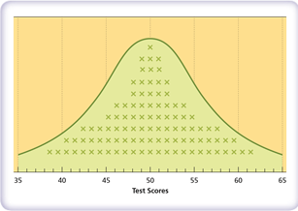
Bell Curve

Slide 18
Standard Scores
Standard scores include:
stanines (based on the standard deviation of scores)
normal curve equivalents (based on a comparison of scores with the normal distribution)
z- scores (the location of scores above or below the mean )

Slide 19
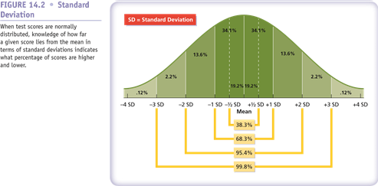

Slide 20
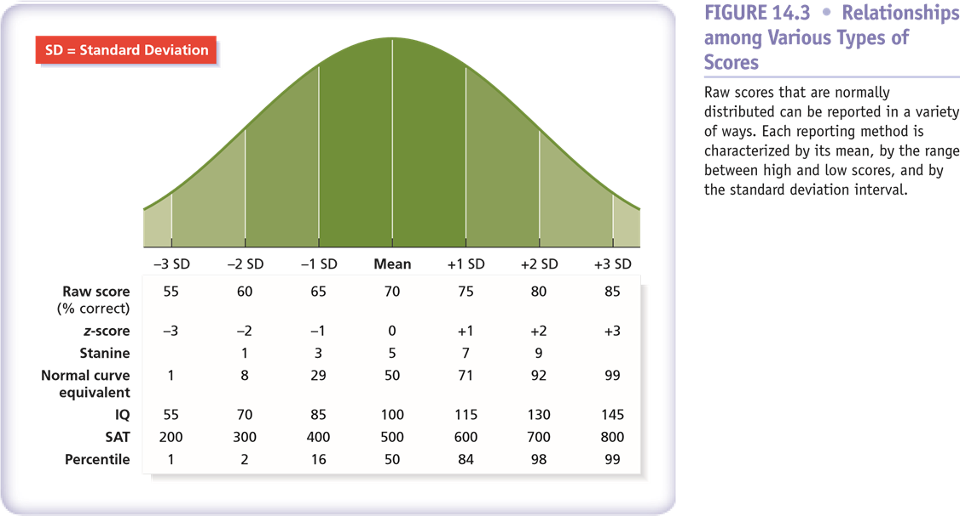

Slide 23
What Are Some Issues Concerning Standardized and Classroom Testing?
The use of standardized tests to assess teachers, schools and districts has increased dramatically in recent years.
All states now have statewide testing programs in which students at selected grade levels take state tests.
In recent years there have been many developments and proposals for changes in testing.

Slide 24
Test Validity
The validity of a test is the extent to which those inferences are justified.
The types of evidence that are used to evaluate the validity of a test vary according to the test’s purpose.
    For example, if a test is being selected to help teachers and administrators determine which students are likely to have some difficulty with one or more aspects of instruction, primary interest will be in how well the test predicts future academic performance.

Slide 25
Test Reliability
Reliability of a test relates to the accuracy with which these skills and knowledge are measured.
When a test is administered, aspects related to the test and its administration could cause the results to be inaccurate.
    In theory, if a student were to take equivalent tests twice, he or she should obtain the same score both times.
    Random features of the assessment affect test scores:
    ambiguous test item
    differences in specific item content
    lucky or unlucky guessing
    inconsistent motivation
    anxiety

Slide 26
Test Bias
One major issue in the interpretation of standardized test scores is the possibility of bias against students from low-income or diverse backgrounds.
In one sense, this is a question of test validity:
    A test that gives an unfair advantage to one or another category of student cannot be considered valid.
    Of greatest concern is the possibility that tests could be biased because their items assess knowledge or skills that are common to one group or culture but not another.

Slide 27
Computerized Test Administration
The use of computers to administer tests is becoming more common.
In its simplest form, the same multiple-choice items (in the same order) are presented to students like a typical paper-and-pencil test.
The computer makes it possible to tailor the selection of items to the performance of the student.
In computer-adaptive administration follow-up to any single item depends on the student’s success in answering:
    harder items following correct responses and easier items presented after wrong answers.
    a running estimate of the student’s performance over the entire test is continually updated.

Slide 28
Testing Accommodations for Students with Disabilities
Some kinds of accommodations, such as enlarging text for students with vision problems, are not controversial.
Far more controversial are accommodations for students with learning disabilities, such as extending testing time and reading items to students.
Researchers have found that extending testing time:
    increases scores for all students (not only those with disabilities)
    students with disabilities benefit more than other students.
Reading items to students, however, is primarily beneficial to students with disabilities.

Slide 29
Testing Accommodations for English Learners
NCLB, with its focus on accountability for the achievement of all subgroups, has heightened concern about the testing of English learners.
Students who speak no English cannot respond meaningfully on tests given in English.
Accommodations include:
    rewriting tests to simplify the instructions or the items themselves
    providing extra time
    presenting tests in two languages at the same time

Slide 30
How Are Educators Held Accountable for Student Achievement?
A growing trend in recent years has been the effort to hold teachers, schools, and districts accountable for what students learn.
All U.S. states, most Canadian provinces, and England (among other countries) have implemented regular standardized testing programs and publish results on a school-by-school basis.
Principals and other administrators watch these scores the way business owners watch their profit sheets.
Standardized tests have become “high-stakes” tests-their results have serious consequences for educators and students.

Slide 31
No Child Left Behind
The No Child Left Behind (NCLB) legislation was the main education policy of the George W. Bush Administration.
NCLB is currently being substantially revised or replaced and will certainly have a new name once revisions are passed; check ed.gov for updates.
As of this writing, NCLB is still in effect, but most states have waivers that exempt them from many NCLB provisions.

Slide 32
NCLB continued
Annual testing. Under NCLB, all states had to test students in reading and math. Before NCLB, most states tested children for accountability purposes only in selected grades.
Disaggregated reporting of scores. Under NCLB, states had to report test scores for each school according to each subgroup in the school:
    each ethnic group
    students in special education
    students living in poverty
    limited English proficient students

Slide 33
No Child Left Behind
Adequate yearly progress. All subgroups in all schools were expected to make adequate yearly progress (AYP) on all state assessments. This was defined differently in each state.
Consequences for not meeting AYP. Schools with one or more subgroups not meeting their state’s AYP standards were subject to various consequences under NCLB, depending on how many years they failed to meet AYP.

Slide 34
Education Policies of the Obama Administration
As of this writing, the Obama administration, under Education Secretary Arne Duncan, is continuing many of the policies introduced in NCLB, but the administration and Congress have also introduced many changes.
Elements of the current administration’s policies can be characterized as follows (following slides):

Slide 35
Education Policies of the Obama Administration
One very controversial provision is the pressure to link student test score data to individual teachers, so that this information can be used in decisions about teacher retention and promotion.
Pressure on states to form regional or national consortia to agree on standards and assessments and remove some or all of the state-to-state variations in definitions of success has led to the Common Core State Standards.

Slide 36
Education Policies of the Obama Administration
Pressure for states to make major changes in persistently failing schools, such as closing them, firing some or all of the staff, adopting proven “turnaround” models, or allowing them to become charter schools.
      A charter school is a public school run by an organization separate from any school district that has greater freedom to hire and fire teachers, choose curricula, and set its own policies.
      The administration strongly favors charter schools and is pressuring states to raise caps on the number of charters that can be issued in a given year.

Slide 37
Common Core State Standards
A huge change in testing and accountability is taking place in most states:
    the widespread adoption of the Common Core State Standards (CCSS) in 2010
    state assessments based on the Common Core due to be rolling out in 2014–2015
The purpose of the Common Core standards is to have all American students and schools working toward similar objectives similar to those used in European and Asian countries that routinely score better than the United States does on international assessments.
Part of the focus is eliminating the substantial differences from state to state in standards and in criteria for proficiency on state tests.

Slide 38
Common Core
The biggest change is in the nature of the standards and the assessments based on them.
The Common Core strongly emphasizes:
    writing
    argumentation
    reasoning
    use of technology
Although the standards relate only to English language arts and mathematics, schools are encouraged to focus on reading and math throughout the day, teaching for example:
      reading strategies for factual text in social studies
      relevant mathematics in science

Slide 39
How Can You Use Data to Inform Your Teaching?
The accountability movement has led to many attempts to use data to inform educators about how students, teachers, and schools are doing beyond what is required by each state.
The trend toward using data to drive reform in schools and districts includes:
    Benchmark assessments
    Data driven
    Value-added assessment systems

Slide 40
Benchmark Assessments
In test-obsessed American schools, you’d think the last thing we’d need is more tests.
Yet many districts and states are administering benchmark assessments that:
    assess children three, five, or even eight times a year
    usually in reading and math

Slide 41
Data Driven Reform
Data-driven reform goes beyond simply looking at scores on state tests.
School leaders involved in data driven reforms organize information from state tests and benchmark assessments by:
    subskill
    subgroup
    grade level
    other categories
adding information to find the “root causes” of the school’s problems such as:
    attendance
    dropout programs in use

Slide 42
A Process for Using Data to Guide School Reform
Determine what you want to know- begin with a problem that the educators involved want to solve or a question they want answered.
Collect data-organize existing data and collect new data to answer the questions they have posed.
Analyze results. The next step is to organize the data, first simply computing averages and then using the data to test ideas about what is causing the problems the school is trying to solve.

Slide 43
A Process for Using Data to Guide School Reform
Set priorities and goals. It is not enough simply to know the data. The school must take action based on the data. This begins with setting priorities and goals for solutions the school might try. The goals should be:
    measurable
    focused on student achievement
    realistic
    attainable

Slide 44
A Process for Using Data to Guide School Reform
Develop strategies. The most important step in data-driven reform is to develop specific strategies to solve identified problems.
    School leaders need to consider potential solutions for the problems they have observed.

