Slide 1
Comparison of Requirement Gathering Methods
Student’s name
Institution

Slide 2
Requirement Gathering Methods
The requirement gathering methods include:
Traditional: Based on pre-organized stages of software development lifecycle.
Contemporary utilizes internal culture and modern history
Radical methodology is customer driven that focuses on customer, product and process.
Agile methodology is based on incremental and iterative approach to development (Chandra, 2015).
Notes:
There are different requirement methodologies that are used successful to manage development of software application. These methodologies include traditional contemporary, radical and agile methods. Each method has its value and is based on ideology that it different from others. For instance, traditional methodology is based on pre-organized phases of software development lifecycle. While, radical methodology is customer driven method that prioritizes on customer, product and process. The Agile methodology utilizes iterative and incremental approach when it comes to development of software (Chandra, 2015)..

Slide 3
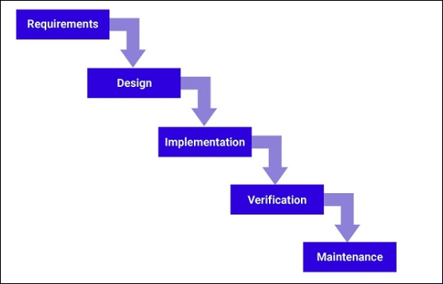
Traditional Methodology
Notes:
Traditional method is considered a rigid method that is based linear model that includes sequential stages. As such the methodology phases include requirements, design, implementation, verification and maintenance. Thus, it allows a effective focus on distinctive goals. Requirements involves the act of determining what the system to be established will be doing hence being able to accumulate enough resources purposely to deliver quality and gaining customer satisfactory. Requirements also involves determining various resources which you require in developing a certain system. Therefore capital needed in establishing a certain system is usually determined and evaluated in this stage. Design involves defining the various components, interfaces and the data for a system to aid in satisfying requirements which were stated in the requirements stage. Implementation stage deals wit purchasing, developing your current hardware and software system. Verification is the approach which aids in identifying the product faults or errors which may result into the failure of the system. Maintenance stage deals with the repairing and fixing of the software incase it breaks.

Slide 4
Advantages and Disadvantages of Traditional Methodology
Advantages:
The linear nature of the method makes easier to understand and manage.
Efficient for the projects with clear goals and stable requirements (Chandra, 2015).
Disadvantages
Often slow and expensive.
The method lacks flexibility
Rigid culture and ensures tight control.
Notes:
The advantages of utilizing traditional method include it is linear nature make the methodology easier to understand and manage compared to other methodology as well, the method is efficient for the projects that have clear and stable requirements . In addition linear nature of the traditional method enables or enhances it to be easily scheduled the time that t will take for the products to be obtained since each stage is usually completed and a specific and desired product obtained before ,moving to the other stages. The cons of the methodology include: the methodology lacks flexibility, its time consuming as well as its expensive. Time consuming definitely results from the act of one stage to be completed before moving to the other stage.

Slide 5
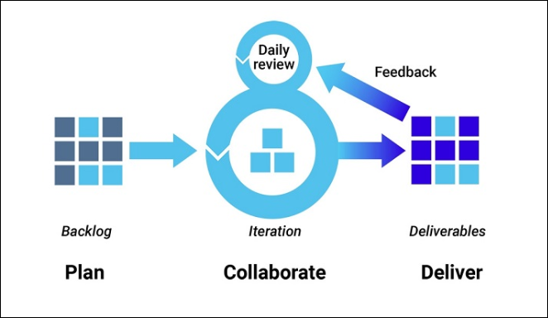
Agile Development Methodology
Notes:
The agile development methodology helps in decreasing risk (such as bugs, cost overruns, and changing requirements) when adding new functionality. Thus, in this method, teams is room for flexibility it allows a new functionality.

Slide 6
Pros and Cons of Agile Methodology
Pros
Allows software development to be released in iterations.
Iterations release allows flexibility that ensure fixation and defects.
Enable users to recognize benefits early, through incremental improvements. (Chandra, 2015).
Cons
It relies on real time communication.
Requires extensive workforce to facilitate each iteration approval.
Hard to predict
Notes:
Agile methodology has got several pros whereby the act of being flexible is among the pros. This enables this methodology to be able to adapt to the various changes or alterations more rapidly than the other project management approaches. Products which are established using agile methodology usually reaches to the market faster since this methodology usually focused on the working deliverables and thus enabling the products to meet the requirements which were defined during particular iteration. In addition the use of the agile methodology is also befallen by some cons. Hard to predict is among the major cons befalling the systems which are established using agile methodology. Being unable to predict is main initiated by the flexible nature of the agile since various customers are able to alter or change requirements nard priorities after every iteration.

Slide 7
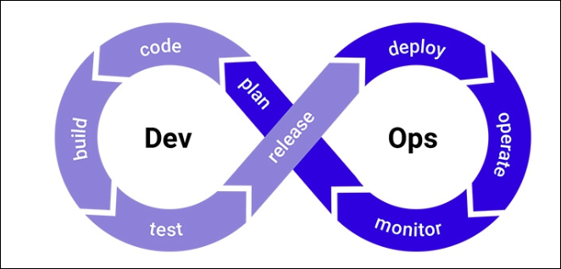
Contemporary Development Method
Notes:
Contemporary development methods include and supports an organizational culture. The methodology is centered on organizational change that encourages use of modern technology, as well as, collaboration (Chandra, V. (2015). The method the development life cycle put a lot of emphasis on development, quality assurance, and operations.

Slide 8
Pros and Cons Contemporary Methodology
Pros
Helps in minimizing disruption while maximizing reliability.
Decrease lower rates of failures.
Ensure automation of continuous deployment
Cons
Some clients don’t approve continuous updates of their systems.
Undetected issues may slip due to use of different measures.
Notes:
There are various pros or advantages which are associated with contemporary methodology. First and foremost it aids in minimizing or reducing disruption while maximizing reliabliity. Decrease in the rates of failures and this is mainly initiated by the fact that this methodology uses linear method and therefore each staege is usually completed before ,moving to the next stage hence facilitating easy identification of faults or failures of the system in one stage. Besides this methodology has various cons which include; failure of some clients to keep continuous updates of their systems hence subjecting their systems to danger of being befallen by faults. In addition this contemporary methodology may result into the occurrence of the undetected issues due to the continuous use of the different measures.

Slide 9
Radical Methodology
Notes:
Radical methodology is customer driven that focuses on customer, product and process.

Slide 10
Pros and Cons of Radical Methodology
Pros
Radical method is most effective method for projects with clearly defined goals and objective.
It is usually effective for small and medium projects.
It clients driven and based on customer, product and process.
Cons
It requires stable team composition
Notes:
There are various advantages which are associated with the radical methodology. First and foremost radical method is most effective method for projects with goals and objectives which are clearly defined. Furthermore, radical methodology is usually effective for small and medium projects. Also it is usually client driven hence it is based on the customer, products and process. Conversely the use of the radial methodology is also befallen by various cons or disadvantages whereby the necessity of stable team composition is among the great challenges affecting it.

Slide 11
Recommendation for Pine Valley Furniture
Out of four methodologies, each has strengths and weaknesses.
Each method works effectively under different situations.
Therefore, Agile Development Methodology is best suited for Pine Valley Furniture.
Notes:
Out of the four methodologies, i.e., traditional, contemporary, radical and agile, agile is the best methodology to utilize for the Pine Valley Furniture Web store. Although the Agile is recommended, the team should utilize the strengths of other methodologies to ensure that project objectives and goals are achieved timely.

Slide 12
The Reasons for Recommending Agile
Agile puts a lot of emphasizes on individuals and their relationship with the tools.
It feature customer collaborations through its development process.
It focuses on presenting working software rather than documentations (Chandra, 2015).
Notes:
Agile puts a lot of emphasizes on individuals and their relationship with the tools. It feature customer collaborations through its development process. As well, it focuses on presenting working software rather than documentations. In addition the use of the agile methodology in establishing or developing various systems has been recommended to be used by the small high-tech companies which needed shorter time to market their products. Therefore agile methodology is recommended to be used in establishing systems for the small business which are enable to sustain for too long without getting the business value out of their products. Besides agile methodology is manly recommended since it manly focus on presenting working software rather than documentations.

Slide 13
Level-O Data Flow
It is a complex data flow that requires a comprehensive methodology.
Agile development methodology is best suited methodology to help in development of the data flow software project.
Notes:
Level-O Data Flow is data flow diagram which is mainly drawn to represent system of distinct levels of abstraction. Therefore the higher level DFDs are usually portioned into low levels-hacking more information and functional elements. Therefore level-O Data Flow is complex data flow which involves the use of comprehensive methodology. Agile methodology is best suited in the development or establishment of the data flow software project.

Slide 14
References
Chandra, V. (2015). Comparison between various software development methodologies. International Journal of Computer Applications, 131(9), 7-10.

