Slide 1
UNDERSTANDING WHITE-COLLAR CRIME: Definitions, Extent, and Consequences
Chapter Two

Slide 2
Understanding White-Collar Crime
Large debate about the definition of white-collar crime
E.A. Ross (1907) originally used the expression “white-collar criminaloid”
Focused on respectable businessmen engaging in misconduct and crime
Sutherland built on Ross’s idea and focused on the behavior of upper class citizens emphasizing that society’s elite were also capable of committing crime

Slide 3
White-Collar Crime: An Evolving Concept
Sutherland (1949) defined white-collar crime as:
“Crime committed by a person of respectability and high social status in the course of his occupation”
Wanted to call attention to criminal behavior that was normally overlooked as being criminal in nature
Wanted to modify the usual theories of criminal behavior

Slide 4
White-Collar Crime: An Evolving Concept
Sutherland’s research and definition of white-collar crime was met with criticism from experts:
Conceptual ambiguity- the definition was too unclear
Empirical ambiguity- research did not accurately reflect reality
Methodical ambiguity- definition focused on upper class, but research focused on all classes
Legal ambiguity- definition did not list specific criminal offenses nor did the definition specify whether the behavior had to be illegal
Policy ambiguity- divide between white-collar crime researchers and policy makers

Slide 5
White-Collar Crime: An Evolving Concept
Clinard and Quinney (1973) separated white-collar crime into two forms:
Corporate crimes: Illegal actions committed by employees of a corporation to benefit the corporation
Occupational crimes: “Violations of legal codes in the course of activity in a legitimate occupation”
Addressed the ambiguities of Sutherland’s definition
Research on white-collar crime increased after the work of Clinard and Quinney
However, no common, agreed upon definition of white-collar crime currently exists

Slide 6
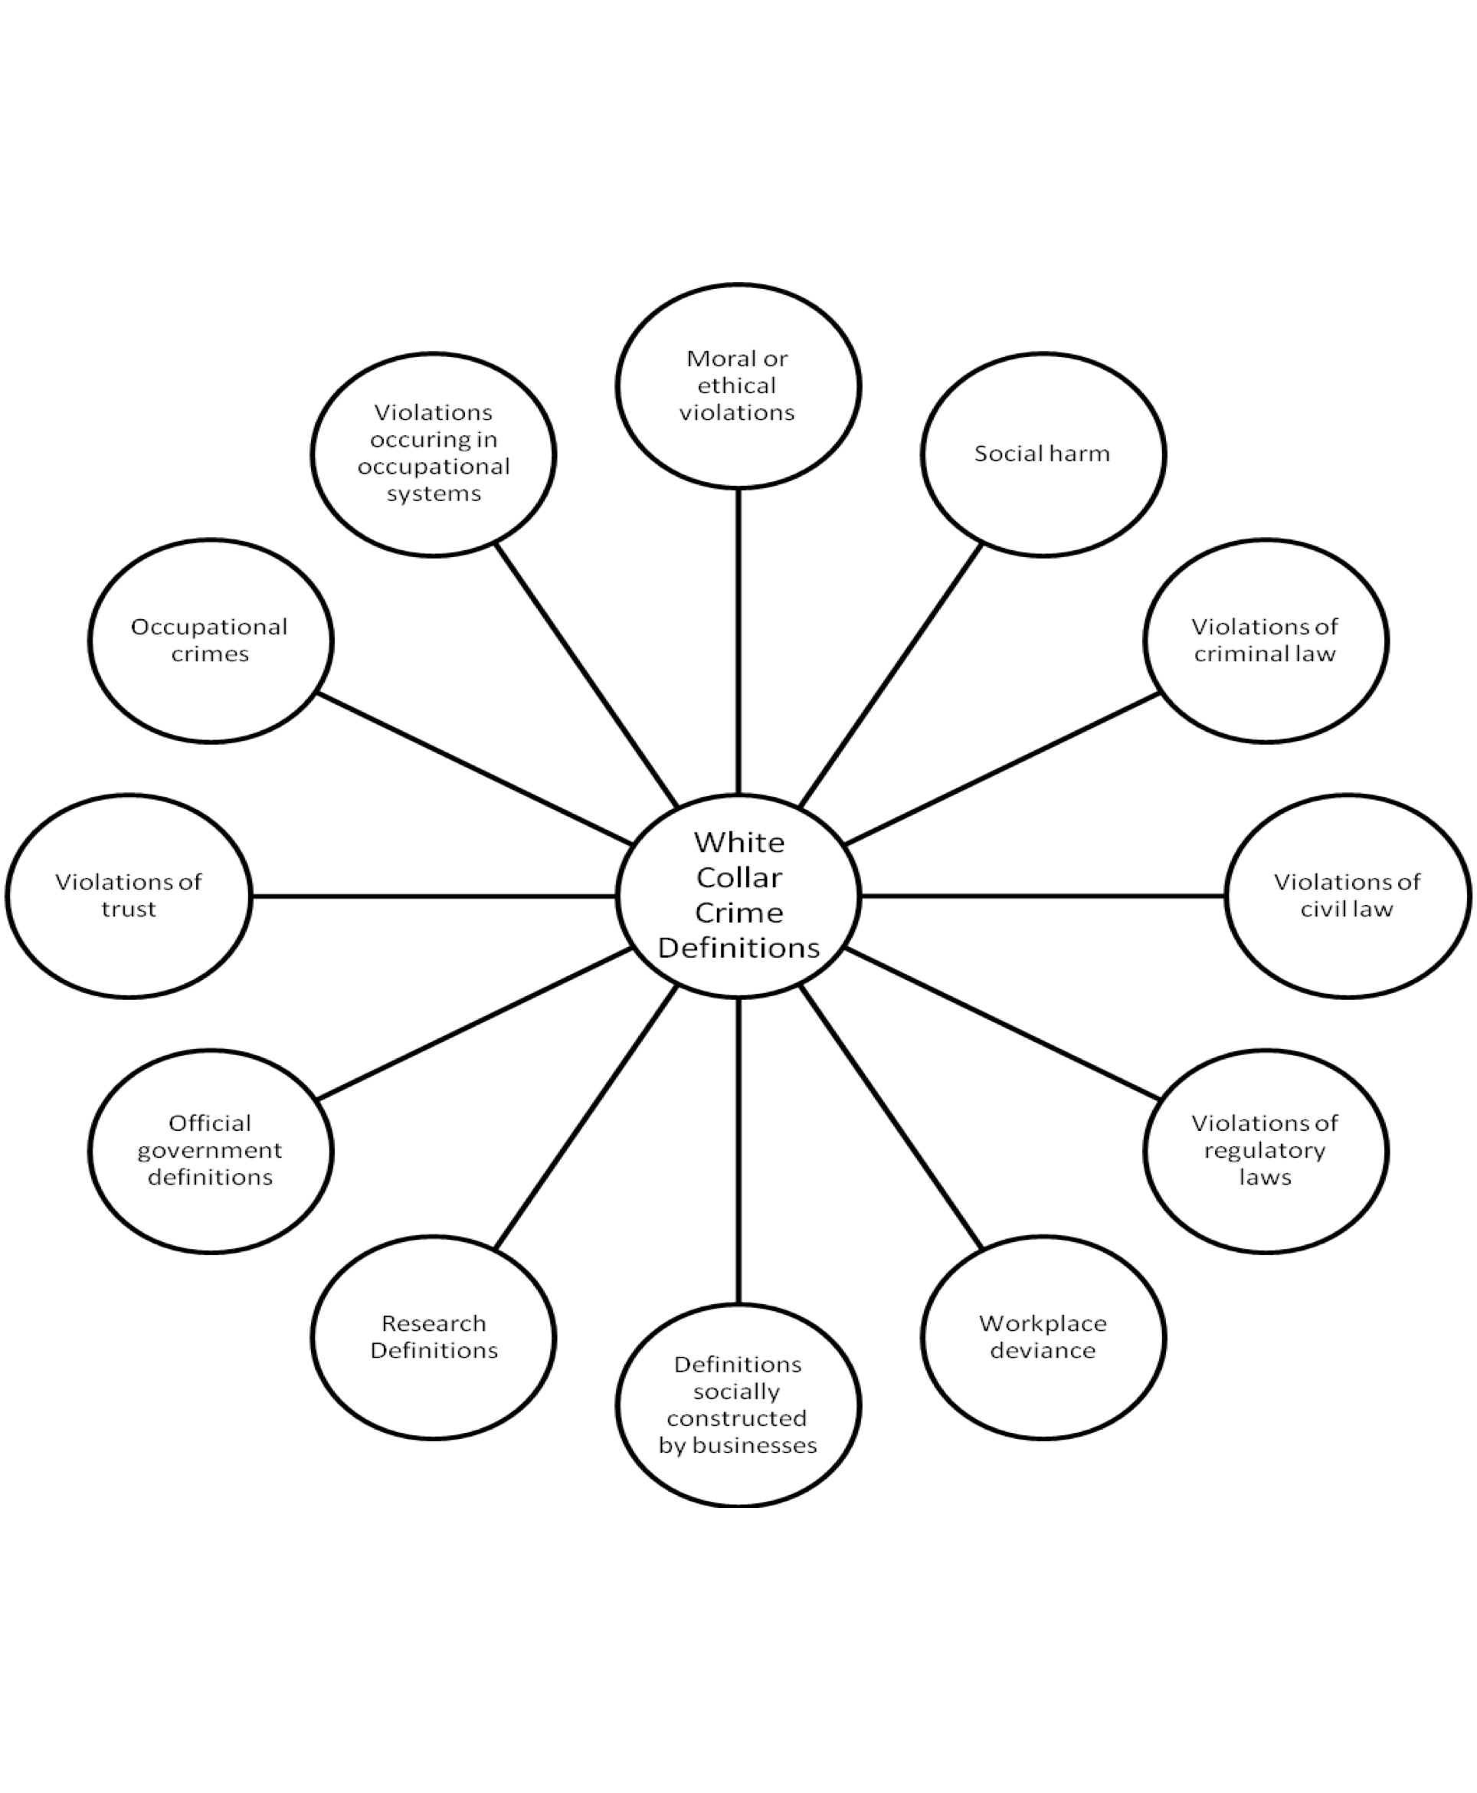
Modern Conceptualizations of White-Collar Crime

Slide 7
Extent of White-Collar Crime
The true extent of white-collar crime is difficult to identify
Only one-third of violations are reported and the definition is still conceptually vague
White-collar crime statistics are derived from:
Official government statistics
National Incident Based Reporting System (NIBRS)
FBI’s Uniform Crime Reports (UCR)
Victimization surveys
National White-Collar Crime Center Victimization Survey
Academic research studies

Slide 8
Extent of White-Collar Crime
According to the UCR, forgery and embezzlement cases increased dramatically between 1990 and 2009
The National White-Collar Crime Center’s (NW3C) 2005 victimization survey revealed that :
Less than one-fifth of victims report being victimized to police
46.5% of households reported that they had been victims of white-collar crime in the past year
One research study found that one in 30 employees was caught stealing from their employer in 2007

Slide 9
Extent of White-Collar Crime

Slide 10
Extent of White-Collar Crime
Problems associated with UCR & NIBRS data:
Some may not agree that the crimes included are white-collar crimes
The database was not created for researchers
Many cases are not reported to law enforcement, but instead are reported to regulatory agencies
A number of white-collar victims are not aware that they have been victimized
Shame may prevent victims from reporting their victimization to law enforcement officials

Slide 11
Consequences of White-Collar Crime
Individual Economic Losses:
Average embezzlement results in $1,000,000 in losses, while the average amount lost to street robbery is $1,032
Societal Economic Losses:
White-collar crime costs the U.S. anywhere between $300 and $600 billion annually
Emotional Consequences:
Moore and Mills (1990) identified three consequences of white-collar crime:
Reduced faith in the free economy and business leaders
Erosion of public morality
Loss of confidence in political institutions and processes

Slide 12
Consequences of White-Collar Crime
Physical Harm:
May be direct or indirect
Positive Consequences:
Warning light syndrome: occurrence of crime sends a message that something needs to be fixed
Boundary maintenance: people learn to follow the rules by watching other people get caught
Social change: Society becomes stronger
Community integration: Brings groups together
The National White-Collar Crime Center fosters and supports collaborations between agencies and individuals who address white-collar crime

Slide 13
Public Attitudes About White-Collar Crime
Surveys of the public reveal that adults view:
White-collar crime as serious as conventional crime
Physically harmful white-collar offenses are more serious than other white-collar crimes
Organizational offenses as more serious than individual offenses
Offenses with higher status offenders as more serious than offenses with lower status offenders

Slide 14
Public Attitudes About White-Collar Crime
Holtfreter and colleagues (2008) surveyed 402 individuals
One-third of those surveyed indicated that white-collar offenders should be punished more harshly than street offenders
Two-thirds of those surveyed said the government should “devote equal or more resources towards white-collar crime control”

Slide 15
Characteristics of White-Collar Offenders
White-collar offenders are more likely than traditional offenders to:
Be college educated
Be White males
Be older
Have a job
Commit fewer offenses
Start their criminal careers later in life
Be Jewish

Slide 16
Characteristics of White-Collar Offenders
White-collar crime is more likely than traditional street crime to:
Be national or international in scope
Involve a large number of victims
Have organizations as victims
Follow demonstrated patterns
Be committed for more than a year
Be committed in groups

