Slide 1
Country Information

Slide 2
Japan
The development of Japanese overseas Construction
Business Strategy
Japanese Government Policy towards Overseas Contractors

Slide 3
The development of Japanese overseas Construction
Japanese overseas construction activity began at the turn of the century- railway between Seoul and Incheon
The period of wartime reparation works (1954-66)
1973- overseas construction gained momentum, peaking in 1979 (boom in middle east); 1983 (boom in SE Asia)
1970s- Domestic Construction was 20% of GDP
1983-85 – Middle East→SE Asia→North America & the Pacific
1984- 2nd largest exporter of construction services

Slide 4
Business Strategy
Advanced level of construction technology and management
High level of Technological research-construction robotics, saleable product lines such as membrane mega-domes, Concrete aseismic high rise towers
Shorter construction times, prompt delivery, absence of construction unions, high quality of construction and labor safety
Increase in Japanese Govt.’s overseas development aid (ODA)
Sogo Shosha ( multi-national trading firms)- help GC in information gathering, initial project formulation and planning, major country or business risk taking, credit provisions, negotiations

Slide 5
Japanese Government Policy towards Overseas Contractors
Overseas construction promotion fund- low interest credit for pre-feasibility studies
A financial guarantee system for overseas construction projects
An “infrastructural facilities investigation” to find out and develop suitable projects in developing countries
An overseas construction technology development project to develop appropriate technology
A training system of consultants and project managers of overseas construction projects

Slide 6
China
The development of Chinese overseas Construction
Business Strategy

Slide 7
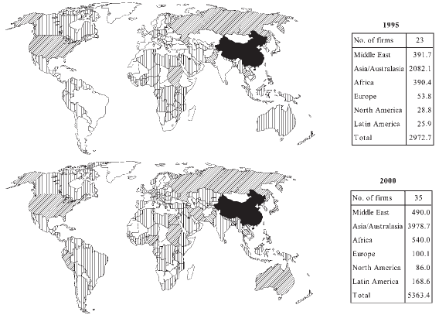
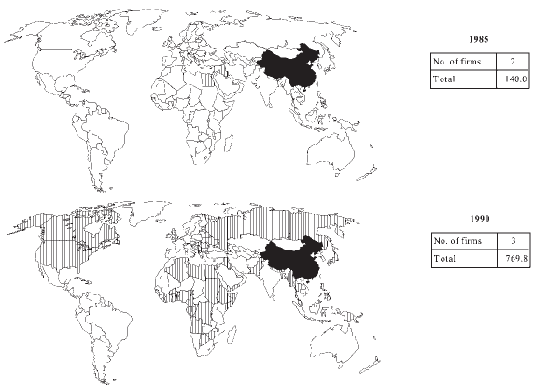
The development of Chinese Overseas Construction
Pheng et al. (2010) “A comparative study of top British and Chinese international contractors in the global market”

Slide 8
Business Strategy
Cheap supply of skilled labor
Relatively low cost of machinery, material, equipment, therefore low bid
Favorable loans and letter of credit from state owned banks
JV with large Japanese, British and German firms are a major strategies for complex projects
Generalist strategy by undertaking a whole range of construction activities

Slide 9
Italy
Introduction
Business strategy
Project execution
Government policy

Slide 10
Introduction

Slide 11
Introduction
1920s – works in Africa
1950s- dam construction know-how
As many as 92 countries
In 1985, third in the world in terms of market share
Sadelmi, Impregilo, Snamprogetti, Saipem, Cogefar (1985)→Saipem (6), Marie Tecnimont, Techint Group,Impregilo SPA, Salini Costruttori (2012)

Slide 12
Business Strategy
Maintain know-how by offering full responsibility for the erection of the facility (no sub-contracts, except for specialist contractors and no CM)
Major firms try to be permanently present once the first contract has been obtained
Project financing- contractor financed work- highest in the world in 1985

Slide 13
Project execution
Italian firms have chosen to maintain their traditional skills as constructors (Civil Works) without diversifying
Labor- skilled workers, technicians and project engineers- develop a vocation for working abroad-high fidelity to one employer- On-the-job training (no formal training)

Slide 14
Government Policy
1977- Reformed law to provide Italian exporters with financial support comparable with other industrialized nations.
Italian contractors offer their customers deferred terms of payment (interest subsidy granted by Govt)

Slide 15
France
Trends, market shares, and employment
Business strategy

Slide 16
Trends and market shares

Slide 17
Top contractors
1982- Bouygues, Spie Batignoles, SAE, GTM, Technip
2012-Vinci (3), Bouygues (8), Technip (11), Prezioso Technilor (188)

Slide 18
Business Strategy
Rigorous efforts at adaptation
New alliances
Obstinate searches for diversification- electrical works, urban services, and industrial maintenance, and new markets- USA, Australia

Slide 19
Germany
The Evolution of German Overseas Contracting
The strategies of German firms

Slide 20
The Evolution of German Overseas Contracting
1950s- Found work in Turkey, Egypt, and Iraq
1970s- Middle east oil boom
1984- Philipp Holzmann, Hochtief, Bilfinger & Berger, Strabag Bau, Dywidag
2012- Hochtief (1), Bilfinger (14), ED. Zublin (82), Bauer (112),

Slide 21
The strategies of German firms
Specialization exclusively in the area of construction (have not diversified for about 100 years)
Move only when the market has a longer term potential for a continuous flow of such contracts
Maintenance of those structures built by them in the preceding years(hospitals, airports, power stations, etc)
Excellent personal contacts (sometimes previous clients), Efficient agents (affiliates)
However, have not asked Government’s intervention to create a competitive advantage to secure projects

Slide 22
Scandinavia
The Evolution of Scandinavian Overseas Contracting (Denmark, Finland, Norway, Sweden)
The strategies of Scandinavian firms

Slide 23
The Evolution of Scandinavian Overseas Contracting
1950s-60s head of the field in “Industrialized” building methods
1970s- Growth in 400-700% in international work
1985- Skanska, ABV, JCC (All Swedish), Christiani & Nielsen (Denmark), Outokumpu OY (Finland)
2012- Skanska (9), Veidekke ASA (96), E. PHIL & Sons AS(133)

Slide 24
The Strategies of Scandinavian firms
Scandinavian Govts. offer complete range of support services
Labor supply-based on developed countries, developing countries, USSR(Russia)
Procurement of building materials from their suppliers (20-25%)
International profile of flexibility and innovation
Complex buildings of high quality, specialized projects, and technological innovation
Scandinavian consultants, at one point, had the 3rd largest share of international market
Competence and willingness to engage counter-trade

Slide 25
South Korea
The development of the industry within Korea
Business strategy: contracts, cooperation and Finance
Government policy on overseas construction

Slide 26
Market Share

Slide 27
The development of the industry within Korea
1945-64- The infant industry-Korean war- Reconstruction- massive construction by foreign firms- learning by doing
1965-72- The developing industry- Work in South East Asia
1973-85- The Global Industry- Middle East (after Fall of South Vietnam)
1984-Hyundai, Dong Ah, Daelim, Daewoo, Hanyang
2012- Samsung Engineering (15), Hundai (25), GS Engineering & Construction (32), Daelim(40), SK Engineering (45)

Slide 28
Business strategy: contracts, cooperation and finance
Sub-contracting and the exportation of workers as the only modes of entry in 1960s and the early 70s
Offered much lower price as a Prime Contractor- subcontracted the most technologically difficult parts to the specialized western companies
Joint-ventures, consortia
Low-cost bidding

Slide 29
Government policy on overseas construction
Govt. controls excessive competition among Korean firms bidding for same project
Tax incentives(Corporate & Individual)
Govt. Financial support
Diplomatic support

Slide 30
Brazil
The development of the industry within Brazil
Business strategy

Slide 31
The development of the industry within Brazil
1980-85- Nine contractors appear off and on
2012- 4 firms appear on top 225 list (2.1% of International revenue)
Odebrecht (13), Construtora(76), OAS SA(122), Construcoes SA(167),

Slide 32
Business strategy
Developing countries as their natural market- Latin America, Africa, Middle East
Brazilian foreign policy distant from the East-West conflict- favorable for business in Africa, Middle East
Barter- oil imports
Maintain permanent offices in countries- to gather information for preparing bid.
Direct negotiations instead of open bidding.
Road Construction, Rail road, dams, airports

Slide 33
References
The Global Construction Industry: Strategies for Entry, Growth, and Survival (Edited by W. Paul Strassmann)
ENR (2008,2009, 2012)
Low Sui Pheng , Hongbin Jiang & Christopher H.Y. Leong (2004) A comparative study of top British and Chinese international contractors in the global market, Construction Management and Economics, 22:7, 717-731

