Slide 1
Developing a Webstore for Pine Valley Furniture
Gabrielle Briscoe
BSA/375
University of Phoenix
Professor Hautzinger-Forrest
02/24/2020

Slide 2
Introduction: Understanding a Webstore
There is a need for the company to strongly tap into the global market through online platform.
PVF only has two options to exploit the online platform: joining the existing online marketplace such as Amazon, Etsy and Bonanza or creating an own customized website (webstore).
Both the existing marketplace and webstore have certain advantages.
Notes:
The case takes us through the journey company, Pine Valley Furniture, has travelled from its inception to the multinational organization it is today. There is a need for the company to strongly tap into the global market through online platform. Many organizations with prominent online sales activities have either used already established online market places or tried to do it through their private websites.
In that sense, PVF only has two options to exploit the online platform: joining the existing online marketplace such as Amazon, Etsy and Bonanza or creating an own customized website (webstore). Both the existing marketplace and webstore have certain advantages.

Slide 3
Advantages
Selling Online
Company Customized Webstore
Better branding opportunity.
One inventory for all operations
Existing Online Marketplace
Massive traffic to benefit from
Notes:
As initially indicated, the choice between a standalone website and a marketplace is never easy. On one hand, if a company chooses to sell on a marketplace, there are numerous advantages to reap from; potential traffic for its items is always immense, huge shopper network and direct exposure to enviable online community. The flip-side of it is that there is limited branding options, limited independent success and limited control to customers which turns out to be the main advantages of selling on own website.
Selling on a marketplace while also maintaining a standalone site can be a big hassle - no one wants to take the time to learn multiple platforms and try to keep your inventory in sync between the two (Valacich & George, 2020). But what if you didn’t have to choose between one or the other - what if there was a third option that’s a perfect middle ground?

Slide 4
Developing a New System
System can be acquired through various methods such as:
Off-the-shelf purchase
Purchasing a ready system and customizing it internally
Renting or leasing
In-house building
Each of the above strategies have various weaknesses and strengths. PVF has decided to use in-house building strategy to build this system.
Notes:
Organizations or an individual seeking to acquire a system can utilize the below four strategies:
• Off-the-shelf purchase
• Purchasing a ready system and customizing it internally
• Renting or leasing
• In-house building
Each of the above strategies has various weaknesses and strengths. An organization will have its own strong reasons for favoring a particular strategy over the others. Analyzing each, the Off-the-shelf purchase is always favored for its cost effectiveness and also quick acquisition process because it only involves testing key requirements only. However, it has several weaknesses hence rendering it very unpopular.
Purchasing a ready system and customizing it internally has been considerably popular because it is always considered as the safest version of the Off-the-shelf purchase Strategy. Renting or leasing is always viewed as costly in the long run hence is usually preferred for short period of time.
In-house building is the most popular strategy because reasons such as better system security features, proper understanding of the system within the users (organization employees) among others. PVF has decided to use in-house building strategy to build this system.

Slide 5
In-house System Development Strategy
The company decided to develop its application software in-house.
It sourced for staff and other necessary resources needed for building a system that suits its own needs.
These resources include necessary software applications, computers and other hardware resources.
This strategy is favored for acquisition of larger and highly secure systems.
Notes:
As previously indicated, in-house building is the most popular strategy because reasons such as better system security features, proper understanding of the system within the users (organization employees) among others. Even though PVF has decided to use this strategy to build its system, it has disadvantages which include — high costs, time needed for recruitment, onboarding and getting to know the team (Valacich & George, 2020). The process of development can also prove to be tedious as sometimes disagreements over development process issues can always lead scope breaches. However, the strategy is well suited for systems that demand high level of security measures such as data encryption and many others.

Slide 6
Resources Needed
Hardware
Four Computers (500 Gb main memory, 8 Gb RAM, Processor of Core i5, 2.8 GHz)
Two Projectors
Software
Operating System (Windows 10/MacOS/Linux)
Supporting system (Diskette Formatting)
Development system (Code blocs)
Anti-virus program (Kaspersky)
Notes:
Every project process requires allocation of resources. For development of a webstore, the development team will definitely a number of resources as specified by the project manager. In this case, some of the resources that are critical as far as the development process is concerned include the following:
Hardware
• Four Computers (500 Gb main memory, 8 Gb RAM, Processor of Core i5, 2.8 GHz)
• Two Projectors
Software
• Operating System (Windows 10/MacOS/Linux)
• Supporting system (Diskette Formatting)
• Development system (Code blocs)
• Anti-virus program (Kaspersky)
Others include the right mix of skills from the personnel making up the development team, enough financial resources and many more as specified in the planning document.

Slide 7
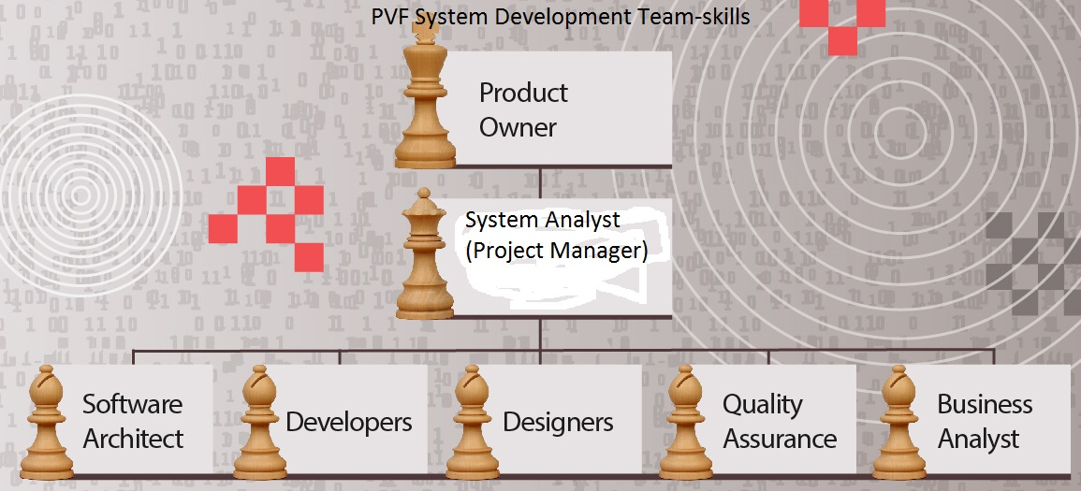
Skills Needed
The System Analyst
will be the Project
Manager
Notes:
The above shows some of the personnel that forms the development team and their respective responsibilities.

Slide 8
Systems Analysis and Design Methodologies
Development of a system can be described as a systematic process that involves phases such as planning, analysis, design, deployment, and maintenance.
There are three main methodologies here:
The traditional Waterfall Method (SDLC)
The Agile method
Object Oriented System Development method (OOSD)
The PVF system development team will use the OOSD method due to a number of reasons discussed in the slides that follow.
Notes:
Development of a system can be described as a systematic process that involves phases such as planning, analysis, design, deployment, and maintenance. Depending on the design and analysis methodology used, the above are the critical phases of any system development process.
There are three main methodologies here:
• The traditional Waterfall Method (SDLC)
• The Agile method
• Object Oriented System Development method (OOSD)
The same way there are a number of reasons that dictates software acquisition strategy that a company or an individual, system design and analysis process that a development team prefers is usually inspired by several reasons that we will be able to see. The PVF system development team will use the OOSD method due to a number of reasons discussed in the slides that follow.

Slide 9
The Waterfall Method (System Development Life Cycle-SDLC)
Analysis
Design
Implementation
Maintenance
Planning
Stages of SDLC
Top-down approach
Activities of one must
be completed before
moving to the next
phase.
Notes:
The traditional waterfall structured approach looks at the system from a top-down view. It is a formalized step by step approach to the systems development lifecycle (SDLC) which consists of phases or activities. The activities of one phase must be completed before moving to the next phase. At the completion of each activity or phase, a milestone has been reached and a document is produced to be approved by the stakeholders before moving to the next activity or phase; painstaking amounts of documentation and signoffs through each part of the development cycle is required. "The center of the structured approach is the process model, which depicts the business processes of the system, and the primary model that presents the processes is the data flow diagram.

Slide 10
Agile Methodologies
Focuses on system users and not the roles they perform in the system.
Embraces change dynamics during system development than the traditional waterfall method.
No need of numerous documentation because the general principle is handling each problem according to circumstances that surround it.
PVF development team will avoid this methodology because of its inferior incremental abilities.
Notes:
This methodology emphasizes on system users and not the roles that the users perform in the system. As opposed to the waterfall development methodology, agile forgoes the documentation but is initially difficult to adapt by adding many new facets to the development model that confuse people.
This methodology attempts to capture and use the dynamics of change embedded in software development in the development process itself rather than resisting the ever-present and quickly changing environment.
Traditional methods demand complete and accurate requirement specification before development; agile methods presume that change is unavoidable and should be embraced throughout the product development cycle. The individuals who fill those roles are more important than roles that people fill. Fowler believes that each talented individual bring something unique to the development team and disagrees with the application of engineering principles that viewed people as interchangeable units.

Slide 11
The Object Oriented Analysis and Design Methodology (OOAD)
Phase 1
Requirements
Phase 2
Design
Phase 3
Implementation
Phase 4
Verification
Phase 5
Maintenance
Notes:
Similar to Waterfall SDLC and Agile methodologies, the OOAD also has the five phases of design and analysis process as shown in the diagram above. The next slide tries to offer explanation on why the company, PVF development team saw it wise to use OOAD over the other two methodologies.

Slide 12
Why OOAD Methodology
Other than being bottom-up approach, OOAD combines data and processes into objects.
(Objects here include customers, suppliers, orders, pending deliveries etc.).
Highly iterative and incremental hence best option for webstore development (not restrictive to design and development principles)
High-level integration of modules that share common data.
Notes:
A close consideration of the three methods of system design and analysis reveals a clear-cut difference that exists between them. By function and characteristics, we are able to understand the type of system that PVF would want to have at the end of the day. For instance, it should be a seamlessly integrated system that encourages the use of data by respective system modules injunctions or request delays. In other words, the inventory and customer activities will utilize data from one centrally placed pool.
Another issue is that there will be a need for incremental development and dynamic switching from one requirement to another. Much as Agile methodology also provides such a feature, the OODA provides the better.

Slide 13
Project Management Process
Initiation
1
Planning
2
Executing
3
Monitoring & Control
Closing
Every project
has five
main processes:
Notes:
Every project, be it launching an app, constructing a building, rolling out a marketing campaign, or software development like the one for the PVF Company; requires a series of processes to bring it to fruition. These processes are pretty consistent, regardless of the industry or the type of deliverable.
The Guide to the Project Management Body of Knowledge (PMBOK Guide) breaks down the overarching process of managing a project into five stages, or “process groups.” These process groups are typically stated as:
Initiating: which is all about the conceptualization and feasibility is determination.
Planning: involves creation of a blueprint to guide the entire project from beginning to closing.
Executing: During which the project manager conducts the procurement required for the project as well as staff the team.
Monitoring and control: where the project managers measures the progress of the project to ensure it is developing properly.
Closing: takes place once the project deliverables have been produced and the stakeholders validate and approve them

Slide 14
Most Challenging Phase
Planning
The project manager develops a blueprint that is shared with the company management.
The blueprint maps out the scope of the project, quantity of resources needed for delivering the final product, communication strategy on how to keep stakeholders abreast of the process, financial commitments and many more.
The challenge is that any mistake made on the planning document presents serious problem to the entire project process.
Notes:
Of all the five project management processes, planning phase presents several challenges than any other phase. We observed that is in the planning phase that any mistake made on the planning document presents serious problem to the entire project process.

Slide 15
Mitigation Measures
Always putting in place a Plan-B to every process (workable worst-case scenarios).
Proper feasibility assessment to unearth underlying issues.
Spreading the risk to limit its impact
Clarifying the requirements to weed off ambiguities.
Always assigning the right personnel for right tasks to avoid obvious mistakes.
Notes:
As a project manager, there has to be a way of dealing with risks that may present themselves in the course of development process. Risks can take place at any stage of project management hence mitigation strategies should not only be targeting those risks that may occur as a result of planning challenges (Meredith et al., 2017). In this project, we identified a number of risks mitigation strategies that can help the project manager overcome or limit the resultant impact. They include;
• Always putting in place a Plan-B to every process (workable worst-case scenarios).
• Proper feasibility assessment to unearth underlying issues.
• Spreading the risk to limit its impact
• Clarifying the requirements to weed off ambiguities.
• Always assigning the right personnel for right tasks to avoid obvious mistakes.

Slide 16
References
Meredith, J. R., Mantel Jr, S. J., & Shafer, S. M. (2017). Project management: a managerial approach. John Wiley & Sons.
Valacich, J., and George, J. (2020). Modern systems analysis and design (9th ed.). Boston, MA: Pearson.
Fuller, M. A., Valacich, J. S., George, J. F., & Schneider, C. (2017). Information Systems Project Management: A Process and Team Approach, Edition 1.1. Prospect Press.

