Slide 1
Alexa Loses Her Voice
Joe C.
Katherine F.
Jason C.
Max T.

Slide 2
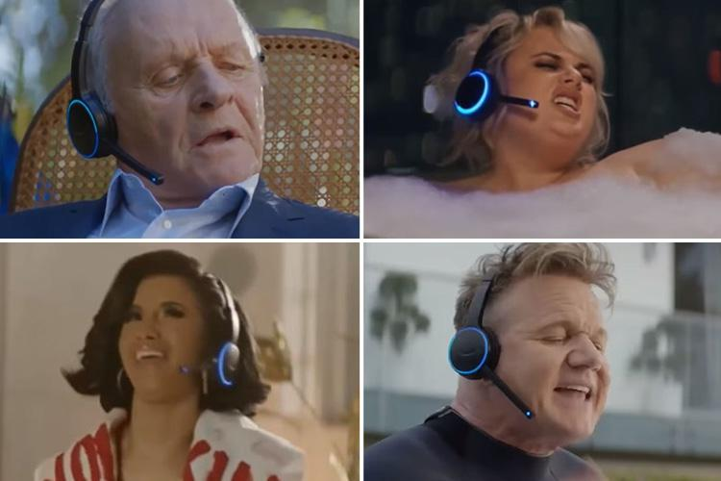
Introduction
-Alexa Loses Her Voice is a 2018 Super Bowl commercial focusing on promoting Amazon’s product Alexa which is a voice command speaker who assists your different questions and commands
The commercial uses a comedic approach to advertise the Alexa with a cast of celebrities including Jeff Bezos, Gordon Ramsay, Rebel Wilson, Cardi B and Sir Anthony Hopkins
https://www.youtube.com/watch?v=iNxvsxU2rJE

Slide 3
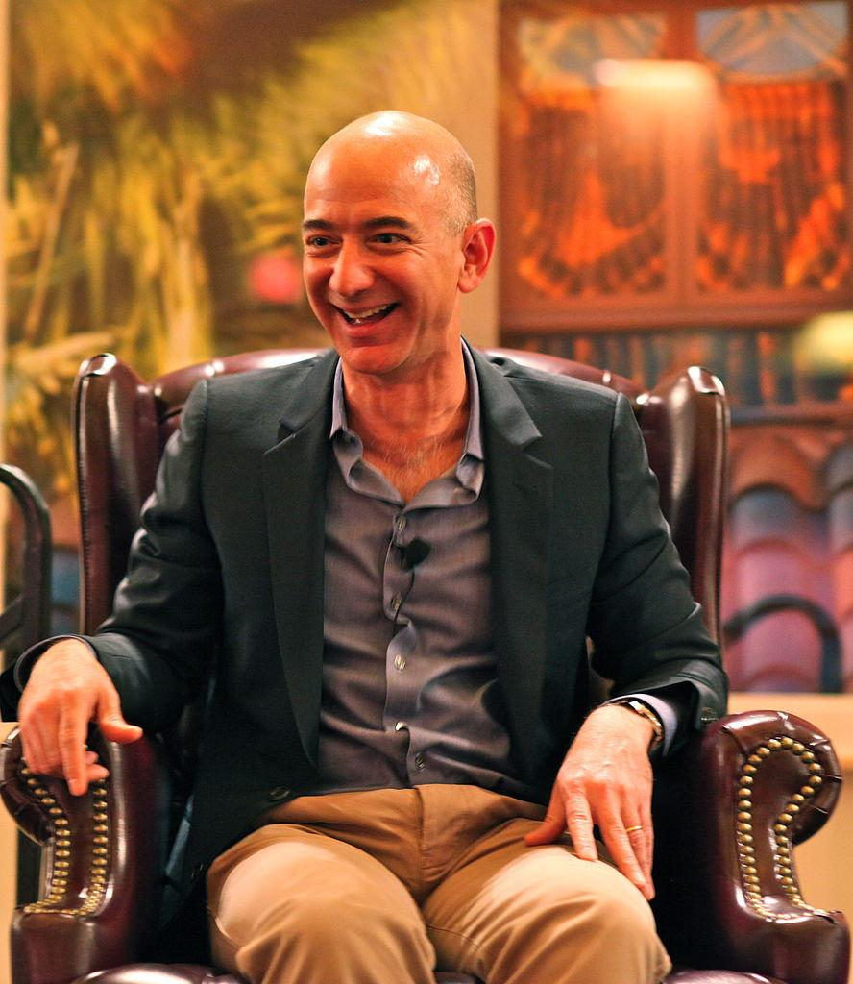
Ethos: Credible
Jeff Bezos sets the tone at the top as Amazon's CEO
Notes:
Is Amazon Credible ? Why?
According to Amazon itself, they are guided by 3 main principles: Customer obsession (not competitor focus). Operational excellence. Passion for invention.
In this commercial we see Jeff Bezo himself , When Alexa lost her voice, Jeff Bezos was there to lead the team and get it fixed.
Amazon’s vision is to be earth's most customer-centric company; to build a place where people can come to find and discover anything they might want to buy online
Amazon began in a garage in 1994 selling books online, we have seen Jeff Bezos build this e-commerce company now worth over $100 Billion USD

Slide 4
Ethos: Trust
Alexa is for YOU
Notes:
Amazon's voice assistant, Alexa, is infiltrating your home, your beach trips and even your ride to work. Now that there are many ways to interact with Alexa -- with the Echo, Echo Dot, Echo Studio, Echo Look, Echo Show, Dash Wand, Echo Flex and the Amazon Fire TV -- you might find yourself talking to her more often
Alexa can perform a variety of simple tasks, like playing music, but you can also use Alexa in your smart home to dim the lights, lock the doors, adjust the thermostat, and control other smart home devices. She is your personal assistant who will never call out sick!

Slide 5
Ethos: Ethical
Amazon Values Privacy
Notes:
If you’re freaked out by the idea that Alexa might mishear a wake word and start recording, they’ll give you a command that lets you check for that. If you’re worried about a growing catalog of voice recordings sitting on an Amazon server somewhere, they’ll give you a way to delete them. In the move-fast-and-break-things school of tech ethics, this is how progress happens. You release a product, objections arise, and you fix the objections. It’s a little messy, but as long as you address customer concerns, you should end in a good place which Amazon has always done, they are number one for customer service!

Slide 6
Ethos: Character
Alexa has a good reputation!
Notes:
Using very important people - not just any CSR
Who is Cardi B - someone we know
Familiar faces that we can relate too
Amazon makes it makes it make sense= Alexa becomes sensible

Slide 7
Pathos
Sense of Community
Different Walks of life
Everyone has it why don’t I?
News scene

Slide 8
Pathos
Chase of a better life
Celebrities
Consumers shown as well off
Warm Dark Colors (Luxurious visual cues)

Slide 9
Pathos
Trust
Jeff bezos opening scene (Index Sign)
Lots of people have it
Proximity of consumers next to their Alexa (Depth visual cues)

Slide 10
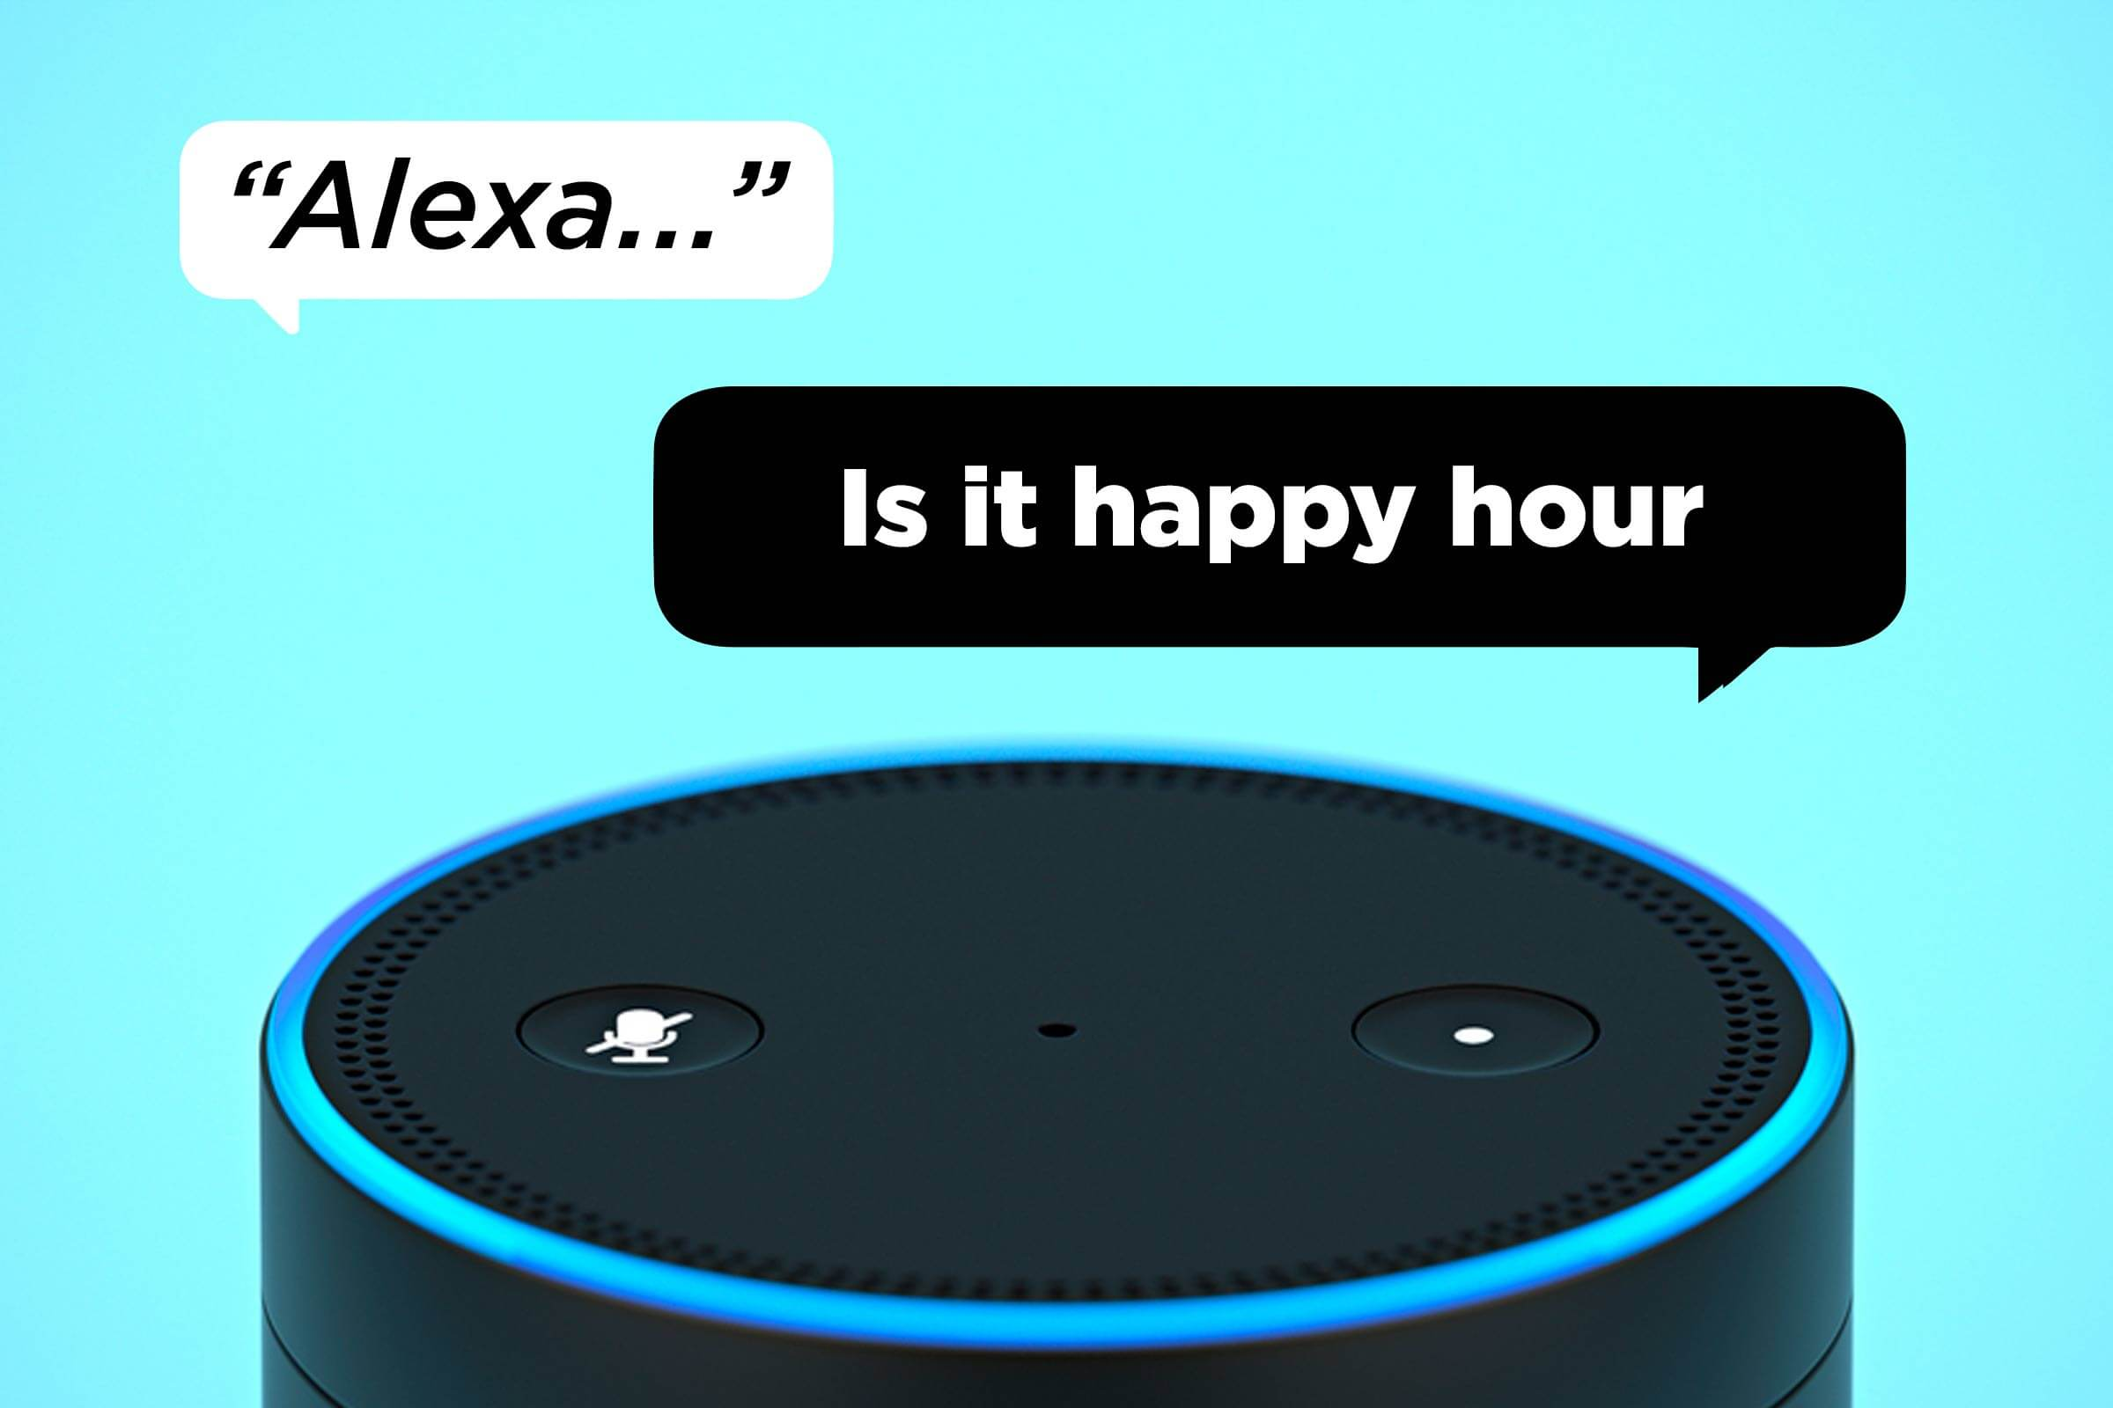
Pathos
Fun
Light hearted conversation
Both voice actors and consumers body language is open and charismatic (Iconic Sign)
Alexa is not a robot assistant it's a friend

Slide 11
Logos
Come up with a solution immediately
After sales service

Slide 12
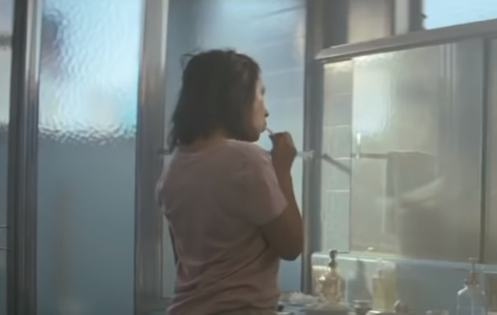
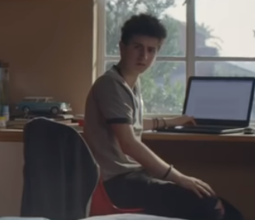
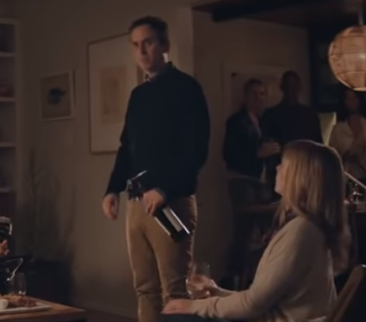
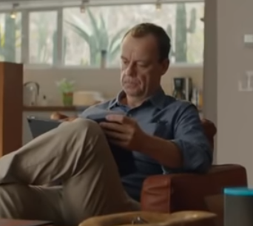
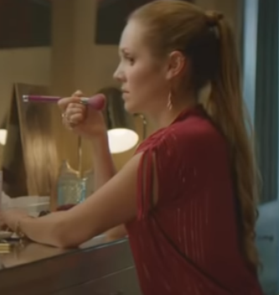
Logos
Ask anything
Weather report
Recipe for food
Your homework
Set the mood for a party
Play music
Make a phone call

Slide 13
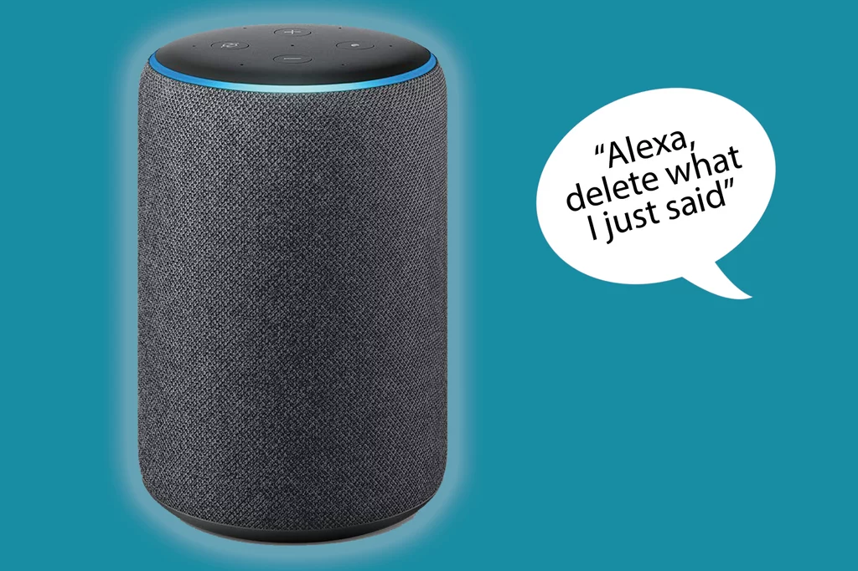
Logos
No matter what you are doing, alexa can help.
Free your hands

Slide 14
Logos
Understand you better than a real person

Slide 15
Conclusion
Overall, the commercial provided a good, convincing message to buy their product with the help of ethos,pathos and logos
The commercial will leave an impact on people who may even decide to seek out and buy the product after watching this due to the influence from celebrities, comedy, and the use of ethos, pathos, and logos

