Slide 1
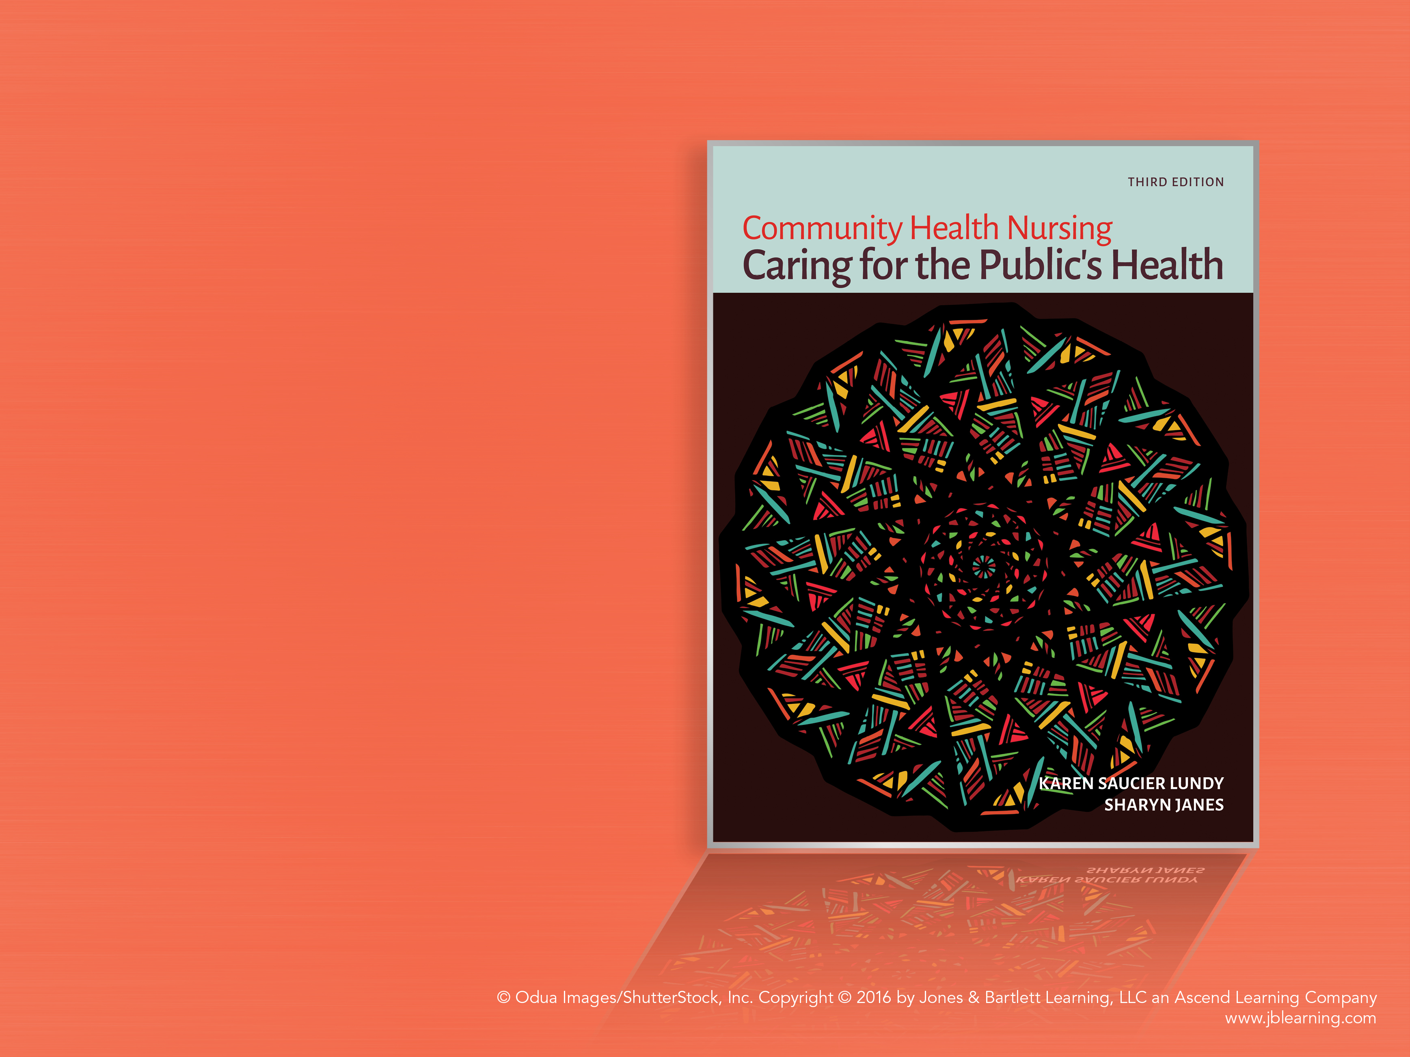
Chapter 30
Caring for the Family in Health and Illness

Slide 2
Thinking Differently About Family Health
Think upstream
Bottom-down health system
Human ecology model

Slide 3
Community-Based Services for Promoting Family Health
Preventive support services
  At-risk groups
    Preterm birth services
    Postpartum home visits
Targeted programs
  Focus on high risk for morbidity and premature mortality
Intensive services

Slide 4
Creating Healthy Families and Communities
Relationship-focused care
Intensity and timing of interventions
Nursing skills and strategies
  Communicating
  Problem solving
  Listening
  Connecting
    Comprehensive community initiatives
    Evaluating

Slide 5
Issues in Family Nursing Today
Least possible contribution theory
Ad Hoc Committee to Defend Health Care
Values: challenges for the future
  Five core values
    Caring
    Courage
    Inclusion
    Reflective thinking
    Social responsibility

