Slide 1
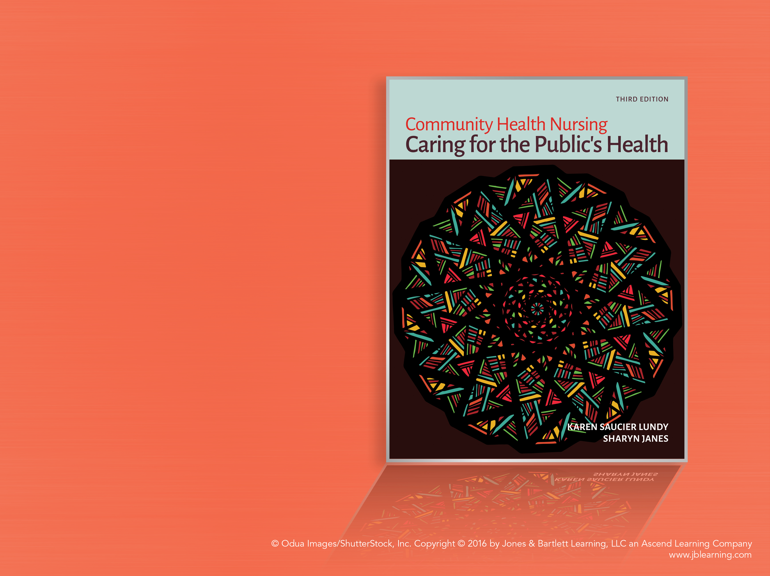
Chapter 29
Foundations of Family Care

Slide 2
Family
Defined:
  Two or more individuals who identify themselves as family and manifest some degree of interdependence in interactions with each other and their environment
Central themes
  Interdependence
  Beliefs

Slide 3
Health Responsibilities of the Family
Development of personal identity and self-worth
  Family interactions facilitate or impede members’ access to the following:
    Affect
    Power
    Meaning
  Failure to thrive

Slide 4
Families
Lifecycle transitions
  Prenatal and postpartum visits
  Changes in family structure
Values
  Families acquire values about health and learn personal health practices relative to nutrition, exercise, smoking, alcohol consumption, and hygiene through their family of origin and transmit those values and beliefs

Slide 5
Families (cont.)
Healthcare system education
  Families serve as a reference for defining illness and what should be done about it.
Provision of care
  Assume major share of responsibility for intergenerational support and assistance
  Two caregiving roles:
    Direct care provider
    Indirect care provider

Slide 6
Theoretical Approaches to Family
Human Ecology Theory
  Nonsummativity
Family Systems Theory
  Structure
  Function
  Self-regulation
  Positive feedback
  Negative feedback
Family development theory
  Family development tasks

Slide 7
Family Assessment
Conceptual framework for family assessment
  Provides direction to the collection, organization, and interpretation of data about the family’s health situation
    Energy
    Consciousness
    Role structure
    Decision-making processes
    Communication patterns
    Values
    Family boundaries

Slide 8
Self-Efficacy Model
Five phases of contracting process:
  Identification of family health concerns and needs
  Mutual setting of goals
  Delineation of alternatives
  Implementation of the plan
  Evaluation

