Slide 1
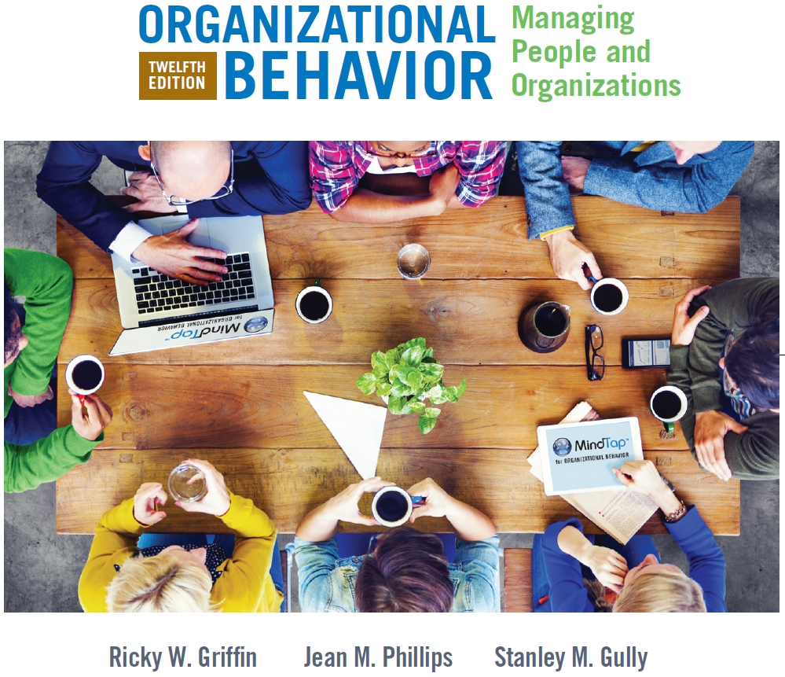
PART 3
Social and Group Processes in Organizations
CHAPTER 10
Managing Conflict and Negotiating

Slide 2
Chapter Learning Objectives After studying this chapter you should be able to:
Describe the nature of conflict, discuss the conflict escalation process, and describe how conflict can be de-escalated.
Identify and discuss the five interpersonal conflict management strategies.
Describe some of the best and worst conflict resolution behaviors and discuss how to create constructive conflict.
Describe the difference between distributive and integrative negotiation and identify the three types of alternative dispute resolution.

Slide 3
The Nature of Conflict in Organizations
Conflict
A disagreement through which two or more parties perceive a threat to their interests, needs, or concerns

Slide 4
The Nature of Conflict…(cont’d)
Dysfunctional Conflict
Destructive conflict focused on emotions and differences between the two parties
Constructive (Functional) Conflict
Adaptive, positive conflict
Balances the interests of both parties to maximize mutual gains and the attainment of mutual goals
Contains elements of creativity and adaptation
Can lead to identification of new alternatives and ideas

Slide 5
Causes/Types of Conflict
Task Conflict
Disagreement about the task or goals
Process Conflict
Disagreement about how to accomplish a task
Relationship Conflict
Incompatibility between individuals or groups
Conflicts of Interest
Competition over resource constraints
Values Conflict
Arises from incompatible belief systems

Slide 6
Causes/Types of Conflict (cont’d)
Information Conflict
Occurs when people lack necessary information, are misinformed, interpret information differently, or disagree about which information is relevant
Task Interdependence
One person or unit is dependent on another for resources or information
Structural Conflict
Results from structural or process features of the organization

Slide 7
Conflict Management Strategies
Avoidance
Accommodation
Competition
Collaboration
Compromise

Slide 8
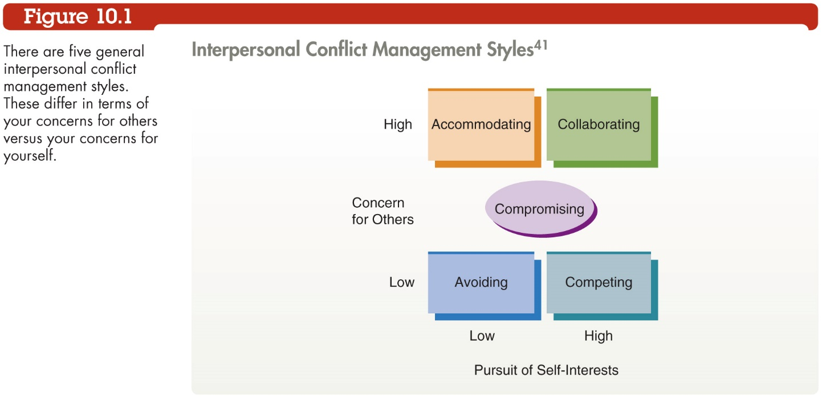

Slide 9
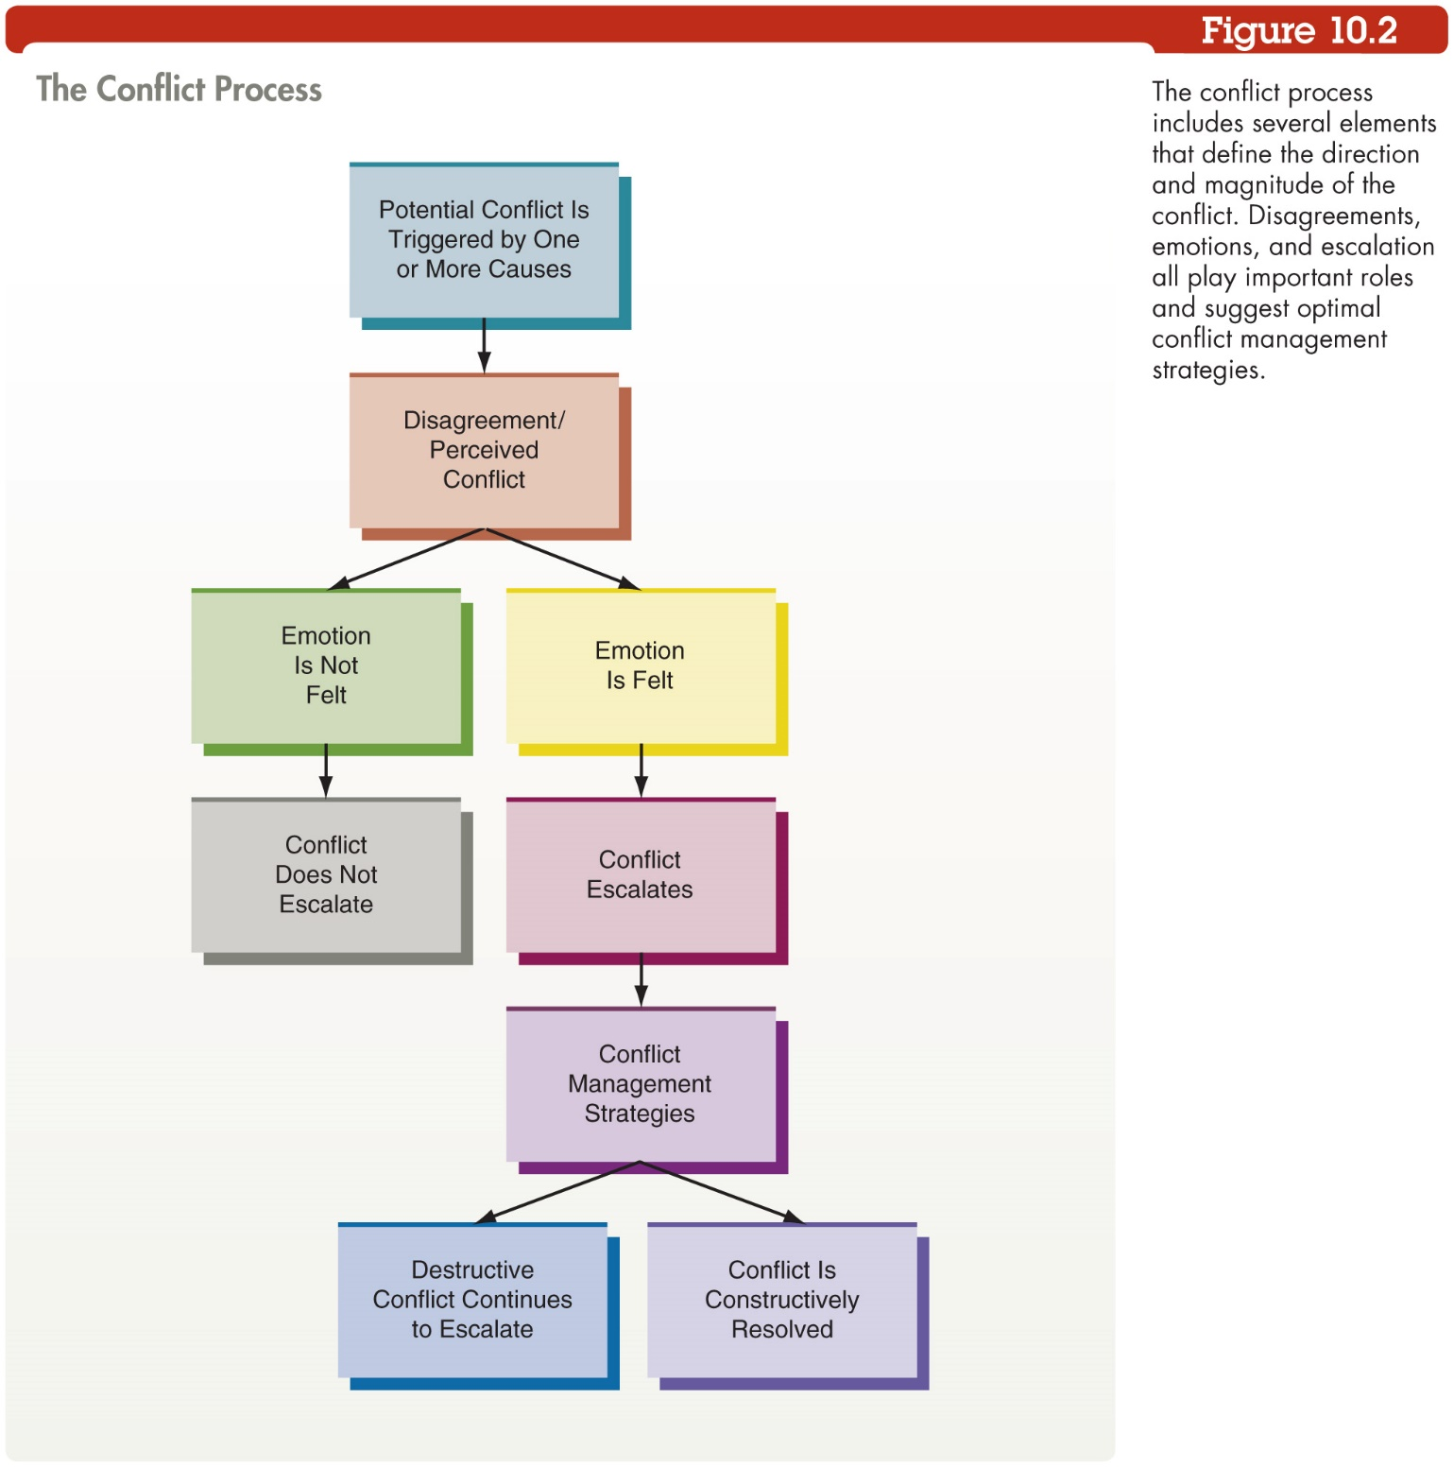

Slide 10
Conflict Management Skills
Best Conflict Resolution Behaviors:
Try to put yourself in the other person’s position
Focus on interests, not positions
Attempt to create solutions to the problem
Express emotions honestly
Reach out, make the first move to make amends
Document areas of agreement and disagreement
Play down differences, emphasize common interests
Identify 3-4 actions other party would like you to take

Slide 11
Conflict Management Skills (cont’d)
Worst Conflict Resolution Behaviors:
Avoiding the conflict
Winning at all costs
Displaying anger
Demeaning the other party
Retaliating or trying to get revenge
Meeting separately with the people in conflict

Slide 12
Negotiation
Negotiation
A process in which two or more parties make offers, counteroffers, and concessions in order to reach an agreement
Distributive Negotiation
Any gain to one party is offset by an equivalent loss to the other party
Integrative Negotiation
A win-win negotiation in which the agreement involves no loss to either party

Slide 13
Integrative Negotiation
Four Fundamental Principles
Separate relationship issues (or “people problems”) from substantive issues
Focus on interests, not positions – negotiate about the things people need, not the things they say they want
Look for new solutions to the problem that will allow both sides to win
Insist on outside, objective fairness criteria

Slide 14
Effective Negotiation
Tips for Effective Negotiation
Make sure each side knows the other’s interests and perception of the issues
Identify what you can and cannot part with
Identify and use sources of leverage
Show the other side that you understand their position
Suppress your emotions
Know your BATNA: “best alternative to a negotiated agreement”

Slide 15
Alternative Dispute Resolution
Alternative Dispute Resolution
Involving a third party in a negotiation to overcome a stalemate
Three types: conciliation, mediation, and arbitration
Ombudsman
Someone who investigates complaints and mediates fair settlements between aggrieved parties

Slide 16
Alternative Dispute Resolution (cont’d)
Conciliation
A third party builds a positive relationship between the parties, improves their communication, and facilitates their discussion
Conciliator may suggest a resolution
Parties can accept or reject conciliator’s proposal

Slide 17
Alternative Dispute Resolution (cont’d)
Mediation
An impartial third party (the mediator) facilitates a discussion using persuasion and logic
Mediator suggests alternatives and establishes each side’s priorities
Mediator’s suggested settlement is not legally binding

Slide 18
Alternative Dispute Resolution (cont’d)
Arbitration
May be required or voluntary
Negotiating parties establish rules for the arbitrator
Arbitrator’s decision is legally binding
Always results in a settlement, but has greater potential to leave at least one party dissatisfied

Slide 19
Organizational Behavior in Action
After reading the chapter:
Have you ever experienced a constructive conflict? What happened? How was the disagreement resolved?
Which of the conflict causes do you feel is most challenging to a manager? Why?

