Slide 1
What is Business Intelligence?

Slide 2
Business Intelligence
Includes a wide range of applications, practices, and technologies for the extraction, transformation, integration, visualization, analysis interpretation, and presentation of data to support improved decision making
Data can be used to build large collections of data called data warehouses, data marts, and data lakes
Require the use of Data Scientists

Slide 3
Benefits of Business Intelligence
Detect fraud
Improve forecasting
Increase sales
Optimize operations
Reduce costs

Slide 4
Business Intelligence & Analytical Tools
Spreadsheets
Reporting and querying tools
Data visualization tools
Online analytical processing (OLAP)
Drill-down analysis
Linear regression
Data Mining
Dashboards

Slide 5
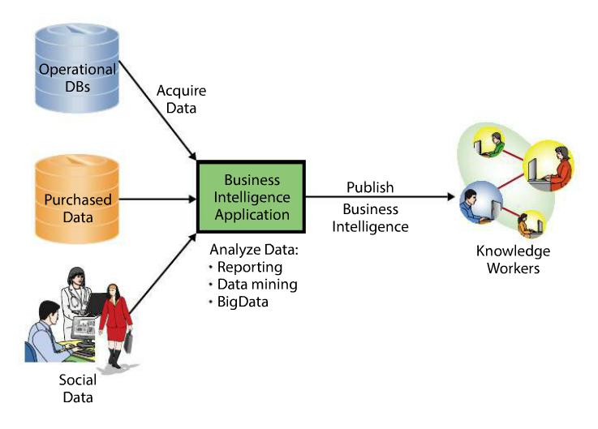
Business Intelligence Data Flow

Slide 6
Uses of Intelligence Systems
Changes in Purchasing patterns
Entertainment
Predictive Policing
Just in Time Medical Reporting

Slide 7
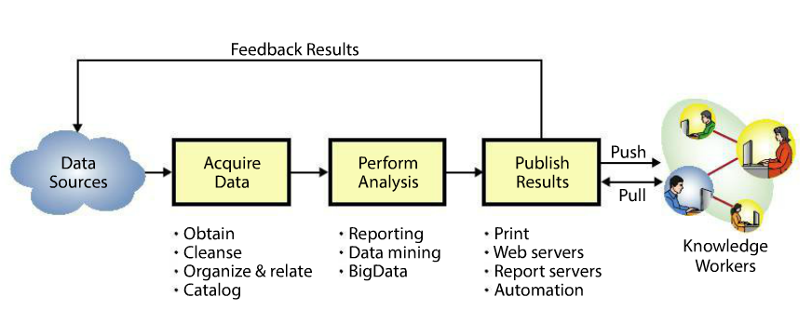
Activities in BI Process

Slide 8
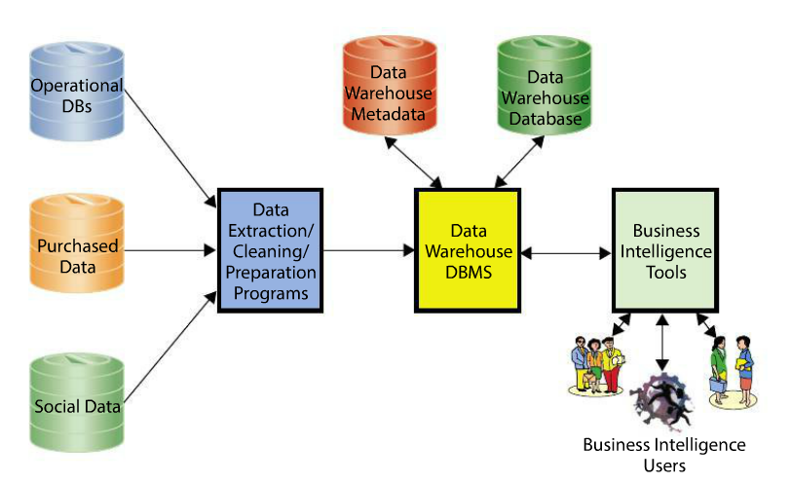
Data Warehouse

Slide 9
Techniques for processing BI data
Reporting Analysis
Structured Data
Exception Reports
Data Mining Analysis
Unsupervised: Cluster Analysis
Supervised: Regression Analysis
Big Data
VVV: Volume, Velocity, Variety

Slide 10
Artificial Intelligence
Artificial intelligence (AI) makes it possible for machines to learn from experience, adjust to new inputs and perform human-like tasks.
Using technologies like deep learning and natural language processing, computers can be trained to accomplish specific tasks by processing large amounts of data and recognizing patterns in the data

