Slide 1
5
Week Five
Foreign consumer predispositions: Consumer Animosity and Affinity
1-<number>

Slide 2
Articles;
Amine, L.S., Chao, M.C.H. and Arnold, M.J. (2005): Exploring the Practical Effects of Country of Origin, Animosity, and Price-Quality Issues: Two Case Studies of Taiwan and Acer in China. Journal of International Marketing, Vol. 13, No. 2, pp. 114-150.
Ettenson, R.E. and Klein, J.G. (2000): Branded By the Past. Harvard Business Review, Vol. 28, (November – December), p. 28.
Klein, J.G., Ettenson, R.E. and Morris, M.D. (1998): The Animosity Model. Journal of Marketing, Vol. 62, No. 1, pp. 89-100.
Oberecker, E.M., and Diamantopoulos, A. (2011): Consumers' Emotional Bonds with Foreign Countries: Does Consumer Affinity Affect Behavioral Intentions? Journal of International Marketing, Vol. 19, No. 2, 2011, pp. 45-72.
Oberecker, E.M., Riefler, P. and Diamantopoulos, A. (2008): The Consumer Affinity Construct: Conceptualization, Qualitative Investigation, and Research Agenda. Journal of International Marketing, Vol. 16, No. 3, pp. 23-56.
Notes:
<number>

Slide 3
Consumer Ethnocentrism
Ethnocentrism: home country viewed as superior to other countries.
Ethnocentrism is the basis for consumer ethnocentrism.
Consumer Disidentification
“I am not an American. There is nothing about me that is American. I don’t want to be American, and I have just as much right to be here as any of you.”
Young Latino in One America Indivisible (Hackney 1999, p. 76)
2
Notes:
<number>
<number>

Slide 4
The Consumer Attraction-Repulsion Matrix
 | Attraction | Repulsion
Domestic country | Consumer Ethnocentrism (Shimp & Sharma, 1987) | Consumer Disidentification (Josiassen, 2011)
Foreign Country | Consumer Affinity (Oberecker et al., 2008) | Consumer Animosity (Klein et al. 1998)
Notes:
<number>

Slide 5
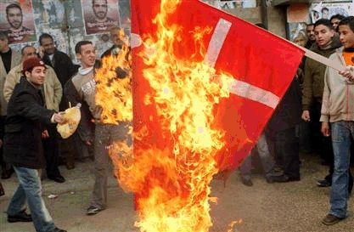
Consumer Animosity
Animosity: strong emotions of dislike and enmity based on beliefs of past and ongoing events of hostility between nations or people (Averill, 1982, 1983).
Notes:
<number>

Slide 6
Consumer Animosity
If international tension can lead to armed conflict and atrocities, it seems plausible that animosity toward a current or former enemy also will affect willingness to buy products produced in or by firms from that country
Notes:
<number>

Slide 7
Consumer Animosity
Consumer Animosity: The unwillingness of consumers to buy products stemming from companies based in or associated with a country towards which they harbour remnants of antipathy related to previous or ongoing military, political or economic events
Notes:
<number>
a deep-seated feeling of aversion

Slide 8
Consumer Animosity
Cause:
Antipathy related to ongoing or previous military, political or economic events
Effect:
willingness to buy
Animosity present an informal but significant barrier to trade.
Notes:
a deep-seated feeling of dislike; aversion
<number>

Slide 9
Ethnocentrism and Animosity
In contrast to Shimp and Sharma's (1987) CETSCALE, Klein et. al. (1998) developed a model that predicts that animosity toward a foreign nation will affect negatively the purchase of products produced by that country independently of judgments of product quality.
Animosity has a significant impact on buying decisions above and beyond the effect of consumer ethnocentrism.
The CETSCALE measures beliefs about buying foreign products in general, whereas animosity is a country-specific construct
The measurement of cross-national hostility enables managers to understand better the purchase behaviour of consumers in the international marketplace
Notes:
<number>

Slide 10
Animosity is not related to product judgement
For those high in animosity, it is not product perceptions that lead to a reluctance to purchase goods from the target country;
it is hostility toward that target.
Apparently, consumers are able to acknowledge the quality of goods from a target country while expressing hostility toward and a marketplace aversion to products from that country
Japanese goods were viewed quite positively by Chinese consumers,
regardless of the consumers' level of animosity
Notes:
<number>

Slide 11
Consumer animosity and product judgement
It is possible, that a product's origin (signalled by place of manufacture and/or brand name) will affect consumers‘ buying decisions directly and independently of product judgments.
For example, Israelis may perceive German cars to be of high quality.
Jewish history does not make consumers blind to the fact that German cars can be high-end, high-quality products.
However, if asked if they would purchase a German car the answer may still be negative
http://www.ynetnews.com/articles/0,7340,L-3446326,00.html
The important thing about consumer animosity is that it is completely divorced from considerations of product quality.
Notes:
<number>

Slide 12
The past and the present matters
A country’s militaristic past can haunt companies for many years after the peace treaty has been signed
A government’s current policies can upset the best-laid plans for penetrating new markets.
Marketing managers in the global economy can’t focus ‘myopically’ on traditional rules of branding, even when their products are superior.
They also need to remember the lessons of history.
Notes:
<number>

Slide 13
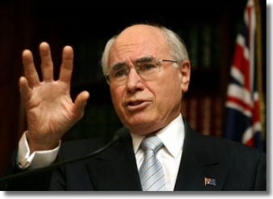
Implications of animosity
Exporting firms associated with a country whose military, economic, or political histories are enduring and controversial (e.g., Japan, Germany, Russia, the United States, Israel, France, Great Britain) should consider administering research surveys that measure levels of animosity in select target markets.
Does this apply to Kuwait firms?
Are the there any countries
that may have animosity
towards Kuwait products?
<number>
Notes:
<number>

Slide 14
Implications of animosity
When high levels of animosity can be detected;
Downplay promotion of the "Made in ..." aspect of the product and use brand names that are not obviously associated with the target country
Notes:
Question;
Could Sony Ericsson benefit from being More Swedish that Japanese in the Chinse market?
<number>

Slide 15
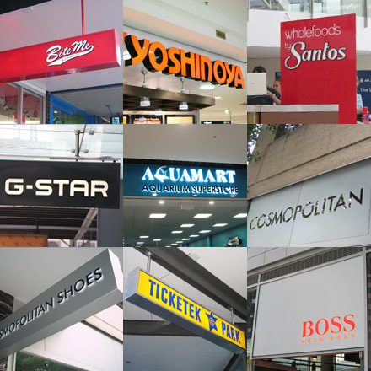
Implications of animosity (retail)
When sourcing abroad, retailers will benefit by identifying the levels of animosity exhibited toward particular foreign suppliers.
This will enable the firm's buying centre to concentrate on purchasing goods from producer nations that do not engender animosity from its customers
<number>
Notes:
cause or give rise to (a feeling, situation, or condition)
<number>

Slide 16
Four types of animosity
Stable versus situational
Stable animosity derives from difficult historical relations between two countries and is a value passed on from one generation to the next.
Situational animosity is closely linked to current economic and political events.
Personal versus national
Personal animosity arises from negative personal experiences that may have occurred during contacts with a foreign country or through relations with nationals.
Consumers can hold national animosity toward a particular country based on perceptions of how that country has treated their home country (as with the U.S. war in Iraq).
Notes:
Recent expression of this was captured in the unflattering phrase "old Europe," which some people in the United States used to describe France and Germany because of their opposition to the war in Iraq.
<number>

Slide 17
Variables influencing the effects of animosity
Geographic region
Demographic variables
Market integration factors
Unusual economic conditions
Notes:
<number>

Slide 18
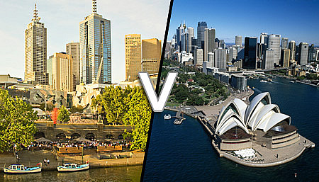
Geographic Region
People in one particular geographic region may exhibit animosity toward people of another specific geographic region.
Regional identity may play a large role in a person's sense of self.
A person's membership in a social group is the foundation for much of that person's self concept.
People identifying with a geographic region try to reinforce their regional self concept.
They exhibit preference for in-group norms and values and often stereotype people from other out-groups or regions.
Notes:
Shimp, Dunn, and Klein (2004) cite the example of persistent tensions between people from the North and the South in the United States; even after approximately 150 years of peace following the Civil War, many people still harbor animosity toward the other side.
<number>

Slide 19
Demographic Variables
Several socioeconomic and attitudinal variables are related to animosity toward Japan among U.S. consumers.
Union membership, age, and race were significantly correlated with consumer animosity, as were prejudicial attitudes toward Asians.
Other socioeconomic indicators were not found to be correlated with animosity, such as education, income, occupation, gender, or indicators of well-being.
Notes:
In studying U.S. animosity toward Japan, Klein and Ettenson (1999) find several distinct antecedents of animosity.
Labour union members and older consumers hold more animosity towards Japan. White Americans have more animosity towards Japan than black Americans.
<number>

Slide 20
Market Integration Factors
The relationship between various outcome variables and animosity toward a foreign nation is likely to be affected by the extent of alternative choices that are available to consumers.
For example, if consumers have choices between domestic goods and foreign goods in a certain product category, ethnocentrism is likely to play a large role in product choice.
In product categories in which few, if any, domestic options are available, animosity is more likely to play a predictive role, especially if there is anger or hostility toward a particular country.
Notes:
<number>

Slide 21
Environmental Factors
With regards to the Asian financial crisis in the late 1990s in five Asian countries, Animosity and ethnocentricity differ in the extent to which the United States and Japan is blamed.
Indonesia, Korea, Malaysia, Singapore, and Thailand.
In general, the more severely a country had been affected by the crisis, the more ethnocentric were respondents, and they were more likely to harbor higher levels of animosity toward the United States or Japan (whom they blamed for the crisis).
For example, Malaysians, Indonesians, and Koreans presented the highest levels of personal- and national-situational animosity toward the United States, reflecting prevalent beliefs in the national political environment.
Notes:
Ang and colleagues' (2004)
<number>

Slide 22
Marketing Implications of Animosity
During the 1970s and 1980s, many people in the United States perceived Japan negatively because U.S. car makers struggled to prevent domestic job losses resulting from the importation of large numbers of cheaper, more fuel-efficient, compact cars into the United States from Japan.
To change U.S. consumers' negative attitudes toward Japan, the three major Japanese car makers Toyota, Honda, and Nissan established manufacturing plants in the United States.
Through the use of extensive advertising campaigns, these companies have consistently demonstrated how they have created jobs for people in the United States
<number>
Notes:
This repeated message of being a "good citizen," along with an unbeatable reputation for zero defects and high resale car values, brought about the success that the Japanese car companies enjoy in the United States today.
<number>

Slide 23
Consumer Animosity
Firm specificity
Chinese in Nanjing Province towards Japanese firms
Lebanese towards Israeli firms
Argentinians towards English firms
http://presstv.com/detail/227118.html
Sri Lankans towards Indian firms
Can you think of others?
Notes:
<number>

Slide 24
Consumer Animosity
Which country would you prefer not to buy from?
Why?
Notes:
Take answers from the class
<number>

Slide 25
Consumer Animosity
Further reasons for CA towards the USA:
“I don't like the USA's permanent intervention in foreign politics”.
“The USA takes advantage of its economic power on expense of weaker nations”.
“I dislike the current US President George Bush”.
“I reject the current government’s policy in Iraq”.
“I don't like the American way of life”.
“I disagree with the existence of the death penalty ”.
“I dislike the American mentality”.
Notes:
<number>

Slide 26
Consumer Animosity
Further reasons for CA towards Germany:
“The Germans complain about everything”.
“I hate that many people think Austria is a part of Germany”.
“I hate that many people think Austrians and Germans are one and the same”
“I dislike Germany's role in World War II”.
Notes:
<number>

Slide 27
Consumer Animosity Today
10 “good” reasons to boycott US products:
Iraq
US Military Expenditure
Global warming
Palestine
Star Wars
Genetically modified food
International Criminal Court
Biological, chemical weapons and landmines
Tobacco and Corporate accountability
Nuclear weapons
Notes:
<number>

Slide 28
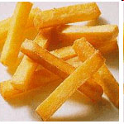
Consumer Animosity Today
Notes:
<number>

Slide 29
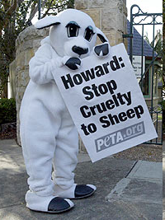
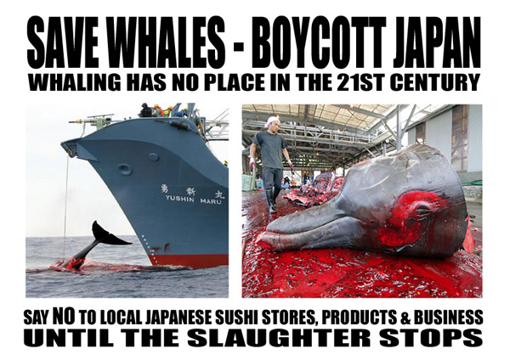
Consumer Animosity Today
Notes:
<number>

Slide 30
Consumer Affinity
<number>
Notes:
<number>

Slide 31
Affinity vs. Animosity
The majority of effort has been directed at understanding the nature and behavioural impact of unfavourable attitudes toward foreign countries by focusing on constructs such as consumer ethnocentrism and consumer animosity.
In contrast, favourable attitudes toward foreign countries, their sources, and their consequences have received only scant consideration,
Several studies have shown that countries can evoke a variety of affective responses, including sympathy and interest.
Positive affective responses can affect general decision making, particularly purchase decisions, by inhibiting further consideration of choice alternatives and by reducing the amount of processed information
Notes:
<number>

Slide 32
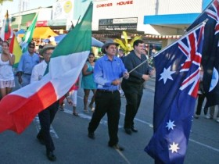
Affinity vs. Ethnocentrism
Affinity captures soft (sympathy) and strong (attachment) positive emotions toward a specific foreign country.
Consumer affinity is unrelated to consumers’ ethnocentric tendencies;
Negative sentiments toward foreign products in general (as captured by consumer ethnocentrism) and
Positive sentiments toward a specific foreign country (as captured by consumer affinity) can coexist.
Notes:
<number>

Slide 33
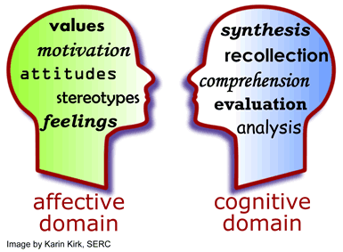
Affinity vs. COO
Oberecker, Riefler, and Diamantopoulos (2008) propose that emotional attachment to a country, as opposed to consumers’ cognitive beliefs about the country’s ability to produce reliable or high-quality goods, affects decisions to consume products or services from the affinity country.
Affective influences (as captured by consumer affinity) and cognitive influences (as captured by country image perceptions) have complementary effects on behavioural outcomes
<number>
Notes:
<number>

Slide 34
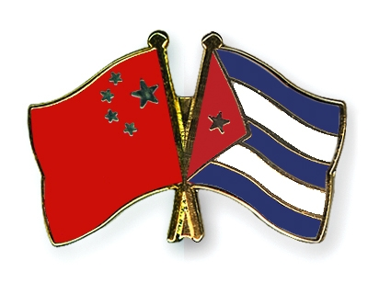
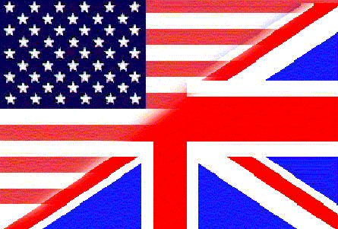
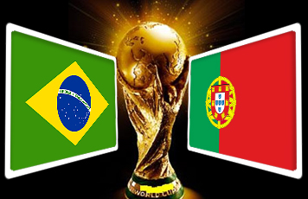
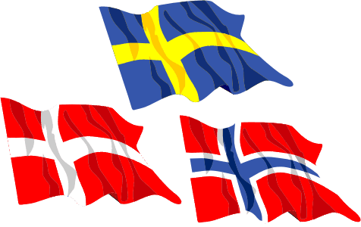
Affinity Example
The brotherhood of the Scandinavian countries, Portugal and brazil, the Latin-American countries, southeast Asia, the Anglo part of the world (NZ, Oz, UK, Canada and USA), the political and common destiny bonds between China, Cuba, Venezuela and so on.
The way countries vote in the Euro song contest often relates to affinity.
<number>
Notes:
<number>

Slide 35
Pop Stars-Affinity
.

Slide 36
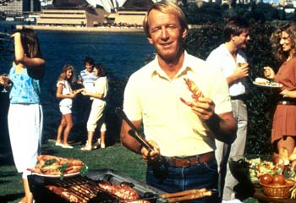
Affinity can be powerful in international advertising
Consumer affinity is more powerful than consumers’ ethnocentric tendencies in explaining both perceived risk and willingness to buy
Internationally active companies can benefit from leveraging consumer affinity feelings in addition to positive country images.
Paul Hogan 80's tourism Australia
Turkey
Croatia
<number>
Notes:
<number>

Slide 37
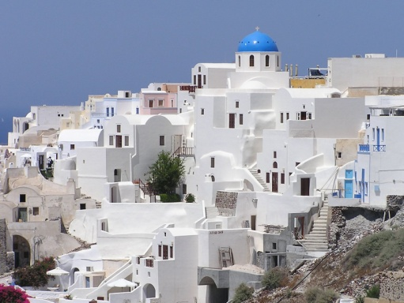
Affinity and investment intentions
Consumer affinity directly affects perceived risk and willingness to buy, as well as intentions to visit or invest in the affinity country.
A strong impact of affinity on investment intentions, indicates that emotions play a role even in decision-making situations in which rational criteria are expected to be predominant.
A recent illustrative example is the decision of German private investors to invest in Greek government bonds in the midst of the Greek debt crisis, as a result of strong affinity feelings toward Greece.
<number>
Notes:
<number>

Slide 38
Affective influences can drive behavioural outcomes
Country-of-origin research has focused almost exclusively on consumers’ cognitive evaluations of countries as predictors of behavioural intentions.
Affective influences are more influential than cognitive evaluations for behavioural outcomes (perceived risk, visit intentions, and investment intentions)
equally influential on willingness to buy
Notes:
<number>

Slide 39
Active management of consumer affinities could be an attractive option for overcoming ethnocentric barriers.
Consumer ethnocentrism has been repeatedly found to be an obstacle to foreign companies offering their products in the global marketplace
If the foreign product already comes from an affinity country, emphasising its COO in product communications is an obvious technique for “neutralizing” consumers’ ethnocentric tendencies
Consumer ethnocentrism does not affect consumer behaviour regarding the purchase of products from the affinity country.
Notes:
<number>

Slide 40
Foreign affective COO evaluations;
consumers moral evaluation cues
Shared language
Common history
and destiny
Shared beliefs
Consumer Affinity
+
+
War Animosity
Economic Animosity
Political Animosity
-
Consumer Animosity
+
Product Judgements
Purchase Willingness
of foreign products
Source: Klein et al. (1998), Oberecker and Diamantopoulos (2011)
Notes:
<number>
Klein et al.'s (1998) study was the first to show a direct effect of consumers’ animosity on buying decisions, independent of product judgments.
This challenged the conventional wisdom in the country-of-origin literature, according to which “made in” influences on consumers' willingness to buy foreign products were assumed to impact on buying decisions indirectly via product judgments

Slide 41
Affective COO evaluation: Moral evaluation cues
Cognitive COO evaluation:
Quality evaluation cues
Foreign predispositions
Product-Origin History
Negative
Positive
War Animosity
Economic Animosity
Political Animosity
Shared language
Common history and destiny
Shared beliefs
Country-of-Origin Image
Supply Chain Image
Brand Image
Consumer Animosity**
Consumer Affinity*
Domestic predispositions
Product Judgements
Positive
Negative
Cultural homogeneity
History of Sovereignty
Consumer Demographics
Ethnic disidentification
Value disidentification
Political disidentification
Consumer Ethnocentrism
Consumer Disidentification
Purchase willingness of
domestic products
Purchase willingness of
foreign products
*Preferences for affinity country only **, Also preferences for other countries than the animosity country
Notes:
<number>
Discuss the entire model.
Note that CA and CE do not affect PJ but directly on PW.
Brand image and Supply chain image affects PW through PJ.
Supply chain image is the image of all the firms in the supply chain that brought them the product – especially the outlet the customer bought the product from.

Slide 42
The Consumer Attraction-Repulsion Matrix
 | Attraction | Repulsion
Domestic country | Consumer Ethnocentrism (Shimp & Sharma, 1987) | Consumer Disidentification (Josiassen, 2011)
Foreign Country | Consumer Affinity (Oberecker et al., 2008) | Consumer Animosity (Klein et al. 1998)
Notes:
<number>

