Slide 1
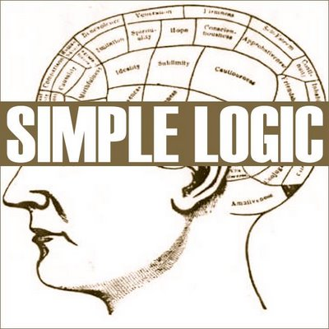
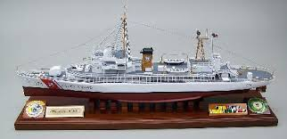
Logic Models
Community Toolbox Chapter 2
(based on McKinley Swims, designed by Kathleen M. Roe, DrPH)
https://ugatheists.files.wordpress.com/2011/07/simple-logic-large.jpg

Slide 2
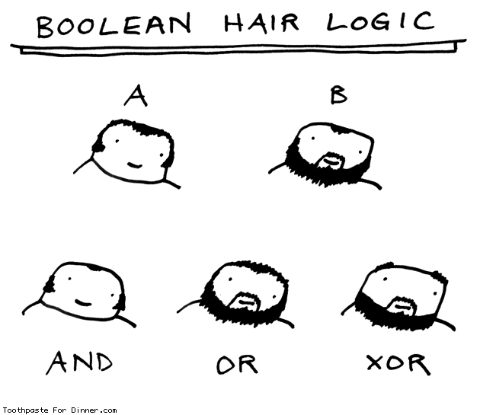
Logic Models
A Logic Model is “a story or picture of how a program is supposed to work”
Visually communicates the big picture view of what you plan to do, why, and what difference it should make
Useful in planning (to check your assumptions), in discussing program details (to make sure you haven’t left anything out), and in evaluation (what worked, what got in the way)
http://www.toothpastefordinner.com/071310/boolean-hair-logic.gif

Slide 3
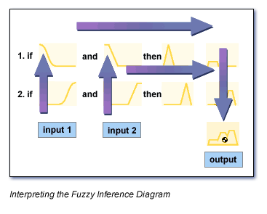
A good logic model….
Is visual
Is organized logically
Is specific
Provides important program details, but….
Fits on one page
http://mncriticalthinking.com/wp-content/uploads/2014/01/spock_logic2.jpg
A logic model connects the (planning) dots…
http://www.mathworks.com/cmsimages/40305_wl_fl_mainimage_wl_3248.gif

Slide 4
Typical Logic Model Template
Assumptions
External Factors

Slide 5
Logic Model for a Health Information Program (NIH)

Slide 6
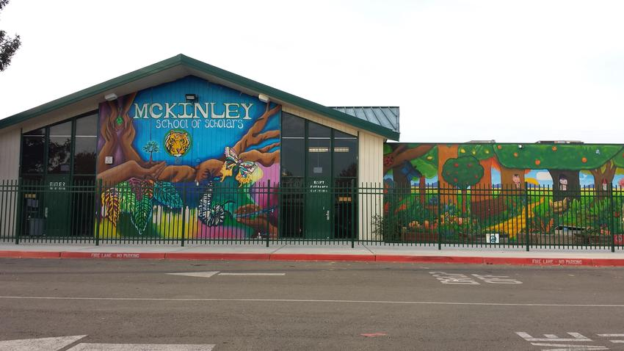
Example - Step by step….
Priority Population:
Children at McKinley
Health Issue:
Water safety, increased access to physical activity, increased confidence for learning
Program:
Summer 2014 Swim Program at the YMCA

Slide 7
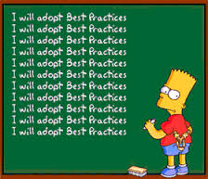
Start the Logic Model by listing your assumptions
Assumptions
Beliefs about the environment and community
Should be confirmed before starting the program!
Best Practice
Brainstorm as many as you can – this is a good way to make sure there’s not a “fatal flaw” in your basic idea!
Check out as many as you can so you minimize surprises
Then, select the most salient ones and put them in your Logic Model
http://cdn2.content.compendiumblog.com/

Slide 8
Assumptions
Children at McKinley will want to learn to swim and will enjoy swim lessons
McKinley parents will want their children to learn to swim
McKinley parents will trust the YMCA
Swim lessons will be a summer priority for McKinley families
McKinley Swims! can successfully manage transportation to and from the YMCA
For McKinley Swims?
http://www.disputeresolutioncounsel.com/

Slide 9
Next...
External factors that may influence your program
YMCA schedule, resources, commitment
McKinley family attitudes and beliefs about swimming, appropriate age to learn to swim, comfort and experience with swim lessons
Competing and emerging priorities among families over the summer
Weather!

Slide 10
Put the most important ones into the Logic Model

Slide 11
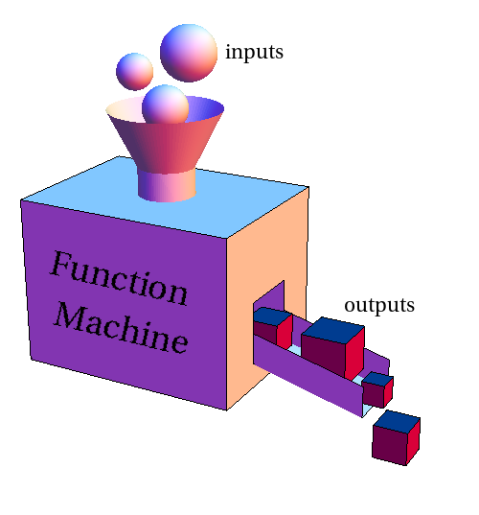
Next…..Inputs
What is going to be invested in this program?
Staff, volunteers, time, money, past experience, research, materials, technology, equipment, partners, grant funds, publicity…
Swimming lessons
Swim instructors
50 McKinley children
15 SJSU volunteers
Salud Familiar staff
Swim suits, towels, goggles
Transportation
Salud Familiar experience
McKinley Moves Outdoors! Grant
PR materials – banner, newsletter, photos
Snacks
http://mathinsight.org/media/image/image/function_machine.png

Slide 12
Add the inputs to the Logic Model….

Slide 13
Next…..Outputs….
Start with our activities (what we will do)
McKinley Swims! Activities
Parent Orientation sessions
Publicity
Visit to the Y (with mothers)
Sign ups and parent commitment
2 sessions, 4 weeks each, 3 days/week
Transportation to and from McKinley and the YMCA
Reminder call system
Provide towels and goggles, swim suits if needed
Snacks after lessons
Ongoing publicity – photos, newsletter
Certificates at the end of each session
Pre-and post evaluation (knowledge, attitudes, behaviors, confidence, intention)

Slide 14
Add in the Activities…

Slide 15
Outputs….Participants (AKA Who We Reach)
McKinley Swims! Participants
McKinley children who will learn to swim
McKinley parents
Broader McKinley community (indirectly)
SJSU volunteers
Donors
Funders
Broader community
YMCA staff and stakeholders
McKinley teachers and leadership
District leadership

Slide 16
Add the Participants to the Logic Model

Slide 17
Get the idea?
Over the next few weeks, develop your own program’s Logic Model
Identify appropriate theory/ies and operational constructs
Identify strategies for environmental and behavior change
Begin to formulate objectives: Impact (short term) and Outcome (long term). Process objectives (administrative) will come later.
Put the most important ones into your Logic Model
Due 11/2: PC 6 – Draft Logic Model of Your Program

Slide 18
Additional References
Betancourt, J.; Carillo, J.E.; & Green, A. (2002) Cultural competency in health care: Emerging frameworks and practical approaches. The Commonwealth fund. Retrieved on October 12, 2012 at http://www.commonwealthfund.org/usr_doc/betancourt_culturalcompetence_576.pdf
Hodges, B. and Videto, D. (2011). Assessment and planning in health programs. Jones and Bartlett. Sudbury, MA.
Multiple Intelligences. (n.d). Retrieved on October 12, 2012 at http://www.spannj.org/BasicRights/appendix_b.htm

