Slide 1
BUSI1630 Cross-Cultural Management and Diversity Management
Lecture 22
Managing Age Diversity in the Workplace

Slide 2
Lecture Outline
Understand the demographic changes and aging trends that have led to the introduction of legal protection against age discrimination and the need to extend working lives
Understand how equality is conceptualised in the context of age and employment, and to what extent the aims of the age equality agenda relates to organisational practice
Define employee’s perceptions and manifestations of age discrimination in the workplace
Explain the concepts and strategic approaches to the management of age diversity in the workplace, and identify the benefits and issues that concern both different generations of workers and organisations.

Slide 3
Age Discrimination
Treating a person or a group of people less favourably because of their age.
For example, denying older workers access to training opportunities that are available to younger workers.

Slide 4
Europe is Aging…
Rate of the population of working age (age 20-64) in 2050 | 52%
Rate of the population aged 15-24 in 2050 | 19%
Rate of the population aged 65 or over in 2050 | 29%
Dependency ratio in 2050 (this is the ratio of people aged 65 or over relative to the working age population of 15-64) | 50%
Fertility rate in 2060 (below replacement threshold of 2.1 children per woman) | 1.68
Life expectancy for women in 2060 | 89
Life expectancy for men in 2060 | 84.5
Source: European Commission (2008) EU27 Demographic future of Europe – from challenge to opportunity.
Notes:
CPW – children per woman

Slide 5
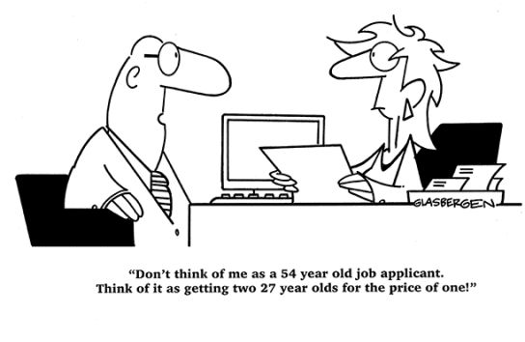
There are already 9.4 million people in employment over the age of 50 in the UK, equivalent to over 30% of the workforce. In future decades, a vast proportion of this group will leave work permanently, taking their acquired skills and experiences with them.
Notes:
It is not just proportions that matter, but absolute numbers too. There are currently over 1.5 million workers over the age of 50 in health and social work and more than 1.2 million over 50 in both education and retail. Replacing such large numbers of people will require a significant number of future school-leavers and potentially migrants to fill the gaps left by older workers leaving these sectors.

Slide 6
Push/Pull Factors for older worker retention
Pull factors • Push factors
Identity derived from work Economic growth
Abolition of retirement age Need to retain staff
Improved health and fitness No forced retirement
Increase in women’s pension age Change of attitude
Better educated Flexible work avail
Less access to disability pension Tax offsets
Family responsibilities Super changes
Need to maintain lifestyle Easy super access
Lack of financial preparedness
Adapted from Bartlett 2003, Kennedy & Hedley 2003,
Murray & Syed 2005, Kennedy & Da Costa 2006 and Lundberg & Marshallsay 2007.
Notes:
Why people leave the labour market at older ages

Slide 7
Conceptual framework for age equality
Concepts and values that support age equality in the workplace | Arguments to justify limitations to age equality in the workplace
Human rights argument based on the principle of equal treatment. Dignity: it is an affront to an individual’s dignity to treat her less favourably because of her age | ‘Fair innings’ argument distinguishes between equality at a given time and equality over a lifetime. We all experience advantages and disadvantages over a lifetime.
Participative democracy: all groups should be entitled to full participation in all aspects of social life, including participation in the labour market. | Neo-liberal perspective: age equality cannot be achieved because of the high costs for business of retaining older workers.
Business case: from a macro economic perspective, there is a need to extend working lives to address demographic changes. From an organisational perspective, older workers can offer valuable expertise and specialist skills. | Business case: there should be a fixed retirement age for workforce planning reasons, or even to promote age diversity by employing younger people.

Slide 8
Notes:
Many industries have a poor record on retaining older workers, seeing a large drop-off in the number of workers between the ages of 45–49 and 60–64. In particular, finance, public administration and ICT all see a drop of greater than 60% between the number of workers they employ in their late forties and in their late sixties.
Such falls suggest that these sectors are not doing enough to support longer working lives and will be hampered by the loss of skilled and experienced staff.

Slide 9
Age-related discriminatory practices
Age-related discriminatory practices in the selection and recruitment of staff | Employment sector
Using length of experience as a selection criterion in recruitment for assessing competencies. | Retailing, hospitality, construction, health and social care, other community sectors
Targeting particular age groups | Retailing
Providing age information of candidates when shortlisting and interviewing staff | Retailing, hospitality, manufacturing, education
Using proximity to retirement and maximum recruitment age to exclude applicants | Transport and logistics

Slide 10
Sourced from the course textbook, page 257

Slide 11
Where will the replacement workers come from?
Extending working lives and supporting and nurturing younger talent
Taking on migrant workers
Raising workforce productivity

Slide 12
What can employers do to mitigate the risks posed by population change?
Inclusive recruitment
Improve the capability of line managers
Invest in training, development and performance management
Support employee health and well-being
Move towards more flexible working
Source: CIPD 2015 Avoiding the demographic crunch: Labour supply and the ageing workforce

Slide 13
References
Kumra, S; Manfredi, S and Vickers, L. 2012 Managing Equality and Diversity. OUP.
CIPD (2015) Policy report: Avoiding the demographic crunch: Labour supply and the ageing workforce, Chartered Institute of Personnel and Development.

