Slide 1
BUSI1630 Cross-Cultural Management and Diversity Management
Lecture 21
Managing Religion or Belief in the Workplace

Slide 2
Lecture Outline
Examine evidence of discrimination on grounds of religious affiliation in the labour market.
Identify the main features of the EU and UK legislation to protect religion or belief in the workplace.
Explain principled and pragmatic reasons that justify protection of religious freedom in the workplace.
Understand the implications for managing religious diversity in the workplace.
Religious Diversity: A Comparative Approach

Slide 3
Religion, Belief and Workplace
Individuals are affected by many factors such as “religious beliefs, norms and practices of others and need to develop awareness of the issues, and processes to manage religion at work“.
The main function of the religion is to give power to individuals for controlling their destiny.

Slide 4
Religion, Spirituality and Workplace
Religion and Spirituality are directly related to the work, because religion obligations can sometimes be strict for workplaces.
Hicks (2002:380) integrates distinctions of those concepts by these authors as “religion is institutional, dogmatic and rigid; spirituality is personal, emotional and adaptable to an individual’s needs”.
For example, some workers can avoid working in a particular job because of religion obligations such as Catholics whose nurses may not work on curetages, Hutterites who may not want to drive car and Muslims who may refuse to work in a company that has produced alcoholic drinks.
Notes:
Hicks (2002) asserts that the roles of religion and spiritually in the workplaces are neglected because of secular thought.
The concept of spirituality is confused and is examined with a negative connotation. It is seen as organized religion in terms of particular beliefs, moral rules and traditions.

Slide 5
The prohibition to discriminate on the grounds of religion in employment and occupation, except where religion is an inherent requirement of a particular occupation, was introduced in 1958 by the International Labour Organization Convention on Discrimination.
Bespoke legislation later adopted by individual countries.
European Union – 2000, by the Employment Equality Directive (2000/78/EC). There is no formal definition of religion or belief in this Directive.
United Kingdom – 2003, and 2010.
Notes:
The EU Employment Equality Directive protects against direct and indirect discrimination, harassment and victimisation on the grounds of religion or belief.
There is no formal definition of religion or belief in this Directive.
Flexible concept that can adapt to reflect modern developments in our understanding of religion or belief.
Can give rise to inconsistencies across member states. Example, Scientology…., and climate change.
Should have a certain level of cogency, seriousness, cohesion and importance.

Slide 6
Policy Context
Religious diversity and the labour market
More than 50% of EU respondents believe that discrimination on the grounds of religion is widespread in their country.
UK 45%; EU average 39%.
Segregation of labour market – hotel, restaurants.
Notes:
Population diversity affects differences in perception (colonial pasts).

Slide 7
Evidence of unfair treatment linked to religious affiliation
Dress restrictions (Muslims, Sikhs, inter-faith)
Working on religious days/holidays (Christians, Jains, Jews, New Religious Movements (NRM), Pagans)
Lack of respect and ignorance of religious customs (Hindus, Jews, Muslims, Zoroastrians)
Applications and recruitment practices (Christians, Muslims, NRMs, Sikhs, Zoroastrians, inter-faith)
Promotion prospects (Sikhs)
Notes:
Qualitative research uncovered evidence of unfair treatment linked to religious affiliation.

Slide 8
Employment Rate by Religion
Source: Department of Work and Pensions
Notes:
Muslims in a disadvantaged position in the labour market.

Slide 9
Why is religion or belief protected in the work place?
Principled reasons:
Dignity, equality, autonomy
Pragmatic reasons:
Conflict resolution and social inclusion

Slide 10
Intersectionality
Interaction between freedom of religion, other equality strands, and freedom of expression.
Religion and gender
Religion and ethnicity
Sexual orientation

Slide 11
Managing religious diversity in the workplace
Direct discrimination and occupational requirement.
Indirect discrimination and reasonable accommodation.
Fostering harmonious and respectful working relations.
Notes:
Ensure the employees and applicants are not directly discriminated because of their religion
Avoid indirect discrimination on the grounds of religion or belief by accommodating employees’ religious observance or belief in so far as it is reasonable and practicable.
Fostering harmonious and respectful working relations and providing a working environment where employees’ religion, lack of religion, or beliefs is fully respected.

Slide 12
Religious Diversity: A Comparative Approach
 | Legislation | Discrimination against Religion | Structure of State | Tendency of Freedom about religion
UK | European Union Legislation | Private sector oriented discrimination can be seen. Therefore, private sector has mostly equality and diversity policy. | Non- Secular | Non- secular liberal
TURKEY | Constitution and International Agreements (European Court of Human Rights) | Mostly, public sector oriented discrimination can be seen. Labour law mentions about freedom with regard to constitution, but there is no implementation for religion discrimination in private sector, because employers can create some other reasons to fire an employee or not to accept him/her for the job. However, some companies have diversity policies under the human resources department, but not professional like UK companies. | Secular | Secular conservative
Notes:
Through the chapter, understanding religion as a diversity aspect was discussed. The legislations with regard to Turkey and UK was examined in order to reveal freedom of religion and to prevent discrimination against religious diversity.
When the legislation of both countries was evaluated, we could understand that Turkey has a secular conservative thought and UK has a non-secular liberal thought regarding religion. This indicated that state sector in Turkey had highly protection tendency of secularism.
Discrimination against to religious diversity was seen in state sector for Turkey
UK has freedom of religious diversity within the state sector owing to not having a secular system.
However discrimination against to religious diversity has been seen in private sector because of the bias with regard to some religions (e.g. Islam) through personal thinking of business owners.

Slide 13
Recommendations
In order to get a good system to prevent religious discrimination:
Legislations related to discrimination and control of implementation of these legislations must be considered.
Organizations must clearly indicate their diversity policies to public. There must be strict legal punishment to organizations which make discrimination against religious.
Education systems of state and discourses of politicians must be unitary rather than discriminatory.
A ranking system must be developed to indicate mostly diverse organizations and this should be a source of good advertisement in the public.
Media and Parties must consider diversity as a policy of organizations.

Slide 14
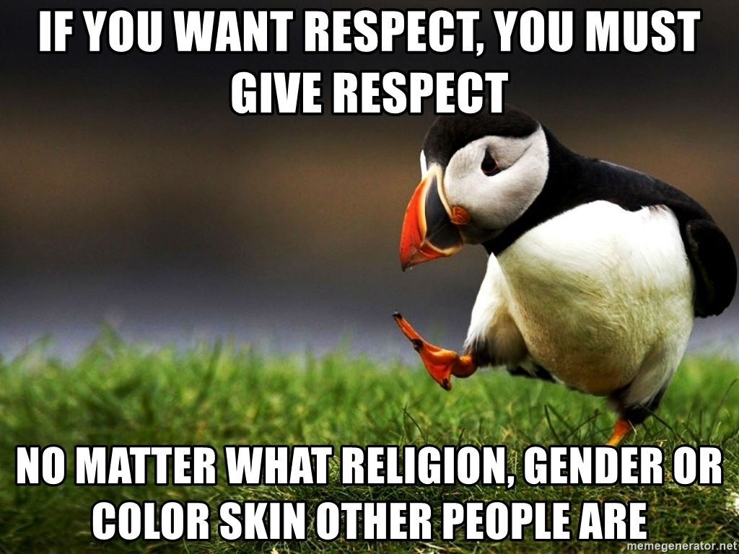

Slide 15
References
Kumra, S; Manfredi, S and Vickers, L. 2012 Managing Equality and Diversity. OUP. (Chapter 10)
Equality and Human Rights Commission (2016) Religion or belief: is the law working?

