Slide 1
BUSI1630 Cross-Cultural Management and Diversity Management
Lecture 18
Managing Gender Diversity in the Workplace

Slide 2
Key learning outcomes
the concept of gender equality and gender segregation at work
key concepts of gender equality such as pay gap, gender stereotyping and glass ceiling
various theories explaining gender segregation at work
approaches to achieve gender equality at work
contextual and organisational influences on approaches to gender equality

Slide 3
What is Gender Equality?
The equal rights, responsibilities and opportunities of women and men in employment (UN, 2013).
Notes:
Does not mean women and men will become the same but that rights, responsibilities and opportunities will not depend on whether they were born male or female.

Slide 4
What is Gender Equality cont…
The needs of men and women are taken into consideration.
Gender segregation in occupations relates to the different work that men and women do as a consequence of their patterns of socialisation, identifying tasks traditionally seen as ‘women’s work’ or ‘men’s work’.
The gender pay gap refers to the difference in earnings between men and women in the workplace (Kirton & Greene, 2005).

Slide 5
The Glass Ceiling
Invisible barrier to progression for women or other minority groups
Women fixed at lower levels in an organisation.
Can be a result of gender stereotypes which view one sex as less competent than another

Slide 6
Context
Research shows that women are represented in a minority of leadership roles despite female university graduates outnumbering male ones (Roussi, 2017)
33% of University Chancellors in Sweden, Finland and Norway were women in 2016, but in Belgium, Italy and the Czech Republic, it was less than 10 %. (Roussi, 2017)
There are persistent gender pay gaps for graduates, male graduates earn more in the UK(EHRC, 2015)
Women were more likely to be unemployed than men and less likely to be in senior positions (EHRC, 2015)
Women were more likely to be employed part-time. (EHRC, 2015)
79.5% of men (16 to 64) were working; the highest rate since March to May 1991 compared to 70.2% of women (16 to 64) working, the highest female employment rate since comparable records started in 1971 (ONS, 2017)

Slide 7
Something changed, but is it enough?

Slide 8
Trends
Source: The World’s Women Report, pg 90.
Notes:
ASK STUDENTS TO DISUCSS WHAT IS GOING ON IN THIS GRAPH.

Slide 9
Trends
Source: The World’s Women Report, pg 96

Slide 10
Trends
Source: The World’s Women Report, pg 100

Slide 11
Classical theories of gender segregation at workplace
Marxist theorists argue that women comprise a ‘reserve army of labour’ (Bruegal 1979).
Main thrust is to analyse the impact of capitalism on gender segregation of the workforce.
Capitalism is the main source of inequality.
Criticism:Marxist theory has also been criticised because of its supposed neglect of childcare.
Radical feminists argue that all kinds of oppression are derived from a system of patriarchal relations (Walby 1990).
Criticism: Colgan and Ledwith (1996) criticise the idea which implies that only males exercise patriarchy. According to Wilson (1995), patriarchy is dated and it refers to only one kind of male supremacy.

Slide 12
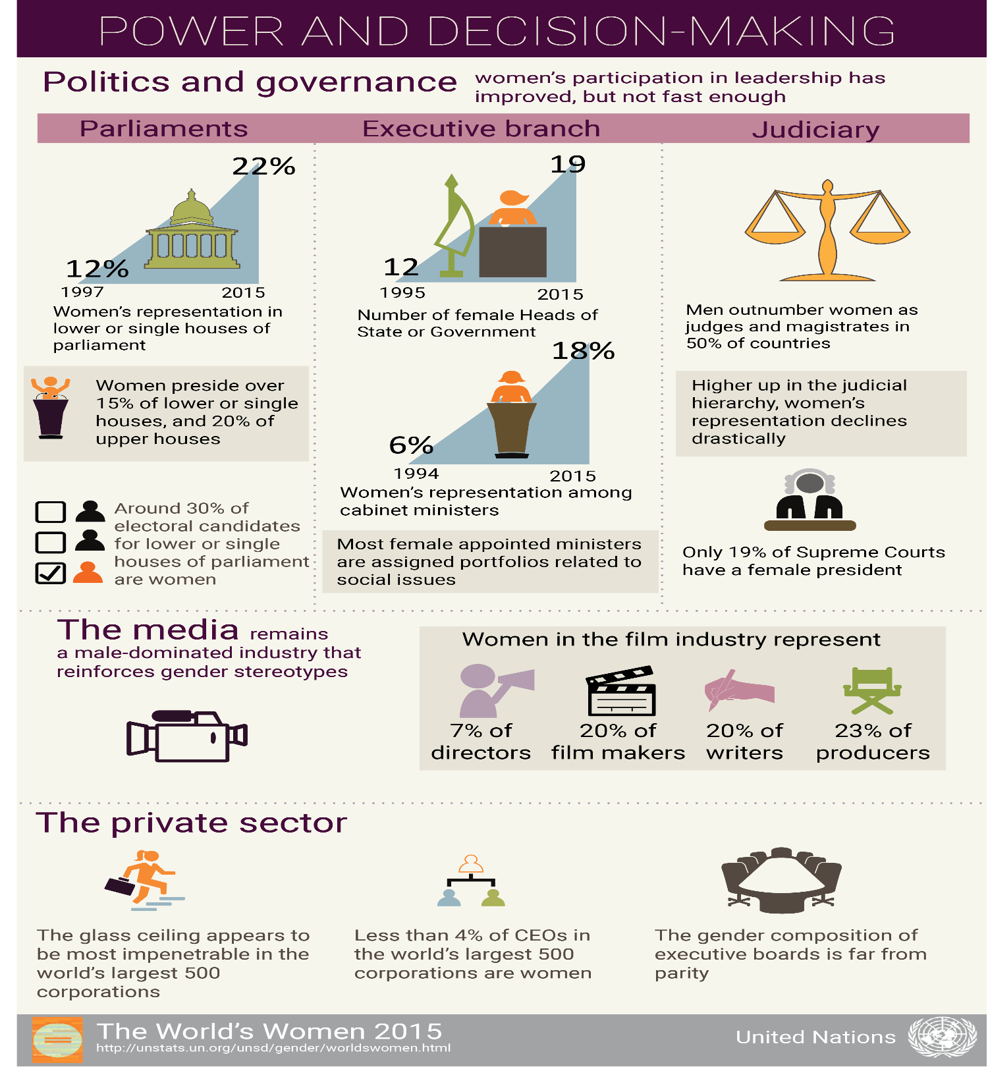

Slide 13
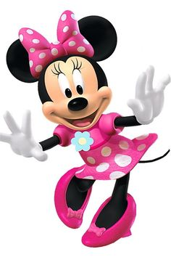
Lockwood (1986) says patriarchy is not applicable to modern societies.
Do you agree or disagree and why?
Diversity in the news (2018)
Minnie Mouse receives her star on the Hollywood walk of fame, after 90 years.
**Mickey received his star four decades ago.

Slide 14
Classical theories of gender segregation at workplace (contd.)
Dual System theory explains the dual role of capitalist system and patriarchy in producing and sustaining gender segregation in labour force.
Criticism: The main issue is whether it was able to maintain an analytic separation between capitalism and patriarchy
Feminist post-structuralism looks philosophically at the way in which women are treated in the world and attempts to break down barriers by identifying how societal influences have led to the status quo.
Criticism: It ignores the maintenance and reproduction of inequality and discrimination at workplaces experienced by most female workers.

Slide 15
Classical theories of gender segregation at workplace (contd.)
Human Capital Theory assumes that a worker’s education, training and natural capability determine the rewards they get from their job
Criticism: Opportunities in the labour market are not equal for males and female (Lonsdale 1985).

Slide 16
Approaches to promote gender equality at workplace
Liberal approaches
aims at achieving the removal of discriminatory policies and practices in employment.
Equal terms and conditions of treatment
Men and women equal in socio-economic positions
Employment practices should be the same for men and women.
Relates to the business case (see first week)

Slide 17
Radical approaches
challenges the existing organisational and social structures
Differentiates between dominant groups e.g. middle class, white, able-bodied men.
Based on ethical and moral principles
Allows affirmative action and positive discrimination
Seeks to eradicate barriers faced by both groups
This is achieved by:
Identifying contribution of men and women
Creating conditions for both kinds of contribution to be made and rewarded
Enabling both contributions to be combined for more powerful managerial procedures and organisational solutions. (Adler and Izraeli, 1988).
Notes:
Ask students what they think affirmative action and positive discrimination looks like.

Slide 18
New approach in the US: Bar employers from asking job applicants what they currently earn, so new salary offers are not based on the previous pay http://www.bbc.co.uk/news/business-42909987 (13 Feb. 2018)

Slide 19
Transformational approaches
aims at ‘combating day to day inequalities in organisational life’ & change the organisational structures and cultures to form a democratic organisation
Two pronged agenda: short term and long term.
Short term – combatting day to day inequalities in organisational life
Long term – change organisational structures and cultures
Not much room for the business case, moral and ethical reasons dominate.
Rarely been adopted in organisations.

Slide 20
Multilevel approaches
focuses on a relational framework that bridges the divide between macro-societal, meso-organisational and micro-individual levels
Relational view is necessary to capture individual choices, organisational processes and structural conditions.

Slide 21
Conclusion
For working women to achieve their full potential, the state and organisational policy makers need to recognise and address equal opportunity related issues facing women at multiple levels within and outside the workplace.
When policies informed by multi-level insights are put in place to fight structural and social barriers, more women will be encouraged to pursue formal employment.
State and organisations both need to play their role to achieve better equal opportunity outcomes in the workplace also taking into account internal heterogeneity of women based on their multiple forms of identity. Through increased awareness, cultural transformation and institutional monitoring at multiple levels, it will be possible to realise the lofty dream of equal opportunity in organisations.

Slide 22
References
Kumra, S; Manfredi, S and Vickers, L. 2012 Managing Equality and Diversity. OUP. (Chapter 6)
EHRC (2015) Is Britain Fairer? London: EHRC
ONS (2017) UK labour market: May 2017. Available online: https://www.ons.gov.uk/employmentandlabourmarket/peopleinwork/employmentandemployeetypes/bulletins/uklabourmarket/may2017. Accessed 5.6.17
Roussi, a (2017) Long way to go for gender equality. Available online: https://www.researchprofessional.com/0/rr/news/europe/other-nations/norway/2017/5/Long-way-to-go-for-gender-equality.html?utm_medium=email&utm_source=rpMailing&utm_campaign=personalNewsWeeklyUpdate_2017-05-26 Accessed 2.6.17

