Slide 1
BUSI1630 Cross-Cultural Management and Diversity Management
Lecture 13
Introduction: Equality and Diversity Issues in the Labour Market
Dr Kenisha Linton
HROB Department

Slide 2
Learning objectives
Understand the concept of equality and its meanings
Define disadvantage and discrimination
Explain patterns of disadvantage and discrimination relating to different social groups
Understand how survey statistics data can be used to monitor rates of labour market participation and employment patterns of different social groups and identify labour market inequalities
Define occupational segregation and understand different theories developed to explain this phenomenon
Explain the role of stakeholders like the European Union, the State and the Social Partners to promote equality and diversity in the labour market and in the workplace.

Slide 3
Diversity is generally conceptualised as a referring to differences between people based on attributes such as gender, age, race, ethnicity, class, sexual orientation, and educational background
(Williams & O’Reilly, 1998).

Slide 4
What is diversity?
Surface-level Diversity—diversity in observable categories (race, gender, etc.)
Deep-level Diversity—diversity in culture, ideas, perspective, or point of view

Slide 5
Equal or diverse?
These two terms reflect different concepts which have evolved as part of the equality discourse.
How the notion of diversity has helped to shape the idea of equality.
Rooted in the Enlightenment
“All men are created equal”
Substantive models of equality:
Equality as dignity
Equality and disadvantage
Equality and inclusion.
The fox and the stork

Slide 6
Understanding disadvantage and discrimination
Disadvantage encompasses those situations where people in some social groups, because of their characteristics, are not able to participate in paid work in the same way as other people (e.g. disability or being a carer).
Discrimination may be experienced by people belonging to a particular social group because of employers’ discriminatory decisions which cannot be objectively justified (e.g. age discrimination).
Notes:
.

Slide 7
Discrimination
Under the Equality Act 2010, it is unlawful to discriminate, harass or victimise someone because they have or are perceived to have a “protected characteristic” or are associated with someone who has a protected characteristic.

Slide 8
Do you think that airlines should stop pilots from flying after the age of 60?

Slide 9
Recent example
The European Court of Justice (ECJ) ruled that Deutsche Lufthansa were discriminatory on the grounds of age by stopping pilots from flying after the age of 60.
For employers to justify keeping a compulsory retirement age:
This has to be objectively justified as a proportionate means of achieving a legitimate aim
Even in professions where a high level of physical aptitude is vital and health and safety is the purported reason for keeping a retirement age, the employer will still needed to provide evidence of why individuals should not be allowed to work past a particular age
Notes:
Pilots do have to have a health check every 3/6 months as a matter of course so what would the justification be for retiring them early?

Slide 10
Multiple and intersectional discrimination
It has been advocated that anti-discrimination laws should take a more holistic approach in order to capture multiple dimensions of discrimination.
Multiple discrimination
Additive multiple discrimination
Intersectional discrimination

Slide 11
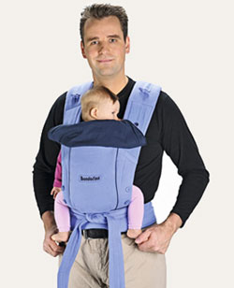
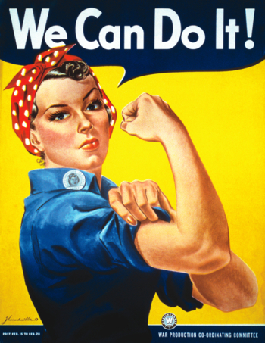
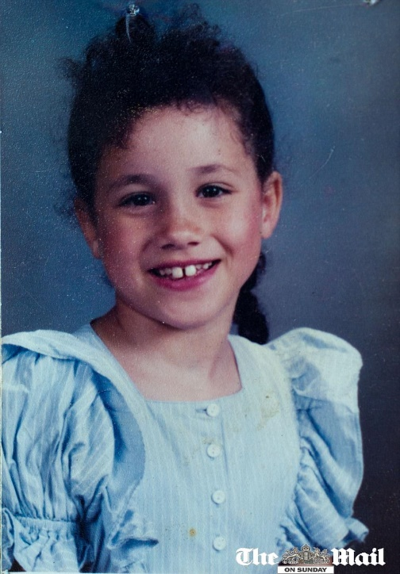
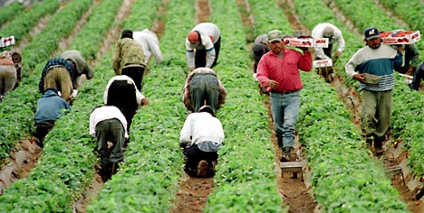
Changing patterns of disadvantage and discrimination
Patterns of disadvantage and discrimination vary not just between different social groups but also within the groups themselves.

Slide 12
Monitoring labour market participation trends
Average Full Time earnings of women are 82% of men’s
Gender segregation & concentration of women in Part Time employment
Disabled workers’ earnings are 80-90% of able-bodied workers’
Unemployment rate of disabled workers is 3 times that of the able-bodied
Average incomes of ethnic minority workers are 79% of white workers’
Unemployment rate of ethnic minorities is twice that of white workers

Slide 13
Why do these disparities exist?

Slide 14
Stereotyping
Associating certain characteristics with people based on type
Prejudice
Assuming that certain groups cannot do certain things. Now more likely to be subtle
Status characteristics
Prototype matching
Social roles
Social identity
Group composition
Social hierarchy. Perceived ‘high status’ (e.g. white, male, well educated) expected to take up leadership roles
Based on tradition, e.g. man as breadwinner
Managers have an ‘ideal prototype’ for a job when recruiting.
Preference for working with people who are the same as us
Majority groups in workplaces exist and values and preferences are likely to be dominant
(Graves and Powell, 2008)

Slide 15
Causes of labour market inequalities and occupational segregation
Labour-supply side
Neo-liberal theories, human capital theory.
Demand-side
Dual market theory, segmented labour market theory.

Slide 16
The role of stakeholders in promoting equality and diversity
European Union
Social partners
The state

Slide 17
Join us at the Department of HROB BUSINESS BREAKFAST
Tuesday 28th January 2020 from 8:30 - 12:00
Queen Anne 163 (Circulation Area)
Meet with your Personal Tutor
Enjoy a free breakfast
Catch up with your lecturers
Meet your dissertation supervisor
Meet with an employability advisor
Earn 20 Passport points (GEP)
This event is organised by the Department of HROB for Business Management and Human Resource Management students.

Slide 18
Further reading:
Kumra, S; Manfredi, S and Vickers, L. 2012 Managing Equality and Diversity. OUP. (Chapter 1)
Cassell, C. & Biswas, R. 2000. Managing Diversity in the New Millennium. Personnel Review, 29 (3), pp. 268-274.
Government Equalities Office, (2013) Equality Act 2010: The Public Sector Equality Duty: A Consultation. London: UK Gov.
Kandola, B. & Fullerton, J. 1994. Managing the Mosaic: Diversity in Action. London: IPD.
Kirton, G. & Greene, A. 2005. The Dynamics of Managing Diversity A Critical Approach. Oxford: Elsevier.
Ozbilgin, M and Tatli, A (2011) . Mapping out the field of equality and diversity: Rise of individualism and voluntarism. Human Relations 64, (9), pp. 1229-1253.

