Slide 1
Leadership

Slide 2
Theories of Leaadership
1. Great Man Theories
2. Trait Theories
3. Contingency Theories
4. Situational Theories
5. Behavioral Theories
6. Participative Theories
7. Transactional Theories
8. Relationship Theories

Slide 3
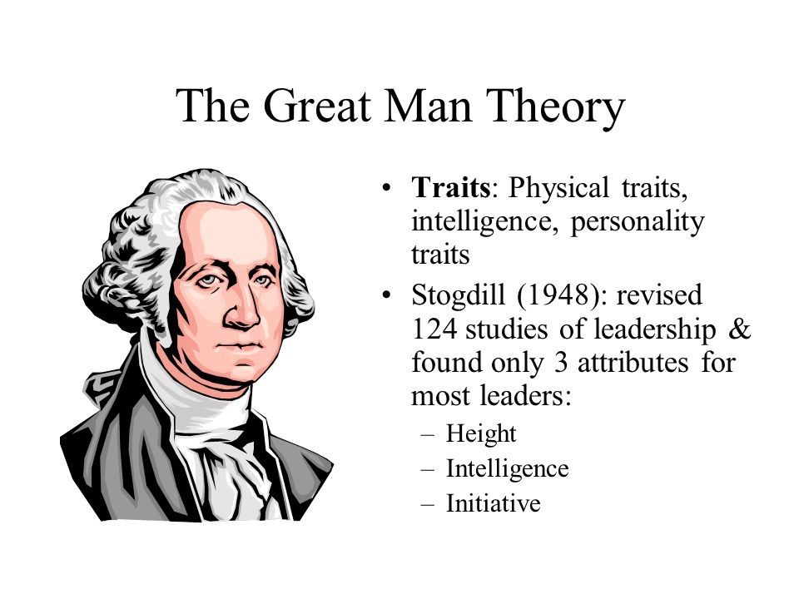

Slide 4
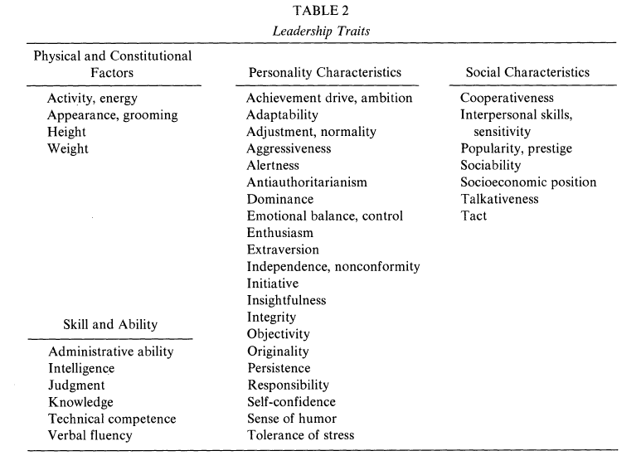

Slide 5
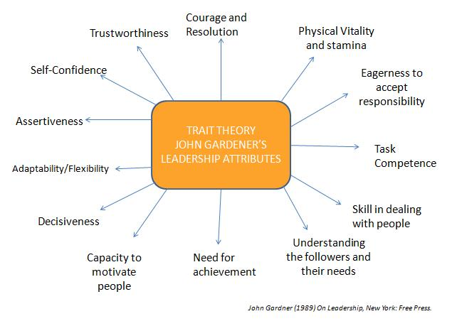

Slide 6
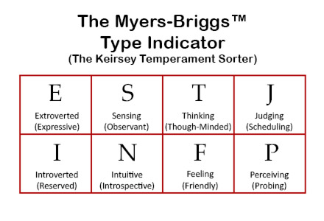

Slide 7
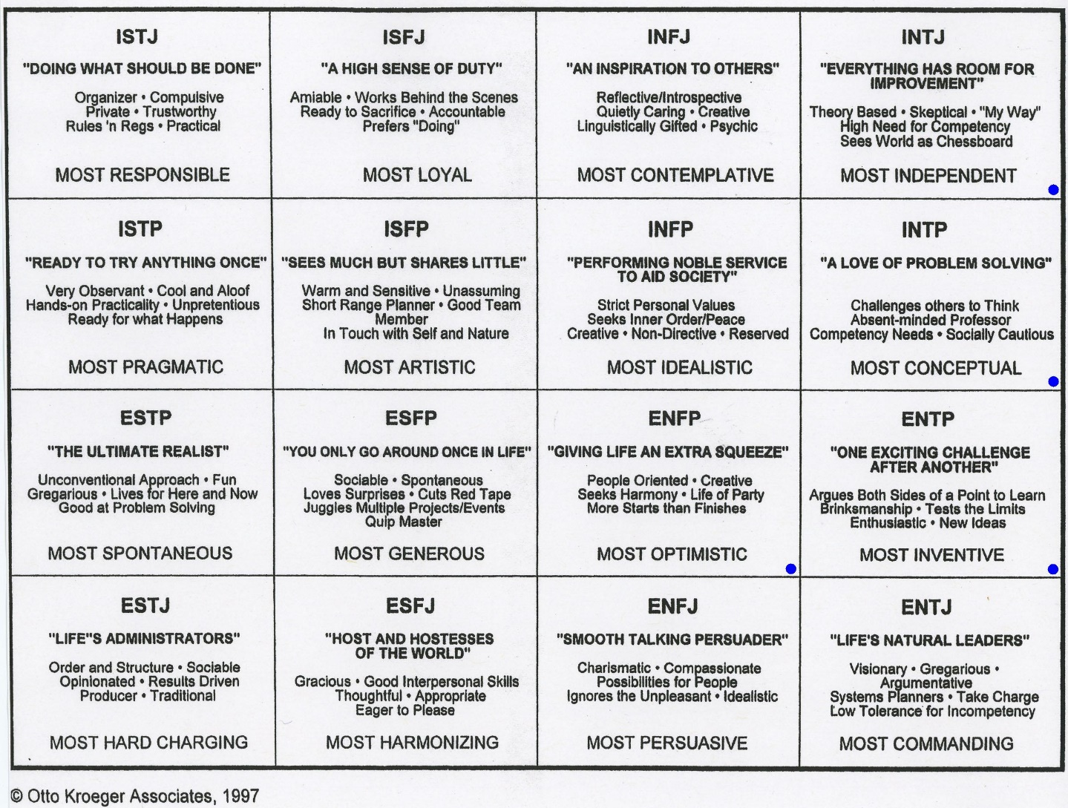

Slide 8
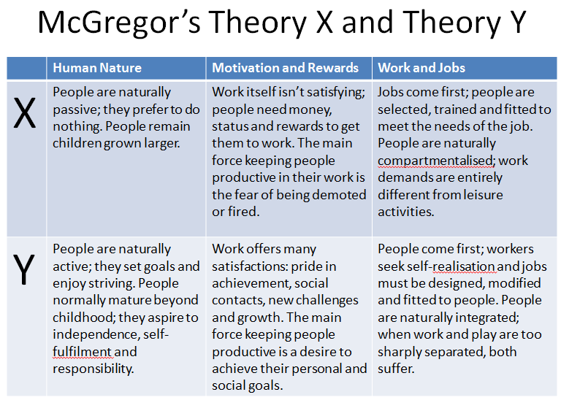

Slide 9
Authority
Charismatic
Traditional
Rational-Legal

Slide 10
Role Theory

Slide 11
Dramaturgical model
Front stage / Back stage

Slide 12
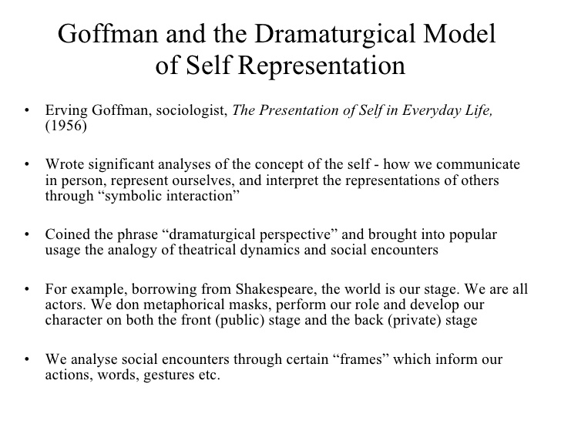

Slide 13
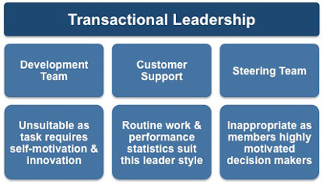

Slide 14
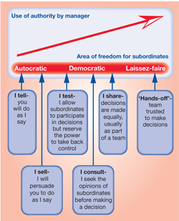

Slide 15
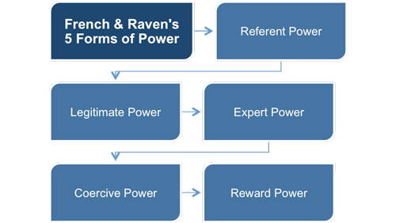

Slide 16
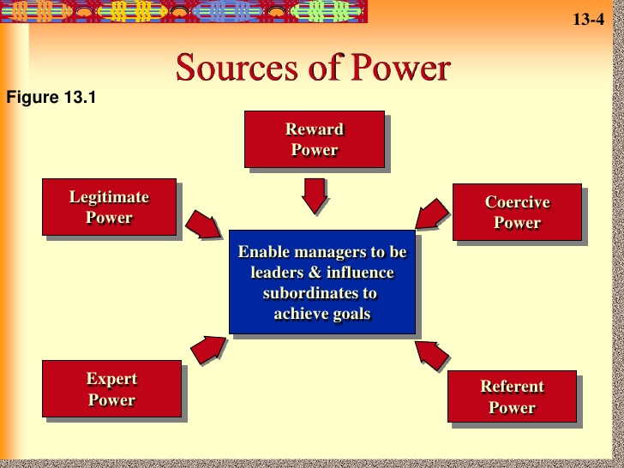

Slide 17
Transformational Leadership

Slide 18
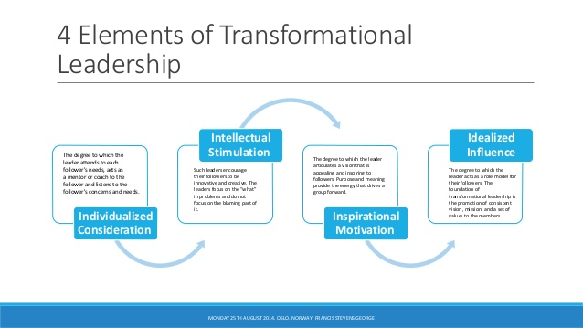

Slide 19
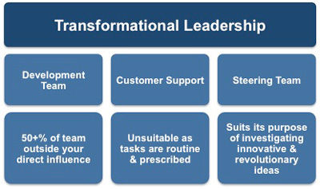

Slide 20
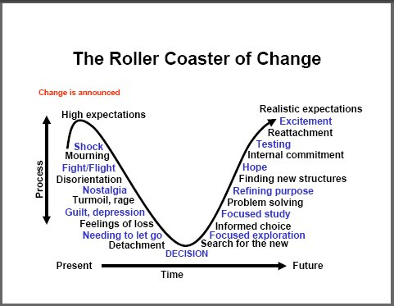

Slide 21
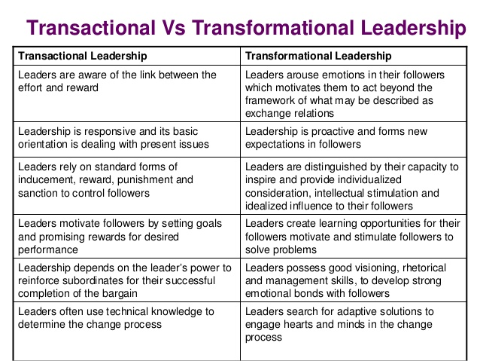

Slide 22
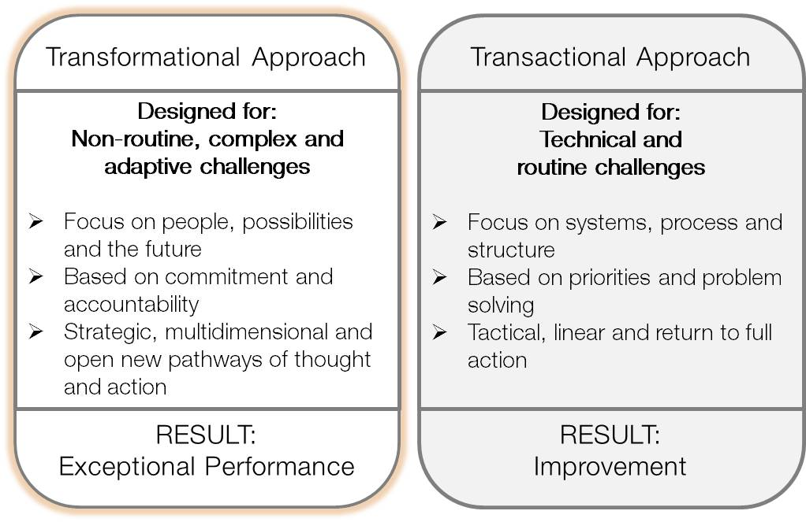

Slide 23
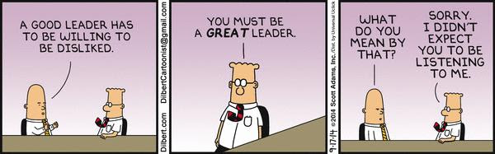

Slide 24
Cross-cultural leadership
Hofstede’s dimensions of culture
Power distance/ Individualism/ Uncertainty Avoidance/ Masculinity/ Long termism
The Globe studies

Slide 25


Slide 26
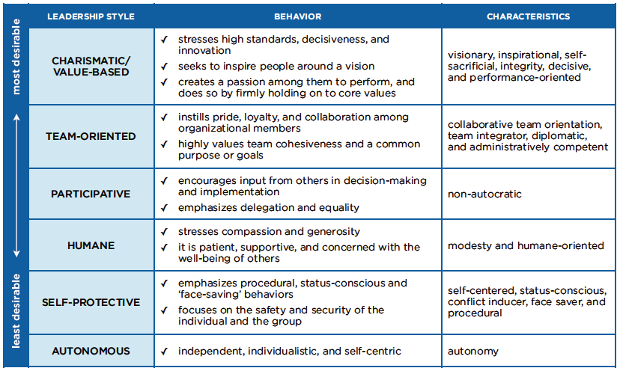

Slide 27
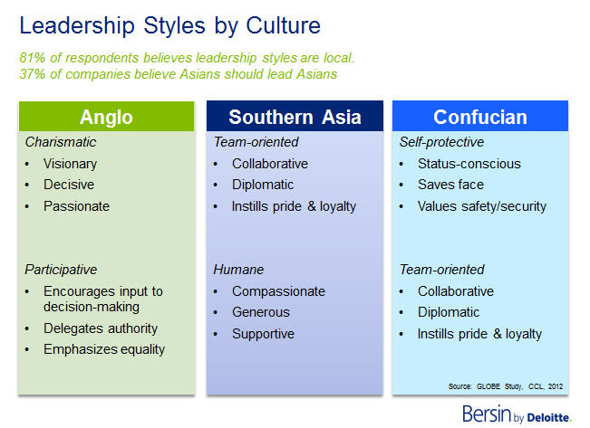

Slide 28

Japanese Leadership

Slide 29
3. Charismatic Leadership
A charismatic leadership style can resemble transformational leadership because these leaders inspire enthusiasm in their teams and are energetic in motivating others to move forward. This ability to create excitement and commitment is an enormous benefit.
The difference between charismatic leaders and transformational leaders lies in their intention. Transformational leaders want to transform their teams and organizations. Charismatic leaders are often focused on themselves, and may not want to change anything.
The downside to charismatic leaders is that they can believe more in themselves than in their teams. This can create the risk that a project or even an entire organization might collapse if the leader leaves. A charismatic leader might believe that she can do no wrong, even when others are warning her about the path she's on; and this feeling of invincibility can ruin a team or an organisation.
Also, in the followers' eyes, success is directly connected to the presence of the charismatic leader. As such, charismatic leadership carries great responsibility, and it needs a long-term commitment from the leader.

Slide 30
4. Democratic/Participative Leadership
Democratic leaders make the final decisions, but they include team members in the decision-making process. They encourage creativity, and team members are often highly engaged in projects and decisions.
There are many benefits of democratic leadership. Team members tend to have high job satisfaction and are productive because they're more involved in decisions. This style also helps develop people's skills. Team members feel in control of their destiny, so they're motivated to work hard by more than just a financial reward.
Because participation takes time, this approach can slow decision-making, but the result is often good. The approach can be most suitable when working as a team is essential, and when quality is more important than efficiency or productivity.
The downside of democratic leadership is that it can often hinder situations where speed or efficiency is essential. For instance, during a crisis, a team can waste valuable time gathering people's input. Another downside is that some team members might not have the knowledge or expertise to provide high quality input.

Slide 31
5. Laissez-Faire Leadership
This French phrase means "leave it be," and it describes leaders who allow their people to work on their own. This type of leadership can also occur naturally, when managers don't have sufficient control over their work and their people.
Laissez-faire leaders may give their teams complete freedom to do their work and set their own deadlines. They provide team support with resources and advice, if needed, but otherwise don't get involved.
This leadership style can be effective if the leader monitors performance and gives feedback to team members regularly. It is most likely to be effective when individual team members are experienced, skilled, self-starters.
The main benefit of laissez-faire leadership is that giving team members so much autonomy can lead to high job satisfaction and increased productivity.
The downside is that it can be damaging if team members don't manage their time well or if they don't have the knowledge, skills, or motivation to do their work effectively.

Slide 32
6. People-Oriented/Relations-Oriented Leadership
With people-oriented leadership, leaders are totally focused on organizing, supporting, and developing the people on their teams. This is a participatory style and tends to encourage good teamwork and creative collaboration. This is the opposite of task-oriented leadership.
People-oriented leaders treat everyone on the team equally. They're friendly and approachable, they pay attention to the welfare of everyone in the group, and they make themselves available whenever team members need help or advice.
The benefit of this leadership style is that people-oriented leaders create teams that everyone wants to be part of. Team members are often more productive and willing to take risks, because they know that the leader will provide support if they need it.
The downside is that some leaders can take this approach too far; they may put the development of their team above tasks or project directives.

Slide 33
7. Servant Leadership
This term, created by Robert Greenleaf in the 1970s, describes a leader often not formally recognized as such. When someone at any level within an organization leads simply by meeting the needs of the team, he or she can be described as a "servant leader."
Servant leaders often lead by example. They have high integrity and lead with generosity. In many ways, servant leadership is a form of democratic leadership because the whole team tends to be involved in decision making. However, servant leaders often "lead from behind," preferring to stay out of the limelight and letting their team accept recognition for their hard work.
Supporters of the servant leadership model suggest that it's a good way to move ahead in a world where values are increasingly important, and where servant leaders can achieve power because of their values, ideals, and ethics. This is an approach that can help to create a positive corporate culture and can lead to high morale among team members.
However, other people believe that in competitive leadership situations, people who practice servant leadership can find themselves left behind by leaders using other leadership styles. This leadership style also takes time to apply correctly: it's ill-suited in situations where you have to make quick decisions or meet tight deadlines.
Although you can use servant leadership in many situations, it's often most practical in politics, or in positions where leaders are elected to serve a team, committee, organisation, or community.

Slide 34
8. Task-Oriented Leadership
Task-oriented leaders focus only on getting the job done and can be autocratic. They actively define the work and the roles required, put structures in place, and plan, organize, and monitor work. These leaders also perform other key tasks, such as creating and maintaining standards for performance.
The benefit of task-oriented leadership is that it ensures that deadlines are met, and it's especially useful for team members who don't manage their time well.
However, because task-oriented leaders don't tend to think much about their team's well-being, this approach can suffer many of the flaws of autocratic leadership, including causing motivation and retention problems.

Slide 35
9. Transactional Leadership
This leadership style starts with the idea that team members agree to obey their leader when they accept a job. The "transaction" usually involves the organization paying team members in return for their effort and compliance. The leader has a right to "punish" team members if their work doesn't meet an appropriate standard.
Although this might sound controlling and paternalistic, transactional leadership offers some benefits. For one, this leadership style clarifies everyone's roles and responsibilities. Another benefit is that, because transactional leadership judges team members on performance, people who are ambitious or who are motivated by external rewards – including compensation – often thrive.
The downside of this leadership style is that team members can do little to improve their job satisfaction. It can feel stifling, and it can lead to high staff turnover.
Transactional leadership is really a type of management, not a true leadership style, because the focus is on short-term tasks. It has serious limitations for knowledge-based or creative work. However, it can be effective in other situations.

Slide 36
10. Transformational Leadership
Transformation leadership is often the best leadership style to use in business situations.
Transformational leaders are inspiring because they expect the best from everyone on their team as well as themselves. This leads to high productivity and engagement from everyone in their team.
The downside of transformational leadership is that while the leader's enthusiasm is passed onto the team, he or she can need to be supported by "detail people."
That's why, in many organisations, both transactional and transformational leadership styles are useful. Transactional leaders (or managers) ensure that routine work is done reliably, while transformational leaders look after initiatives that add new value.
It's also important to use other leadership styles when necessary – this will depend on the people you're leading and the situation that you're in.

Slide 37
Leadership and Performance
Goffman – Presentation of self in everyday life
Backstage/ Frontstage
Myers-Briggs Personality Test and Dimensions
The Big 5
IQ/ EQ

Slide 38
Leadership –
Changing Minds and Habits
Relationship between leadership and change.
Organizations and psychic prisons. Leader’s role in getting people out from this.

Slide 39
Major modern theories of leadership
Transactional leadership/ LMX theory/
Transformational leadership
Bass & Avolio
Charisma – Trust-Communication-Change Cycle
Transforms the organization
Transforms followers

Slide 40
Leadership and Motivation
Various theories of motivation
Hawthorne Studies - physical factors and social factors
Valence etc.

Slide 41
Politics, networks and leadership
Ferris’ work on politics etc.
Arab world - “wasta” Chinese guan xi
Importance of family in politics – Bush, Brenninkmeijers, Vietnamese business
Petty corruption/ Grand corruption
Effective corrupt leadership
Thaksin/ Berlusconi/ Hariri – “tycoonocracy”

Slide 42
Politics and Politicking
Front stage/ Back Stage
Spotting the political naive
Drinking Coffee
Entertaining
Ingratiating with the powerful
Ingratiating with the soon to be powerful
“Friend of Bill”
Influencing Others
Bill Clinton’s tears.

Slide 43
Humor and agreeableness
Blair’s jokes. Sergey Brin’s “boxers”
Speechmaking – thinking on your feet.
Being the centre of attention

Slide 44
The big Indian speech.
In other culture’s - less is more

Slide 45
The trappings of leadership
The leader’s walk. Look at videos of leaders walking, and interacting.
The leader’s way of talking
The office/ The car etc.

Slide 46
Leaders and Followers
Followership
Japanese Karaoke
Duty - Formal
Loyalty – Informal
Combination of duty and loyalty can be very powerful
Organizational Citizenship
Servant leadership

Slide 47
Confidence & Vision
Difference between a Vision and a Plan.
Standing for something.
What do you stand for?

Slide 48
Leadership and Seniority
Age is an important factor in leadership in many cultures
Increasing age is related to increased power and authority
Is seniority (age) an important factor in VN?

Slide 49
Collective Leadership
The Arab Spring

Slide 50
Leadership and Power
Social capital – networks
Tricks to enhance power over colleagues
Leaders as agents of capital

Slide 51
Reputation
The importance of reputation – Brother Mullen
Reputation management
Threats to reputation
Parties
Leaders as brands
IMF leaders

Slide 52
Ethics of leadership
Consideration for others
Propriety
Sustainability and leadership
Toxic leadership/ Bad leadership
Sexual harassment

Slide 53
Most leadership is bad – or not so good.

Slide 54
Leadership and Control
Does a leader need to control?
Leader – followers – trust cycle
The importance of trust

Slide 55
Succession planning
Particular importance in family firms – brothers etc.
How do we develop leaders?

Slide 56
Assuming leadership
Ghost of former leaders
“The Good Old Days”
Margaret Thatcher – John Major
Tony Blair – Gordon Brown
Professor West

Slide 57
Women and leadership
Networks
Presentation of self etc
Thatcher
Using sexuality as a positive
Film about sex harassment

Slide 58
Critical approaches
Are leaders in the interest of workers?
Should leaders be resisted?
How can everybody be a leader?
Is leadership just a buzz word?

Slide 59
The future of leadership
Is the nature of leadership changing?
Are the circumstances of leadership changing? e.g. increased scrutiny/ transparency etc.
Is the Mark Zuckerberg a leader?
Entrepreneurial leadership
Team leadership
R&D leadership
Marketing leadership
Political leadership
Military leadership

Slide 60
Cement industry leadership

Slide 61
Cases
NASA ground staff
Bob Geldof
Steve Jobs
Mark Zuckerberg
Harold Geneen

Slide 62
How do we get rid of leaders we do not want?

Slide 63
Common mistakes of leaders
Surrounding yourself with “yes men”
Getting lost in the details
Micromanaging
Feuding
Becoming prima donnas – believing their own myth
Becoming more concerned about their legacy than their followers
Abusing power
Becoming corrupt
Becoming too greedy

Slide 66
Blake and Mouton

Slide 67
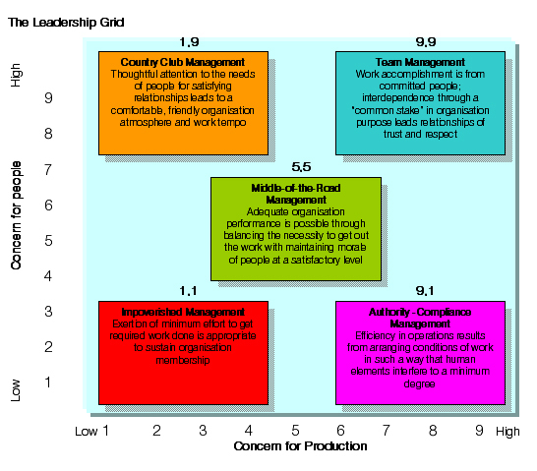

Slide 68
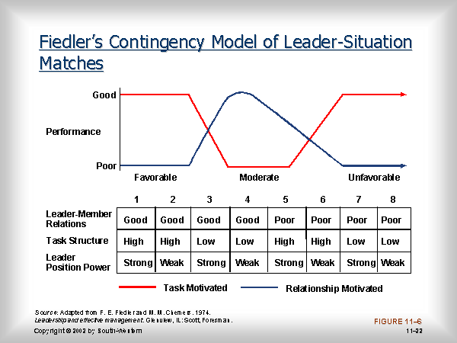

Slide 69
University of Michigan (1950s)
The study showed that task and relationship-oriented behaviours weren't of major significance within the world of organizational psychology.
However it was the third observation that introduced a new concept, one of participative leadership.

