Slide 1
Ethos, Pathos, or Logos?
What appeal are advertisers using to get you to buy their product?

Slide 2
Objective:
As you view each advertisement that comes up on the screen, decide if it’s appealing to your sense of ethos, pathos, or logos.
Write/log your answers on the document handed out to you as the slide show continues.

Slide 3
ETHOS, PATHOS, and LOGOS
AS YOU ANALYZE THE ADVERTISMENTS:
Ethos: Is it Ethical?
Pathos: Does it make you feel a strong emotion?
Logos: Does it make you use your sense of reason?

Slide 4
Ethos
Ethos: Character
To make the audience perceive the character of the ad.
Political issues, national beliefs, religious issues, etc…
Sometimes has contrasting colors symbolizing the difference between good and evil.

Slide 5
Pathos
Pathos: Emotion
To make the audience feel something about what is presented to it
Children, animals, illness, memories, etc…
“Tugs at your heart strings”

Slide 6
Logos
Logos: Logic
To make the audience think about what is presented to it
Statistics, facts, authorities, etc…
Very straightforward, and not “fluff”. It has a very scientific, factual approach.

Slide 7
Can some advertisements have more than one appeal?
Yes! The more appeals used in an ad the more likely the consumer is to connect with it.
For the case of this lesson or power point, pick the MOST emphasized appeal used in each ad to write onto your sheet.

Slide 8
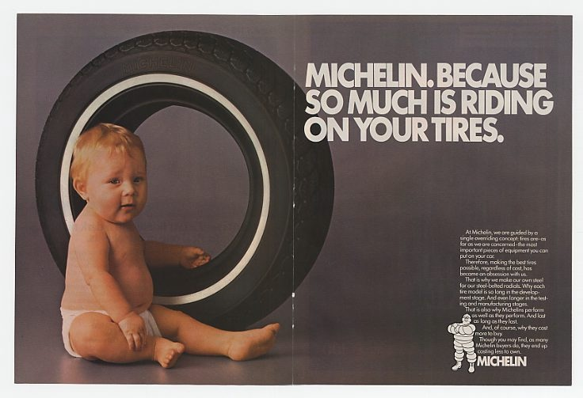
Ethos, Pathos, or Logos?

Slide 11
Ethos, Pathos, or Logos?

Slide 13
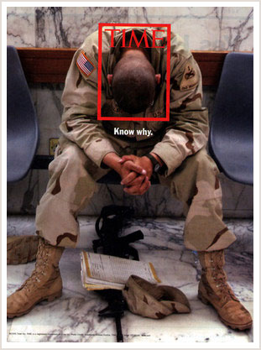

Slide 14
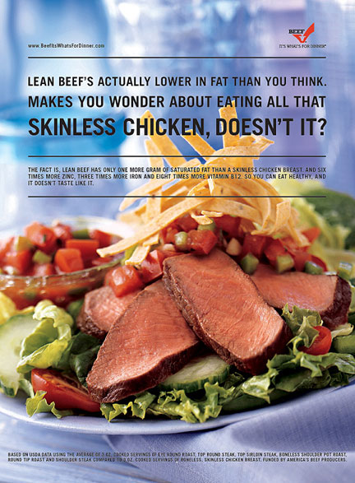
Ethos, Pathos, or Logos?

Slide 15
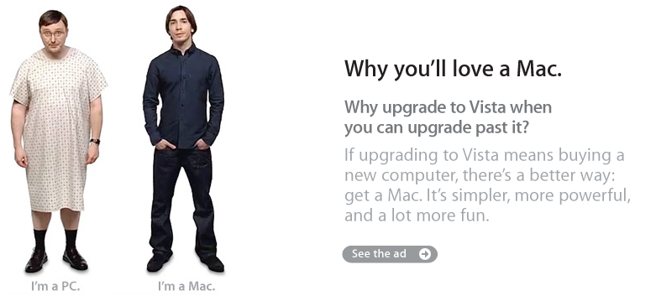
Ethos, Pathos, or Logos?

Slide 16
Ethos, Pathos, or Logos?

Slide 17
Ethos, Pathos, or Logos?

Slide 18
Ethos, Pathos, or Logos?

Slide 19
Ethos, Pathos, Logos?

Slide 20
Ethos, Pathos, or Logos?

Slide 21
FOR EXAMPLE: Ad Analysis
#1: Michelin Tires
Little Baby
Don’t skimp on the important stuff, we need good tires our families depend on it.
Pathos (little babies are cute and we want them to live)

