Slide 1
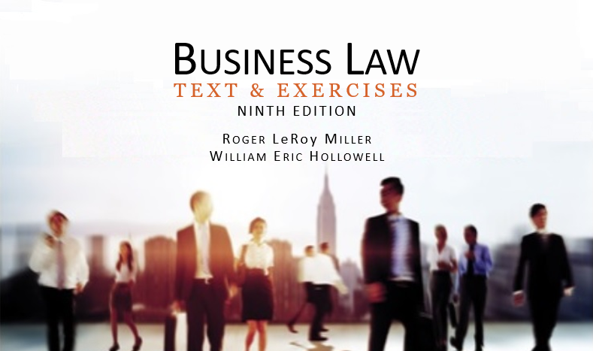
Business Law Text & Exercises Ninth Edition Roger LeRoy Miller William Eric Hollowell
Chapter 35 Insurance

Slide 2
Learning Outcomes (1)
LO1 Define important insurance terms.
LO2 State when insurance coverage begins.
LO3 Explain how courts interpret insurance provisions.

Slide 3
Learning Outcomes (2)
LO4 Identify defenses an insurance company may have against payment on a policy.

Slide 4
LO1 Insurance Terminology and Concepts (1)
LO1
Insurance.
Contract by which the insurer (insurance company) promises to pay something of value (usually money) to its insured in the event of the insured’s injury as a result of “covered” incidents.

Slide 5
LO1 Insurance Terminology and Concepts (2)
LO1
Policy (insurance contract).
Premium is the consideration to be paid to the insurer.
Underwriter (usually an insurance company).
Broker v. agent.

Slide 6
LO1 Insurance Terminology and Concepts (3)
LO1
Risk Management and Risk Pooling.
Insurance is essentially a contractual arrangement for transferring and allocating risk.
Risk: Prediction concerning potential loss based on known and unknown factors.

Slide 7
LO1 Insurance Terminology and Concepts (4)
LO1
Risk Management and Risk Pooling.
Risk Pooling: spread the risk among a large number of people to make the premiums small, compared to the coverage.

Slide 8
LO1 Insurance Terminology and Concepts (5)
LO1
Classifications of Insurance.
Classified according to the risk involved.
Fire, casualty, life, and title insurance have different risks, some foreseeable, some not foreseeable.

Slide 9
LO1 Insurance Terminology and Concepts (6)
LO1
Insurable Interest.
A person can insure anything in which he or she has an insurable interest.
Types of insurable interest:
Property.
Life.

Slide 10
The Insurance Contract (1)
Governed by the general principles of contract law, and regulated by the state.

Slide 11
The Insurance Contract (2)
Application.
Is an offer, which the insurance company can either reject or accept. And acceptance can sometimes be conditional.
Need consideration.
Parties need capacity.

Slide 12
The Insurance Contract (3)
Effective Date.
Coverage can begin when:
Binder is written,
Policy is issued,
Contract is formed, or
Condition specified in contract is met.
LO2

Slide 13
The Insurance Contract (4)
Effective Date.
Binder.
Broker is agent for applicant.
Insured who seeks insurance will usually be protected from time of filing the application, provided a premium has been paid. Binder indicates a pending policy.
LO2

Slide 14
The Insurance Contract (5)
Effective Date.
Binder.
If parties agree, contract is not effective until policy is issued and delivered to insured.
Life insurance.
Parties may agree that life insurance policy is binding at the time of first premium payment.
LO2

Slide 15
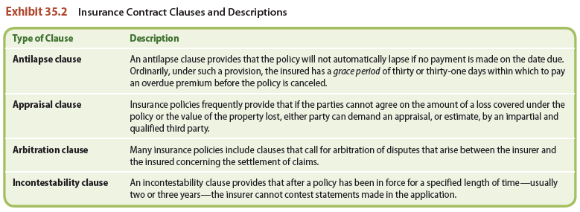
LO3 The Insurance Contract: Provisions and Clauses
LO3

Slide 16
The Insurance Contract (6)
Cancellation.
Insured can cancel policy at any time, and the insurer can cancel according to terms of policy.
Insurer must give written notice of cancellation.

Slide 17
The Insurance Contract (7)
Defenses against Payment.
Insurance company can raise any of the defenses that would be valid in any ordinary action or contract:
Fraud or Misrepresentation.
Lack of an Insurable Interest.
Illegal Actions.
LO4

Slide 18
The Insurance Contract (8)
Defenses against Payment.
When Defenses Are Not Available.
Incontestability clause.
The Need to Avoid Bad Faith.

