Slide 1
Location Planning and Analysis
© McGraw-Hill Education. All rights reserved. Authorized only for instructor use in the classroom. No reproduction or further distribution permitted without the prior written consent of McGraw-Hill Education.

Slide 2
Learning Objectives
You should be able to:
8.1 Identify some of the main reasons organizations need to make location decisions
8.2 Explain why location decisions are important
8.3 Discuss the options that are available for location decisions
8.4 Give examples of the major factors that affect location decisions
8.5 Outline the decision process for making these kinds of decisions
8.6 Use the techniques presented to solve typical problems

Slide 3
The Need for Location Decisions
Location decisions arise for a variety of reasons:
Addition of new facilities
As part of a marketing strategy to expand markets
Growth in demand that cannot be satisfied by expanding existing facilities
Depletion of basic inputs requires relocation
Shift in markets
Cost of doing business at a particular location makes relocation attractive
Learning Objective 8.1

Slide 4
Location Decisions: Strategically Important
Location decisions:
Are closely tied to an organization’s strategies
Low-cost
Convenience to attract market share
Effect capacity and flexibility
Represent a long-term commitment of resources
Effect investment requirements, operating costs, revenues, and operations
Impact competitive advantage
Importance to supply chains
Learning Objective 8.2

Slide 5
Location Decisions: Objectives
Location decisions are based on:
Profit potential or cost and customer service
Finding a number of acceptable locations from which to choose
Position in the supply chain
End: accessibility, consumer demographics, traffic patterns, and local customs are important
Middle: locate near suppliers or markets
Beginning: locate near the source of raw materials
Web-based retail organizations are effectively location independent

Slide 6
Supply Chain Considerations
Supply chain management must address supply chain configuration:
Number and location of suppliers, production facilities, warehouses and distribution centers
Centralized vs. decentralized distribution
The importance of such decisions is underscored by their reflection of the basic strategy for accessing customer markets

Slide 7
Location: Options
Existing companies generally have four options available in location planning:
Expand an existing facility
Add new locations while retaining existing facilities
Shut down one location and move to another
Do nothing
Learning Objective 8.3

Slide 8
Global Location: Facilitating Factors
Two key factors have contributed to the attractiveness of globalization:
Trade agreements such as
North American Free Trade Agreement (NAFTA)
General Agreement on Tariffs and Trade (GATT)
U.S.-China Trade Relations Act
EU and WTO efforts to facilitate trade
Technology
Advances in communication and information technology
Learning Objective 8.3

Slide 9
Global Location: Benefits
A wide range of benefits have accrued to organizations that have globalized operations:
Markets
Cost savings
Legal and regulatory
Financial
Other
Learning objective 8.4

Slide 10
Global Location: Disadvantages
There are a number of disadvantages that may arise when locating globally:
Transportation costs
Security costs
Unskilled labor
Import restrictions
Criticism for locating out-of-country
Learning objective 8.4

Slide 11
Global Location: Risks
Organizations locating globally should be aware of potential risk factors related to:
Political instability and unrest
Terrorism
Economic instability
Legal regulation
Ethical considerations
Cultural differences
Learning Objective 8.4

Slide 12
Managing Global Operations
Managerial implications for global operations:
Language and cultural differences
Risk of miscommunication
Development of trust
Different management styles
Corruption and bribery
Increased travel (and related) costs
Challenges associated with managing far-flung operations
Level of technology and resistance to technological change
Domestic personnel may resist locating, even temporarily
Learning Objective 8.4

Slide 13
Location Decision: General Procedure (1 of 2)
Steps:
Decide on the criteria to use for evaluating location alternatives
Identify important factors, such as location of markets or raw materials
Learning Objective 8.5

Slide 14
Location Decision: General Procedure (2 of 2)
3. Develop location alternatives
Identify the country or countries for location
Identify the general region for location
Identify a small number of community alternatives
Identify the site alternatives among the community alternatives
4. Evaluate the alternatives and make a decision
Learning Objective 8.5

Slide 15
Location: Identifying a Country (1 of 2)
Factors Relating to Foreign Locations | Factors Relating to Foreign Locations
Government | Policies on foreign ownership of production facilities Local content requirements Import restrictions Currency restrictions Environment regulations Local product standards Liability laws Stability issues
Cultural differences | Living circumstances for foreign workers and their dependents Ways of doing business Religious holidays/traditions
Customer preferences | Possible “buy locally” sentiment
Learning Objective 8.5

Slide 16
Location: Identifying a Country (2 of 2)
Factors Relating to Foreign Locations | Factors Relating to Foreign Locations
Labor | Level of training and education of workers Work ethic Wage rates Possible regulations limiting the number of foreign employees Language differences
Resources | Availability and quality of raw materials, energy, transportation infrastructure
Financial | Financial incentives, tax rates, inflation rates, interest rates
Technological | Rate of technological change, rate of innovations
Market | Market potential, competition
Safety | Crime, terrorism threat
Learning Objective 8.5

Slide 17
Location: Identifying a Region (1 of 2)
Primary regional factors:
Location of raw materials
Necessity
Perishability
Transportation costs
Location of markets
As part of a profit-oriented company’s competitive strategy
So not-for-profits can meet the needs of their service users
Distribution costs and perishability
Learning Objective 8.5

Slide 18
Location: Identifying a Region (2 of 2)
Labor factors
Cost of labor
Availability of suitably skilled workers
Wage rates in the area
Labor productivity
Attitudes toward work
Whether unions pose a serious potential problem
Other factors
Climate and taxes may play an important role in location decisions
Learning Objective 8.5

Slide 19
Location: Identifying a Community
Many communities actively attempt to attract new businesses they perceive to be a good fit for the community
Businesses also actively seek attractive communities based on such factors such as:
Quality of life
Services
Attitudes
Taxes
Environmental regulations
Utilities
Development support
Learning Objective 8.5

Slide 20
Location: Identifying a Site
Primary site location considerations are
Land
Transportation
Zoning
Other restrictions
Learning Objective 8.5

Slide 21
Multiple Plant Manufacturing Strategies (1 of 2)
Organizing operations
Product plant strategy
Entire products or product lines are produced in separate plants, and each plant usually supplies the entire domestic market
Market area plant strategy
Plants are designated to serve a particular geographic segment of the market
Plants produce most, if not all, of a company’s products
Learning Objective 8.5

Slide 22
Multiple Plant Manufacturing Strategies (2 of 2)
Organizing operations
Process plant strategy
Different plants focus on different aspects of a process
Automobile manufacturers – engine plant, body stamping plant, etc.
Coordination across the system becomes a significant issue
General-purpose plant strategy
Plants are flexible and capable of handling a range of products
Learning Objective 8.5

Slide 23
Geographic Information System (GIS)
GIS
A computer-based tool for collecting, storing, retrieving, and displaying demographic data on maps
Aids decision makers in
Targeting market segments
Identifying locations relative to their market potential
Planning distribution networks
Portraying relevant information on a map makes it easier for decision makers to understand
Learning Objective 8.5

Slide 24
Service and Retail Locations (1 of 2)
Considerations:
Nearness to raw materials is not usually a consideration
Customer access is a
Prime consideration for some: restaurants, hotels, etc.
Not an important consideration for others: service call centers, etc.
Learning Objective 8.5

Slide 25
Service and Retail Locations (2 of 2)
Tend to be profit or revenue driven, and so are
Concerned with demographics, competition, traffic volume patterns, and convenience
Clustering
Similar types of businesses locate near one another
Learning Objective 8.5

Slide 26
Evaluating Location Alternatives
Common techniques:
Locational cost-volume-profit analysis
Factor rating
Transportation model
Center of gravity method
Learning Objective 8.6

Slide 27
Locational Cost-Profit-Volume Analysis (1 of 3)
Locational cost-profit-volume analysis
Technique for evaluating location choices in economic terms
Steps:
Determine the fixed and variable costs for each alternative
Plot the total-cost lines for all alternatives on the same graph
Determine the location that will have the lowest total cost (or highest profit) for the expected level of output
Learning Objective 8.6

Slide 28
Locational Cost-Profit-Volume Analysis (2 of 3)
Assumptions
Fixed costs are constant for the range of probable output
Variable costs are linear for the range of probable output
The required level of output can be closely estimated
Only one product is involved
Learning Objective 8.6

Slide 29
Locational Cost-Profit-Volume Analysis (3 of 3)
For a cost analysis, compute the total cost for each alternative location:
Learning Objective 8.6

Slide 30
Example: Cost-Profit-Volume Analysis (1 of 3)
Fixed and variable costs for four potential plant locations are shown below:
Location | Fixed Cost per Year | Variable Cost per Unit
A | $250,000 | $11
B | $100,000 | $30
C | $150,000 | $20
D | $200,000 | $35
Learning Objective 8.6

Slide 31
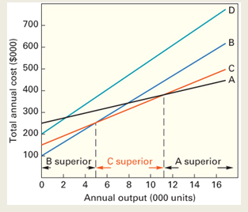
Example: Cost-Profit-Volume Analysis (2 of 3)
Plot of Location Total Costs
Learning Objective 8.6

Slide 32
Example: Cost-Profit-Volume Analysis (3 of 3)
Range approximations
B Superior (up to 4,999 units)
C Superior (>5,000 to 11,111 units)
A superior (11,112 units and up)
Learning Objective 8.6

Slide 33
Factor Rating (1 of 2)
Factor rating
General approach to evaluating locations that includes quantitative and qualitative inputs
Procedure:
Determine which factors are relevant
Assign a weight to each factor that indicates its relative importance compared with all other factors
Weights typically sum to 1.00
Learning Objective 8.6

Slide 34
Factor Rating (2 of 2)
Decide on a common scale for all factors, and set a minimum acceptable score if necessary
Score each location alternative
Multiply the factor weight by the score for each factor, and sum the results for each location alternative
Choose the alternative that has the highest composite score, unless it fails to meet the minimum acceptable score
Learning Objective 8.6

Slide 35
Example: Factor Rating (1 of 2)
A photo-processing company intends to open a new branch store. The following table contains information on two potential locations. Which is better?
Factor | Weight | Scores (Out of 100): Alt 1 | Scores (Out of 100): Alt 2
Proximity to existing source | .10 | 100 | 60
Traffic volume | .05 | 80 | 80
Rental costs | .40 | 70 | 90
Size | .10 | 86 | 92
Layout | .20 | 40 | 70
Operating Cost | .15 | 80 | 90
 | 1.00
Learning Objective 8.6

Slide 36
Example: Factor Rating (2 of 2)
A photo-processing company intends to open a new branch store. The following table contains information on two potential locations. Which is better?
Factor | Weight | Scores (Out of 100): Alt 1 | Scores (Out of 100): Alt 2 | Weighted Scores: Alt 1 | Weighted Scores: Alt 2
Proximity to existing source | .10 | 100 | 60 | .10(100) = 10.0 | .10(60) = 6.0
Traffic volume | .05 | 80 | 80 | .05(80) = 4.0 | .05(80) = 4.0
Rental costs | .40 | 70 | 90 | .40(70) = 28.0 | .40(90) = 36.0
Size | .10 | 86 | 92 | .10(86) = 8.6 | .10(92) = 9.2
Layout | .20 | 40 | 70 | .20(40) = 8.0 | .20(70) = 14.0
Operating Cost | .15 | 80 | 90 | .15(80) = 12.0 | .15(90) = 13.5
 | 1.00 |  |  | 70.6 | 82.7
Learning Objective 8.6

Slide 37
Center of Gravity Method (1 of 6)
Center of gravity method
Method for locating a distribution center that minimizes distribution costs
Treats distribution costs as a linear function of the distance and the quantity shipped
The quantity to be shipped to each destination is assumed to be fixed
The method includes the use of a map that shows the locations of destinations
The map must be accurate and drawn to scale
A coordinate system is overlaid on the map to determine relative locations
Learning Objective 8.6

Slide 38
Center of Gravity Method (2 of 6)
Figure 8.1
Map showing destinations
Learning Objective 8.6

Slide 39
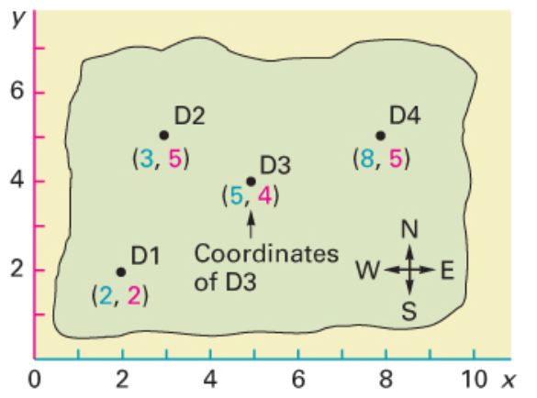
Center of Gravity Method (3 of 6)
Coordinate system added
Learning Objective 8.6

Slide 40
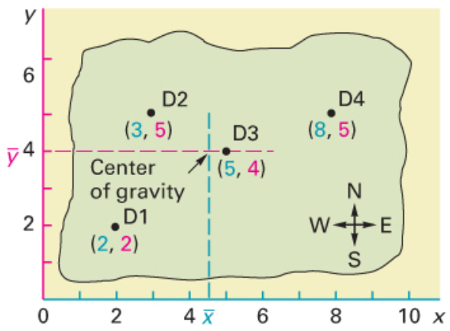
Center of Gravity Method (4 of 6)
Center of gravity
Learning Objective 8.6

Slide 41
Center of Gravity Method (5 of 6)
If quantities to be shipped to every location are equal, you can obtain the coordinates of the center of gravity by finding the average of the x-coordinates and the average of the y-coordinates.
Learning Objective 8.6

Slide 42
Center of Gravity Method (6 of 6)
When the quantities to be shipped to every location are unequal, you can obtain the coordinates of the center of gravity by finding the weighted average of the x-coordinates and the average of the y-coordinates.
Learning Objective 8.6

Slide 43
Example: Center of Gravity Method (1 of 4)
Suppose you are attempting to find the center of gravity for the problem depicted in Figure 8.1c.
Destination | x | y
D1 | 2 | 2
D2 | 3 | 5
D3 | 5 | 4
D4 | 8 | 5
 | 18 | 16
Here, the center of gravity is (4.5,4). This is slightly west of D3 from Figure 8.1.
Learning Objective 8.6

Slide 44
Example: Center of Gravity (2 of 4)
Suppose the shipments for the problem depicted in Figure 8.1a are not all equal. Determine the center of gravity based on the following information.
Destination | x | y | Weekly Quantity
D1 | 2 | 2 | 800
D2 | 3 | 5 | 900
D3 | 5 | 4 | 200
D4 | 8 | 5 | 100
 | 18 | 16 | 2,000
Learning Objective 8.6

Slide 45
Example: Center of Gravity (3 of 4)
The coordinates for the center of gravity are (3.05, 3.7). You may round the x-coordinate down to 3.0, so the coordinates for the center of gravity are (3.0, 3.7). This is south of destination D2 (3, 5).
Learning Objective 8.6

Slide 46
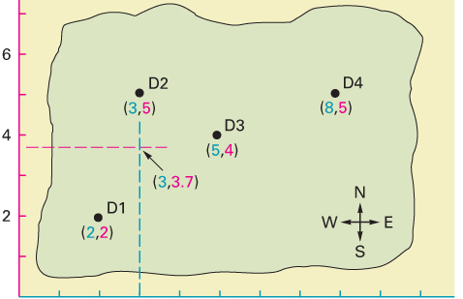
Example: Center of Gravity (4 of 4)
Learning Objective 8.6

Slide 47
Designing Process Layouts
The main issue in designing process layouts concerns the relative placement of the departments
Measuring effectiveness
A major objective in designing process layouts is to minimize transportation cost, distance, or time
Learning objective 6.9

Slide 48
Information Requirements
In designing process layouts, the following information is required:
A list of departments to be arranged and their dimensions
A projection of future work flows between the pairs of work centers
The distance between locations and the cost per unit of distance to move loads between them
The amount of money to be invested in the layout
A list of any special considerations
The location of key utilities, access and exit points, etc.
Learning Objective 6.9

Slide 49
Process Layout Problem (1 of 2)
Distance between locations in meters
 | To A | To B | To C
From A |  | 20 | 40
From B |  |  | 30
From C
Interdepartmental work flows (loads per day)
 | To 1 | To 2 | To 3
From 1 |  | 30 | 170
From 2 |  |  | 100
From 3
Learning Objective 6.9

Slide 50
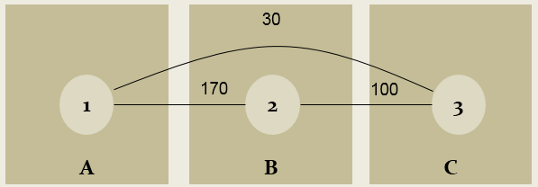
Process Layout Problem (2 of 2)
Dept. | Loads | Location | Distance (meters) | Load Distance Score
1 to 2 | 170 | A to B | 20 | 170×20 = 3,400
1 to 3 | 30 | A to C | 40 | 30×40 = 1,200
2 to 3 | 100 | B to C | 30 | 100×30 = 3,000
 |  |  | Total | 7,600
Learning Objective 6.9

Slide 51
End of Presentation

