Slide 1
Lecture 5b: Creative careers (cont’d)

Slide 2
Inequality in creative careers

Slide 3
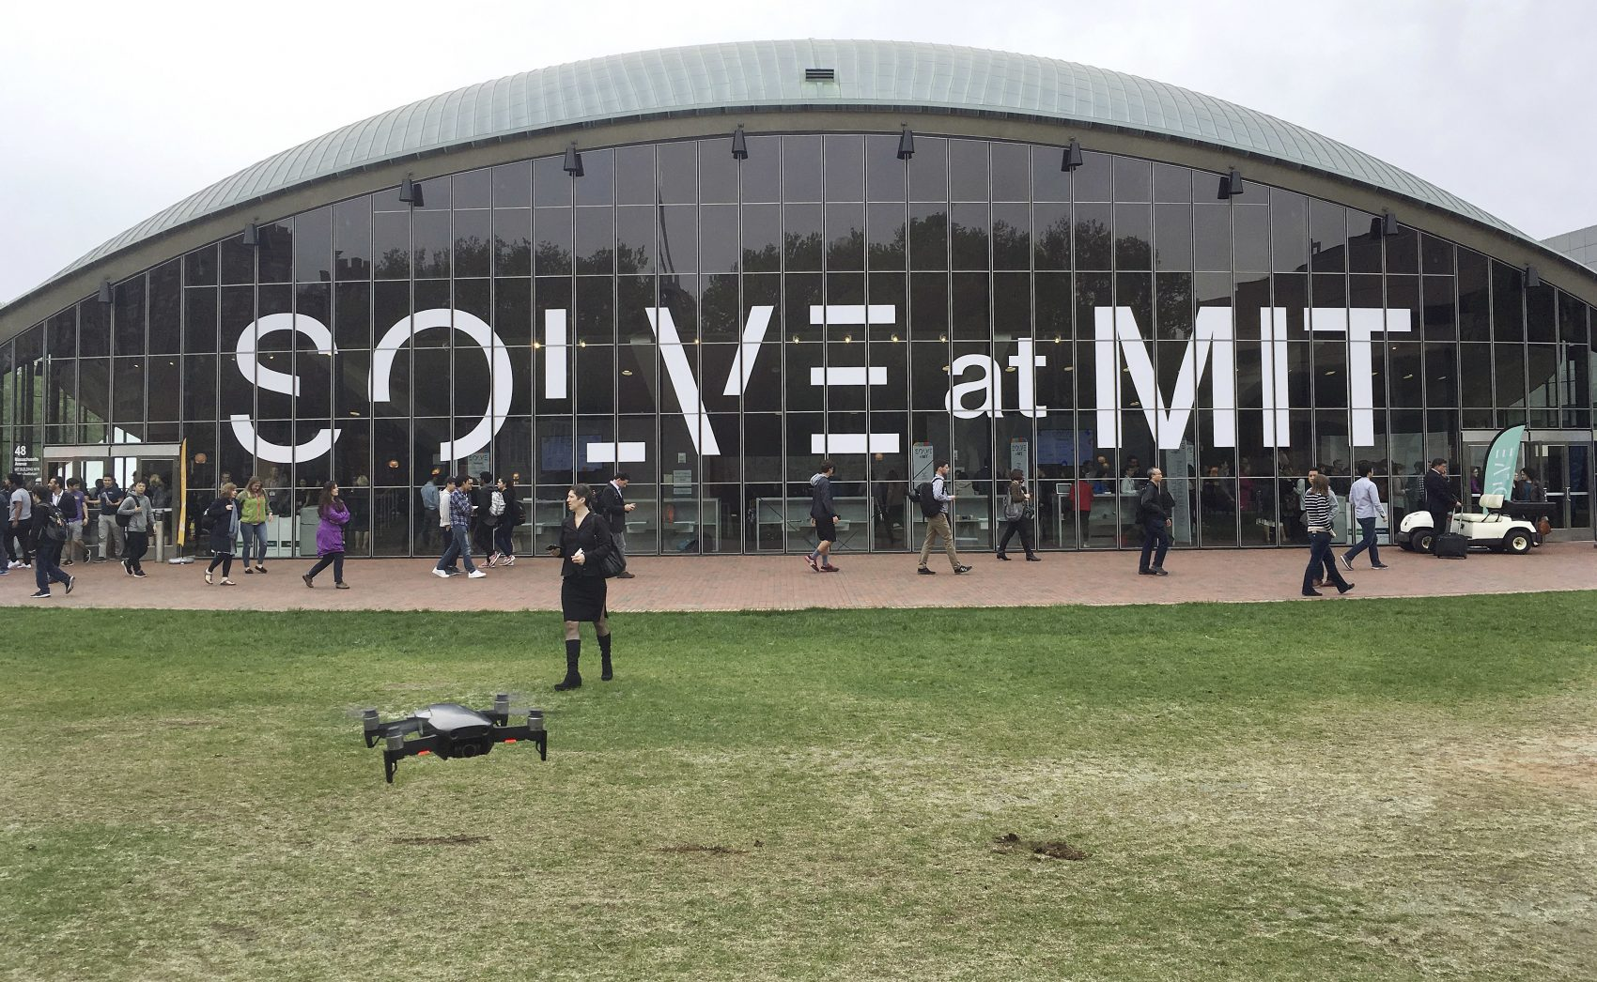
Credentials Credentials = Certificates and degrees that show evidence of authority, status, expertise, or qualification

Slide 4
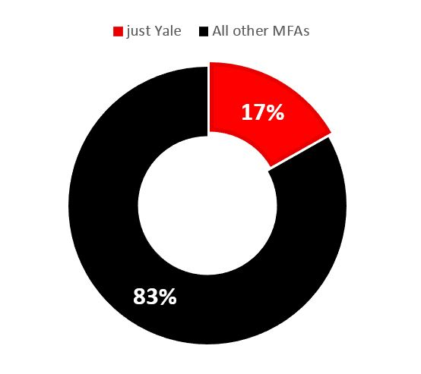
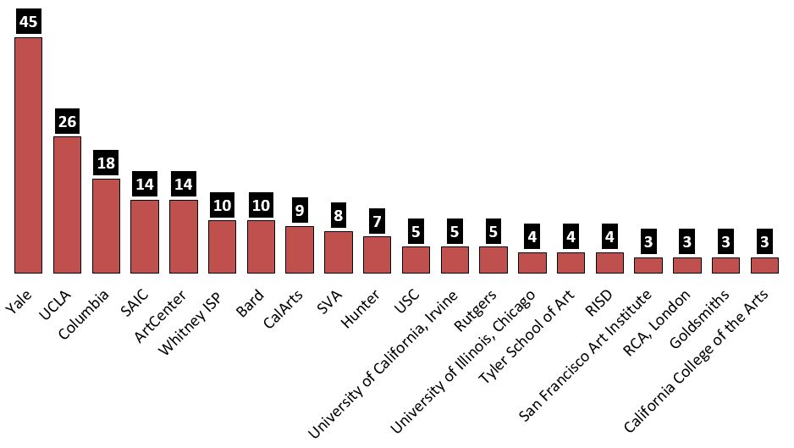
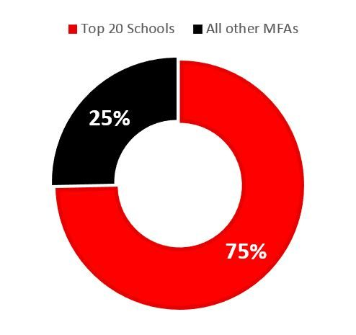
Credentials

Slide 5
Credentials

Slide 6
Credentials – PhD-granting Institutions of Harvard’s Sociology Faculty (n=22)

Slide 7
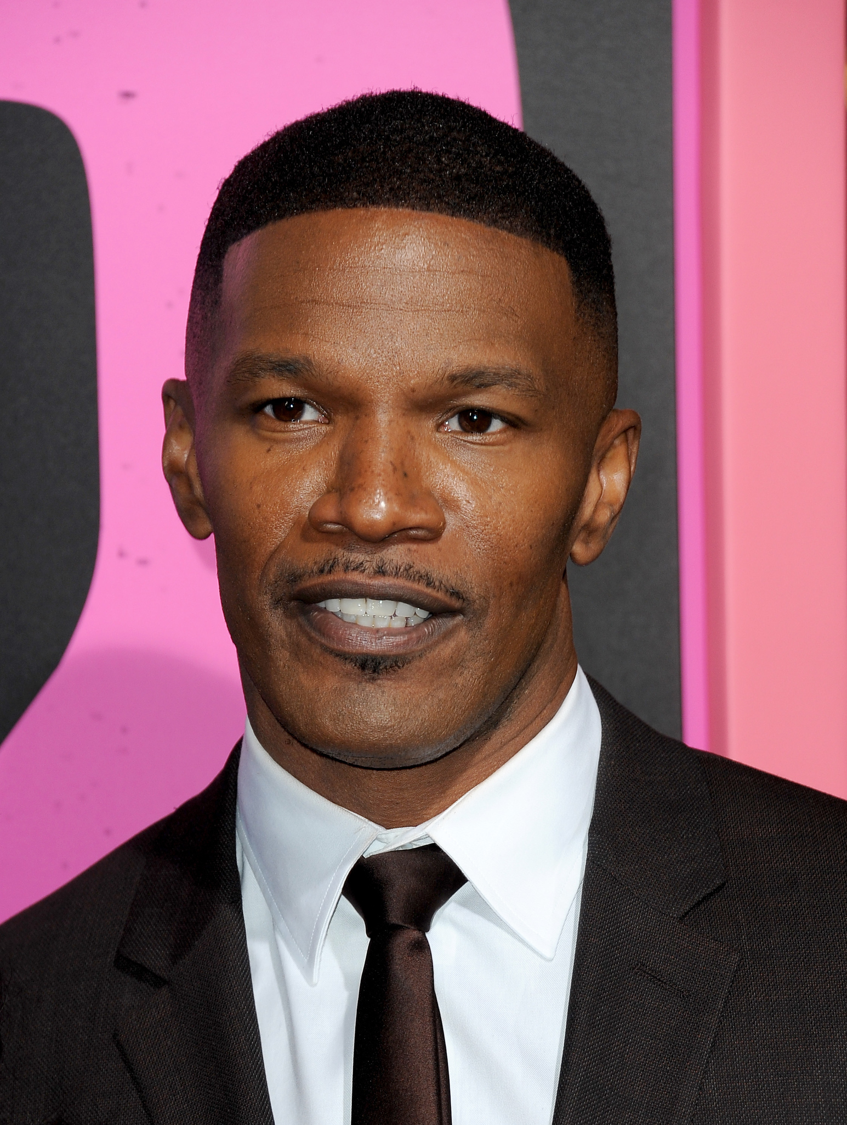
Social networks
Trenseta’s friend
Trenseta
Jamie Foxx

Slide 8
When Women Stopped Coding

Slide 9
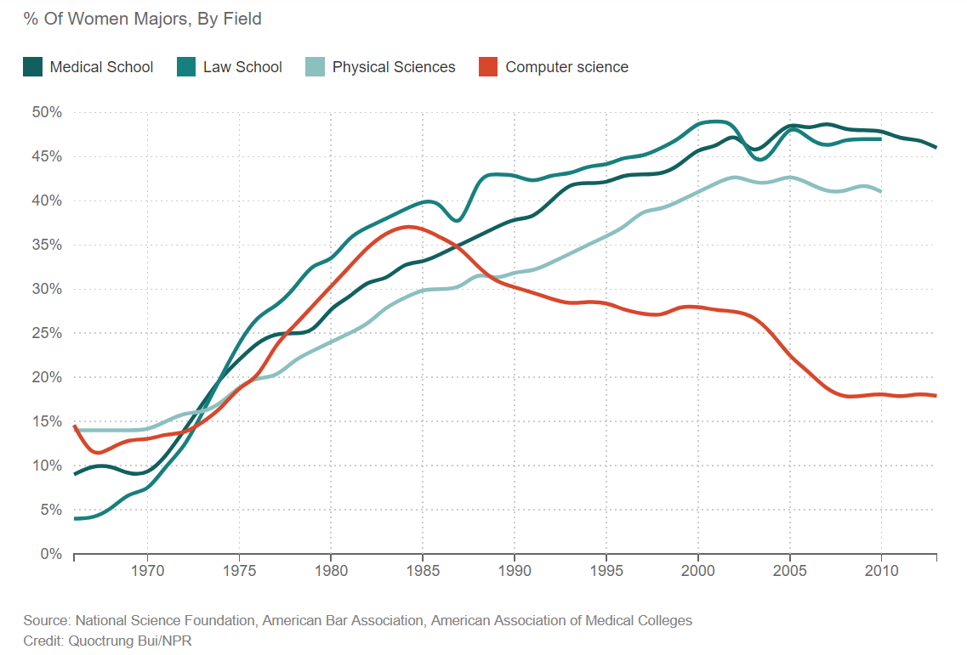

Slide 10
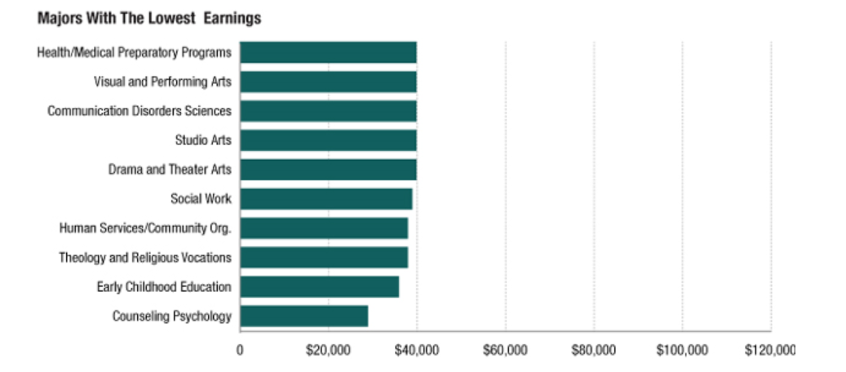

Slide 11
The “Racist” Soap Dispenser
https://www.youtube.com/watch?v=87QwWpzVy7I

Slide 12
Male Models

Slide 13
Key Point
Elite credentials, insider social ties, and socialization make success more likely for certain creative producers.

Slide 14
Lecture 6: Experimentation

Slide 15
Lecture Overview
How do creative producers improvise?
How do creative producers make original products?
How do creative producers convince others that their products are improvised and original?

Slide 16
Improvisation and Scripting

Slide 17
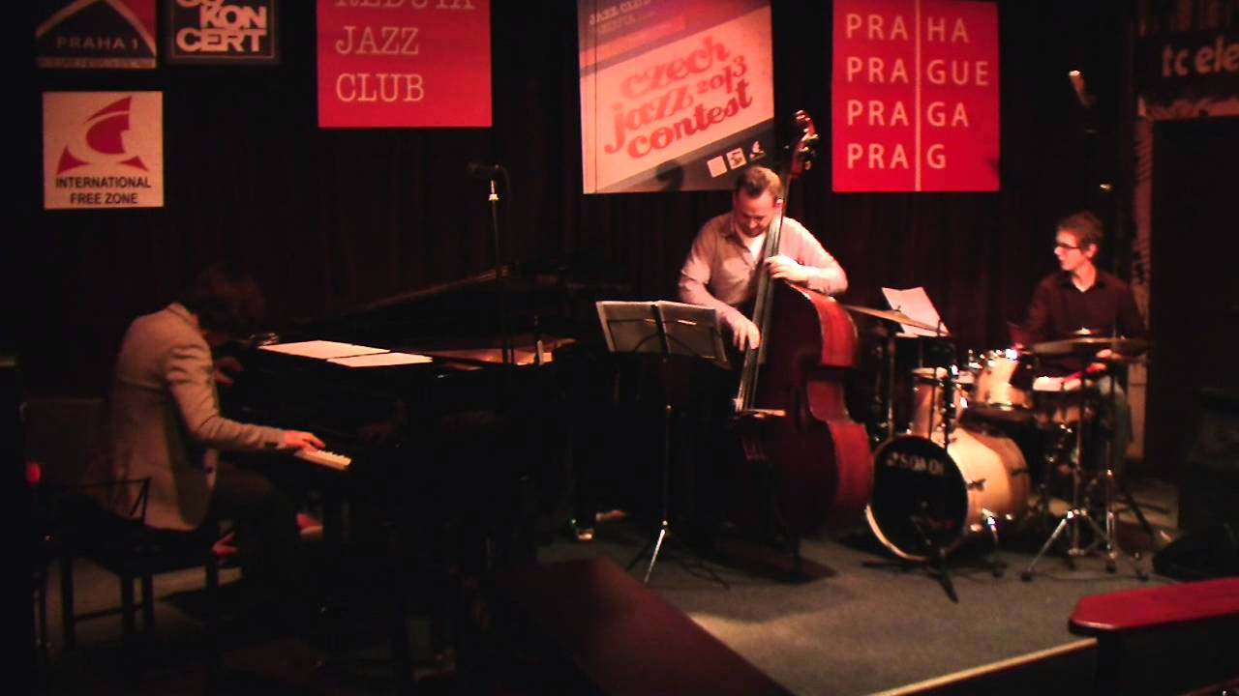
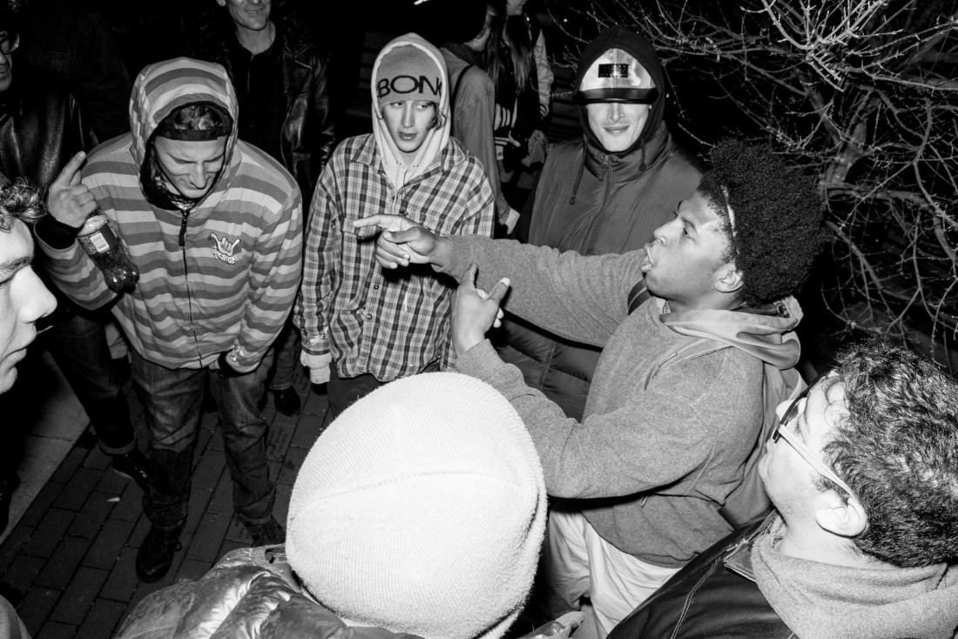
Improvisation

Slide 18
Scripting
Building vocabulary
“Spitting writtens”

Slide 19
Symbolic Interaction – Erving Goffman

Slide 20
Symbolic Interaction – Erving Goffman
Face = The positive self-image that a person holds when interacting with others
Face-work = Actions that individuals do in order to maintain and protect their face

Slide 21
Performance of Spontaneity
Elongating syllables
Making announcements that downplay doubts
i.e. “Only rapper to rewrite history without a pen”
Jay-Z, “Death of Auto-Tune” (Album: The Blueprint 3)
Avoiding calling out others

Slide 22
Key Points
Creative producers improvise by building scripts (stock knowledge), which they combine in different ways with new elements
They emphasize improvisation by downplaying scripting so as to save face

Slide 23
Originality and borrowing

Slide 24
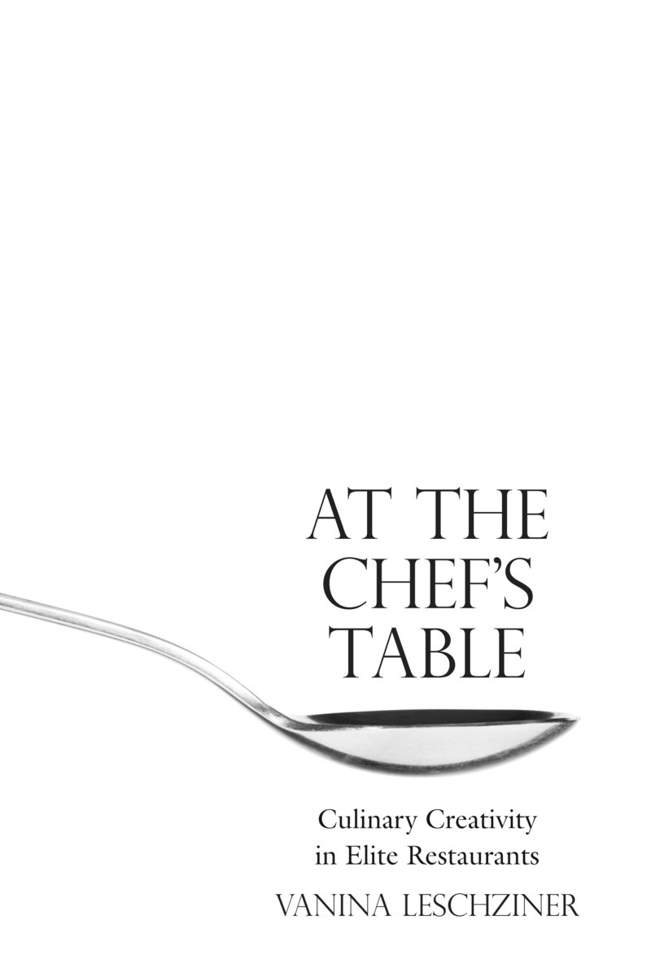
Elite Chefs - Leschziner

Slide 25
Eating in Other Restaurants

Slide 26
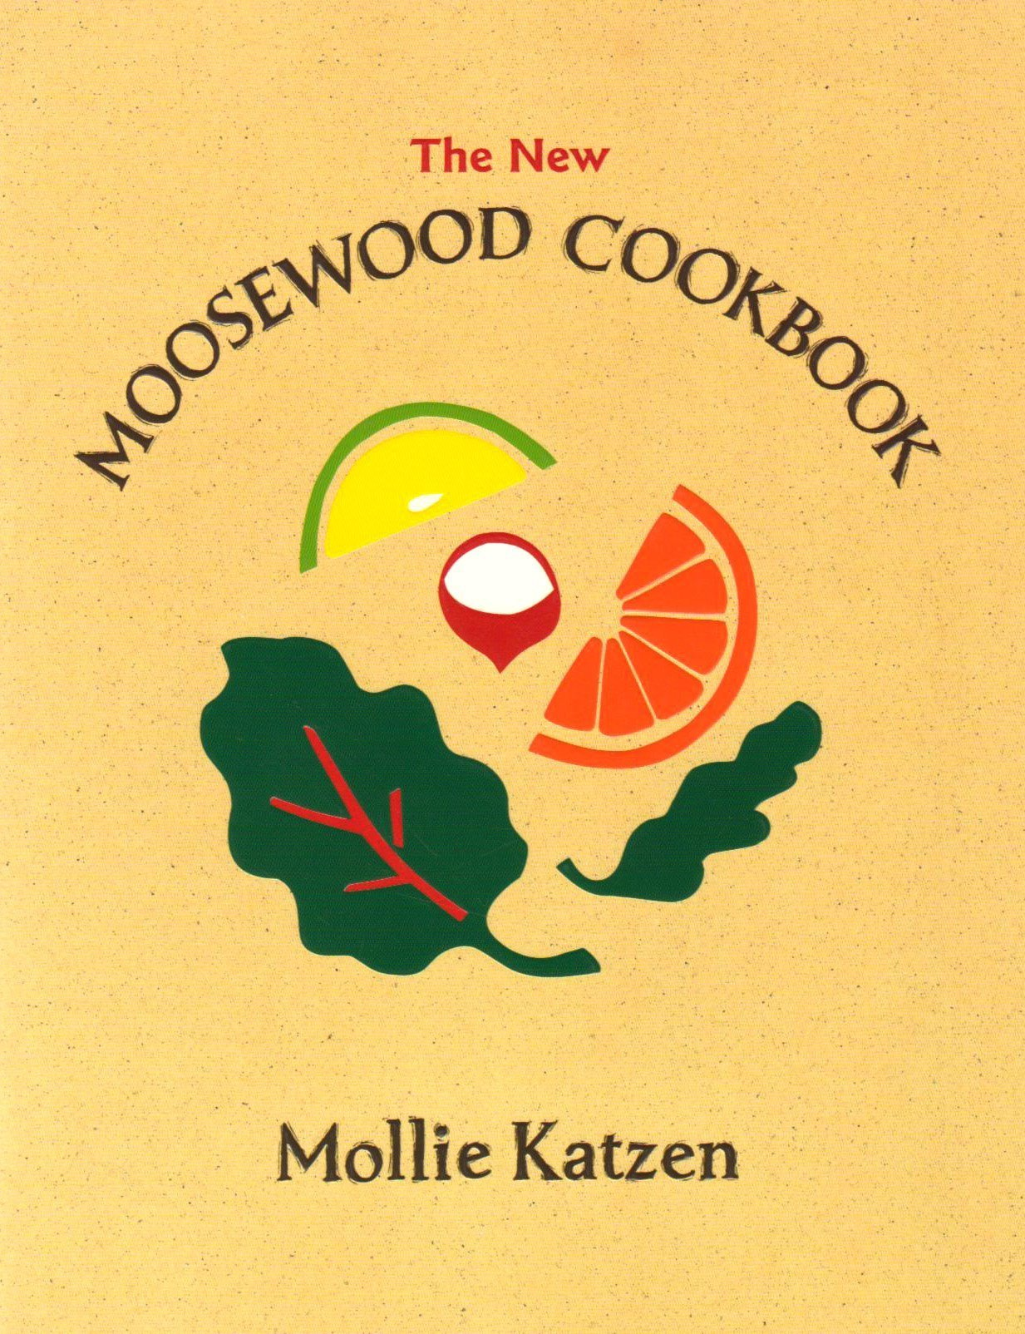
Cookbooks

Slide 27
Professional Lineage

Slide 28
Making Dishes Distinctive

Slide 29
Borrowing in Ciphers
https://www.youtube.com/watch?v=WzJMsgVnldo

Slide 30
Key Point
Creative producers make original products by combining borrowed elements in new ways

Slide 31
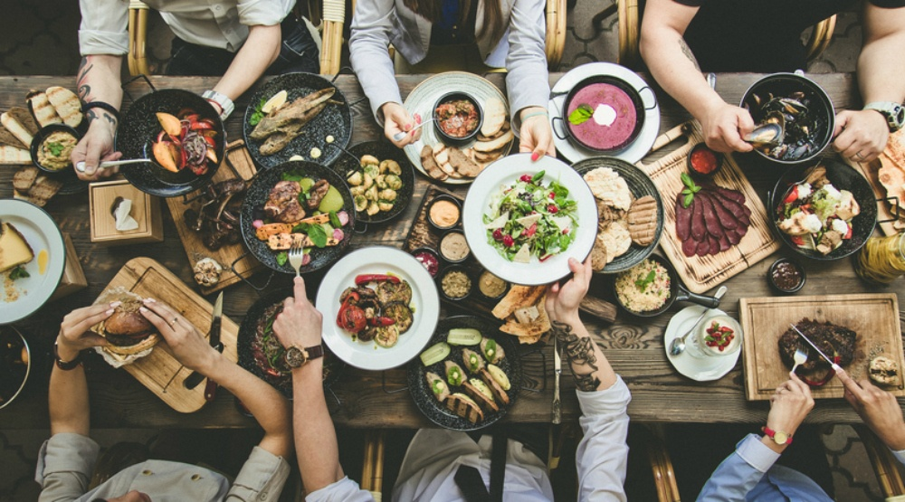
Performance of Originality

Slide 32
Performance of Originality (Pat Reilly)

Slide 33
Joke Theft?
https://www.youtube.com/watch?v=dI5hy6aDEDA

Slide 34
Performance of Originality
“The lack of legal regulation makes cuisine seem like an information commons to outsiders, but it is treated by insiders as a space with normative fences, with clear regulations about which borrowing practices are acceptable and which are unacceptable.”
- Leschziner, P. 89

Slide 35
Exercise
Choose a creative industry
How do creative producers borrow from one another?
When is borrowing considered theft?
How do creative producers protect themselves against charges of theft?

Slide 36
Key Point
They emphasize originality by downplaying certain kinds of borrowing in accordance with group conventions

Slide 37
Key Points
Elite credentials, insider social ties, and socialization for creative careers make success more likely for creative producers [creative careers]
Creative producers improvise by combining scripts, borrowed elements, and new elements
Creative producers make original products by combining borrowed elements in new ways
They emphasize improvisation and originality by downplaying scripting and borrowing in accordance with group conventions

Slide 38
Readings for Next Lecture
*Lena, Jennifer and Richard Peterson. “Changing Musical Styles.” Pp. 239-267 in Cultural Sociology: An Introductory Reader, edited by Matt Wray (2014). W.W. Norton.
*Baumann, Shyon. “Making Film into Art.” Pp. 314-331 in Cultural Sociology: An Introductory Reader, edited by Matt Wray (2014). W.W. Norton.
VanDerWolff, Todd. 2018. “The Oscars’ New ‘Popular Film’ Category is a Bad Idea from a Panicked Organization.” Vox. Aug 9th. https://www.vox.com/culture/2018/8/8/17664682/oscars-popular-film-category-2019

Slide 39
Readings for Next Lecture
*Lena, Jennifer and Richard Peterson. “Changing Musical Styles.” Pp. 239-267 in Cultural Sociology: An Introductory Reader, edited by Matt Wray (2014). W.W. Norton.
*Baumann, Shyon. “Making Film into Art.” Pp. 314-331 in Cultural Sociology: An Introductory Reader, edited by Matt Wray (2014). W.W. Norton.
VanDerWolff, Todd. 2018. “The Oscars’ New ‘Popular Film’ Category is a Bad Idea from a Panicked Organization.” Vox. Aug 9th. https://www.vox.com/culture/2018/8/8/17664682/oscars-popular-film-category-2019

Slide 40
Readings for Next Lecture
*Lena, Jennifer and Richard Peterson. “Changing Musical Styles.” Pp. 239-267 in Cultural Sociology: An Introductory Reader, edited by Matt Wray (2014). W.W. Norton.
*Baumann, Shyon. “Making Film into Art.” Pp. 314-331 in Cultural Sociology: An Introductory Reader, edited by Matt Wray (2014). W.W. Norton.
VanDerWolff, Todd. 2018. “The Oscars’ New ‘Popular Film’ Category is a Bad Idea from a Panicked Organization.” Vox. Aug 9th. https://www.vox.com/culture/2018/8/8/17664682/oscars-popular-film-category-2019

Slide 41
Readings for Next Lecture
*Lena, Jennifer and Richard Peterson. “Changing Musical Styles.” Pp. 239-267 in Cultural Sociology: An Introductory Reader, edited by Matt Wray (2014). W.W. Norton.
*Baumann, Shyon. “Making Film into Art.” Pp. 314-331 in Cultural Sociology: An Introductory Reader, edited by Matt Wray (2014). W.W. Norton.
VanDerWolff, Todd. 2018. “The Oscars’ New ‘Popular Film’ Category is a Bad Idea from a Panicked Organization.” Vox. Aug 9th. https://www.vox.com/culture/2018/8/8/17664682/oscars-popular-film-category-2019

