Slide 1
Lecture 2: FOUNDATIONAL APPROACHES

Slide 2
Lecture Overview
What is the sociology of creative industries?
What are the foundational approaches to studying creative industries sociologically?

Slide 3
The Sociology of Creative Industries

Slide 4
Sociology is….

Slide 5
Sociology is….
The study of the development, functioning, and structure of society
social relationships
social interactions
social institutions
Sociologists view social life as socially constructed

Slide 6
Sociologists often study
Social Change
Change across different types of people
Change over time
Identify and explain what caused this change: X → Y

Slide 7
Sociological Methods
Qualitative Research
Interview
Ethnography
Content Analysis
Survey Research
Quantitative Research
Analyzing large-scale datasets
Survey Research

Slide 8
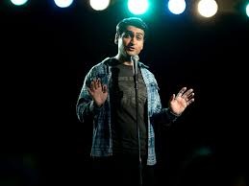
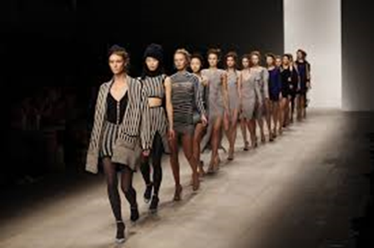
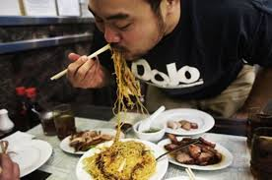
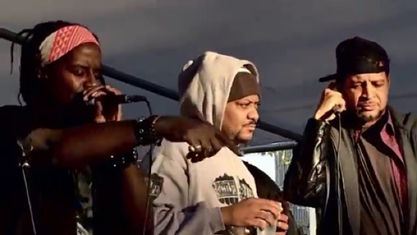
Creative Industries are…

Slide 9
Creative Industries are…
Sectors of organized activity concerning the production, distribution, and consumption of cultural, artistic, and intellectual products

Slide 10
Sociology of Creative Industries
Sociology of Culture
Economic Sociology
Moral Sociology
Political Sociology
Sociology of Gender
Sociology of Race
Urban Sociology
Science and Technology Studies
Sociology of Education

Slide 11
Social Change in Creative Industries
Pick a creative industry
Identify a change over time or groups
Choose data and method for studying this change
Make hypothesis of potential finding

Slide 12
Humanistic Approach vs Sociological Approach

Slide 13
Foundational Approaches

Slide 14
Becker – Art Worlds Approach

Slide 15
Becker – Art Worlds Approach
Artists
Support Personnel

Slide 16
Becker – Art Worlds Approach
Artists – people who do activities collectively perceived as requiring special gift or sensibility of artist
Support Personnel – people who do activities collectively perceived as requiring craft, business acumen, or other less rarified and less artistic ability
(p. 161)

Slide 17
Ex: Rihanna’s “Man Down”

Slide 18
Ex: Rihanna’s “Man Down”
Beat, Lyrics, and Melody → Demo
Songwriters
Vocal Producer
Label President
Various Marketers
Video Drop
DJs
Video Production Team
Producers
Rihanna
Ads and Radio Play
Track

Slide 19
Becker – Art Worlds Approach
Conventions = collective standards that allow people to
cooperate
evaluate art

Slide 20
Becker – Art Worlds Approach
Conventions also create constraints
Artistic Freedom → tension
Following Conventions → smooth interaction

Slide 21
Becker – Art Worlds Approach

Slide 22
Becker – Art Worlds Approach

Slide 23
Becker – Art Worlds Approach
“If we focus on a specific art work, it becomes useful to think of social organization as a network of people who cooperate to produce that work. We see that the same people often cooperate repeatedly, even routinely, in similar ways to produce similar works. They organize their cooperation by reference to the conventions current among those who participate in the production and consumption of such works.” p. 172

Slide 24
Becker – Art Worlds Approach
Key Ideas:
Production of art is not work of individual genius, but social and collective
It is social in ways that are patterned

Slide 25
Hirsch’s “Culture Industry System” (from Griswold)
Producers
Visual artists
Intermediaries
(Distribution)
Agents
Consumers
Moviegoers
Actors
Singers
Publishing houses
Film critics
Art collectors
Readers

Slide 26
Ex: Fifty Shades of Grey

Slide 27
Ex: Fifty Shades of Grey
Production | Distribution | Consumption

Slide 28
Hirsch’s “Culture Industry System” (from Griswold)
Producers
Visual artists
Intermediaries
(Distribution)
Agents
Consumers
Moviegoers
Actors
Singers
Publishing houses
Film critics
Art collectors
Readers

Slide 29
Key Points
Defining sociology of creative industries
Art as collectively produced (via network of people interacting with shared set of conventions)
Feedback between processes of production, distribution, and consumption

Slide 30
Readings for Next Lecture
*DeSoucey, Michaela. 2016. “Chapter 3: Gastronationalism on the Ground.” In Contested Tastes: Foie Gras and the Politics of Food. Princeton University Press. Read pp. 66-83 and pp. 99-109 [Stop at “Visit with the Ducks” on p. 83, start at “Symbolic Boundaries in Time, Place, Space” on p. 99]
Benzecry, Claudio. 2014. “Together Now: Producing Fashion at the Global Level.” White Paper in The Society Pages. https://thesocietypages.org/papers/all-together-now/

Slide 31
Readings for Next Lecture
*DeSoucey, Michaela. 2016. “Chapter 3: Gastronationalism on the Ground.” In Contested Tastes: Foie Gras and the Politics of Food. Princeton University Press. Read pp. 66-83 and pp. 99-109 [Stop at “Visit with the Ducks” on p. 83, start at “Symbolic Boundaries in Time, Place, Space” on p. 99]
Benzecry, Claudio. 2014. “Together Now: Producing Fashion at the Global Level.” White Paper in The Society Pages. https://thesocietypages.org/papers/all-together-now/

Slide 32
Readings for Next Lecture
*DeSoucey, Michaela. 2016. “Chapter 3: Gastronationalism on the Ground.” In Contested Tastes: Foie Gras and the Politics of Food. Princeton University Press. Read pp. 66-83 and pp. 99-109 [Stop at “Visit with the Ducks” on p. 83, start at “Symbolic Boundaries in Time, Place, Space” on p. 99]
Benzecry, Claudio. 2014. “Together Now: Producing Fashion at the Global Level.” White Paper in The Society Pages. https://thesocietypages.org/papers/all-together-now/

Slide 34
Sign-In

