Slide 1
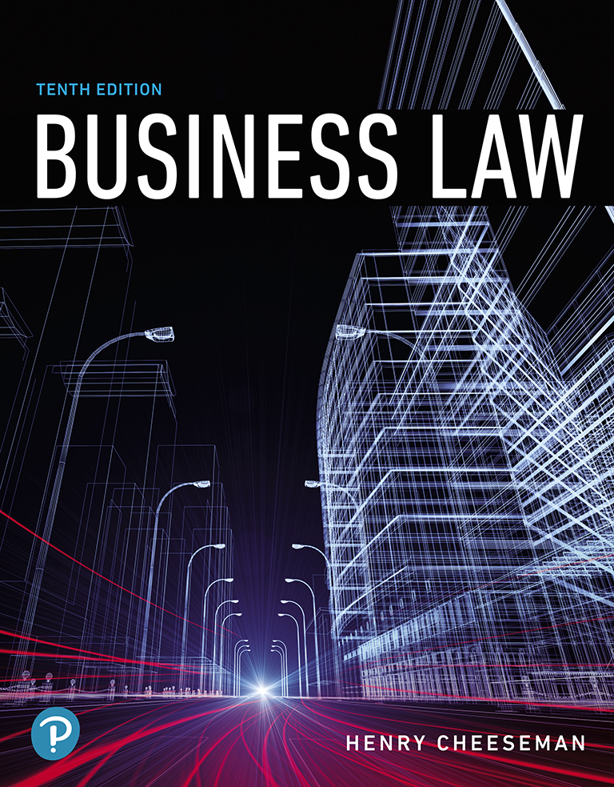
Business Law
Tenth Edition
Chapter 16
Breach of Contract and Remedies
Copyright © 2019, 2016, 2013 Pearson Education, Inc. All Rights Reserved.

Slide 2
Learning Objectives (1 of 3)
16.1 Describe complete, substantial, and inferior performance of contractual duties.
16.2 Describe the monetary damages that can be awarded when there is a breach of contract.
16.3 Define compensatory damages and describe when they can be awarded.
16.4 Define consequential damages and describe when they can be awarded.

Slide 3
Learning Objectives (2 of 3)
16.5 Define nominal damages and describe when they can be awarded.
16.6 Explain mitigation of damages and describe when this is required.
16.7 Define liquidated damages and describe when they are awarded.
16.8 Describe rescission of a contract and the payment of restitution.

Slide 4
Learning Objectives (3 of 3)
16.9 Describe the equitable remedies of specific performance, reformation, and injunction.
16.10 Identify when contract disputes are to be resolved using arbitration.
16.11 Describe torts associated with contracts, including the tort of bad faith.

Slide 5
Performance and Breach (1 of 4)
Breach of contract: If one or both of the parties do not perform their duties as specified in the contract
Types of performances
Complete performance (strict performance)
Substantial performance (minor breach)
Inferior performance (material breach)
Complete performance: Party to a contract renders performance exactly as required by the contract

Slide 6
Performance and Breach (2 of 4)
Tender of performance: Unconditional and absolute offer by a contracting party to perform his or her obligations under a contract
Substantial performance: Performance by a contracting party that deviates only slightly from complete performance
Minor breach: Occurs when a party renders substantial performance of his or her contractual duties

Slide 7
Exhibit 16.1: Substantial Performance: Minor Breach

Slide 8
Performance and Breach (3 of 4)
Inferior performance: Party fails to perform express or implied contractual obligations and impairs or destroys the essence of a contract
Material breach: Occurs when a party renders inferior performance of his or her contractual duties
Nonbreaching party is permitted to:
Rescind contract and seek restitution, or
Sue to enforce contract and seek damages

Slide 9
Exhibit 16.2: Inferior Performance: Material Breach

Slide 10
Performance and Breach (4 of 4)
Anticipatory breach:
Party indicates that he or she will not perform duties
Nonbreaching party is immediately discharged
Nonbreaching party may sue immediately

Slide 11
Monetary Damages
Monetary damages: An award of money
Available to nonbreaching party upon:
Minor breach
Material breach
Types
Compensatory damages
Consequential damages
Liquidated damages
Nominal damages

Slide 12
Compensatory Damages (1 of 2)
Award of money intended to compensate a nonbreaching party for the loss of the bargain
Purposes
To place the nonbreaching party in the position it would have had if contract had been fully performed
Restore benefit of the bargain

Slide 13
Compensatory Damages (2 of 2)
Amount awarded depends on:
Type of contract
Party that breached the contract
Contracts where compensatory damages are applied:
Sale of goods
Construction contracts
Employment contracts

Slide 14
Consequential Damages
Foreseeable damages that arise from circumstances outside the contract
Can be disclaimed in a sales or license agreement
The breaching party is not responsible to pay disclaimed consequential damages
Disclaimer of consequential damages is mostly lawful

Slide 15
Nominal Damages
Damages awarded when the non-breaching party sues the breaching party
Even though no financial loss has resulted from the breach
Usually awarded in a small amount, such as one dollar
Cases involving nominal damages are usually brought on principle
Disfavored by most courts

Slide 16
Mitigation of Damages
Nonbreaching party has a duty to avoid or reduce damages caused by a breach of contract
Extent of mitigation depends on the type of contract
If an employer breaches an employment contract, the employee:
Must try to mitigate damages
Should try to find substitute employment
Can accept only comparable employment

Slide 17
Liquidated Damages
Parties agree in advance that certain damages will be available if contract is breached
Actual damages must be difficult or impracticable to determine
Liquidated amount must be reasonable in the circumstances
Considered a penalty if actual damages can be determined in advance

Slide 18
Case 16.1: Liquidated Damages
Case
Burke v. 401 N. Wabash Venture, LLC
716 F.3d 432, 2013 U.S. App. Lexis 11047 (2013)
United States Court of Appeals for the Seventh Circuit
Issue
Is the liquidated damages clause enforceable?

Slide 19
Rescission and Restitution (1 of 2)
Rescission: An action to undo a contract
Available if there has been:
A material breach of contract
Fraud
Duress
Undue influence
Mistake

Slide 20
Rescission and Restitution (2 of 2)
Restitution: The return of goods or property received from the other party to rescind a contract
If the actual goods or property are not available, a cash equivalent must be made
Adequate notice must be given
Rescission and restitution restore the parties to the positions they occupied prior to the contract

Slide 21
Equitable Remedies (1 of 2)
Remedy available if there has been a breach of contract that cannot be adequately compensated through a legal remedy
Also available to prevent unjust enrichment
Types
Specific performance
Reformation
Injunction

Slide 22
Equitable Remedies (2 of 2)
Specific performance: Remedy that orders the breaching party to perform the acts promised in the contract
Reformation: Equitable doctrine permitting the court to rewrite a contract to express the parties’ true intentions
Injunction: A court order that prohibits a person from doing a certain act

Slide 23
Case 16.2: Specific Performance
Case
Alba v. Kaufmann
27 A.D.3d 816, 810 N.Y.S.2d 539, Web 2006 N.Y. App. Div. Lexis 2321 (2006)
Supreme Court of New York, Appellate Division
Issue
Is an order of specific performance of the real estate contract warranted in this case?

Slide 24
Arbitration of Contract Disputes
Arbitration: A nonjudicial, private resolution of a contract dispute
Arbitration agreements stipulate binding arbitration

Slide 25
Case 16.3: Arbitration of a Contract Dispute
Case
Mance v. Mercedes-Benz USA
901 F.Supp.2d 1147, 2012 U.S. Dist. Lexis 140778 (2012)
United States District Court for the Northern District of California
Issue
Is the arbitration clause enforceable?

Slide 26
Torts Associated with Contracts (1 of 2)
Intentional interference with contractual relations: Arises when a third party induces contracting party to breach the contract
Elements
A valid, enforceable contract between the contracting parties
The third-party’s knowledge of this contract
The third-party’s inducement to breach the contract

Slide 27
Torts Associated with Contracts (2 of 2)
Covenant of good faith and fair dealing:
Parties held to the express terms of the contract
Also required to act in good faith, deal fairly in all respects
A breach of this implied covenant is a tort for which tort damages are recoverable
Implied in contracts where the parties have a special relationship that involves a fiduciary duty

Slide 28
Copyright

