Slide 1
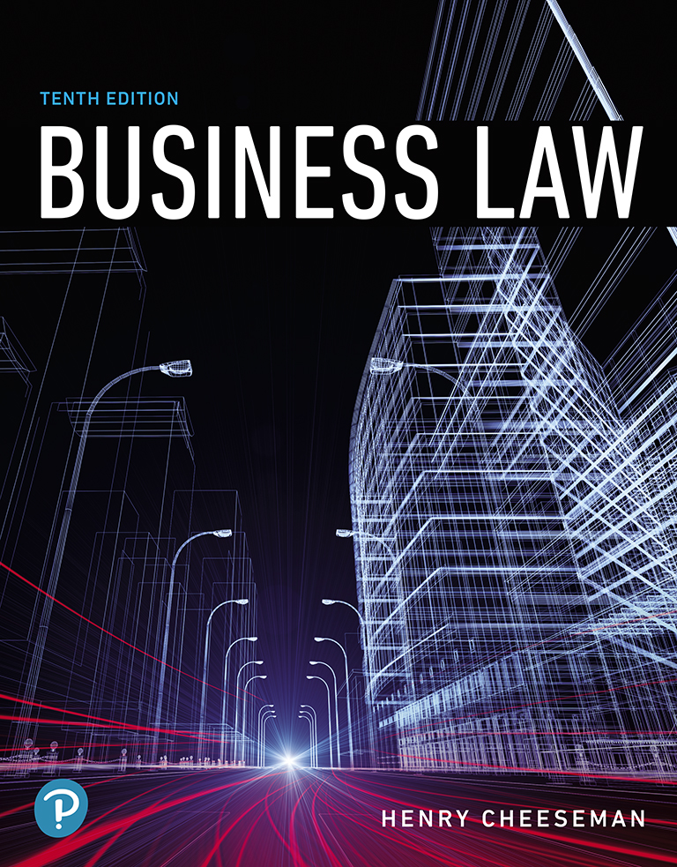
Business Law
Tenth Edition
Chapter 13
Genuineness of Assent and Undue Influence
Copyright © 2019, 2016, 2013 Pearson Education, Inc. All Rights Reserved.

Slide 2
Learning Objectives
13.1 Explain how mutual mistake of fact excuses performance.
13.2 Describe the elements of intentional misrepresentation (fraud).
13.3 List and describe the various types of fraud.
13.4 Describe duress.
13.5 Define the equitable doctrine of undue influence.

Slide 3
Introduction
Genuineness of assent: Requirement that a party’s assent to a contract be genuine

Slide 4
Mistake
Occurs where one or both of the parties to a contract have an erroneous belief about the subject matter, value, or some other aspect of the contract
The law permits rescission of some contracts made in mistake
Rescission: An action to undo a contract

Slide 5
Unilateral Mistake (1 of 2)
Mistake in which only one party is mistaken about a material fact regarding the subject matter of a contract
A contract may not be enforced due to a unilateral mistake when:
One party makes a unilateral mistake of fact, and the other party knew that a mistake was made

Slide 6
Unilateral Mistake (2 of 2)
A unilateral mistake occurs because of a clerical or mathematical error that is not the result of gross negligence
The mistake is so serious that enforcing the contract would be unconscionable

Slide 7
Mutual Mistake of a Material Fact
Mistake made by both parties concerning a material fact that is important to the subject matter of a contract
Ambiguity in contract may constitute a mutual mistake of a material fact
Ambiguity occurs when a word of the contract is susceptible to more than one logical interpretation
Mutual mistake of value occurs if both parties know the object of the contract but are mistaken as to its value

Slide 8
Fraud
Intentional misrepresentation or fraudulent misrepresentation
A misrepresentation occurs when an assertion is made that is not in accord with the facts
Fraudulent misrepresentation: An event that occurs when one person consciously decides to induce another person to rely and act on a misrepresentation

Slide 9
Elements of Fraud (1 of 4)
The wrongdoer made a false representation of material fact
The wrongdoer intended to deceive the innocent party
The innocent party justifiably relied on the misrepresentation
The innocent party was injured

Slide 10
Elements of Fraud (2 of 4)
Misrepresentation of a material fact
Occurs by words or by the conduct of a party
To be actionable as fraud, the misrepresentation must be of a past or existing material fact
Intent to deceive: To prove that a person intended to deceive an innocent party
Person making the misrepresentation must have either had knowledge that the representation was false or made it without sufficient knowledge of the truth

Slide 11
Elements of Fraud (3 of 4)
Reliance on the misrepresentation
A misrepresentation is not actionable unless the innocent party to whom the misrepresentation was made relied on the misrepresentation and acted on it
An innocent party who acts in reliance on a misrepresentation must justify his or her reliance

Slide 12
Elements of Fraud (4 of 4)
Injury to the innocent party
To recover damages, the innocent party must prove that the fraud caused him or her economic injury
The measure of damages is the difference between the value of the property as represented and the actual value of the property
This measure of damages gives the innocent party the benefit of the bargain

Slide 13
Types of Fraud (1 of 4)
Fraud in the inception (fraud in the factum): Fraud that occurs if a person is deceived as to the nature of his or her act and does not know what he or she is signing
Fraud in the inducement: Fraud that occurs when the party knows what he or she is signing but has been fraudulently induced to enter into the contract

Slide 14
Case 13.1: Fraud in the Inducement
Case
Portugués-Santana v. Rekomdiv International, Inc.
725 F.3d 17, 2013 U.S. App. Lexis 15331 (2013)
United States Court of Appeals for the First Circuit
Issue
Are Domingo and Rekomdiv liable to Portugués for dolo?

Slide 15
Types of Fraud (2 of 4)
Fraud by concealment: Fraud that occurs when one party takes specific action to conceal a material fact from another party
Silence as misrepresentation
Neither party to a contract owes a duty to disclose all the facts to the other party

Slide 16
Types of Fraud (3 of 4)
Silence is not a misrepresentation unless:
Nondisclosure would cause bodily injury or death
There is a fiduciary relationship between the contracting parties
Federal and state statutes require disclosure

Slide 17
Types of Fraud (4 of 4)
Misrepresentation of law
The misrepresentation will be allowed as grounds for rescission of the contract:
If one party to the contract is a professional who should know what the law is and intentionally misrepresents the law to a less sophisticated contracting party
Innocent misrepresentation: Fraud that occurs when a person makes a statement of fact that he or she honestly and reasonably believes to be true even though it is not

Slide 18
Case 13.2: Fraud
Case
Krysa v. Payne
176 S.W.3d 150, 2005 Mo. App. Lexis 1680 (2005)
Court of Appeals of Missouri
Issue
Did Payne engage in fraudulent nondisclosure, fraudulent misrepresentation, and reckless disregard for the safety of the Krysas and the public to support the award of $500,000 in punitive damages?

Slide 19
Duress
A situation in which one party threatens to do a wrongful act unless the other party enters into a contract
If the victim of the duress signs the contract, it is not enforceable against the victim
Duress can also occur where a threat does not involve physical harm

Slide 20
Undue Influence (1 of 2)
One person takes advantage of another person’s mental, emotional, or physical weakness
Unduly persuades that person to enter into a contract
The persuasion by the wrongdoer must overcome the free will of the innocent party

Slide 21
Undue Influence (2 of 2)
The following elements must be shown to prove undue influence:
A fiduciary or confidential relationship must have existed between the parties
The dominant party must have unduly used his or her influence to persuade the servient party to enter into a contract

Slide 22
Copyright

