Slide 1
Chapter 3
Data Management,
Big Data Analytics, and
Records Management

Slide 2
Data Warehouse and Big Data Analytics
Data and Text Mining
Business Intelligence
Electronic Records Management
Database Management Systems

Slide 3
Database Management Systems
Chapter 3
Databases
Collections of data sets or records stored in a systematic way.
Stores data generated by business apps, sensors, operations, and transaction-processing systems (TPS).
The data in databases are extremely volatile.
Medium and large enterprises typically have many databases of various types.
Volatile data changes frequently

Slide 4
Database Management Systems
Chapter 3
Data Warehouses
Integrate data from multiple databases and data silos, and organize them for complex analysis, knowledge discovery, and to support decision making.
May require formatting processing and/or standardization.
Loaded at specific times making them non-volatile and ready for analysis.

Slide 5
Database Management Systems
Chapter 3
Data Marts
Small-scale data warehouses that support a single function or one department.
Enterprises that cannot afford to invest in data warehousing may start with one or more data marts.

Slide 6
Database Management Systems
Chapter 3
Business intelligence (BI)
Tools and techniques that process data and conduct statistical analysis for insight and discovery.
Used to discover meaningful relationships in the data, keep informed of real time, detect trends, and identify opportunities and risks.

Slide 7
Database Management Systems
Chapter 3
Database Management System (DBMS)
Integrate with data collection systems such as TPS and business applications.
Stores data in an organized way.
Provides facilities for accessing and managing data.
Standard database model adopted by most enterprises.
Store data in tables consisting of columns and rows, similar to the format of a spreadsheet.

Slide 8
Database Management Systems
Chapter 3
Relational Management System (DBMS)
Provides access to data using a declarative language.
Declarative Language
Simplifies data access by requiring that users only specify what data they want to access without defining how they will be achieved.
Structured Query Language (SQL) is an example of a declarative language:
SELECT column_name(s)
FROM table_name
WHERE condition

Slide 9
Database Management Systems
Chapter 3
DBMS Functions
Data filtering and profiling
Data integrity and maintenance
Data synchronization
Data security
Data access

Slide 10
Database Management Systems
Chapter 3
Online Transaction Processing and Online Analytics Processing
Online Transaction Processing (OLTP)
Designed to manage transaction data, which are volatile & break down complex information into simpler data tables to strike a balance between transaction-processing efficiency and query efficiency.
Cannot be optimized for data mining
Online Analytics Processing (OLAP)
A means of organizing large business databases.
Divided into one or more cubes that fit the way business is conducted.

Slide 11
Database Management Systems
Chapter 3
DBMSs (mid-2014)
Oracle’s MySQL
Microsoft’s SQL Server
PostgreSQL
IBM’s DB2
Teradata Database.

Slide 12
Database Management Systems
Chapter 3
Trend Toward NoSQL Systems
Higher performance
Easy distribution of data on different nodes
enables scalability and fault tolerance
Greater flexibility
Simpler administration

Slide 13
Database Management Systems
Chapter 3
Centralized and Distributed Database Architecture
Centralized Database Architecture
Better control of data quality.
Better IT security.
Distributed Database Architecture
Allow both local and remote access.
Use client/server architecture to process requests.

Slide 14
Database Management Systems
Chapter 3
Garbage In, Garbage Out
Dirty Data
Lacks integrity/validation and reduces user trust.
Incomplete, out of context, outdated, inaccurate, inaccessible, or overwhelming.
Cost to Prevent Errors
Cost to Correct Errors
Cost of Poor
Quality Data
Lost Business

Slide 15
Database Management Systems
Chapter 3
Principle of Diminishing Data Value
The value of data diminishes as they age.
Blind spots (lack of data availability) of 30 days or longer inhibit peak performance.
Global financial services institutions rely on near-real-time data for peak performance.
Principle of 90/90 Data Use
As high as 90 percent, is seldom accessed after 90 days (except for auditing purposes).
Roughly 90 percent of data lose most of their value after 3 months.

Slide 16
Database Management Systems
Chapter 3
Principle of data in context
The capability to capture, process, format, and distribute data in near real time or faster requires a huge investment in data architecture.
The investment can be justified on the principle that data must be integrated, processed, analyzed, and formatted into “actionable information.”

Slide 17
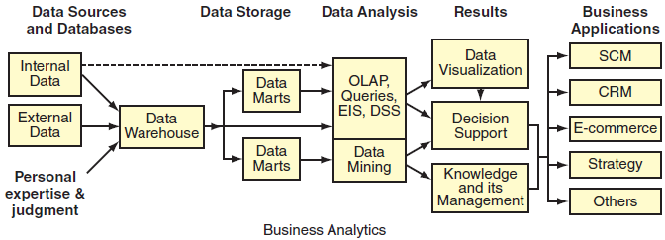
Database Management Systems
Chapter 3
Data Life Cycle
Figure 3.11 Data life cycle.

Slide 18
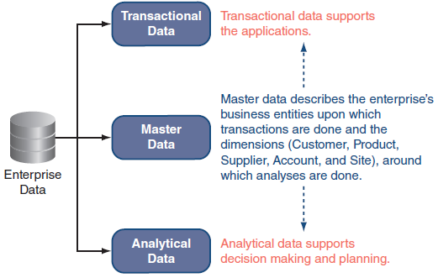
Database Management Systems
Chapter 3
Figure 3.12 An enterprise has transactional, master, and analytical data.

Slide 19
Database Management Systems
Chapter 3
Describe a database and a database management system (DBMS).
Explain what an online transaction-processing (OLAP) system does.
Why are data in databases volatile?
Explain what processes DBMSs are optimized to perform.
What are the business costs or risks of poor data quality?
Describe the data life cycle.
What is the function of master data management (MDM)?
Notes:
Suggested Answers:
1. A database is a collection of data sets or records stored in a systematic way. A database stores data generated by business apps, sensors, and transaction processing systems. Databases can provide access to all of the organization’s data collected for a particular function or enterprise-wide, alleviating many of the problems associated with data file environments. Central storage of data in a database reduces data redundancy, data isolation, and data inconsistency and allows for data to be shared among users of the data. In addition, security and data integrity are easier to control, and applications are independent of the data they process. There are two basic types of databases: centralized and distributed.
A database management system (DBMS) is software used to manage the additions, updates, and deletions of data as transactions occur; and support data queries and reporting. DBMSs integrate with data collection systems such as TPS and business applications; store the data in an organized way; and provide facilities for accessing and managing that data.
2. OLTP is a database design that breaks down complex information into simple data tables in order to be efficient for capturing transactional data, including additions, updates, or deletions. OLTP databases are capable of processing millions of transactions every second.
3. Data in databases are volatile because they can be updated millions of times every second, especially if they are transaction processing systems (TPS).
4. Data filtering and profiling: Inspecting the data for errors, inconsistencies, redundancies, and incomplete information.
Data integrity and maintenance: Correcting, standardizing, and verifying the consistency and integrity of the data.
Data synchronization: Integrating, matching, or linking data from disparate sources.
Data security: Checking and controlling data integrity over time.
Data access: Providing authorized access to data in both planned and ad hoc ways within acceptable time.
5. Poor quality data cannot be trusted and may result in the inability to make intelligent business decisions. Poor data may lead to lost business opportunities, increased time, and effort trying to prevent errors, increased time, and effort trying to correct errors, misallocation of resources, flawed strategies, incorrect orders, and customers becoming frustrated and driven away.
The cost of poor quality data spreads throughout the company affecting systems from shipping and receiving to accounting and customer services. Errors can be difficult, time-consuming, and expensive to correct, and the impacts of errors can be unpredictable or serious.
6. Three general data principles relate to the data life cycle perspective and help to guide IT investment decisions.
Principle of diminishing data value. Viewing data in terms of a life cycle focuses attention on how the value of data diminishes as the data age. The more recent the data, the more valuable they are. This is a simple, yet powerful, principle. Most organizations cannot operate at peak performance with blind spots (lack of data availability) of 30 days or longer.
Principle of 90/90 data use. Being able to act on real-time or near real-time operational data can have significant advantages. According to the 90/90 data-use principle, a majority of stored data, as high as 90 percent, is seldom accessed after 90 days (except for auditing purposes). Put another way, roughly 90 percent of data lose most of their value after three months.
Principle of data in context. The capability to capture, process, format, and distribute data in near real-time or faster requires a huge investment in data management architecture and infrastructure to link remote POS systems to data storage, data analysis systems, and reporting applications. The investment can be justified on the principle that data must be integrated, processed, analyzed, and formatted into “actionable information.” End users need to see data in a meaningful format and context if the data are to guide their decisions and plans.
7. Master data management (MDM) is a process whereby companies integrate data from various sources or enterprise applications to provide a more complete or unified view of an entity (customer, product, etc.) Although vendors may claim that their MDM solution creates “a single version of the truth,” this claim probably is not true. In reality, MDM cannot create a single unified version of the data because constructing a completely unified view of all master data simply is not possible. Realistically, MDM consolidates data from various data sources into a master reference file, which then feeds data back to the applications, thereby creating accurate and consistent data across the enterprise.

Slide 20
Data Warehouse and Big Data Analytics
Data and Text Mining
Business Intelligence
Electronic Records Management
Database Management Systems

Slide 21
Data Warehouse and Big Data Analytics
Chapter 3
Market share
Percentage of total sales in a market captured by a brand, product, or company.
Operating Margin
A measure of the percent of a company’s revenue left over after paying variable costs: wages, raw materials, etc.
Increased margins mean earning more per dollar of sales.
The higher the operating margin, the better.

Slide 22
Data Warehouse and Big Data Analytics
Chapter 3
TORTURE DATA LONG ENOUGH AND IT WILL CONFESS . . .
BUT MAY NOT TELL THE TRUTH

Slide 23
Data Warehouse and Big Data Analytics
Chapter 3
Human Expertise and Judgment Required
Data are worthless if you cannot analyze, interpret, understand, and apply the results in context.
Data need to be prepared for analysis.
Dirty data degrade the value of analytics.
Data must be put into meaningful context.

Slide 24
Data Warehouse and Big Data Analytics
Chapter 3
Enterprise data warehouses (EDW)
Data warehouses that pull together data from disparate sources and databases across an entire.
Warehouses are the primary source of cleansed data for analysis, reporting, and Business Intelligence (BI).
Their high costs can be subsidized by using Data marts.

Slide 25
Data Warehouse and Big Data Analytics
Chapter 3
Procedures to Prepare EDW Data for Analytics
Extract from designated databases.
Transform by standardizing formats, cleaning the data, integration.
Loading into a data warehouse.

Slide 26
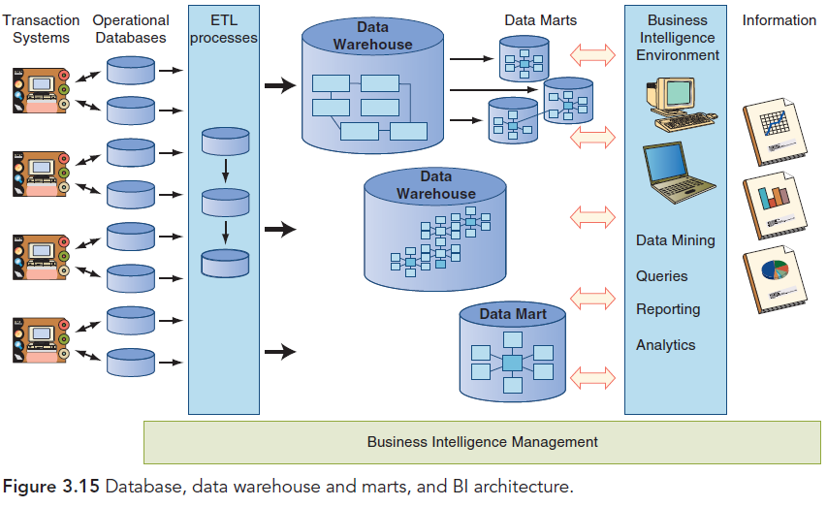
Data Warehouse and Big Data Analytics
Chapter 3

Slide 27
Data Warehouse and Big Data Analytics
Chapter 3
Active Data Warehouse (ADW)
Real-time data warehousing and analytics.
Transform by standardizing formats, cleaning the data, integration.
They Provide
Interaction with a customer to provide superior customer service.
Respond to business events in near real time.
Share up-to-date status data among merchants, vendors, customers, and associates.

Slide 28
Data Warehouse and Big Data Analytics
Chapter 3
Supporting Actions as well as Decisions
Marketing and Sales
Pricing and Contracts
Forecasting
Sales
Financial

Slide 29
Data Warehouse and Big Data Analytics
Chapter 3
Really Big Data
Low-cost sensors collect data in real time in all types of physical things (machine-generated sensor data):
Regulate temperature and climate
Detect air particles for contamination
Machinery conditions/failures
Engine wear/maintenance

Slide 30
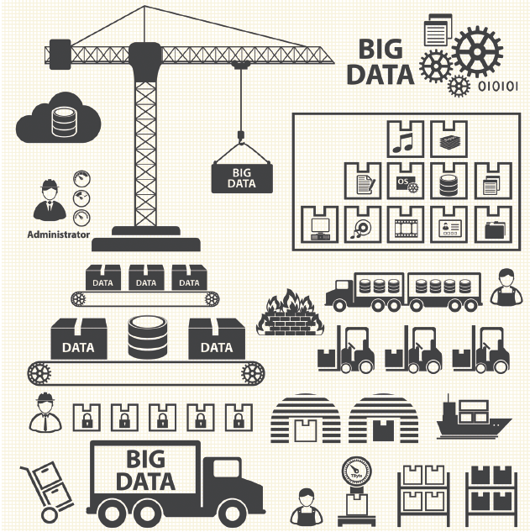
Data Warehouse and Big Data Analytics
Chapter 3
Figure 3.16 Machine generated data from physical objects are becoming a much larger portion of big data and analytics..

Slide 31
Data Warehouse and Big Data Analytics
Chapter 3
Hadoop and MapReduce
Hadoop is an Apache processing platform that places no conditions on the processed data structure.
MapReduce provides a reliable, fault-tolerant software framework to write applications easily that process vast amounts of data (multi-terabyte data-sets) in-parallel on large clusters (thousands of nodes) of commodity hardware.
Map stage: breaks up huge data into subsets
Reduce stage: recombines partial results

Slide 32
Data Warehouse and Big Data Analytics
Chapter 3
Why are human expertise and judgment important to data analytics? Give an example.
What is the relationship between data quality and the value of analytics?
Why do data need to be put into a meaningful context?
What are the differences between databases and data warehouses?
Explain ETL and CDC.
What is an advantage of an active data warehouse (ADW)?
Why might a company invest in a data mart?
How can manufacturers and health care benefit from data analytics?
Explain how Hadoop implements MapReduce in two stages.
Notes:
Suggested Answers
1. Human expertise and judgment are needed to interpret the output of analytics (refer to Figure 3.1). Data are worthless if you cannot analyze, interpret, understand, and apply the results in context.
For example, some believe that Super Bowl results in February predict whether the stock market will go up or down that year. If the National Football Conference (NFC) wins, the market goes up; otherwise, stocks take a dive. Looking at results over the past 30 years, most often the NFC has won the Super Bowl and the market has gone up. Does this mean anything? No.
2. Dirty data degrade the value of analytics. The “cleanliness” of data is very important to data mining and analysis projects.
3. Managers need context in order to understand how to interpret traditional and big data. If the wrong analysis or datasets are used, the output would be nonsense, as in the example of the Super Bowl winners and stock market performance.
4. Databases are:
Designed and optimized to ensure that every transaction gets recorded and stored immediately.
Volatile because data are constantly being updated, added, or edited.
OLTP systems.
Medium and large enterprises typically have many databases of various types.
Data warehouses are:
Designed and optimized for analysis and quick response to queries.
Nonvolatile. This stability is important to being able to analyze the data and make comparisons. When data are stored, they might never be changed or deleted in order to do trend analysis or make comparisons with newer data.
OLAP systems.
Subject-oriented, which means that the data captured are organized to have similar data linked together.
Data warehouses integrate data collected over long time periods from various source systems, including multiple databases and data silos.
5. ETL refers to three procedures – Extract, Transform, and Load – used in moving data from databases to a data warehouse. Data are extracted from designated databases, transformed by standardizing formats, cleaning the data, integrating them, and loaded into a data warehouse.
CDC, the acronym for Change Data Capture, refers to processes which capture the changes made at data sources and then apply those changes throughout enterprise data stores to keep data synchronized. CDC minimizes the resources required for ETL processes by only dealing with data changes.
6. An ADW provides real-time data warehousing and analytics, not for executive strategic decision making, but rather to support operations. Some advantages for a company of using an ADW might be interacting with a customer to provide superior customer service, responding to business events in near real time, or sharing up-to-date status data among merchants, vendors, customers, and associates.
7. The high cost of data warehouses can make them too expensive for a company to implement. Data marts are lower-cost, scaled-down versions that can be implemented in a much shorter time, for example, in less than 90 days. Data marts serve a specific department or function, such as finance, marketing, or operations. Since they store smaller amounts of data, they are faster, and easier to use and navigate.
8. Machine-generated sensor data are becoming a larger proportion of big data (Figure 3.16). Analyzing them can lead to optimizing cost savings and productivity gains. Manufacturers can track the condition of operating machinery and predict the probability of failure, as well as track wear and determine when preventive maintenance is needed.
Federal health reform efforts have pushed health-care organizations toward big data and analytics. These organizations are planning to use big data analytics to support revenue cycle management, resource utilization, fraud prevention, health management, and quality improvement, in addition to reducing operational expenses.
9. Apache Hadoop is a widely used processing platform which places no conditions on the structure of the data it can process.
Hadoop implements MapReduce in two stages:
Map stage: MapReduce breaks up the huge dataset into smaller subsets; then distributes the subsets among multiple servers where they are partially processed.
Reduce stage: The partial results from the map stage are then recombined and made available for analytic tools

Slide 33
Data Warehouse and Big Data Analytics
Data and Text Mining
Business Intelligence
Electronic Records Management
Database Management Systems

Slide 34
Data and Text Mining
Chapter 3
Creating Business Value
Business Analytics: the entire function of applying technologies, algorithms, human expertise, and judgment.
Data Mining: software that enables users to analyze data from various dimensions or angles, categorize them, and find correlative patterns among fields in the data warehouse.
Text Mining: broad category involving interpreted words and concepts in context.
Sentimental Analysis: trying to understand consumer intent.

Slide 35
Data and Text Mining
Chapter 3
Text Analytics (Mining) Procedure
Exploration
Simple word counts
Topics consolidation
Preprocessing
Standardization
May be 80% of processing time
Grammar and spell checking
Categorizing and Modelling
Create business rules and train models for accuracy and precision

Slide 36
Data and Text Mining
Chapter 3
Text Analytics Procedure
Exploration
Simple word counts
Topics consolidation
Preprocessing
Standardization
May be 80% of processing time
Grammar and spell checking
Categorizing and Modelling
Create business rules and train models for accuracy and precision

Slide 37
Data and Text Mining
Chapter 3
Describe data mining.
How does data mining generate or provide value? Give an example.
What is text mining?
Explain the text mining procedure.
Notes:
Suggested Answers:
1. Data mining is the process of analyzing data from various dimensions or angles, categorizing them, and finding correlations or patterns among fields in the data warehouse.
2. Data mining is used to discover knowledge that you did not know existed in the databases.
Answers may vary. A data mining example: The mega-retailer Walmart wanted its online shoppers to find what they were looking for faster. Walmart analyzed clickstream data from its 45 million monthly online shoppers then combined that data with product and category related popularity scores which were generated by text mining the retailer’s social media streams. Lessons learned from the analysis were integrated into the Polaris search engine used by customers on the company’s website. Polaris has yielded a 10 to 15 percent increase in online shoppers completing a purchase, which equals roughly $1 billion in incremental online sales.
3. Up to 75 percent of an organization’s data are non-structured word processing documents, social media, text messages, audio, video, images and diagrams, fax and memos, call center or claims notes, and so on. Text mining is a broad category that involves interpreting words and concepts in context. Then the text is organized, explored, and analyzed to provide actionable insights for managers. With text analytics, information is extracted out of large quantities of various types of textual information. It can be combined with structured data within an automated process. Innovative companies know they could be more successful in meeting their customers’ needs if they just understood them better. Text analytics is proving to be an invaluable tool in doing this.
4. The basic steps involved in text mining/analytics include:
Exploration. First, documents are explored. This might be in the form of simple word counts in a document collection, or manually creating topic areas to categorize documents by reading a sample of them. For example, what are the major types of issues (brake or engine failure) that have been identified in recent automobile warranty claims? A challenge of the exploration effort is misspelled or abbreviated words, acronyms, or slang.
Preprocessing. Before analysis or the automated categorization of the content, the text may need to be preprocessed to standardize it to the extent possible. As in traditional analysis, up to 80 percent of the time can be spent preparing and standardizing the data. Misspelled words, abbreviations, and slang may need to be transformed into a consistent term. For instance, BTW would be standardized to “by the way” and “left voice message” could be tagged as “lvm.”
Categorizing and Modeling. Content is then ready to be categorized. Categorizing messages or documents from information contained within them can be achieved using statistical models and business rules. As with traditional model development, sample documents are examined to train the models. Additional documents are then processed to validate the accuracy and precision of the model, and finally new documents are evaluated using the final model (scored). Models then can be put into production for automated processing of new documents as they arrive.

Slide 38
Data Warehouse and Big Data Analytics
Data and Text Mining
Business Intelligence
Electronic Records Management
Database Management Systems

Slide 39
Business Intelligence
Chapter 3
Key to competitive advantage
Across industries in all size enterprises
Used in operational management, business process, and decision making
Provides moment of value to decision makers
Unites data, technology, analytics, & human knowledge to optimize decisions

Slide 40
Business Intelligence
Chapter 3
Challenges
Data Selection & Quality
Alignment with Business Strategy and BI Strategy
Alignment
Clearly articulates business strategy
Deconstructs business strategy into targets
Identifies PKIs
Prioritizes PKIs
Creates a plan based on priorities
Transform based on strategic results and changes

Slide 41
Business Intelligence
Chapter 3
Smart Devices
Everywhere
have created demand for
effortless 24/7 access to
insights.
Data is Big
Business
when they provide insight that supports decisions and action.
Advanced BI and Analytics
help to ask questions that were previously unknown and unanswerable.
Cloud Enabled BI and Analytics
are providing low-cost and flexible solutions.
Figure 3.20 Four factors contributing to increased use of BI.

Slide 42
Business Intelligence
Chapter 3
BI Architecture and Analytics
Advances in response to big data and end-user performance demands.
Hosted on public or private clouds.
Limits IT staff and controls costs
May slow response time, add security and backup risks

Slide 43
Business Intelligence
Chapter 3
How has BI improved performance management at Quicken Loans?
What are the business benefits of BI?
What are two data-related challenges that must be resolved for BI to produce meaningful insight?
What are the steps in a BI governance program?
What is a business-driven development approach?
What does it mean to drill down, and why is it important?
What four factors are contributing to increased use of BI?
How did BI help CarMax achieve record-setting revenue growth?
Notes:
Suggested Answers:
1. Using BI, the company has increased the speed from loan application to close, which allows it to meet client needs as thoroughly and quickly as possible. Over almost a decade, performance management has evolved from a manual process of report generation to BI-driven dashboards and user-defined alerts that allow business leaders to proactively deal with obstacles and identify opportunities for growth and improvement.
2. BI provides data at the moment of value to a decision maker—enabling it to extract crucial facts from enterprise data in real time or near real time. BI solutions help an organization to know what questions to ask and to find answers to those questions. BI tools integrate and consolidate data from various internal and external sources and then process them into information to make smart decisions. According to The Data Warehousing Institute (TDWI), BI “unites data, technology, analytics, and human knowledge to optimize business decisions and ultimately drive an enterprise’s success. BI programs… transform data into usable, actionable business information” (TDWI, 2012).
Managers use business analytics to make better-informed decisions and hopefully provide them with a competitive advantage. BI is used to analyze past performance and identify opportunities to improve future performance.
3. Data selection and data quality.
Information overload is a major problem for executives and for employees. Another common challenge is data quality, particularly with regard to online information, because the source and accuracy might not be verifiable.
4. The mission of a BI governance program is to achieve the following:
Clearly articulate business strategies.
Deconstruct the business strategies into a set of specific goals and objectives—the targets.
Identify the key performance indicators (KPIs) that will be used to measure progress toward each target.
Prioritize the list of KPIs.
Create a plan to achieve goals and objectives based on the priorities.
Estimate the costs needed to implement the BI plan.
Assess and update the priorities based on business results and changes in business strategy.
5. A business-driven development approach starts with a business strategy and work backward to identify data sources and the data that need to be acquired and analyzed.
6. Drilling down into the data is going from highly consolidated or summarized figures into the detail numbers from which they were derived. Sometimes a summarized view of the data is all that is needed; however, drilling down into the data, from which the summary came, provides the ability to do more in-depth analyses.
7. Smart Devices Everywhere creating demand for effortless 24/7 access to insights.
Data is Big Business when they provide insight that supports decisions and action.
Advanced Bl and Analytics help to ask questions that were previously unknown and unanswerable.
Cloud Enabled Bl and Analytics are providing low-cost and flexible solutions.
8. The ISs that helped CarMax include:
A proprietary IS that captures, analyzes, interprets, and distributes data about the cars CarMax sells and buys.
Data analytics applications that track every purchase; number of test drives and credit applications per car; color preference in every demographic and region.
Proprietary store technology that provides management with real-time data about every aspect of store operations, such as inventory management, pricing, vehicle transfers, wholesale auctions, and sales consultant productivity.
An advanced inventory management system helps management anticipate future inventory needs and manage pricing.

Slide 44
Data Warehouse and Big Data Analytics
Data and Text Mining
Business Intelligence
Electronic Records Management
Database Management Systems

Slide 45
Electronic Records Management
Chapter 3
Business Records
Documentation of a business event, action, decision, or transaction.
Electronic Records Management (EMR)
Workflow software, authoring tools, scanners, and databases that manage and archive electronic documents and image paper documents.
Index and store documents according to company policy or legal compliance.
Success depends on partnership of key players.

Slide 46
Electronic Records Management
Chapter 3
Best Practices
Effective systems capture all business data.
Input from online forms, bar codes, sensors, websites, social sites, copiers, e-mails, and more.
Industry Standards
Association for Information and Image Management (AIIM; www.aiim.org)
National Archives and Records Administration (NARA; www.archives.gov)
ARMA International (formerly the Association of Records Managers and Administrators; www.arma.org)

Slide 47
Electronic Records Management
Chapter 3
Primary Benefits
Access and use the content contained in documents.
Cut labor costs by automating business processes.
Reduce time and effort to locate required information for decision making.
Improve content security, thereby reducing intellectual property theft risks.
Minimizes content printing, storing, and searching costs.

Slide 48
Electronic Records Management
Chapter 3
DISASTER RECOVERY, BUSINESS CONTINUITY, AND COMPLIANCE
Does the software meet the organization’s needs? For example, can the DMS be installed on the existing network? Can it be purchased as a service?
Is the software easy to use and accessible from Web browsers, office applications, and e-mail applications? If not, people will not use it.
Does the software have lightweight, modern Web and graphical user interfaces that effectively support remote users?
Before selecting a vendor, it is important to examine workflows and how data, documents, and communications flow throughout the company.

Slide 49
Electronic Records Management
Chapter 3
What are business records?
Why is ERM a strategic issue rather than simply an IT issue?
Why might a company have a legal duty to retain records? Give an example.
Why is creating backups an insufficient way to manage an organization’s documents?
What are the benefits of ERM?
Notes:
Suggested Answers:
1. All organizations create and retain business records. A record is documentation of a business event, action, decision, or transaction. Examples are contracts, research and development, accounting source documents, memos, customer/client communications, hiring and promotion decisions, meeting minutes, social posts, texts, e-mails, website content, database records, and paper and electronic files. Business documents such as spreadsheets, e-mail messages, and word-processing documents are a type of records. Most records are kept in electronic format and maintained throughout their life cycle—from creation to final archiving or destruction by an electronic records management (ERM) system.
2. Because senior management must ensure that their companies comply with legal and regulatory duties, managing electronic records (e-records) is a strategic issue for organizations in both the public and private sectors. The success of ERM depends greatly on a partnership of many key players, namely, senior management, users, records managers, archivists, administrators, and most importantly, IT personnel. Properly managed, records are strategic assets. Improperly managed or destroyed, they become liabilities.
3. Companies need to be prepared to respond to an audit, federal investigation, lawsuit, or any other legal action against them. Types of lawsuits against companies include patent violations, product safety negligence, theft of intellectual property, breach of contract, wrongful termination, harassment, discrimination, and many more.
4. Simply creating backups of records is not sufficient because the content would not be organized and indexed to retrieve them accurately and easily. The requirement to manage records—regardless of whether they are physical or digital—is not new. ERM systems consist of hardware and software that manage and archive electronic documents and image paper documents; then index and store them according to company policy. Properly managed, records are strategic assets. Improperly managed or destroyed, they become liabilities.
5. Departments or companies whose employees spend most of their day filing or retrieving documents or warehousing paper records can reduce costs significantly with ERM. These systems minimize the inefficiencies and frustration associated with managing paper documents and workflows. However, they do not create a paperless office as had been predicted.
An ERM can help a business to become more efficient and productive by:
Enabling the company to access and use the content contained in documents.
Cutting labor costs by automating business processes.
Reducing the time and effort required to locate information the business needs to support decision making.
Improving the security of content, thereby reducing the risk of intellectual property theft.
Minimizing the costs associated with printing, storing, and searching for content.
When workflows are digital, productivity increases, costs decrease, compliance obligations are easier to verify, and green computing becomes possible.

