Slide 1
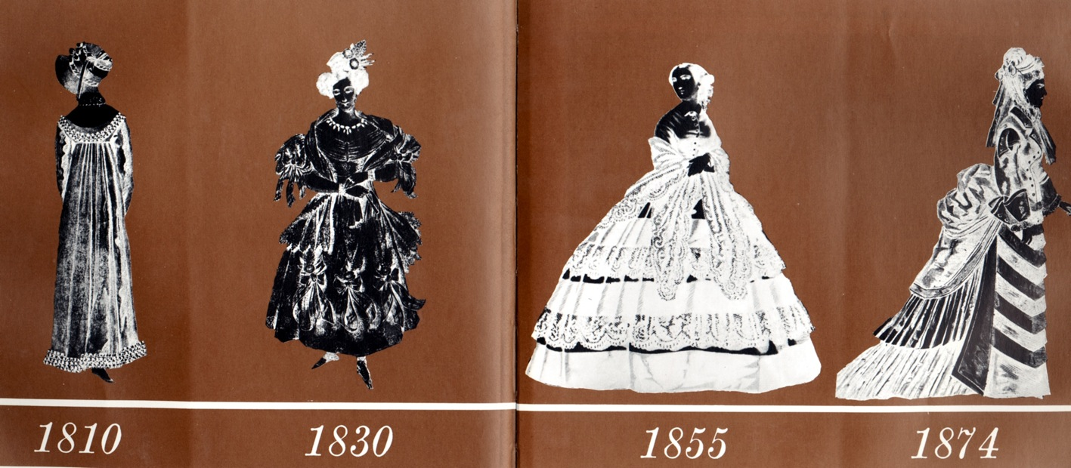
19th century silhouettes empire, romantic, crinoline(industrial), bustle

Slide 2
EMPIRE
TAILCOATS
CRAVATS
WAISTCOATS
TROUSERS
JOCKEY BOOTS
POKE BONNET
PAISLEY SHAWL

Slide 3
EMPIRE

Slide 4
EMPIRE

Slide 5
EMPIRE
COTTON BATISTE
WAIST JUST BELOW BUST
EMBROIDERY
SHORT PUFFED SLEEVES
OPEN NECK
SHEER

Slide 6
EMPIRE
SHAWL
POKE BONNET NOT A PURSE

Slide 7
EMPIRE
BRUTUS CUT
HIGH COLLARS POINT TOWARDS CHEEK
SOFT LINEN CRAVAT

Slide 8
EMPIRE
TOP HAT
TAIL COAT
STIRRUP PANTS
BUTTON CLOSURES ARE NOW BLACK SATIN STRIP ON TUX PANTS

Slide 9
EMPIRE
POKE BONNET
REDINGOTE ?
GREAT COAT?
GARRICK?

Slide 10
EMPIRE

Slide 11
EMPIRE
TOP HAT
TAIL COAT
SIDEBURNS
TROUSERS

Slide 12
EMPIRE
WALKING COAT DRESS

Slide 13
EMPIRE
TOP HAT
WALKING COAT
GOWNS, MULTIPLE LAYERS
FUR BOAS

Slide 14
EMPIRE
JOSEPHINE’S CORONATION GOWN

Slide 15
EMPIRE, ROMANTIC
POKE BONNET

Slide 16
ROMANTIC
POKE BONNET
LEG-O-MUTTON SLEEVES
FROCK COAT
TROUSERS

Slide 17
ROMANTIC
APOLLO KNOT
SPANIEL EARS
BERTHA COLLAR
IMBECILE

Slide 18
FROCK COAT
HIS BOOTS ARE WELLINGTONS

Slide 19
ROMANTIC
SAUSAGE CURLS
LACE BERTHA COLLAR

Slide 20
ROMANTIC
DAY DRESSES
POKE BONNET
BALLET SLIPPERS
IMBECILE SLEEVES, BERTHA COLLARS
CALICO PRINTS
APOLLO KNOTS

Slide 21
ROMANTIC
PRINTED CRAVAT TREND

Slide 22
ROMANTIC
APOLLO KNOT
FOREHEAD CHAIN (INDIAN INFLUENCE)
IMBECILE PUFFED SHORT SLEEVES
FICHEU BLOWING

Slide 23
ROMANTIC
DAY DREAMING?
WRITING?
FULL TROUSERS

Slide 24
ROMANTIC

Slide 25
CRINOLINE
CAGED CRINOLINE

Slide 26
CRINOLINE
PAGODA SLEEVES

Slide 27
CRINOLINE
HAIR IN SMALLER BONNETS, HATS
SLEEVES SMALL AT CAP AND FLAIR AT CUFF (PAGODA SHAPE)
CAGED CRINOLINE

Slide 28
CRINOLINE
NATURAL WAIST
SLEEVE FLARES
CAGED CRINOLINE UNDERNEATH THE DRESS

Slide 29
CRINOLINE
WALKING COSTUMES

Slide 30
HANDY CHAMBER POT NEAR THE BASE

Slide 31
BUSTLE

Slide 32
BUSTLE
POLKA DOTS…NOT POPULAR HISTORICALLY
RUFFS AT NECK AND CUFFS
HAIR SMOOTHED BACK ON THE FOREHEAD AND UP OFF OF THE NECK

Slide 33
BUSTLE
‘SENSIBLE’ BUSTLES
HORSEHAIR RUFFLES
WIRED CAGE
PADDED ROLLS AND RUFFLES

Slide 34
BUSTLE
OVER DRAPE
UNDERSKIRT OF RUFFLES
DUST RUFFLE ON THE HEM

Slide 35
BUSTLE
PANTALOONS

Slide 36
BUSTLE

Slide 37
BUSTLE
GEORGE AND HENRY
(MIXING CONTEMPORARY AND EARLIER STYLES)
TOP HATS
STIFFENED COLLARS
PRINTED CRAVATS
GLOVED W/WALKING STICK.
HENRY IN SACK COAT

Slide 38
BUSTLE
DOLMA

Slide 39
BUSTLE
BLENDING INTO THE “HOURGLASS” SILHOUETTE
LESS BULK IN BACK
SMALL CAP OF SLEEVE AND FITTED TO CUFF
JACKET, BLOUSE, BUSTLE, OVERDRAPE, UNDERSKIRT
HANDS ALWAYS GLOVED
HAT

Slide 40
HOURGLASS

Slide 41
HOURGLASS
EVENING GOWN
NOTICE THE “WASP” WAIST

Slide 42
HOURGLASS
FROCK COAT (SKIRT IN FRONT WITH A WAIST SEAM)

Slide 43
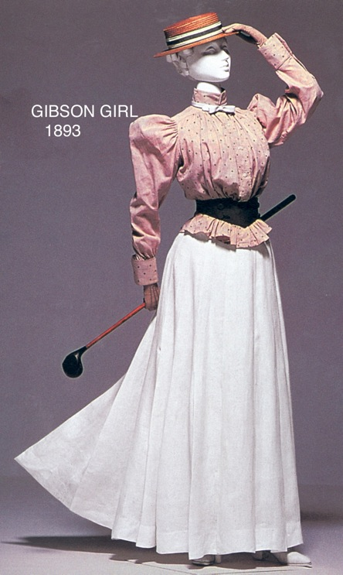
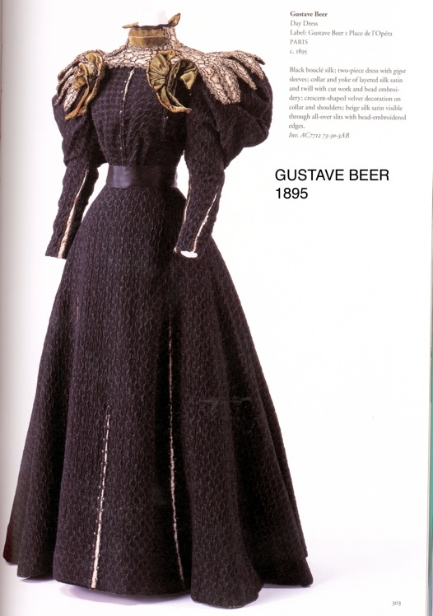
End of the 19th century: Hourglass

Slide 44
HOURGLASS
TAFFETA, CHINTZ
BATHING COSTUMES

Slide 45
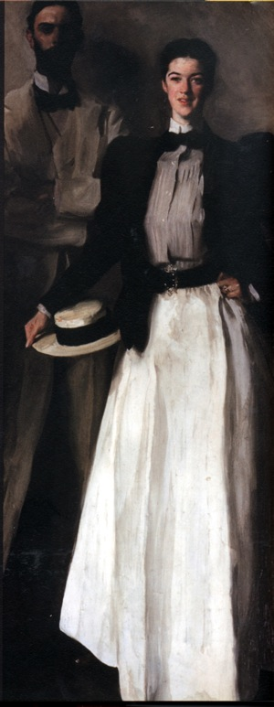
hourglass
LINEN SACK SUIT
STARCHED COLLAR
BOW TIE
BLACK LEG-O-MUTTON SLEEVED JACKET
SHIRTWAIST, PLEATED BLOUSE…IN TRANSITION
GORED SKIRT
BOATER

Slide 46
HOURGLASS/GIBSON GIRLS

