Slide 1
Italian Renaissance
Late 14th – early 17th centuries
Renaissance = rebirth
Refers to a sense of awakening of the arts and learning in the Western world

Slide 2
In the Medieval period the Catholic Church had heavily influenced artistic styles and traditions, in particular hiding and distorting the human body
In the Italian Renaissance there was a return to:
representing realistic proportions in art
the classical proportions taught in ancient Greece and Rome

Slide 3
New developments in philosophy and the arts:
Humanism – Study of and emphasis on humanity rather than God or the gods
Perspective = Creating the illusion of 3-dimensional depth on 2-dimensional surfaces
This inspires innovations in theatrical design

Slide 4
This was an age of
Exploration (North and South America)
Discoveries (North and South America)
Inventions (i.e. the printing press in 1440)

Slide 5
Earth was still the center of the solar system (for the time being),
And Italy was the center of the rebirth
Ruled by wealthy kings and princes
Who had leisure time
Loved to display their wealth
Hired artists to create lavish works

Slide 6
DEVELOPMENTS IN THEATER
1550-1660
Improvisational theater
Acting
Dramatic Criticism
Theater architecture
Scenic design

Slide 7
4 Important Dramatic Innovations:
Intermezzi
Pastorals
Opera
Commedia del’ Arte

Slide 8
1. INTERMEZZI =
Short Interludes (with music) performed between the acts of full –length plays
Use mythology (the allegory flatters the patron)
Full production values (esp. special effects)
(By the late 16th century, the intermezzo had become the most spectacular form of dramatic performance, a deferential, and an important precursor to opera)

Slide 9
2. PASTORALS =
Short comic pieces (based on satyr plays)
Subject is romance
Country settings (nymphs, satyrs & shepherds) but sentimental, not vulgar
Always a happy ending

Slide 10
3. OPERA =
Dramatic work combines text and music (with singers, musicians, scenery, costumes + sometimes dance)
Re-creation of the Greek tragic style
Fuse music and drama (POSSIBLE INFLUENCE OF THE INTERMEZZI?)

Slide 11
4. COMMEDIA DELL’ARTE = (Comedy of Professional Artists)
Improvisational comedy
Stock Characters
Masks
Plot- ultimate reunion of the two young lovers
Resolved when lovers finally get together

Slide 12
Stock Characters = have identifiable characters + characteristics
Recognizable costumes
Recognizable masks
Recognizable ways of speaking, moving
Standard LAZZI = comic “bits” or “gags”

Slide 13
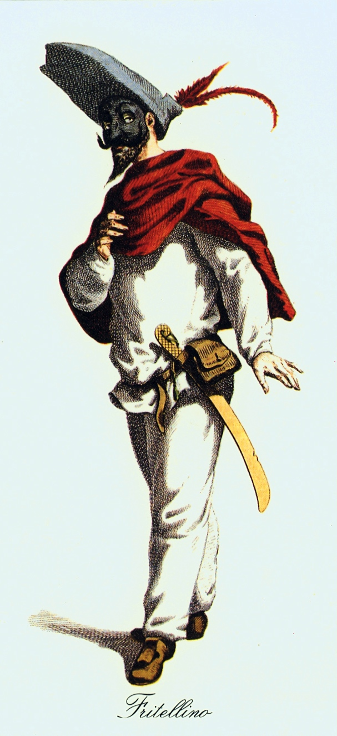
Commedia del’ arte characters
Zanni = Comic male servants

Slide 14
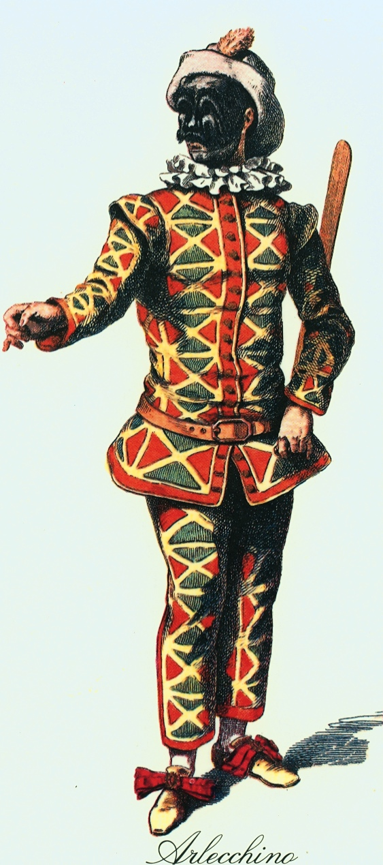
Zanni/ Harlequino – Comic servant/slave is an opportunistic trickster
His Lazzo is to drop whatever he is doing for a banana (or any food)
***He uses a Slapstick
Harlequino with slapstick

Slide 15
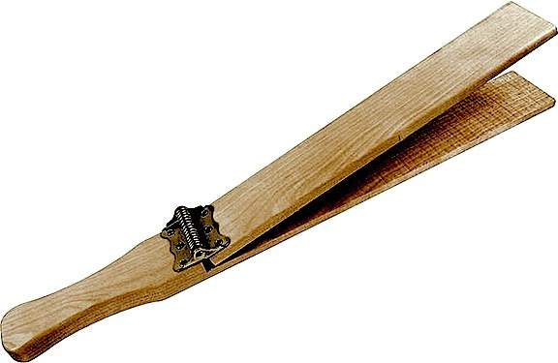
Slapstick - paddle designed to produce a loud whacking sound

Slide 16
ZANNI/ HARLEQUINO – Lazzi of poor sight. Speaks in the direction of the last person to speak. That person moves but Zanni continues to talk to them as if they are there.
Lazzi of poor hearing. Can't understand what people say to him, or repeats back gross misinterpretations.
Lazzo of wandering out of the playing area aimlessly and quickly reappearing in another part of the playing area which he could not have possibly gotten to.

Slide 17
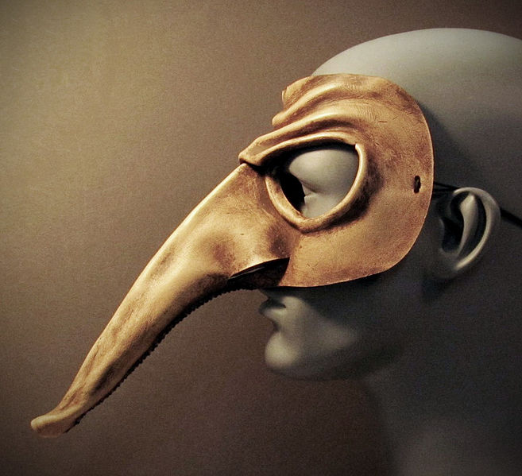
Commedia del’ arte mask with very long nose
Some zannis are smarter –
longer nose = fewer brains

Slide 18
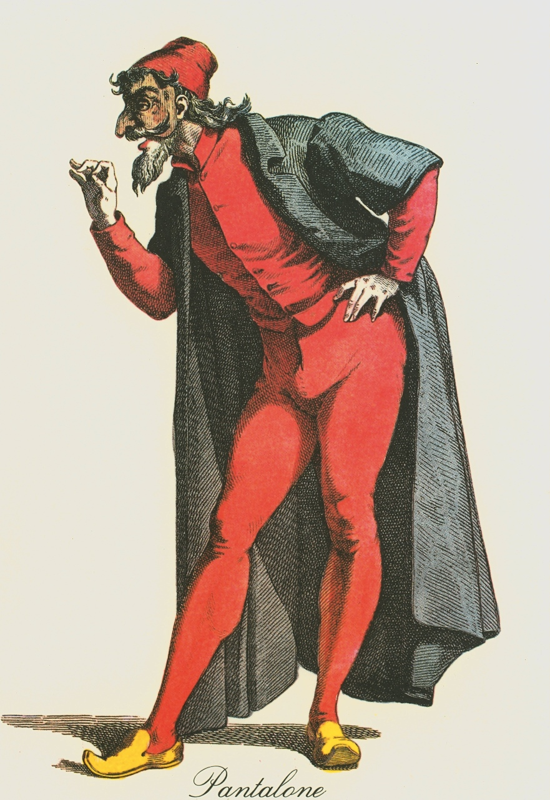
PANTALONE - Old father – greedy - rich and almost miserly old merchant
Self-important
Goal = get more money and/or win a young maiden
Usually stupid - always decrepit and stumbling
Pantalone costume

Slide 19
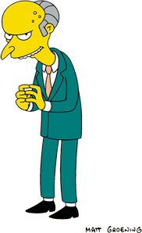
Mr. Burns is a modern Pantalone
Matt Groening’s Mr. Burns character from The Simpsons

Slide 20
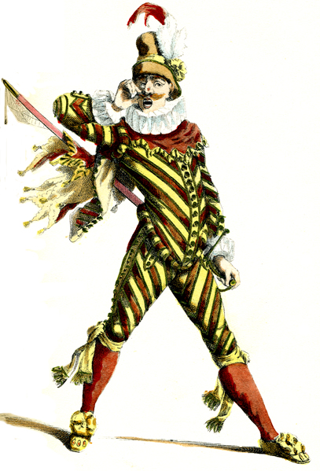
Capitano = Braggart Soldier
Lazzo of Excuses
long spiel - he could kill whoever he is talking to-
he could destroy them in so many ways with so much ease-
BUT there is always some silly reason why he can’t
A coward

Slide 21
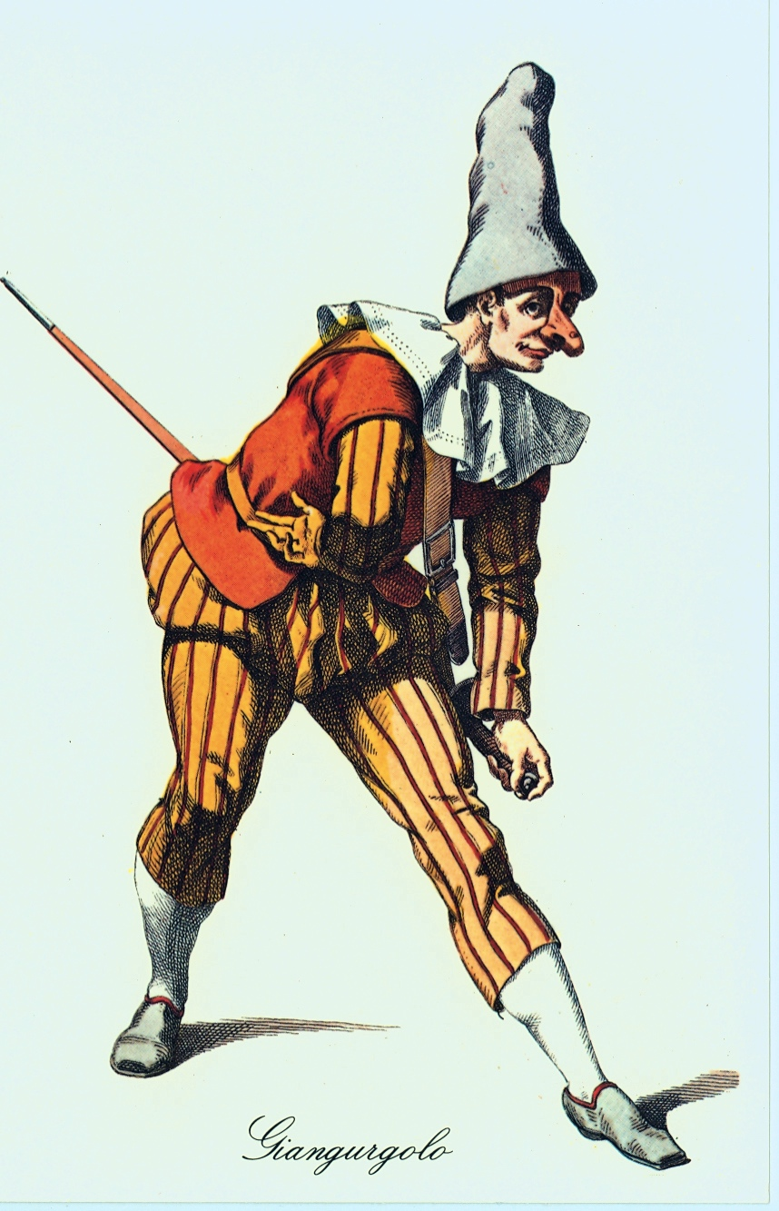
Capitano – Military man
In the uniform of the region
Self-important, loudmouthed
Tries to win the young maiden with boasting
Capitano in exaggerated uniform

Slide 22
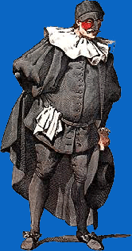
Dottore – Doctor - Overeducated but stupid about life could also be a lawyer, teacher or philosopher
(may not know how to cure but sure knows how to talk)
Dottore mask –only over the nose and forehead. Cheeks are revealed and may be reddened to show Il’ Dottore’s fondness for the bottle.
Dottore in mask

Slide 23
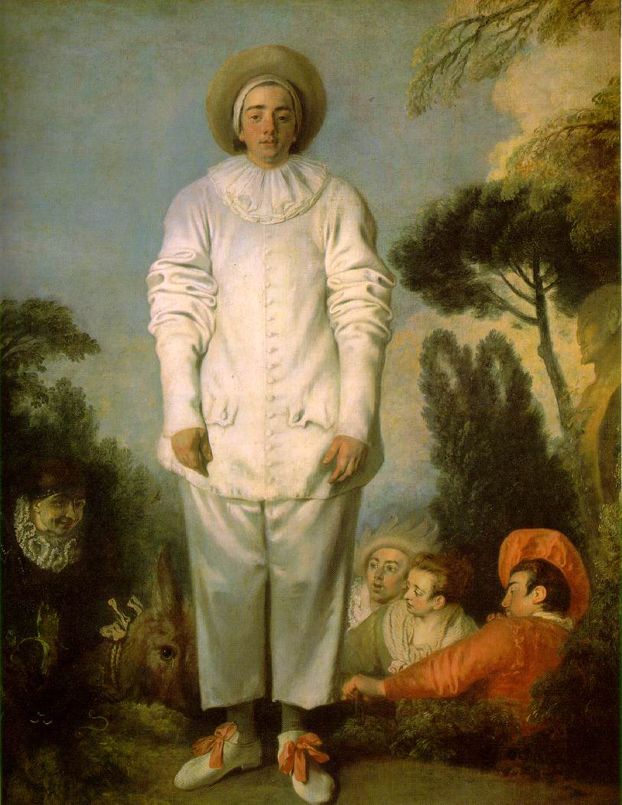
Pierrot
Sad clown in white,
pines for the love of Columbine –
who often leaves him for Harlequino
Pierrot all in white (satin)

Slide 24
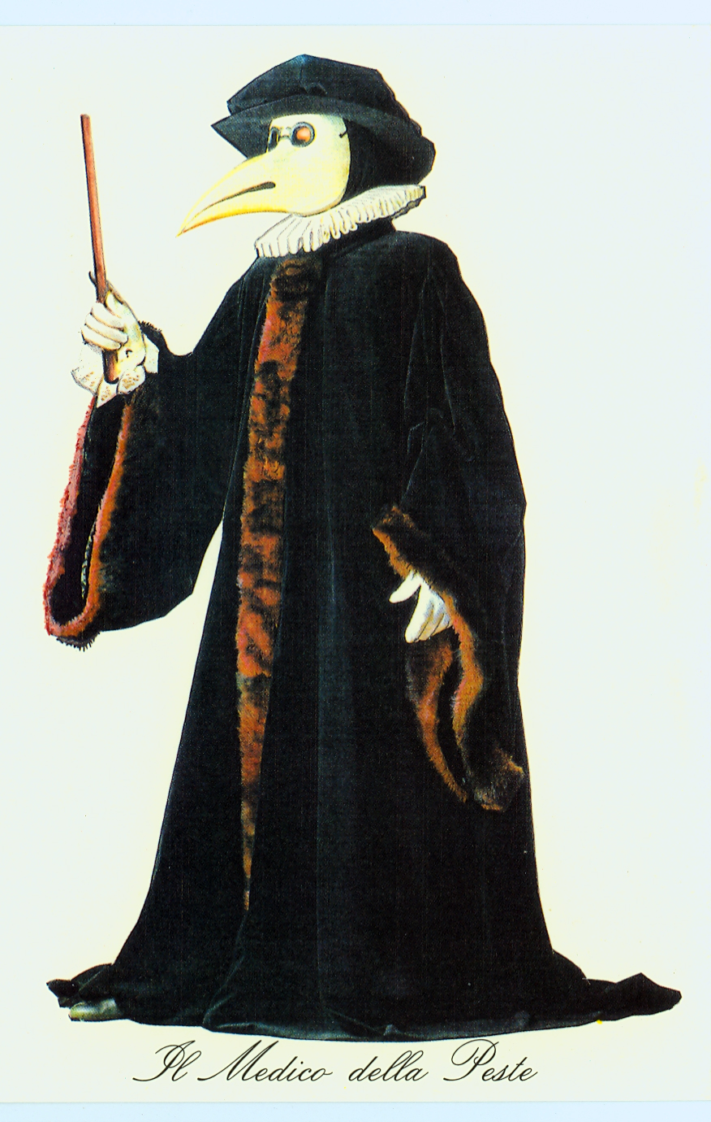
Il Medico della Peste Plague Doctor

Slide 25
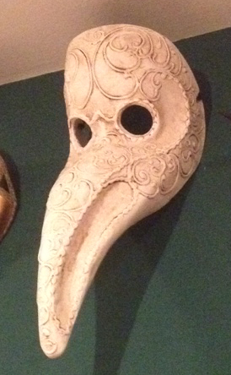
Mask for the Plague Doctor

Slide 26
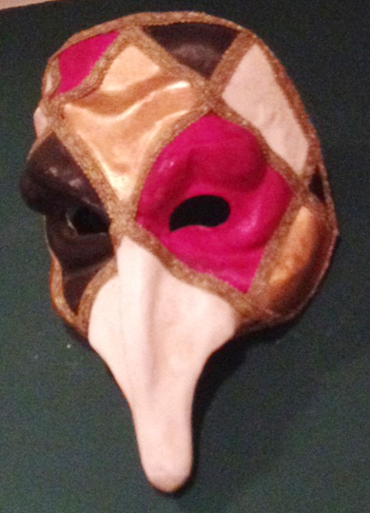

Slide 27
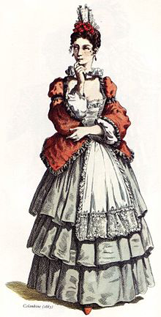
Columbina
– tricky servant/slave to inamorata, helps mistress fend off Pantalone with a tambourine, helps her get to the inamorato
Columbina

Slide 28
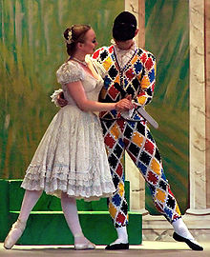
Modern Columbina and Harlequino

Slide 29
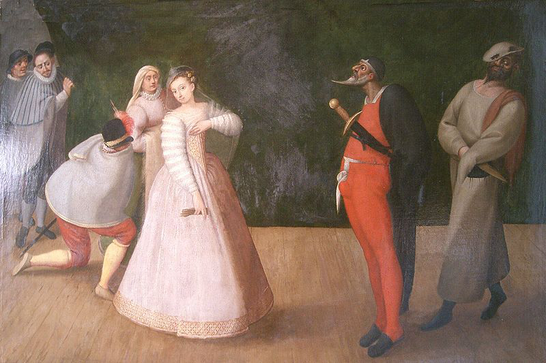
Painting of performance with Columbina and Pantalone

Slide 30
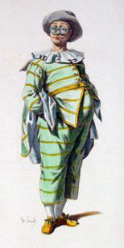
Tartaglia – the stutterer

Slide 31
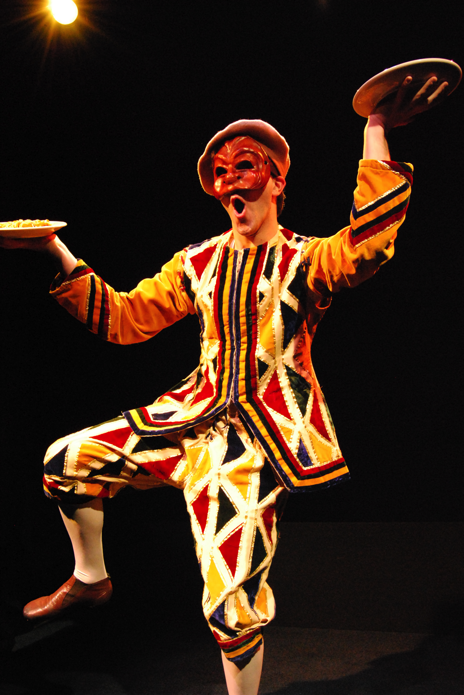
Harlequino with cream pies

Slide 32
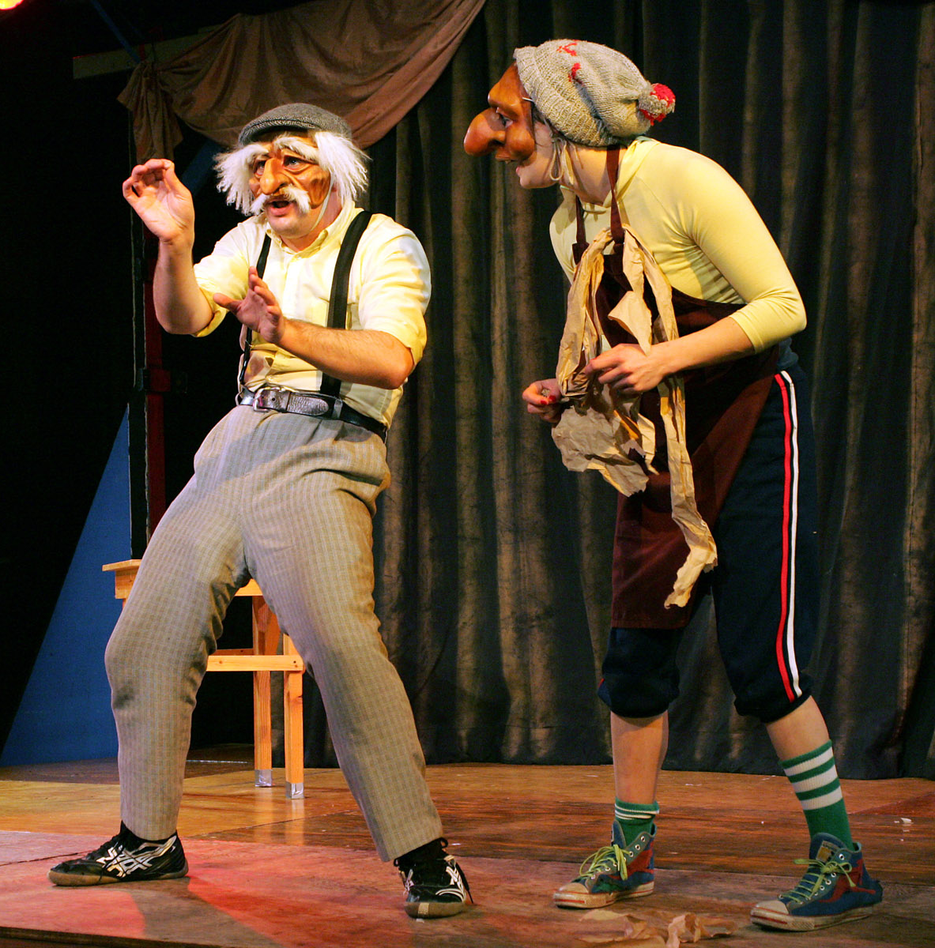
Modern comic characters – old man and silly servant

Slide 33
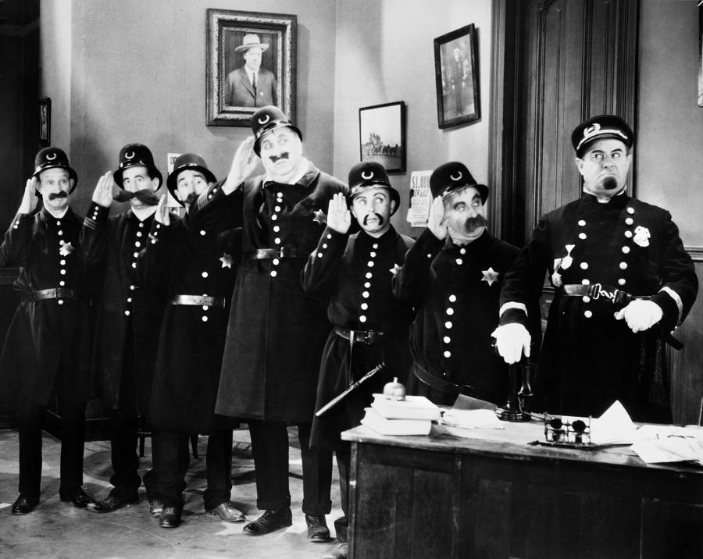
Keystone Kops modern zannis

Slide 34
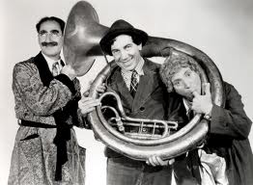
Marx brothers: Groucho, Chico, Harpo

Slide 35
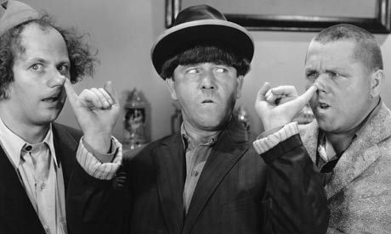
The Three Stooges – Larry, Moe, and Curly

Slide 36
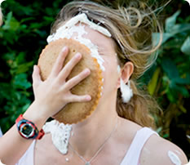
Girl getting a pie in the face

Slide 37
Links to more info on commedia del arte
http://www.youtube.com/watch?v=h_0TAXWt8hY
http://www.youtube.com/watch?v=XQUiNDZM9aE

Slide 38
Italian Renaissance Dramatic Rules: Neoclassical Ideals
Critics created rules for playwrights to follow
1 –Needed to follow VERISIMILITUDE – be ‘True to Life’
2 – Have a stock situation and characters
3 – Insisted on the THREE UNITIES:
TIME – All takes place within 24 hours
PLACE – Only one locale
ACTION – Focus on one central story, no subplots

Slide 39
NEOCLASSICAL PURITY OF GENRE
Tragedy – Deals with royalty – must end sadly usually in poetic language
Comedy – About common people – must end happily
Function of all drama - TEACH A MORAL LESSON
No - onstage violence
No - chorus or supernatural beings
No - soliloquy – Monologue through which a character (alone onstage) reveals thoughts by speaking them aloud

Slide 40
THEATER PRODUCTION
First introduction of the Proscenium Arch
Pro scenium = Picture frame (in front of scene)
Used three dimensional scenic tricks
In Venice. opera theaters designed to attract a larger audience = make more money...

Slide 41
Parts of theater (audience)
Pit = commoners stood could get rowdy
Boxes = upper classes
Gallery = least expensive, benches

Slide 42
GALLERIES
PIT
BOXES

Slide 43
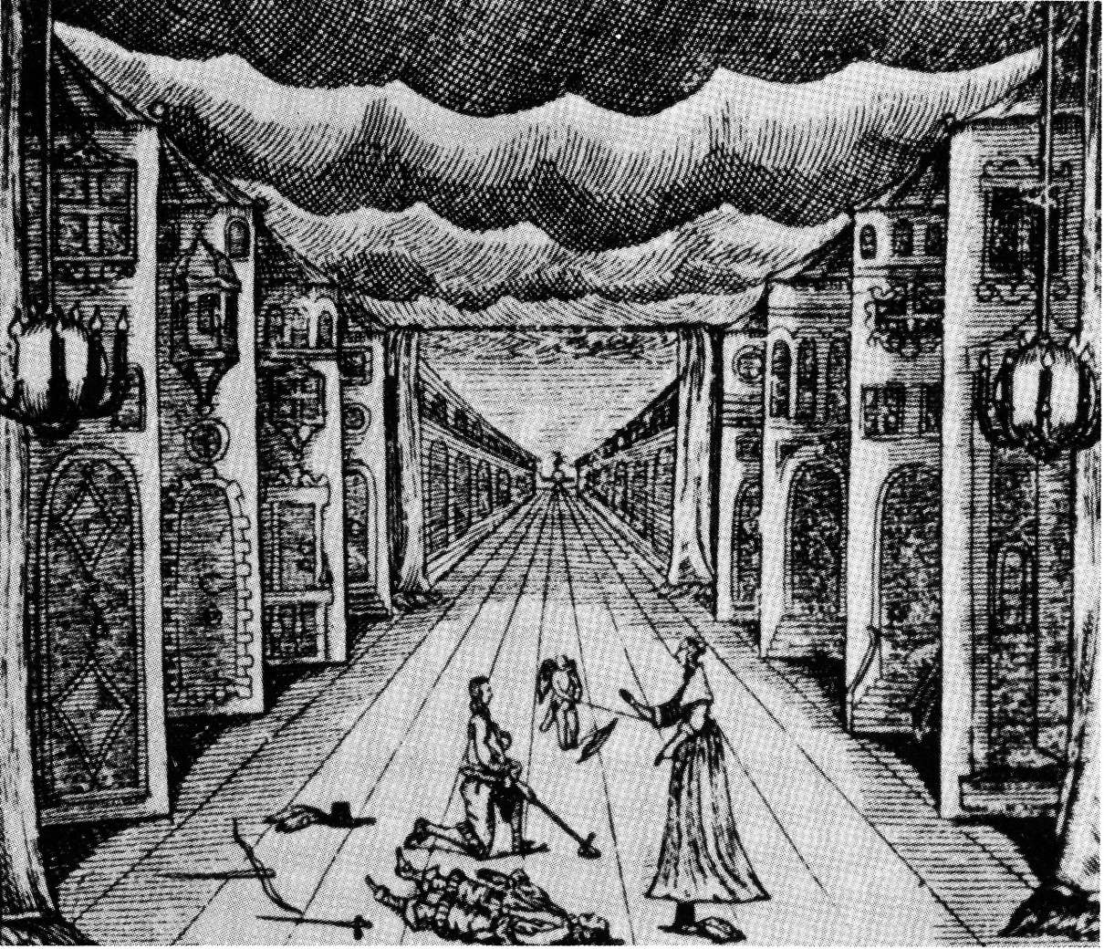
PERSPECTIVE – Creating the illusion of 3-dimensions Inspires innovations in theatrical design – especially the PROSCENIUM ARCH
Illustration of stage scene with perspective, shutters

Slide 44
PROSCENIUM

Slide 45
Two systems to move scenery:
Groove system
Pole and chariot

Slide 46
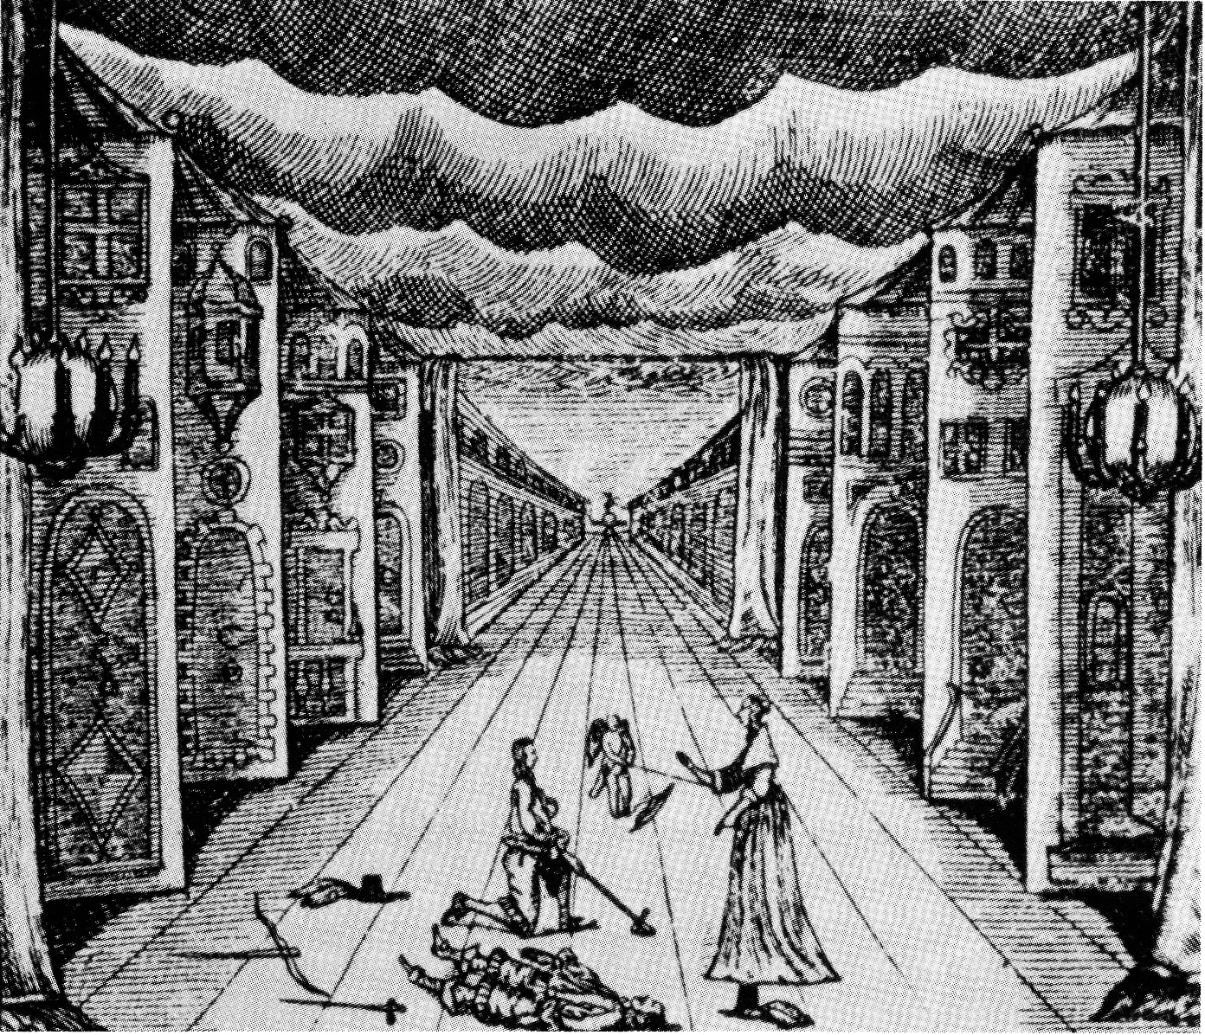

Slide 47
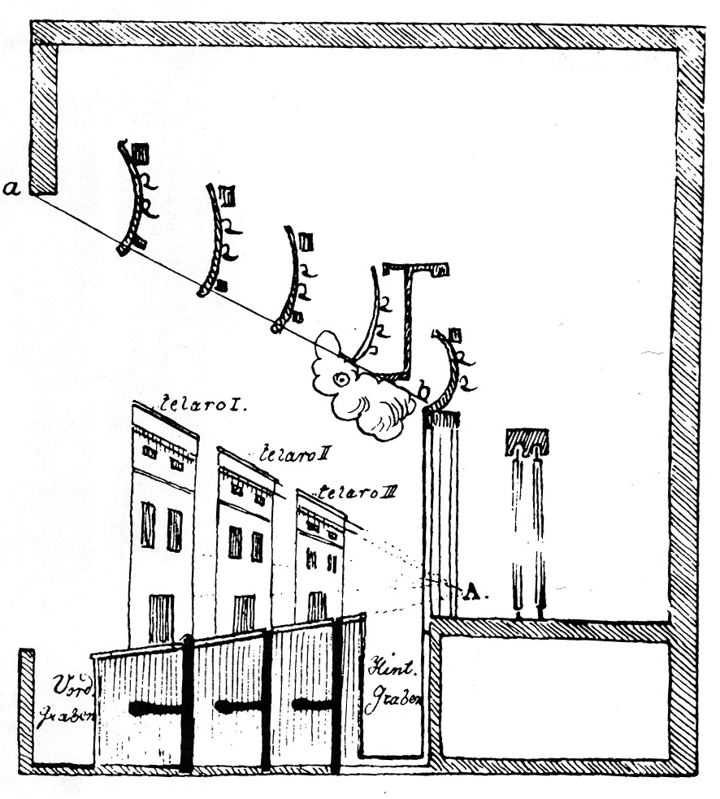
Audience
Wing and groove system seen from the side

Slide 48
Pole and chariot system showing stage level and below stage

Slide 49
Reconstructed Globe Theater, London
with full audience in pit, boxes and galleries

Slide 50
Illustration showing bearbaiting
Notes:
Bear Baiting

