Slide 1
Essay writing
FPEL 800
Academic writing

Slide 2
What is an essay?
An essay is a collection of separate paragraphs and it includes three parts.
1- Introduction
2- Body paragraphs
3- Conclusion

Slide 3
1- Introduction
The introduction consists of
1- hook
2- general statements
(background information)
3- THESIS STATEMENT

Slide 4
1- What should we write in the thesis statement?
It includes the focus of the essay
You answer the essay question in this sentence.

Slide 5
2- Body paragraphs
The body paragraphs is about paragraphs.
It can be one paragraph, two or three paragraphs or more than that.

Slide 6
Each body paragraph consists of:
1- topic sentence
Here we should write the main idea, but in general.
2- supporting sentences
Here we write the points in details with some examples.
3- concluding sentence

Slide 7
3- conclusion
In the conclusion, you can:
Restate the thesis statement.
Summarize the main points.
Give final thought to let the reader think.

Slide 8
1- Introduction

Slide 9
1- Introduction
The introduction consists of
1- general statements
(hook + background information)
2- THESIS STATEMENT

Slide 10
Example of introduction

Slide 11
Example 1 Essay question
There are many forms of the transport, for example plane, cars, bus and train.
What are the advantages and disadvantages of travelling by train?

Slide 12
Example 1
Nowadays, there are many different ways to travel from one place to another. For example by plane, by car, by bus, or by train. Many people prefer to travel by train because it is fast and comfortable, but there are also some drawbacks of this form of transport.

Slide 13
1- Nowadays, there are many different ways to travel from one place to another. >> General statement 1
For example by plane, by car, by bus, or by train. >> General statement 2
2- Many people prefer to travel by train because it is fast and comfortable, but there are also some drawbacks of this form of transport. >> thesis statement

Slide 14
Example 2
The internet has changed the world.
What are the advantages and disadvantages of using internet nowadays?
Nowadays, the internet has become an essential element in people’s lives. People from different parts of the world use internet for different purposes. It has made the globe as a small village where people can communicate with each other from different parts of the world. However, people spend more hours using internet for less important purposes.

Slide 15
Example 3
What are the benefits of using mobile phones?
Nowadays, mobile phones are one of the most important inventions in the world. People are using mobile phones in different places, at home, at work or in a park and they use them for different purposes. There are a lot of benefits of using mobile phones, for example communication, entertainment and running business.

Slide 16
2- Body paragraphs

Slide 17
Each body paragraph is about:
A- a topic sentence
B- Supporting sentences
C- concluding sentence

Slide 18
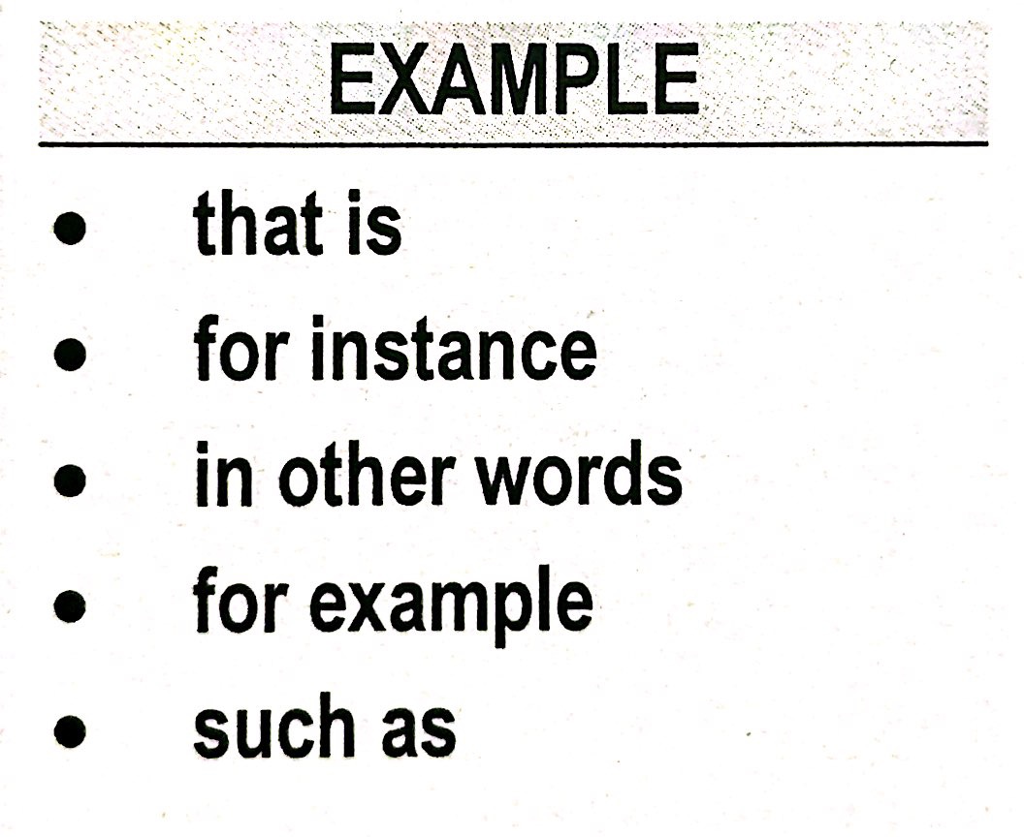
Linking words

Slide 19
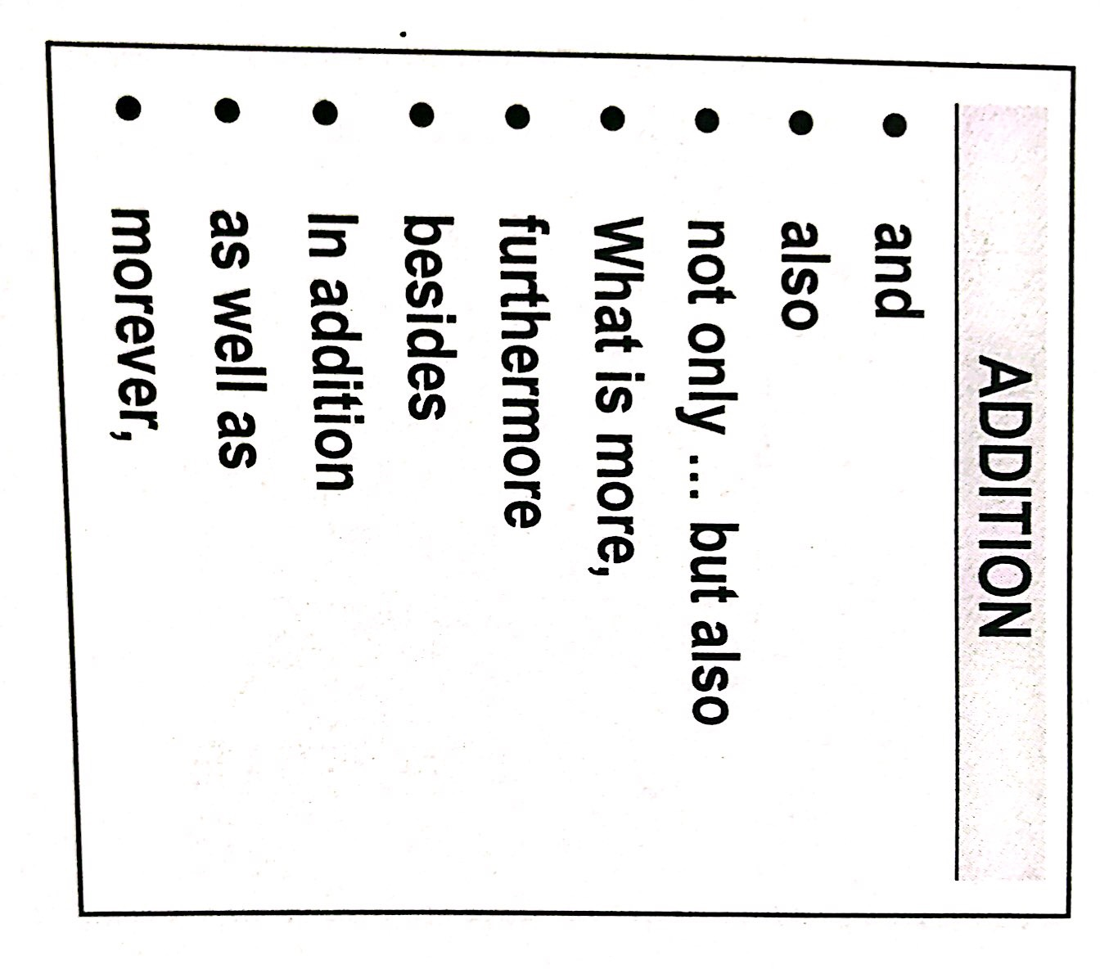

Slide 20
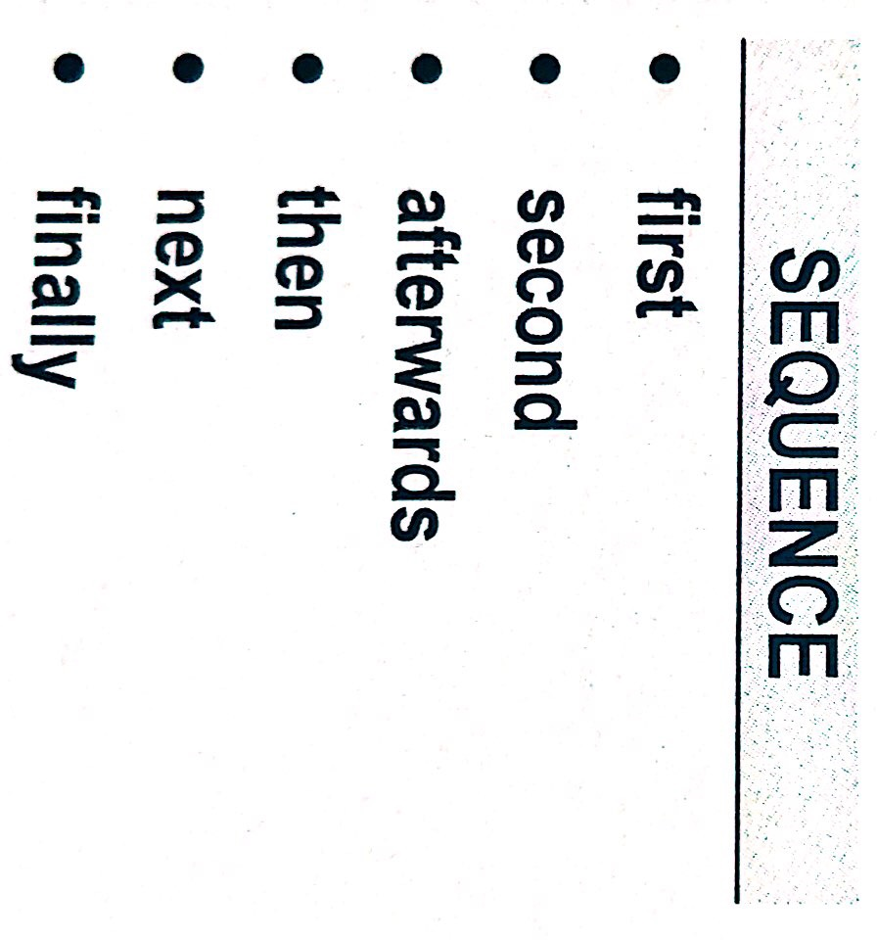

Slide 21
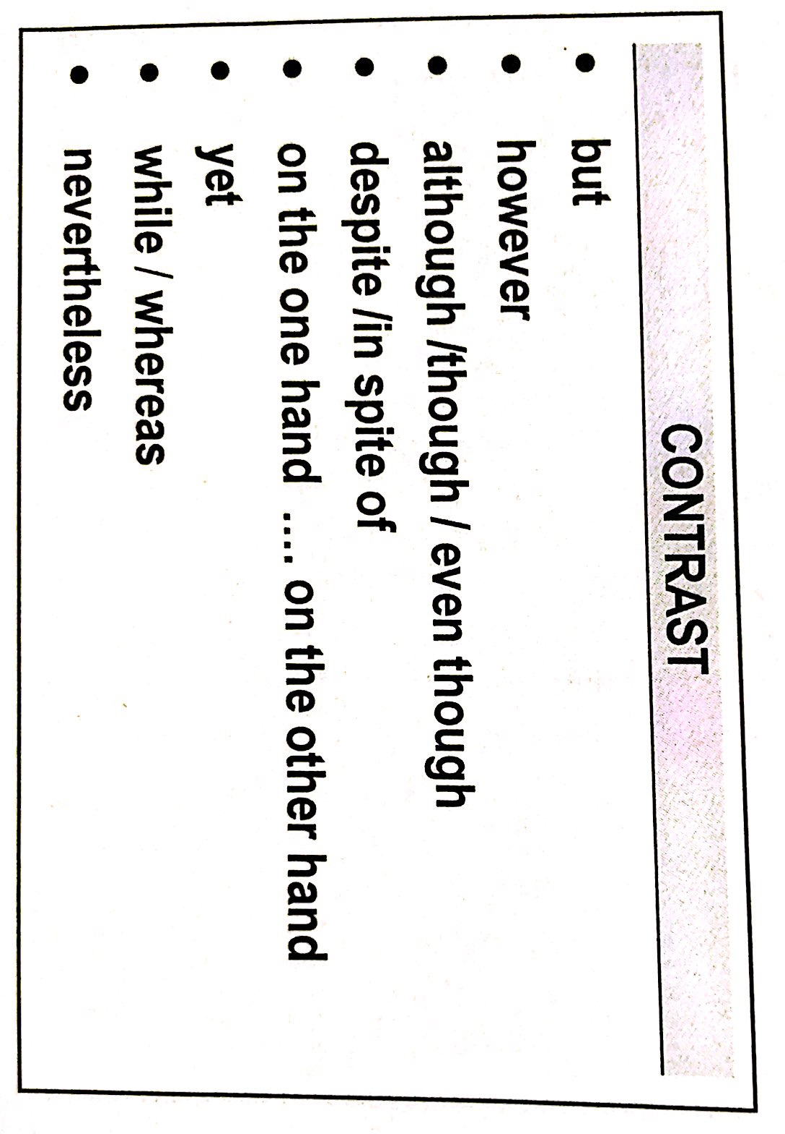

Slide 22
Essay topic
There are many forms of the transport, for example plane, cars, bus and train.
What are the advantages and disadvantages of travelling by train?

Slide 23
Writing body paragraphs
Example 1
Travelling by train has many advantages. First of all, there are no stressful traffic jams and trains are fast and comfortable. You can also use the time in different ways. For example, you can just sit and read, or watch the world go by. Moreover, you can have a meal or a snake in the train. These are some advantages of travelling by train.

Slide 24
On the other hand,
In contrast,
However, travelling by train has some disadvantages. First, it is expensive and the trains are sometimes crowded and delayed. second, you have to travel at certain times and trains cannot take you from door to door. For example, you need a bus or a taxi to take you to the railway station.
it is clear or It can be clearly seen that travelling by train has some drawbacks.

Slide 25
Writing body paragraphs
Travelling by train has many advantages. First of all, there are no stressful traffic jams and trains are fast and comfortable. You can also use the time in different ways. For example, you can just sit and read, or watch the world go by. Moreover, you can have a meal or a snake in the train. These are some advantages of travelling by train.
However, there are some disadvantages of travelling by train. First, it is expensive and the trains are sometimes crowded and delayed. second, you have to travel at certain times and trains cannot take you from door to door. For example, you need a bus or a taxi to take you to the railway station. It can be clearly seen that travelling by train has some drawbacks.

Slide 26
Writing body paragraphs
Example 2
What are the benefits of using mobile phones?

Slide 27
There are significant benefits of using mobile phones. First, people use mobile phones in order to communicate with other people from different parts of the world as well as to communicate with family and friends. Second, it is also a means of entertainment for people. For example, they can watch videos, listen to music and play games. Third, mobile phones help students to study, for instance they can use the dictionary to look up the meaning of new words. In addition, they can download some books to read and search for information. Finally, with mobile phones, we can become wealthy by selling and trading online. It can be concluded that mobile phones provide us with many benefits.

Slide 28
3- conclusion
.

Slide 29
3- conclusion
In the conclusion, you can:
Restate the thesis statement.
Summarize the main points.
Give final comment to let the reader think.

Slide 30
Some concluding linking words

Slide 31
Example 1
Topic:
There are many forms of the transport, for example plane, cars, bus and train.
What are the advantages and disadvantages of travelling by train?

Slide 32
In summary, although travelling by train is a useful means of transport, it has some disadvantages. A lot of people prefer to travel by train as they can sit and spend the time they want. On the other hand, others think that they cannot afford travelling by trains as it costs a lot of money. In the future, it is likely to have better train services.

Slide 33
To give final comment
In my opinion, I think …
I believe …
I feel …
I think people should …
People should …
In the future, It is likely that …

Slide 34
Example 2

Slide 37
1
In conclusion, I prefer travelling by train rather than other forms of transport. In my opinion, I feel more relaxed when I reach my destination by train.

Slide 38
2
In summary, nowadays more and more people are choosing to travel by train rather than other forms of transport. In the future, It is likely that government will develop new train network to meet this need.

Slide 39
3
To sum up, I believe that people should travel by train rather than other forms of transport. This is because you can relax and easily meet new people on the train.

Slide 40
Wish you all the best

