Slide 1

Our Time Line
Tuesday, October 16
Assignment 3 Workshop.
Bring two copies of your persuasive letter.
Reminder: Mid-term overview and practice begins next week!

Slide 2

Assignment 3
Research:
Sources available on BrightSpace
canadianlabour

Slide 3

Documenting Data
Reasons for crediting sources
Strengthens your argument
Protects you from charges of plagiarism
Instructs readers
Copyright © 2010 Nelson Education Ltd.
Ch. 12, Slide 3

Slide 4
How do we reference our information sources?
We’re not using APA citation style
We’re using signal phrases + in-your-own-words summary of your website source material = paraphrasing
You do not have to source references to what Coastal Events and the HCC offers, but you must avoid word-for-word copying from website and source materials.
If you must re-state anything as it appears on your source’s site make sure it’s enclosed in “quotation marks,” and used sparingly.

Slide 5

Documenting Data
Learn to paraphrase
Read the original material carefully so that you can comprehend its full meaning.
Write your own version without looking at the original.
Do not repeat the grammatical structure of the original, and do not merely replace words of the original with synonyms.
Reread the original to be sure you covered the main points but did not borrow specific language.
Copyright © 2010 Nelson Education Ltd.
Ch. 12, Slide 5

Slide 6
Source of paraphrased material acknowledged using signal phrase
Signal phrase introduces and identifies on-line source before paraphrased material.
The Canada Labour Congress reported…+ your summarized sentence.
Discover Halifax highlighted…+ your summarized sentence.
Last year the HCC hosted two major political party conventions with close to 3000 delegates in attendance.

Slide 7
Source of paraphrased material acknowledged using signal phrase
Signal phrase introduces and identifies on-line source before paraphrased material.
According to one Environment Canada study, green roofs reduce heat loss by 26 percent in winter and cool buildings substantially during summer months, reducing overall air conditioning costs.

Slide 8

Requesting Actions
Plan your strategy.
Determine your purpose. Know exactly what you are requesting. Be specific.
Anticipate the reaction of your audience.

Slide 9
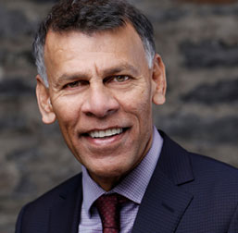
Hassan Yussuff, President

Slide 10
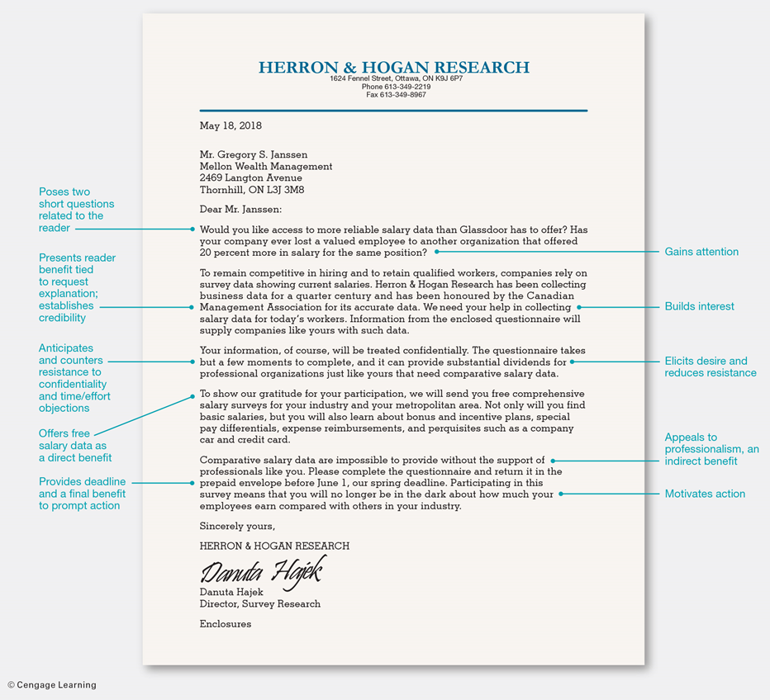
Letter format, p. 246
Create a letterhead

Slide 11
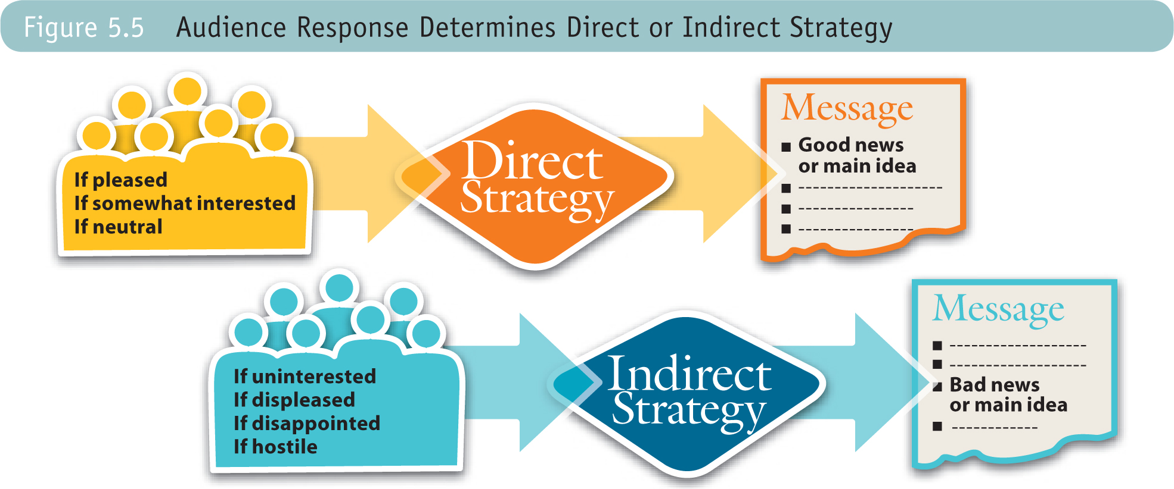
Audience Reaction Determines Strategy, p. 112

Slide 12
Applying the 3-x-3 Writing Process
Analyze the purpose; know what you want to achieve.
Adapt the message to the audience to make your message heard.
Research and organize persuasive data.
Use the AIDA strategy to persuade readers.

Slide 13
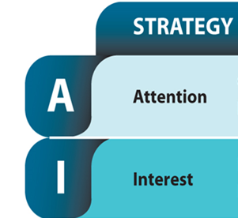
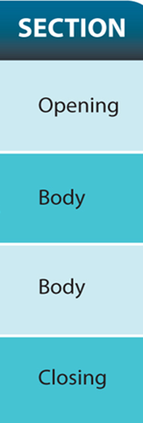

The AIDA Components:
How to Organize Your Persuasive Message
Paragraph 1: Brief: one to two sentences. Does not reveal request or reason for writing.
Paragraph 2: Builds on your opening attention-getting sentence.
Your request that CLC hold its next convention at the HCC in Halifax goes here at the end of your interest-building section.
Paragraph 4: Reduces reader’s resistance to your request by countering skepticism or doubt with facts. Develop at least two or three reasons.
Paragraph 5: Motivate action by offering first realistic step towards making this event happen. Read your textbook for other suggestions.

Slide 14

Challenge 1: How do I avoid revealing my request (main idea) too soon?
Paragraph 1: One to two sentences.
Paragraph 2: Builds on your opening attention-getting sentence.
Your request that CLC hold its next convention at the HCC in Halifax goes here at the end of your interest-building section.
Tip: Choose an attention-getting opening that offers a natural transition to your second paragraph and gives you something to build and expand on in paragraph two.

Slide 15
Your Opening
Brief, relevant attention-getting statement (a sentence or two)
Adapted to reader
Doesn’t give away message’s purpose (reason for writing)
Attention-getting techniques p. 243

Slide 16
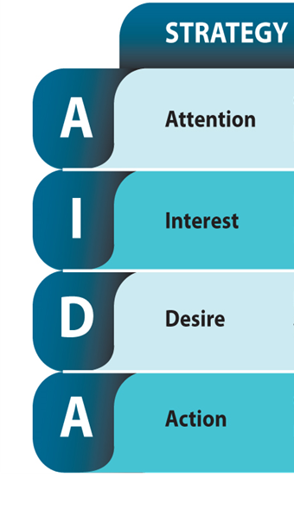

Challenge 2: How do I “reduce resistance”?
What does that even mean?
Your request that CLC hold its next convention at the HCC in Halifax goes here at the end of your interest-building section.
Paragraph 4: Reduces reader’s resistance to your request by countering skepticism or doubt with facts. Develop at least two reasons.
See Pages 244 and 246

Slide 17
Four-Part AIDA Strategy
Elicit desire by doing the following:
Reduce resistance.
Anticipate objections.
Offer counterarguments.
Use What if? scenarios.

Slide 18
Create Desire
Avoid bringing up objections that my never have occurred to the receiver.
Establish credibility and expertise.
Ensure your request is reasonable and that you are believable.
Refer to your credentials and demonstrate your competence.

Slide 19
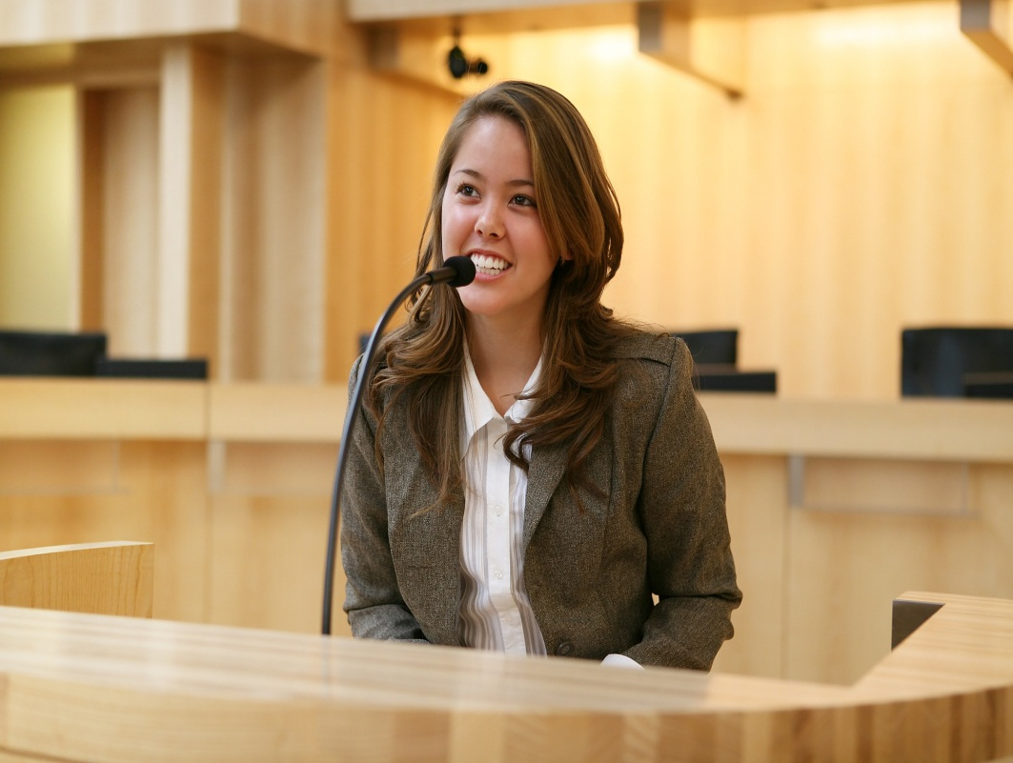
Direct and Indirect Benefits
Direct Benefit : Tangible items
Tax deduction, t-shirt, name on a poster.
If you accept our invitation to speak, you will have an audience of 50 potential customers for your products.
Indirect Benefit: Intangible
Sense of achievement, recognition, helping others, pride.
Your appearance would prove your professionalism and make us grateful for your willingness to give something back to our field.
Copyright Ltd.

