Slide 1
The Americas, Europe, and Africa before 1492
Learning Objectives:
1.1: Describe and compare the major American civilizations before the arrival of the Spanish.
1.2: Describe the European societies that engaged in conversion, conquest, commerce, and exploration.
1.3: Discuss the roles of Islam and Europe in West Africa and the slave trade.

Slide 2
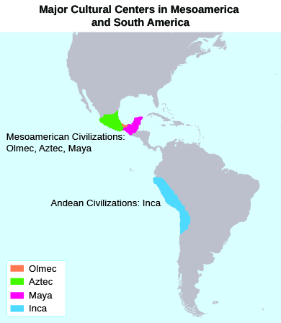
Learning Objective 1.1: Describe and compare the major American civilizations before the arrival of the Spanish.
People Come to the Americas
Nine to fifteen thousand years ago, people migrated from Asia to the Americas over a land bridge called Beringia.
Beringia sunk into the waters and became the Bering Strait.
Groups of people spread out around North and South America, forming diverse cultures.
Ten thousand years ago people began to domesticate plants and animals, allowing them to build permanent settlements.
A number of large and sophisticated settlements grew up in Mesoamerica and South America.
Authored by OpenStax College (License: CC-BY Attribution). Available for download at www.openstaxcollege.org. Adapted by: Barnes & Noble Education.

Slide 3
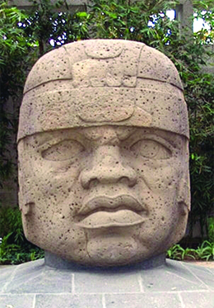
Learning Objective 1.1: Describe and compare the major American civilizations before the arrival of the Spanish.
The Olmec
Lived along the Gulf Coast of Mexico from 1200 to 400 BCE
Agricultural society
Worshipped rain god, maize god, and feathered serpent god
Traded throughout Mesoamerica
Distinctive art style included giant head sculptures
Authored by OpenStax College (License: CC-BY Attribution). Available for download at www.openstaxcollege.org. Adapted by: Barnes & Noble Education.

Slide 4
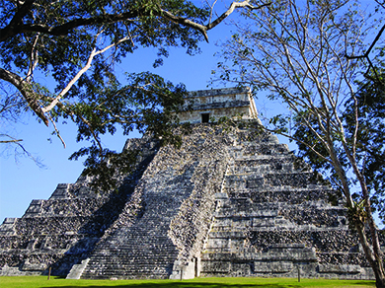
Learning Objective 1.1: Describe and compare the major American civilizations before the arrival of the Spanish.
The Maya
Lived in Mexico, Belize, Honduras, and Guatemala from 2000 BCE to 900 CE
Perfected calendar and written language developed by Olmec
Created mathematical systems to improve farming and trade
Primarily traders
Connected to Teotihuacan, major city near modern Mexico City
Authored by OpenStax College (License: CC-BY Attribution). Available for download at www.openstaxcollege.org. Adapted by: Barnes & Noble Education.

Slide 5
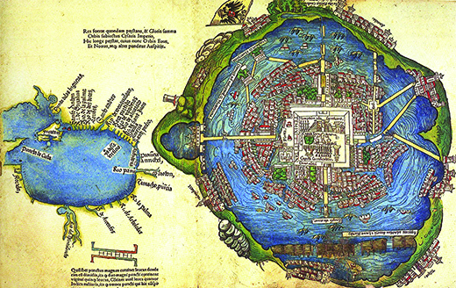
Learning Objective 1.1: Describe and compare the major American civilizations before the arrival of the Spanish.
The Aztec
Lived in the area around the site of modern Mexico City
Built large sophisticated city called Tenochtitlán on an island in Lake Texcoco
City was organized with planned neighborhoods, aqueducts, and trash collection systems
Practiced human sacrifice
Conquered in 1519 by Spanish explorer Hernán Cortés.
Authored by OpenStax College (License: CC-BY Attribution). Available for download at www.openstaxcollege.org. Adapted by: Barnes & Noble Education.

Slide 6
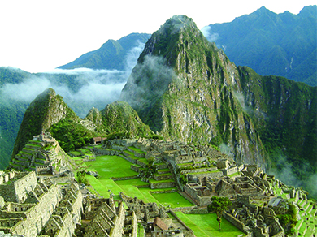
Learning Objective 1.1: Describe and compare the major American civilizations before the arrival of the Spanish.
The Inca
An empire along the Pacific coast, from present-day Colombia to Chile
Highly developed road system kept empire connected
Communicated via chasquis, runners who carried messages
Used a system of knots and colored strings called quipu to keep records instead of writing
Lived in a feudal-type system where peasants farmed for their lords
Site of Machu Picchu, Incan ceremonial city, was rediscovered in 1911.
Authored by OpenStax College (License: CC-BY Attribution). Available for download at www.openstaxcollege.org. Adapted by: Barnes & Noble Education.

Slide 7
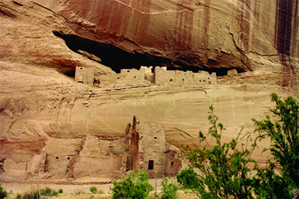
Learning Objective 1.1: Describe and compare the major American civilizations before the arrival of the Spanish.
Indians of North America
Societies were looser and more widely dispersed
Many relied on hunting and gathering
Pueblo Indians in the southwestern US built complex cities around farmland or in cliffs
Groups in the Ohio Valley and along the Mississippi relied on trading
Matriarchal societies were common in the East
Fought with Europeans over land use
Authored by OpenStax College (License: CC-BY Attribution). Available for download at www.openstaxcollege.org. Adapted by: Barnes & Noble Education.

Slide 8
Learning Objective 1.1: Describe and compare the major American civilizations before the arrival of the Spanish.
The Americas Discussion Question
How did geography and the environment contribute to the development of societies in the Americas?

Slide 9
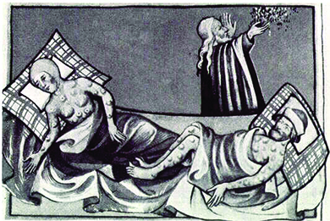
Learning Objective 1.2: Describe the European societies that engaged in conversion, conquest, commerce, and exploration.
Europe on the Brink of Change
The fall of the Roman Empire in 476 CE left a power void in Europe.
People hid from marauders in walled cities and bargained with lords and knights for protection, leading to feudalism.
The Christian Church emerged as a powerful institution
Plague epidemics devastated populations in the 14th century
Periods of high crop production and good health led to a recovery by the mid-14th century.
Authored by OpenStax College (License: CC-BY Attribution). Available for download at www.openstaxcollege.org. Adapted by: Barnes & Noble Education.

Slide 10
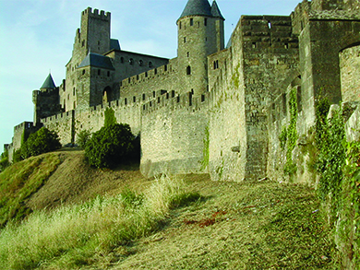
Learning Objective 1.2: Describe the European societies that engaged in conversion, conquest, commerce, and exploration.
Feudal Europe
Most Europeans lived in feudal societies.
Feudalism was a system where serfs or peasants worked and lived on land owned by a lord who lived in a castle or manor house. The serfs turned over part of their harvest to the lord.
Up to 60% of all Europeans were serfs.
Serfs lived in small, cold hovels, where illness and death were common.
Feudalism was an agrarian society. During the spring and summer, serfs’ lives were a constant grind of farming and harvesting
During the fall and winter they celebrated the harvest and tried to live off their stores of provisions; a bad crop meant starvation.
Authored by OpenStax College (License: CC-BY Attribution). Available for download at www.openstaxcollege.org. Adapted by: Barnes & Noble Education.

Slide 11
Learning Objective 1.2: Describe the European societies that engaged in conversion, conquest, commerce, and exploration.
The Christian Church
The Catholic Church became wealthy by buying up land and collecting tithes, or required contributions, from parishioners.
The Church became the center of society and a unifying force among people.
The Church offered organization, guidance, and even a calendar of worship and holidays.
Christianity spread to replace or adopt paganism/animism.
Illiterate serfs were dependent on priests who could read the Bible and explain it to them.
The pope was seen as God’s representative on Earth, and therefore as more powerful than the kings and lords who he could condemn.

Slide 12
Learning Objective 1.2: Describe the European societies that engaged in conversion, conquest, commerce, and exploration.
Islam Comes to Europe
In 622, a prophet in Saudi Arabia named Mohammed developed the belief that Christ was not God, but a prophet.
He wrote his beliefs in the Koran and established the religion of Islam.
Islam began to spread across the Middle East and into Europe. Muslims gained control of much of Spain.
Over centuries beginning Spaniards gradually pursued the Reconquista, slowly pushing the Muslims out of Spain.
The Crusades were four expeditions led by European Christian armies into the Middle East to reclaim land considered “Holy” to Christians, such as the city of Jerusalem.
The Crusaders gained control of Jerusalem in 1099 but the Muslims finally regained it in 1295.
Negative effects of the crusades included the persecution of Jews, who Christians considered “infidels.”
Positive effects included increased trade as knights of the Crusade brought goods such as silk and spices back to Europe.

Slide 13
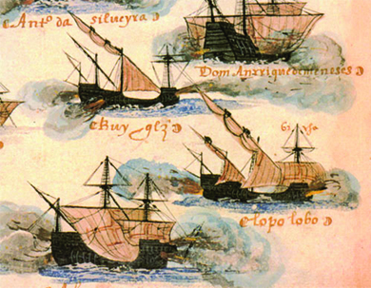
Learning Objective 1.2: Describe the European societies that engaged in conversion, conquest, commerce, and exploration.
The Iberian Explorers
Portugal, located on the far western side of Europe, became known for its naval exploration. They began to trade with western Africa.
Fifteenth century Spain was led by the powerful King Ferdinand and Queen Isabella, who took brutal measures to rid their kingdom of Jews and Muslims.
Exploration was fueled by a desire to find treasure such as silver and gold.
Spanish and Portuguese explorers also wanted to take back land from Muslims and convert people to Christianity.
In 1492, a sailor named Christopher Columbus persuaded the Spanish monarchs to finance his journey to the Far East. Instead, he landed in the Americas.
Authored by OpenStax College (License: CC-BY Attribution). Available for download at www.openstaxcollege.org. Adapted by: Barnes & Noble Education.

Slide 14
Learning Objective 1.2: Describe the European societies that engaged in conversion, conquest, commerce, and exploration.
The Religion Discussion Question
How did the wars of religion in Europe help to transform the continent?

Slide 15
Learning Objective 1.3: Discuss the roles of Islam and Europe in West Africa and the slave trade.
West Africa and the Role of Slavery
Area covering present-day Mauritania to Democratic Republic of Congo
Variety of land types, including rainforests and savannas
Mostly hunter-gatherers until about 600 CE
Later people relied on herding and small-scale farming
People lived inland near the major rivers: the Senegal, Gambia, Niger, Volta, and Congo
Societies were based on clans rather than nations

Slide 16
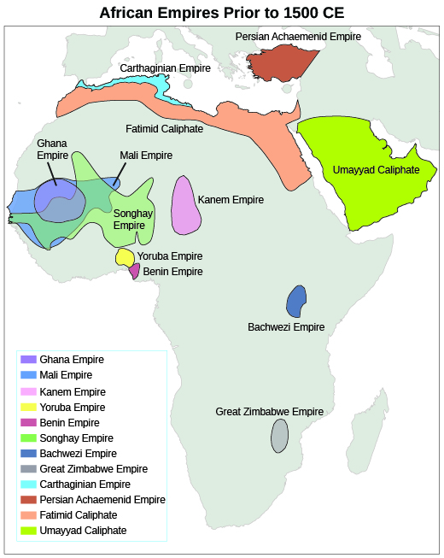
Learning Objective 1.3: Discuss the roles of Islam and Europe in West Africa and the slave trade.
African Empires
The Ghana Empire rose to power in the 8th century by taxing traders. Ghana’s king controlled the gold supply, allowing him to control prices and the military.
In 1200 CE, Mali became the new power in West Africa after gold was discovered east of the Niger.
Timbuktu, Mali’s capital city, became a center of Islamic business, education, and the slave trade.
Weak leadership in Mali led to its fall and the rise of the the Empire of Songhay.
Authored by OpenStax College (License: CC-BY Attribution). Available for download at www.openstaxcollege.org. Adapted by: Barnes & Noble Education.

Slide 17
Learning Objective 1.3: Discuss the roles of Islam and Europe in West Africa and the slave trade.
The Slave Trade
The slave trade in Africa was long established, including evidence that slaves from Africa were imported to the Roman Empire.
Arab slave traders traveled through Africa before and after the rise of Islam. Europeans were among the slaves traded in Africa.
The European interest in African slaves began with the Portuguese, who needed workers for their new colonies and their sugar plantations.
Other European nations developed colonies and needed slaves to work plantations growing rice, tobacco, and cotton.
Slaves in the New World took the place of Native Americans, who died from European diseases and poor treatment. Indentured servants from Europe were too expensive and few.
Chattel slaves from Africa were seen as the most economic way to farm plantations with labor-intensive crops.
Race became an identifying characteristic of slaves, as imported Africans were brought to the New World for no other purpose than to work.

Slide 18
Learning Objective 1.3: Discuss the roles of Islam and Europe in West Africa and the slave trade.
The Slavery Discussion Question
Could the plantations of the European colonies have operated without slaves? Why or why not?

