Slide 3
1. Ayanna Pressley became Massachusetts’ first black Congresswoman.
2. Sylvia Garcia and Veronica Escobar became Texas’ first Latina Congresswomen.
3. Jared Polis became America’s first openly gay governor by winning Colorado.
4. Alexandria-Ocasio Cortez became the youngest woman ever elected to Congress.
5. Rashida Tlaib and Ilhan Omar became the first Muslim women elected to Congress.
6. Sharice Davids and Deb Haaland became the first Native American women elected to Congress.
7. Marsha Blackburn became the first woman Senator from Tennessee.
8. Joe Neguse was the first black Congressperson elected by Colorado.
9. Michelle Lujan Grisham became the first Latina governor of New Mexico.
10. Chris Pappas became the first openly gay Congressperson elected by New Hampshire.
11. Letitia James became the first black woman Attorney General of New York.
12. Jahana Hayes became the first black woman elected to Congress by Connecticut.
13. Keith Ellison became Minnesota’s first Muslim statewide official by winning Attorney General.
14. 19 year-old Kalan Haywood was elected to Wisconsin’s state assembly, becoming the youngest legislator in the U.S.
15. Angie Craig became the first lesbian mother in Congress after winning Minnesota’s 2nd district.
16. Janet Mills became Maine’s first female governor.
17. Kristi Noem became South Dakota’s first female governor.
18. Young Kim is the first Korean-American woman elected to Congress.
19. Lauren Underwood is the first black woman to win Illinois’ 14th district.
20. Abby Finkenauer and Cindy Axne became the first women sent to the House by Iowa.

Slide 8
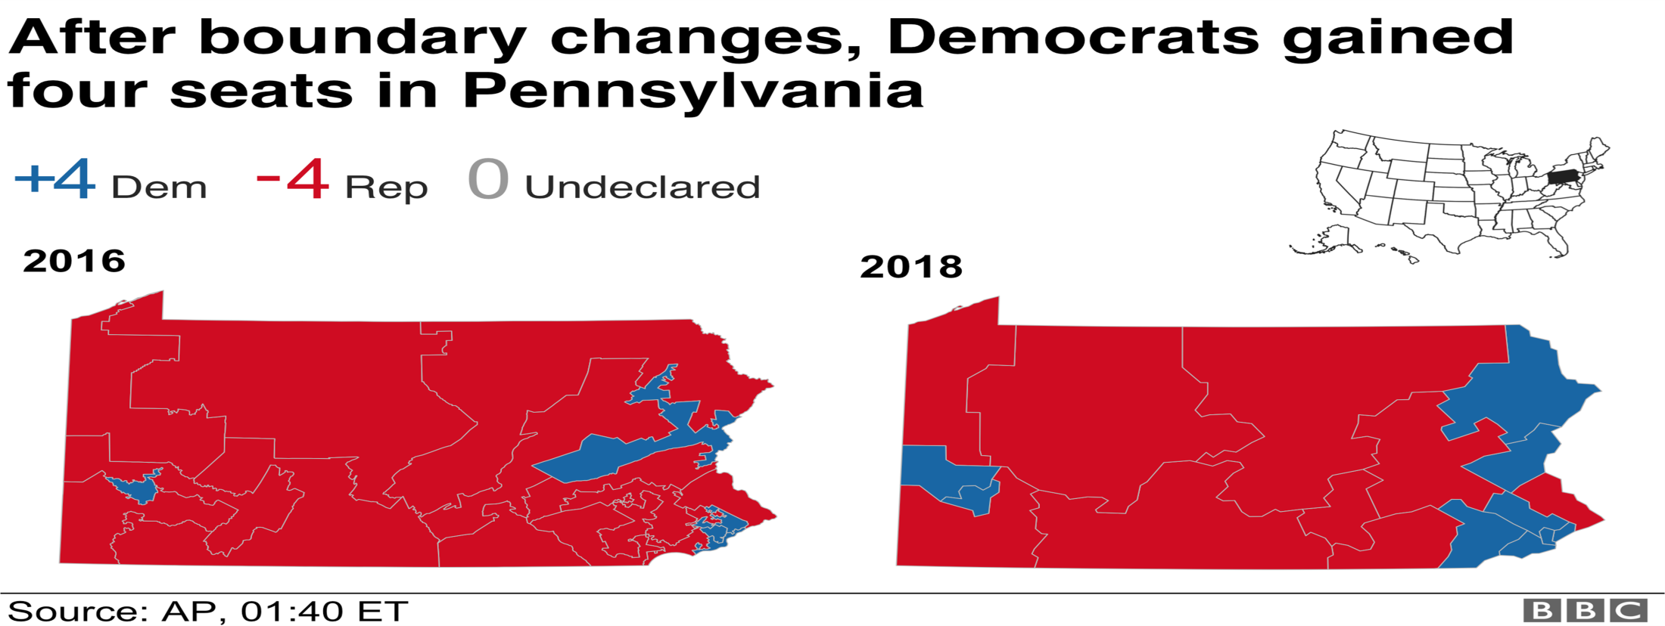
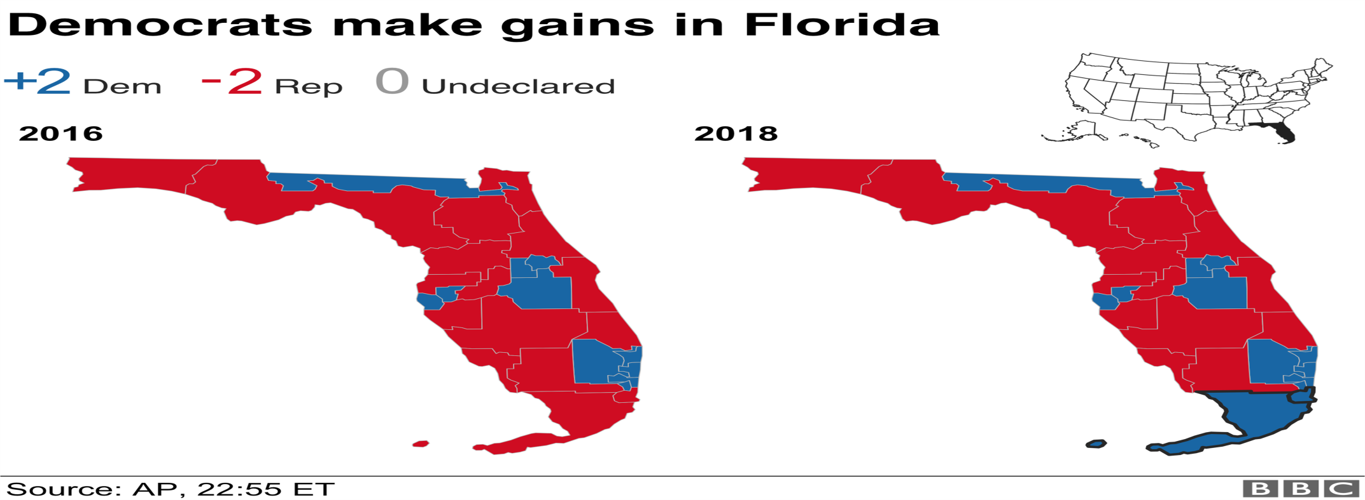

Slide 9
New York 11th District Representative
Candidate | Party | Votes | Pct.
Max Rose | Dem. | 95,458 | 52.8%
Dan Donovan* | Rep. | 84,665 | 46.8
Henry Bardel | Green | 700 | 0.4
180,823 votes, 100% reporting (489 of 489 precincts)
* Incumbent

