Slide 1
Management
Fourteenth Edition
Chapter 6
Managing Social Responsibility and Ethics
Copyright © 2018, 2016, 2014 Pearson Education, Inc. All Rights Reserved

Slide 2
Learning Objectives
6.1 Discuss what it means to be socially responsible and what factors influence that decision.
6.2 Explain green management and how organizations can go green.
6.3 Discuss the factors that lead to ethical and unethical behavior.
Develop your skill at creating trust in work groups.
6.4 Describe management’s role in encouraging ethical behavior.
Know how to make good decisions about ethical dilemmas.
6.5 Discuss current social responsibility and ethics issues.

Slide 3
From Obligations to Responsiveness to Responsibility
Social obligation: when a firm engages in social actions because of its obligation to meet certain economic and legal responsibilities
Classical view: the view that management’s only social responsibility is to maximize profits
Notes:
The concept of social responsibility has been described in different ways. For instance, it’s been called “profit making only,” “going beyond profit making,” “any discretionary corporate activity intended to further social welfare,” and “improving social or environmental conditions.” We can understand it better if we first compare it to two similar concepts: social obligation and social responsiveness. Social obligation is when a firm engages in social actions because of its obligation to meet certain economic and legal responsibilities. The organization does what it’s obligated to do and nothing more. This idea reflects the classical view of social responsibility, which says that management’s only social responsibility is to maximize profits. The most outspoken advocate of this approach is economist and Nobel laureate Milton Friedman. He argued that managers’ primary responsibility is to operate the business in the best interests of the stockholders, whose primary concerns are financial.

Slide 4
The Socioeconomic View
Socioeconomic view: the view that managers’ social responsibilities go beyond making profits to include protecting and improving society’s welfare
Social responsiveness: when a company engages in social actions in response to some popular social need
Social responsibility: A business’s intention, beyond its legal and economic obligations, to do the right things and act in ways that are good for society
Notes:
The other two concepts—social responsiveness and social responsibility—reflect the socioeconomic view, which says that managers’ social responsibilities go beyond making profits to include protecting and improving society’s welfare. This view is based on the belief that corporations are not independent entities responsible only to stockholders, but have an obligation to the larger society. Organizations around the world have embraced this view as shown by a survey of global executives in which 84 percent said that companies must balance obligations to shareholders with obligations to the public good.
Social responsiveness is when a company engages in social actions in response to some popular social need. Managers are guided by social norms and values and make practical, market-oriented decisions about their actions. For instance, Ford Motor Company became the first automaker to endorse a federal ban on sending text messages while driving.
A socially responsible organization goes beyond what it’s obligated to do or chooses to do because of some popular social need and does what it can to help improve society because it’s the right thing to do. We define social responsibility as a business’s intention, beyond its legal and economic obligations, to do the right things and act in ways that are good for society. A socially responsible organization does what is right because it feels it has an ethical responsibility to do so.

Slide 5
Should Organizations Be Socially Involved?
Social screening: Applying social criteria (screens) to investment decisions
Notes:
Another way to view social involvement and economic performance is by looking at socially responsible investing (SRI) funds, which provide a way for individual investors to support socially responsible companies. Typically, these funds use some type of social screening; that is, they apply social and environmental criteria to investment decisions.
SRI funds usually will not invest in companies involved in liquor, gambling, tobacco, nuclear power weapons, price fixing, fraud, or in companies that have poor product safety, employee relations, and environmental track records

Slide 6
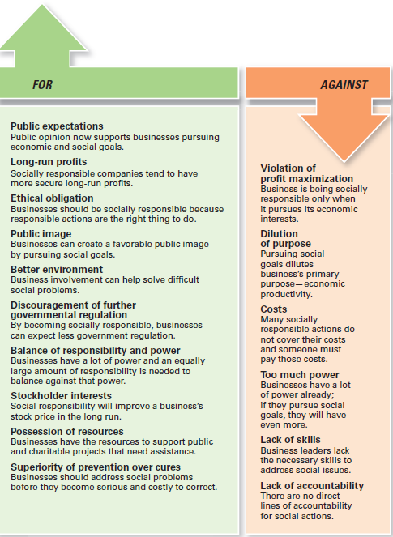
Exhibit 6-1 Arguments For and Against Social Responsibility
Exhibit 6-1 outlines arguments for and against social involvement.
Notes:
Other than meeting their social obligations (which they must do), should organizations be socially involved? One way to look at this question is by examining arguments for and against social involvement. Several points are outlined in Exhibit 6-1.

Slide 7
Green Management and Sustainability
Green management: managers consider the impact of their organization on the natural environment
Notes:
Until the late 1960s, few people (and organizations) paid attention to the environmental consequences of their decisions and actions. However, a number of environmental disasters brought a new spirit of environmentalism to individuals, groups, and organizations. Increasingly, managers have begun to consider the impact of their organization on the natural environment, which we call green management.

Slide 8
How Organizations Go Green
Legal (light green) approach
Market approach
Stakeholder approach
Activist approach
Notes:
Managers and organizations can do many things to protect and preserve the natural environment. Some do no more than what is required by law; that is, they fulfill their social obligation. The first approach, the legal (or light green) approach, is simply doing what is required legally. In this approach, which illustrates social obligation, organizations exhibit little environmental sensitivity. They obey laws, rules, and regulations without legal challenge and that’s the extent of their being green.
As an organization becomes more sensitive to environmental issues, it may adopt the market approach and respond to environmental preferences of customers. Whatever customers demand in terms of environmentally friendly products will be what the organization provides.
In the stakeholder approach, an organization works to meet the environmental demands of multiple stakeholders such as employees, suppliers, or community.
Finally, if an organization pursues an activist (or dark green) approach, it looks for ways to protect the earth’s natural resources. The activist approach reflects the highest degree of environmental sensitivity and illustrates social responsibility.

Slide 9
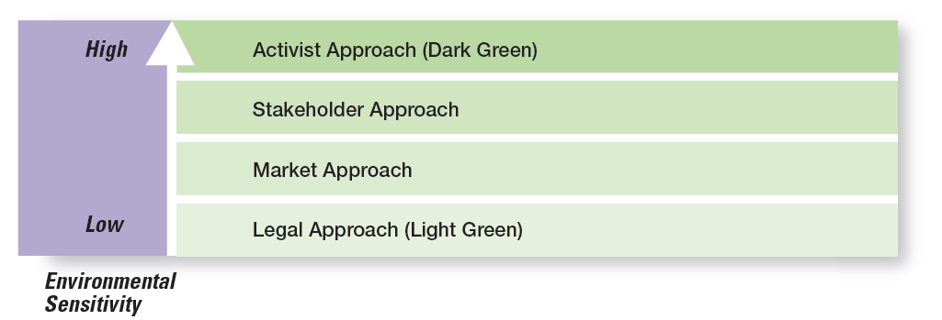
Exhibit 6-2 Green Approaches
Exhibit 6-2 uses the terms shades of green to describe the different environmental approaches that organizations may take.
Notes:
Source: Based on R. E. Freeman, J. Pierce, and R. Dodd, Shades of Green: Business Ethics and the Environment (New York: Oxford University Press, 1995).

Slide 10
Evaluating Green Management Actions
Company-issued reports on environmental performance
ISO 9000 (quality management) and ISO 14000 (environmental management) standards
Global 100 list of the most sustainable corporations in the world
Notes:
More than 7,500 companies around the globe now voluntarily report their efforts in promoting environmental sustainability using the guidelines developed by the Global Reporting Initiative (GRI). These reports, which can be found on the GRI website (www.globalreporting.org), describe the numerous green actions of these organizations.
Another way organizations show their commitment to being green is through pursuing standards developed by the nongovernmental International Organization for Standardization (ISO). Organizations that want to become ISO 14000 compliant must develop a total management system for meeting environmental challenges.
One final way to evaluate a company’s green actions is to use the Global 100 list of the most sustainable corporations in the world (www.corporateknights.com). To be named to this list a company has displayed a superior ability to effectively manage environmental and social factors.

Slide 11
Managers and Ethical Behavior
Ethics: principles, values, and beliefs that define right and wrong behavior
Notes:
What do we mean by ethics? We’re defining it as the principles, values, and beliefs that define right and wrong decisions and behavior. Many decisions managers make require them to consider both the process and who’s affected by the result. To better understand the ethical issues involved in such decisions, let’s look at the factors that determine whether a person acts ethically or unethically.

Slide 12
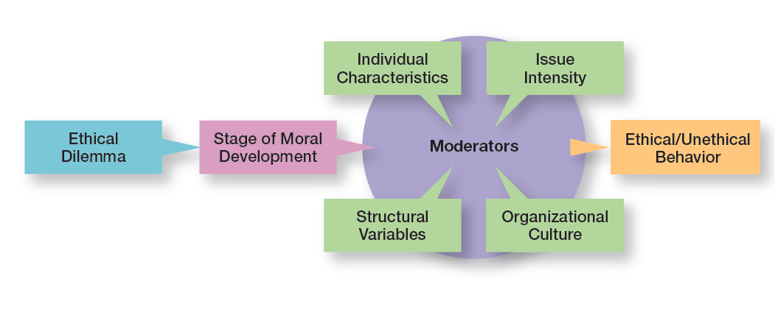
Exhibit 6-3 Factors that Determine Ethical and Unethical Behavior
Exhibit 6-3 shows factors that determine ethical and unethical behavior.
Notes:
Whether someone behaves ethically or unethically when faced with an ethical dilemma is influenced by several things: his or her stage of moral development and other moderating variables, including individual characteristics and the organization’s structural design, which we will discuss in a later section of the chapter, and the intensity of the ethical issue.

Slide 13
Stage of Moral Development
Preconventional level
Conventional level
Principled level
Notes:
Research divides moral development into three levels, each having two stages. At each successive stage, an individual’s moral judgment becomes less dependent on outside influences and more internalized.
At the first level, the preconventional level, a person’s choice between right or wrong is based on personal consequences from outside sources, such as physical punishment, reward, or exchange of favors.
At the second level, the conventional level, ethical decisions rely on maintaining expected standards and living up to the expectations of others.
At the principled level, individuals define moral values apart from the authority of the groups to which they belong or society in general.

Slide 14
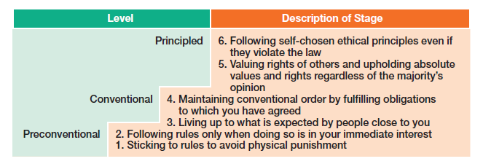
Exhibit 6-4 Stages of Moral Development
Exhibit 6-4 shows the three levels and six stages of moral development.
Notes:
Source: L. Kohlberg, “Moral Stages and Moralization: The Cognitive-Development Approach,” in Moral Development and Behavior: Theory, Research, and Social Issues, ed. T. Lickona (New York: Holt, Rinehart & Winston, 1976), pp. 34–35.

Slide 15
Individual Characteristics
Values
Ego strength
Locus of control
Notes:
Two individual characteristics—values and personality—play a role in determining whether a person behaves ethically. Each person comes to an organization with a relatively entrenched set of personal values, which represent basic convictions about what is right and wrong. Our values develop from a young age based on what we see and hear from parents, teachers, friends, and others.
Two personality variables have been found to influence an individual’s actions according to his or her beliefs about what is right or wrong: ego strength and locus of control. Ego strength measures the strength of a person’s convictions. People with high ego strength are likely to resist impulses to act unethically and instead follow their convictions. Locus of control is the degree to which people believe they control their own fate. People with an internal locus of control believe they control their own destinies. They’re more likely to take responsibility for consequences and rely on their own internal standards of right and wrong to guide their behavior.

Slide 16
Structural Variables
Ethical behavior can be influenced by:
An organization’s structural design
Goals
Performance appraisal system
Reward allocation
Notes:
Those structures that minimize ambiguity and uncertainty with formal rules and regulations and those that continuously remind employees of what is ethical are more likely to encourage ethical behavior.
Although many organizations use goals to guide and motivate employees, those goals can create some unexpected problems. One study found that people who don’t reach set goals are more likely to engage in unethical behavior, even if they do or don’t have economic incentives to do so
An organization’s performance appraisal system can also influence ethical behavior. Some systems focus exclusively on outcomes, while others evaluate means as well as ends. When employees are evaluated only on outcomes, they may be pressured to do whatever is necessary to look good on the outcomes and not be concerned with how they got those results.
The more that rewards or punishment depend on specific goal outcomes, the more employees are pressured to do whatever they must to reach those goals—perhaps to the point of compromising their ethical standards.

Slide 17
Exhibit 6-5 Issue Intensity
As Exhibit 6-5 shows, six characteristics determine issue intensity or how important an ethical issue is to an individual: greatness of harm, consensus of wrong, probability of harm, immediacy of consequences, proximity to victim(s), and concentration of effect.
Notes:
As Exhibit 6-5 shows, six characteristics determine issue intensity or how important an ethical issue is to an individual: greatness of harm, consensus of wrong, probability of harm, immediacy of consequences, proximity to victim(s), and concentration of effect.

Slide 18
Issue Intensity
The six factors suggest that:
the larger the number of people harmed
the more agreement that the action is wrong
the greater the likelihood that the action will cause harm
the more immediately the consequences of the action will be felt
the closer the person feels to the victim
The more concentrated the effect of the action on the victim(s)…
The greater the issue intensity or importance
Notes:
A student who would never consider breaking into an instructor’s office to steal an accounting exam doesn’t think twice about asking a friend who took the same course from the same instructor last semester what questions were on an exam. Similarly, a manager might think nothing about taking home a few office supplies, yet be highly concerned about the possible embezzlement of company funds. These examples illustrate the final factor that influences ethical behavior: the intensity of the ethical issue itself.

Slide 19
Ethics in an International Context
Ethical standards are not universal
Foreign Corrupt Practices Act
United Nations Global Contract
Notes:
Are ethical standards universal? Although some common moral beliefs exist, social and cultural differences between countries are important factors that determine ethical and unethical behavior.
In the case of payments to influence foreign officials or politicians, U.S. managers are guided by the Foreign Corrupt Practices Act (FCPA), which makes it illegal to knowingly corrupt a foreign official. However, even this law doesn’t always reduce ethical dilemmas to black and white. In some countries, government bureaucrat salaries are low because custom dictates that they receive small payments from those they serve. Payoffs to these bureaucrats “grease the machinery” and ensure that things get done.
Another guide to being ethical in international business is the United Nations Global Compact, shown in Exhibit 6-6.

Slide 20
Exhibit 6-6 The Ten Principles of the UN Global Compact (1 of 2)
Principle Number | Principle Text
Human Rights | blank
Principle 1 | Business should support and respect the protection of internationally proclaimed human rights within their sphere of influence; and
Principle 2 | Make sure they are not complicit in human rights abuses.
Labor Standards | blank
Principle 3 | Business should uphold the freedom of association and the effective recognition of the right to collective bargaining;
Principle 4 | The elimination of all forms of forced and compulsory labor;
Principle 5 | The effective abolition of child labor; and
Principle 6 | The elimination of discrimination in respect to employment and occupation.
Exhibit 6-6 shows the UN Global Compact, which asks companies to embrace, support, and enact, within their sphere of infuence, a set of core values in the areas of human rights, labor standards, the environment, and anti-corruption.
Notes:
Source: Copyright © 2012 by United Nations Global Compact (www.unglobalcompact.org). Reprinted with permission.

Slide 21
Exhibit 6-6 The Ten Principles of the UN Global Compact (2 of 2)
Principle Number | Principle Text
Environment | blank
Principle 7 | Business should support a precautionary approach to environmental challenges;
Principle 8 | Undertake initiatives to promote greater environmental responsibility; and
Principle 9 | Encourage the development and diffusion of environmentally friendly technologies.
Anti-Corruption | blank
Principle 10 | Business should work against corruption in all its forms, including extortion and bribery.
Exhibit 6-6 shows the UN Global Compact, which asks companies to embrace, support, and enact, within their sphere of infuence, a set of core values in the areas of human rights, labor standards, the environment, and anti-corruption.
Notes:
Source: Copyright © 2012 by United Nations Global Compact (www.unglobalcompact.org). Reprinted with permission.

Slide 22
Employee Selection
Values-based management: the organization’s values guide employees in the way they do their jobs
Notes:
The selection process (interviews, tests, background checks, and so forth) should be viewed as an opportunity to learn about an individual’s level of moral development, personal values, ego strength, and locus of control.
Because shared values can be powerful influences, many organizations are using values-based management, in which the organization’s values guide employees in the way they do their jobs.
A strong culture exerts more influence on employees than does a weak one. If a culture is strong and supports high ethical standards, it has a powerful and positive influence on the decision to act ethically or unethically.

Slide 23
Codes of Ethics and Decision Rules
Code of ethics: a formal statement of an organization’s primary values and the ethical rules it expects its employees to follow
Notes:
Uncertainty about what is and is not ethical can be a problem for employees. A code of ethics, a formal statement of an organization’s values and the ethical rules it expects employees to follow, is a popular choice for reducing that ambiguity. Research shows that 97 percent of organizations with more than 10,000 employees have a written code of ethics.

Slide 24
Exhibit 6-7 Codes of Ethics (1 of 3)
Cluster 1. Be a Dependable Organizational Citizen
1. Comply with safety, health, and security regulations.
2. Demonstrate courtesy, respect, honesty, and fairness.
3. Illegal drugs and alcohol at work are prohibited.
4. Manage personal finances well.
5. Exhibit good attendance and punctuality.
6. Follow directives of supervisors.
7. Do not use abusive language.
8. Dress in business attire.
9. Firearms at work are prohibited.
Exhibit 6-7 shows the three categories into which the content of codes of ethics falls.
Notes:
Source: F. R. David, “An Empirical Study of Codes of Business Ethics: A Strategic Perspective,” paper presented at the 48th Annual Academy of Management Conference, August 1988, Anaheim, California. Used with permission of Fred David.

Slide 25
Exhibit 6-7 Codes of Ethics (2 of 3)
Cluster 2. Do Not Do Anything Unlawful or Improper That Will Harm the Organization
1. Conduct business in compliance with all laws.
2. Payments for unlawful purposes are prohibited.
3. Bribes are prohibited.
4. Avoid outside activities that impair duties.
5. Maintain confidentiality of records.
6. Comply with all antitrust and trade regulations.
7. Comply with all accounting rules and controls.
8. Do not use company property for personal benefit.
9. Employees are personally accountable for company funds.
10. Do not propagate false or misleading information.
11. Make decisions without regard for personal gain.
Exhibit 6-7 shows the three categories into which the content of codes of ethics falls.
Notes:
Source: F. R. David, “An Empirical Study of Codes of Business Ethics: A Strategic Perspective,” paper presented at the 48th Annual Academy of Management Conference, August 1988, Anaheim, California. Used with permission of Fred David.

Slide 26
Exhibit 6-7 Codes of Ethics (3 of 3)
Cluster 3. Be Good to Customers
1. Convey true claims in product advertisements.
2. Perform assigned duties to the best of your ability.
3. Provide products and services of the highest quality.
Exhibit 6-7 shows the three categories into which the content of codes of ethics falls.
Notes:
Source: F. R. David, “An Empirical Study of Codes of Business Ethics: A Strategic Perspective,” paper presented at the 48th Annual Academy of Management Conference, August 1988, Anaheim, California. Used with permission of Fred David.

Slide 27
Developing Codes of Ethics
Organizational leaders should model appropriate behavior and reward those who act ethically.
Managers should reaffirm the importance of the ethics code and discipline those who break it
Stakeholders should be considered as an ethics code is developed or improved
Managers should communicate and reinforce the ethics code regularly
Managers should use the five-step process to guide employees when faced with ethical dilemmas
Notes:
Unfortunately, codes of ethics may not work as well as we think they should. A survey of employees in U.S. businesses found that 41 percent of those surveyed had observed ethical or legal violations in the previous 12 months, including such things as conflicts of interest, abusive or intimidating behavior, and lying to employees. And 37 percent of those employees didn’t report observed misconduct. Does this mean that codes of ethics shouldn’t be developed? No. However, in doing so, managers should use these suggestions.

Slide 28
Exhibit 6-8 A Process for Addressing Ethical Dilemmas
A Process for Addressing Ethical Dilemmas
Step 1: What is the ethical dilemma?
Step 2: Who are the affected stakeholders?
Step 3: Which personal, organizational, and external factors are important in this decision?
Step 4: What are possible alternatives?
Step 5: What is my decision and how will I act on it?
Exhibit 6-8 shows the five-step process to guide employees when faced with ethical dilemmas.
Notes:
Managers should use the five-step process to guide employees when faced with ethical dilemmas.

Slide 29
Leadership at the Top
Doing business ethically requires a commitment from managers at all levels, but especially the top level because:
they uphold the shared values and set the cultural tone
they’re role models in both words and actions
Notes:
Doing business ethically requires a commitment from managers at all levels, but especially the top level. Why? Because they’re the ones who uphold the shared values and set the cultural tone. They’re role models in terms of both words and actions, though what they do is far more important than what they say. If top managers, for example, take company resources for their personal use, inflate their expense accounts, or give favored treatment to friends, they imply that such behavior is acceptable for all employees.

Slide 30
Job Goals and Performance Appraisal
Under the stress of unrealistic goals, otherwise ethical employees may feel they have no choice but to do whatever is necessary to meet those goals.
Notes:
Under the stress of unrealistic goals, otherwise ethical employees may feel they have no choice but to do whatever is necessary to meet those goals. Also, goal achievement is usually a key issue in performance appraisal. If performance appraisals focus only on economic goals, ends will begin to justify means. To encourage ethical behavior, both ends and means should be evaluated. For example, a manager’s annual review of employees might include a point-by-point evaluation of how their decisions measured up against the company’s code of ethics as well as how well goals were met.

Slide 31
Ethics Training
More organizations are setting up seminars, workshops, and similar ethics training programs to encourage ethical behavior.
Notes:
Such training programs aren’t without controversy, as the primary concern is whether ethics can be taught. Critics stress that the effort is pointless because people establish their individual value systems when they’re young. Proponents note, however, that several studies have shown that values can be learned after early childhood. In addition, they cite evidence that shows that teaching ethical problem solving can make an actual difference in ethical behaviors; that training has increased individuals’ level of moral development; and that, if nothing else, ethics training increases awareness of ethical issues in business.

Slide 32
Independent Social Audits
Independent social audits: evaluate decisions and management practices in terms of the organization’s code of ethics
Notes:
The fear of being caught can be an important deterrent to unethical behavior. Independent social audits, which evaluate decisions and management practices in terms of the organization’s code of ethics, increase that likelihood. Such audits can be regular evaluations or they can occur randomly with no prior announcement. An effective ethics
program probably needs both. To maintain integrity, auditors should be responsible to the company’s board of directors and present their findings directly to the board.

Slide 33
Managing Ethical Lapses and Social Responsibility
One survey reported that among 5,000 employees: 45 percent admitted falling asleep at work and 22 percent said they spread a rumor about a coworker
Notes:
Even after public outrage over the Enron-era misdeeds, irresponsible and unethical practices by managers in all kinds of organizations haven’t gone away. One survey reported that among 5,000 employees: 45 percent admitted to falling asleep at work; 22 percent said they spread a rumor about a coworker; 18 percent said they snooped after hours; and 2 percent said they took credit for someone else’s work.
Unfortunately, it’s not just at work that we see such behaviors. Studies conducted by the Center for Academic Integrity showed that 26 percent of college and university business majors admitted to “serious cheating” on exams and 54 percent admitted to cheating on written assignments. But business students weren’t the worst cheaters—that distinction belonged to journalism majors, of whom 27 percent said they had cheated.

Slide 34
Ethical Leadership
What managers do has a strong influence on employees’ decisions whether to behave ethically.
Notes:
Managers must provide ethical leadership. As we said earlier, what managers do has a strong influence on employees’ decisions whether to behave ethically. When managers cheat, lie, steal, manipulate, take advantage of situations or people, or treat others unfairly, what kind of signal are they sending to employees (or other stakeholders)? Probably not the one they want to send. Exhibit 6-9 gives some suggestions on how managers can provide ethical leadership.

Slide 35
Exhibit 6-9 Being an Ethical Leader
Being an Ethical Leader
Be a good role model by being ethical and honest.
• Tell the truth always.
• Don’t hide or manipulate information.
• Be willing to admit your failures.
Share your personal values by regularly communicating them to employees.
Stress the organization’s or team’s important shared values.
Use the reward system to hold everyone accountable to the values.
Exhibit 6-9 gives some suggestions on how managers can provide ethical leadership.

Slide 36
Protection of Employees Who Raise Ethical Issues
Whistle-blower: individual who raises ethical concerns or issues to others
Notes:
It’s important for managers to assure employees who raise ethical concerns or issues that they will face no personal or career risks. These individuals, often called whistle-blowers, can be a key part of any company’s ethics program.
How can employees be protected so they’re willing to step up if they see unethical or illegal things occurring? One way is to set up toll-free ethics hotlines. Another way is to have in place a “procedurally just process,” which means making sure the decision-making process is fair and that employees are treated respectfully about their concerns. Backlash against whistle-blowers can be costly.
Finally, federal legislation offers some legal protection. According to the Sarbanes-Oxley Act, any manager who retaliates against an employee for reporting violations faces a stiff penalty: a 10-year jail sentence. Antiretaliation protections against whistle-blowers have been strengthened by the more recent Dodd-Frank Wall Street Reform Act. Unfortunately, despite this protection, fewer than two of every three employees felt they would be protected from retaliation, and about the same proportion fear losing their jobs if they do not meet performance targets.

Slide 37
Social Entrepreneurship
Social entrepreneur: an individual or organization that seeks out opportunities to improve society by using practical, innovative, and sustainable approaches
Notes:
Social entrepreneurs want to make the world a better place and have a driving passion to make that happen. For example, Microsoft Corporation announced that it would donate $1 billion in cloud services to nonprofits and university researchers. Microsoft’s goal is to provide the same computing tools that have allowed business firms to become more agile and tackle substantial technical challenges. Also, social entrepreneurs use creativity and ingenuity to solve problems. For instance, Seattle-based PATH (Program for Appropriate Technology in Health) is an international nonprofit organization that uses low-cost technology to provide needed health-care solutions for poor, developing countries.

Slide 38
Business Promoting Positive Social Change
Corporate philanthropy: can be an effective way for companies to address societal problems
Employee volunteering efforts: a popular way for businesses to be involved in promoting social change
Notes:
Corporate philanthropy can be an effective way for companies to address societal problems. For instance, the breast cancer “pink” campaign and the global AIDS Red campaign (started by Bono) are ways that companies support social causes.
Employee volunteering is another popular way for businesses to be involved in promoting social change. For instance, Dow Corning sent a small team of employees to rural India to help women “examine stitchery and figure out prices for garments to be sold in local markets.” Molson-Coors’ 11-member executive team spent a full day at their annual team-building retreat building a house in Las Vegas with Habitat for Humanity. PricewaterhouseCoopers employees renovated an abandoned school in Newark, New Jersey. Every Wachovia employee is given six paid days off from work each year to volunteer in his or her community.

Slide 39
Review Learning Objective 6.1
Discuss what it means to be socially responsible and what factors influence that decision.
Social obligation: a firm engages in social actions because of its obligation to meet certain economic and legal responsibilities
Social responsiveness—when a firm engages in social actions in response to some popular social need
Notes:
Social obligation, which reflects the classical view of social responsibility, is when a firm engages in social actions because of its obligation to meet certain economic and legal responsibilities.
Social responsiveness is when a firm engages in social actions in response to some popular social need. Social responsibility is a business’s intention, beyond its economic and legal obligations, to pursue long-term goals that are good for society. Both these reflect the socioeconomic view of social responsibility. Determining whether organizations should be socially involved can be done by looking at arguments for and against it. Other ways are to assess the impact of social involvement on a company’s economic performance and evaluate the performance of SRI funds versus non-SRI funds. We can conclude that a company’s social responsibility doesn’t appear to hurt its economic performance.

Slide 40
Review Learning Objective 6.2
Explain green management and how organizations can go green.
Different approaches
Light green
Market approach
Stakeholder approach
Activist or dark green approach
Notes:
Green management is when managers consider the impact of their organization on the natural environment. Organizations can “go green” in different ways.
The light green approach is doing what is required legally, which is social obligation. Using the market approach, organizations respond to the environmental preferences of their customers.
Using the stakeholder approach, organizations respond to the environmental demands of multiple stakeholders. Both the market and stakeholder approaches can be viewed as social responsiveness.
With an activist or dark green approach, an organization looks for ways to respect and preserve the earth and its natural resources, which can be viewed as social responsibility.
Green actions can be evaluated by examining reports that companies compile about their environmental performance, by looking for compliance with global standards for environmental management (ISO 14000), and by using the Global 100 list of the most sustainable corporations in the world.

Slide 41
Review Learning Objective 6.3
Discuss the factors that lead to ethical and unethical behavior.
Factors that affect ethical and unethical behavior include
An individual’s level of moral development
Individual characteristics
Structural variables
Organizational culture
Issue intensity
Notes:
Ethics refers to the principles, values, and beliefs that define right and wrong decisions and behavior. The factors that affect ethical and unethical behavior include an individual’s level of moral development (preconventional, conventional, or principled), individual characteristics (values and personality variables—ego strength and locus of control), structural variables (structural design, use of goals, performance appraisal systems, and reward allocation procedures), organizational culture (shared values and cultural strength), and issue intensity (greatness of harm, consensus of wrong, probability of harm, immediacy of consequences, proximity to victims, and concentration of effect). Since ethical standards aren’t universal, managers should know what they can and cannot do legally as defined by the Foreign Corrupt Practices Act. It’s also important to recognize any cultural differences and to clarify ethical guidelines for employees working in different global locations. Finally, managers should know about the principles of the Global Compact and the Anti-Bribery Convention.

Slide 42
Review Learning Objective 6.4
Describe management’s role in encouraging ethical behavior.
The behavior of managers is the single most important influence on an individual’s decision to act ethically or unethically).
Nonprogrammed decisions are unique decisions that require a custom-made solution and are used when the problems are new or unusual (unstructured) and for which information is ambiguous or incomplete.
Notes:
The behavior of managers is the single most important influence on an individual’s decision to act ethically or unethically. Some specific ways managers can encourage ethical behavior include paying attention to employee selection, having and using a code of ethics, recognizing the important ethical leadership role they play and how what they do is far more important than what they say, making sure that the performance appraisal process doesn’t reward goal achievement without taking into account how those goals were achieved, using ethics training and independent social audits, and establishing protective mechanisms.

Slide 43
Review Learning Objective 6.5
Discuss current social responsibility and ethics issues.
Ethical leaders also are honest, share their values, stress important shared values, and use the reward system appropriately.
Managers can protect whistle-blowers (employees who raise ethical issues or concerns) by encouraging them to come forward.
Notes:
Managers can manage ethical lapses and social irresponsibility by being strong ethical leaders and by protecting employees who raise ethical issues. The example set by managers has a strong influence on whether employees behave ethically. Ethical leaders also are honest, share their values, stress important shared values, and use the reward system appropriately. Managers can protect whistle-blowers (employees who raise ethical issues or concerns) by encouraging them to come forward, by setting up toll-free ethics hotlines, and by establishing a culture in which employees can complain and be heard without fear of reprisal. Social entrepreneurs play an important role in solving social problems by seeking out opportunities to improve society by using practical, innovative, and sustainable approaches. Social entrepreneurs want to make the world a better place and have a driving passion to make that happen. Businesses can promote positive social change through corporate philanthropy and employee volunteering efforts.

Slide 44
Copyright

