Slide 1
American Imperialism
1890s - c. 1920

Slide 2
Imperialism
Imperialism: Colonization of foreign nations and lands
  Economic, political, and military structures used to rule colonized peoples and exploit resources
Imperialism common among European powers during final 30 years of nineteenth century
  1875-1902: Europeans imperialized 90% of Africa
  1870-1900: handful of European states imperialized 25% of the world’s land

Slide 3
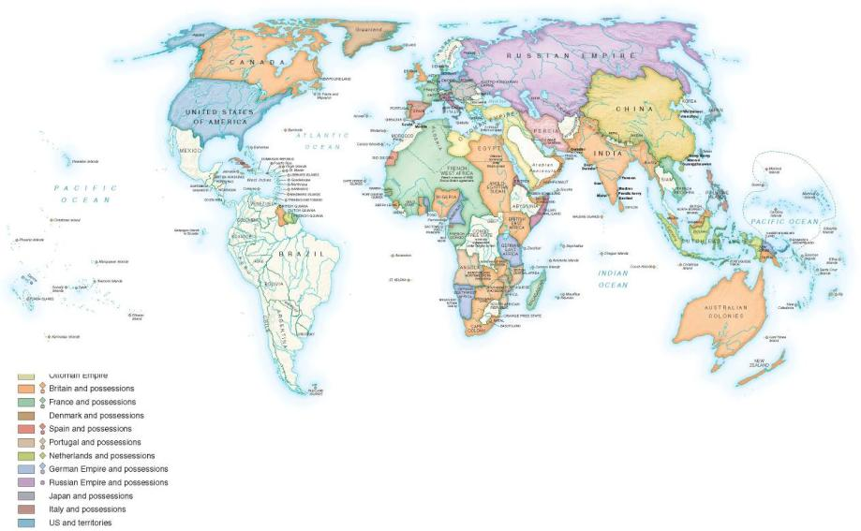

Slide 4
Imperialism
Reasons and justifications for European imperialism:
  Need for raw materials/natural resources
    Historical context for imperialism: Industrial Revolution
    Competition among countries for resources
  Gaining national glory (or diverting attention from embarrassing national troubles)
  Adding to a nation’s power (political, economic, territorial)
  Spreading progress and civilization
    See White Man’s Burden

Slide 5
Imperialism
United States late in joining “the game”, but shared similar reasons and justifications for imperializing
Four main/primary motivations for expansion/imperializing:
  Search for economic markets and resources
  Assertion of national power and honor
  Civilizing mission and religious conversion
  Manipulation of public opinion (e.g., distract popular attention from depression of 1893)

Slide 6
American Imperialism
United States had always been an expansionist country
Examples:
  Louisiana Purchase (1803)
  Monroe Doctrine (1823)
  Manifest Destiny
  Mexican-American War (1846-1848)
  Homestead Act (1862)
  Dawes Act (1887)

Slide 7
American Imperialism
United States focused its imperial interests in Asia, the Pacific, and Latin America.
1867: U.S. Secretary of State, William Seward, purchased Alaska from Russia for $7.2 million.
  Fortuitous purchase as Alaska filled with valuable resources, including gold
  Alaskan statehood in 1959
Seward also acquired the Midway Islands in the Pacific
1887: U.S. secured exclusive right to have access to a harbor in Honolulu, Hawaii.
  Future site of Pearl Harbor naval base

Slide 8
American Imperialism
Early 1890s, U.S. secured business interests focused around sugar in Hawaii.
  Hawaiian queen concerned with the influence American business interests had in Hawaii, generated anti-American support
1893: U.S. sugar business owners imprisoned Hawaiian queen.
  Islands subsequently declared an American protectorate
1898: U.S. officially annexed Hawaii.
  statehood 1959

Slide 9
American Imperialism
1898: Spanish-American War
1899-1902: Filipino-American War
1899: Open-Door Policy in China
1904-1914: Construction of the Panama Canal

Slide 10
Spanish-American War, 1898
Cuba one of Spain’s final American colonies
Spanish oppressively ruled Cuba
1878: Spain vowed to grant Cuba increased autonomy
Continued Spanish oppression resulted in Cuban rebellion in mid-1890s
Cuban revolt for independence violently put down by Spanish government

Slide 11
Spanish-American War, 1898
Many Americans viewed Spain’s violent response as excessively brutal
Cubans in U.S. and American media would publicize (sensationalize) events in Cuba
  Villify Spanish
Americans increasingly demanded that U.S. government intervene in Cuba
  On behalf of the oppressed Cuban people
U.S. had a vested economic interest in Cuba
  American sugar and tobacco

Slide 12
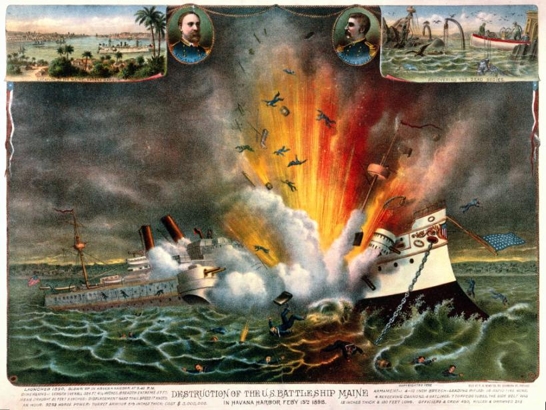
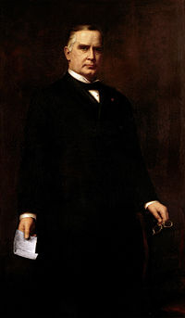
Spanish-American War, 1898
February 1898: U.S. president McKinley sent U.S.S. Maine into harbor of Havana
  Maine exploded while stationed in the harbor
  Over 200 American sailors died
Belief that Spain had deliberately destroyed the ship
  Actual cause: malfunctioning ship equipment
Many media, Americans, and politicians demanded that McKinley declare war on Spain
  Both a war for revenge and a war to help Cuba secure independence

Slide 13
Spanish-American War, 1898
War declared in April 1898
Teller Amendment: Congressional promise “to leave the government and control of the [Cuban] Island to its people” at the end of the Spanish-American War
  American promise of independence for Cuba

Slide 14
Spanish-American War, 1898
U.S. was well-prepared for war.
1890: government passed the Naval Act.
  Authorized creation of a steel-built naval force
  Over one-hundred new ships built
  U.S. naval fleet numbered over 150 ships, one of the largest naval fleets in the world
Further naval growth in 1898 at the behest of the assistant secretary to the navy, Theodore Roosevelt.

Slide 15
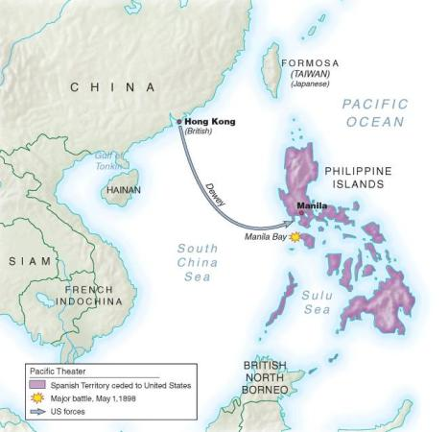
“A Splendid Little War”
War waged from April to August 1898 (5 months)
U.S. strategy: capture the Philippines
Why the Philippines?
  Philippines a Spanish colony
  Goal: destroy the Pacific Spanish fleet and cripple the Spanish navy
  Bonus: U.S. would acquire the Philippines, which would serve as strategic naval base and economic port
Roosevelt ordered the attack
  Subsequently resigned his post
U.S. easily defeated Spain
  American naval fleet destroyed Spanish naval fleet
  American ground forces defeated Spanish ground forces

Slide 16
“A Splendid Little War”
U.S. faced greater Spanish resistance in Cuba
U.S. ground forces numbered over 15,000
  Some of the American forces were made up of volunteers, namely the cavalry unit of Teddy Roosevelt
  Known as the Rough Riders
American forces, led by Roosevelt’s Rough Riders, led a decisive charge against the Spanish in Santiago
  Southeastern portion of the island

Slide 17
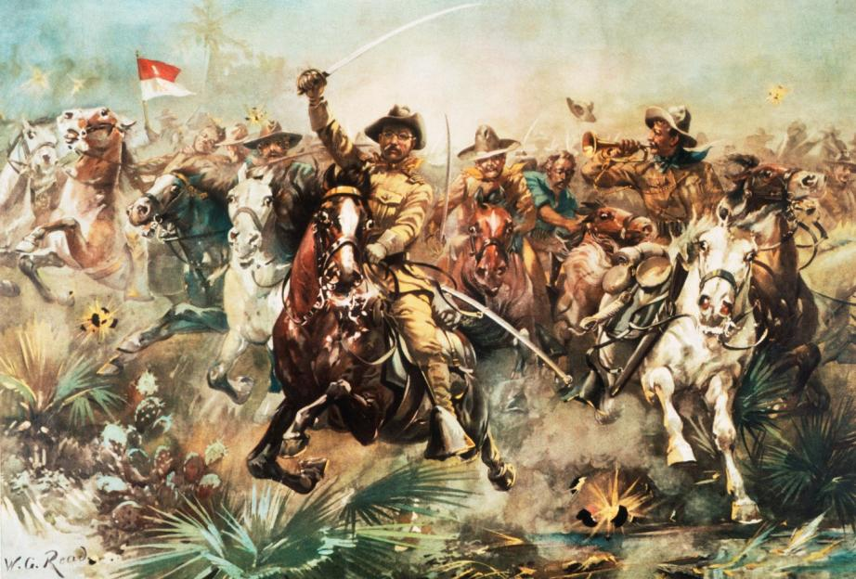
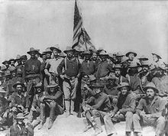
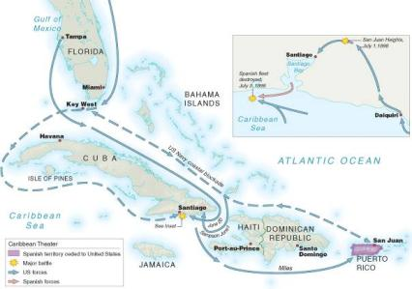

Slide 18
“A Splendid Little War”
The conflict declared “a splendid little war” by U.S. Secretary of State, John Hay.
Conflict was truly splendid for the United States:
  Only 350 combat fatalities
  Approximately 1,600 wounded
  Approximately 3,000 died due to disease
Victory over Spain cemented U.S. as a formidable world military power.

Slide 19
“A Splendid Little War”
Dec. 1898: Treaty of Paris
  Ended the war;
  Spain relinquished its claim to Cuba
  United States received Puerto Rico and Pacific island group of Guam
  For $20 million, Spain turned the Philippines over to United States

Slide 20
“A Splendid Little War”
U.S. honored the Teller Amendment
  U.S. did not annex Cuba
1902: U.S. passed the Platt Amendment
  Granted United States exclusive possession of land in Southeastern Cuba at Guantánamo Bay;
  United States had right to intervene militarily in Cuba if stable Cuban government was threatened;
  United States would have privileged trading relationship with Cuba
  Required Cuban government to obtain permission from United States before entering into treaties with other nations

Slide 21
The Philippines
Fate of Philippines undecided
  Many politicians argued for annexation, others argued for granting Filipino independence
Ultimately, McKinley decided to retain Philippines as an American possession
    See Decision on the Philippines
Decision triggered a revolt in Philippines against American control
  Like Cuba, Philippines had been struggling for independence against Spanish rule

Slide 22
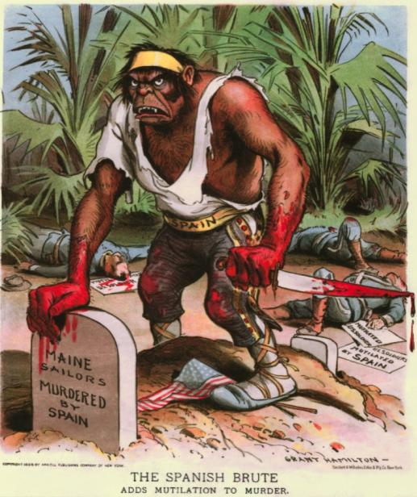
Filipino-American War, 1899-1902
American forces eventually won war
However, U.S. committed several atrocities during war and used brutal tactics
U.S. criticized (both internally and externally) for its tactics
  U.S. was similar to Spain
  How can the U.S. claim to be civilized when it used such brutality?
Estimated casualties: nearly 4200 Americans; 200,000 Filipinos, both military and civilian (some estimates as high as 250,000)

Slide 23
American Imperialism
Theodore Roosevelt major figure in American imperialism
As president, Roosevelt contributed to American imperial efforts
Motto: “speak softly and carry a big stick”
  Utilized threats (military force) to advance American foreign policy
Advocated “national unity” and a “nation of men, not weaklings”
Question: Was Roosevelt a Social Darwinist?

Slide 24
American Imperialism
Roosevelt used executive power to become directly involved in international affairs.
  Established a precedent that would be followed by future presidents (e.g., George W. Bush)
Roosevelt Corollary (1904): United States would essentially be the police of the western hemisphere and justified American involvement in Latin American affairs if American interests were involved or at stake
  Addition to (or consequence of) the Monroe Doctrine

Slide 25
Panama and the Panama Canal
U.S. desired to create a canal in Central America
  Facilitate U.S. trade with Asia
  Faster mobilization of American naval fleet
Isthmus of Panama ideal location to construct a manmade waterway

Slide 26
Panama and the Panama Canal
Panama was a department of Colombia
  French initially attempted to construct a canal
In 1901, president Roosevelt negotiated with Colombian government for construction of canal
Colombia refused

Slide 27
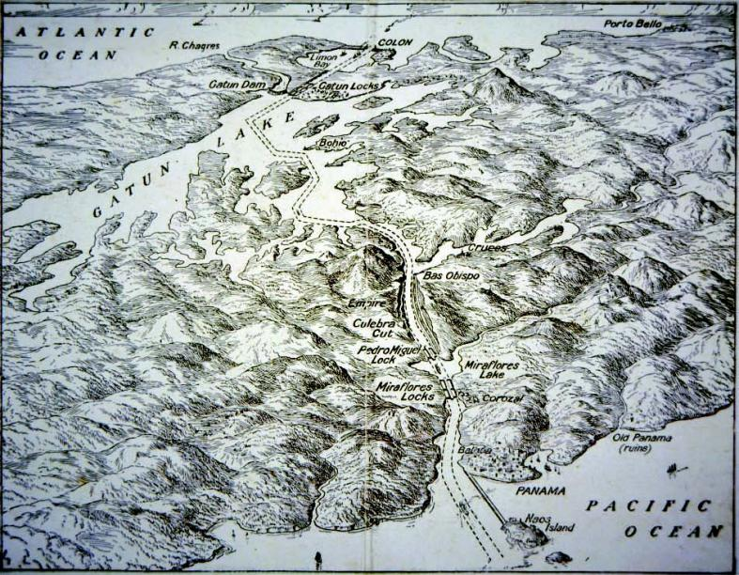
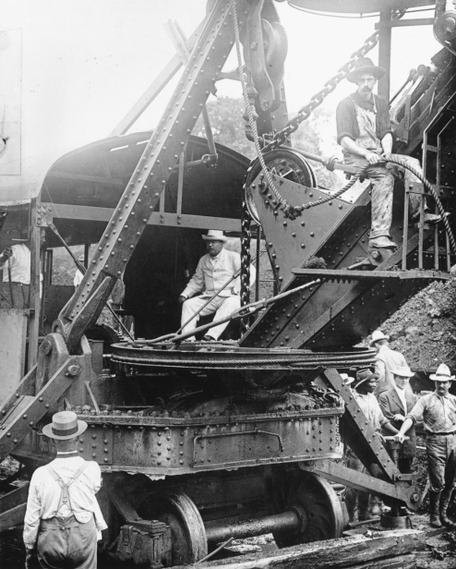
Panama and the Panama Canal
Panamanian rebels began an insurrection for Panamanian independence in 1903
President Roosevelt provided “assistance” to rebels
Hay-Bunau-Varilla Treaty: U.S. purchased 10-mile strip of land for $10 million in Panama to construct the canal
  U.S. would control the canal in “perpetuity”
  In 1999, however, the U.S. gave control of the canal to Panama
Construction began in 1904 and concluded in 1914
  A great feat of engineering

Slide 28
