Slide 1
ENVIRONMENTAL ANALYSIS Name: Institution: Date:

Slide 2
Introduction
Environmental issues refer to challenges facing various systems of the planet, such as air, soil, water among others, and which have resulted from human involvement or misuse of the world’s resources.
Various environmental problems, such as global warming, ozone-layer depletion, air pollution, climate change, urban sprawl, waste disposal, acid rain, water pollution among others have adverse effects on humans, animals and the entire universe.
Notes:
The environment plays a significant role in life. It provides indispensable necessities to humans, animal life and plant life, such as water, food, shelter, and air resources. Meanwhile, human everyday actions and decisions are negatively impacting the environment, causing pollution, deforestation, overfishing.
As the human population increases, it is understood that the environment will change; scenic roads become busy interstates, livestock pastures transform into shopping centers, peaceful forests are destroyed to make room for waste.

Slide 3
Global Warming
Global warming has been on the rise due to industrial activities which result to increases in the temperatures of the earth.
The temperature rises are caused by greenhouses gases (GHGs) like CO2 (carbon dioxide), steam, methane, among other hazardous gases.
The gases have a heat-trapping capacity which is required to produce a greenhouse effect that generates temperatures.
Notes:
During past several decades, the accumulation of greenhouse gases have grown rapidly, which means more heat gets trapped in the atmosphere and few of these gases escapes back into the space. These gases heat up the earth’s surface and this results in global warming.
According to Environmental Protection Agency (EPA) reports, the earth’s temperature has increased by 0.8 degrees Celsius over the past century.

Slide 4
Effects
Global warming is one of the most serious environmental issues as well as a health concern.
To this age, global warming has had serious and catastrophic impacts on societies, the health sector and climate.
Global warming has long term impacts which may cause climate change, diseases, glacier melting, droughts, and increased frequency of hurricanes (Baer, & Singer, 2016).
Notes:
Average global sea level has increased eight inches since 1880, but is rising much faster on the U.S. East Coast and Gulf of Mexico. Global warming is now accelerating the rate of sea level rise, increasing flooding risks to low-lying communities and high-risk coastal properties whose development has been encouraged by today's flood insurance system.
While hurricanes are a natural part of our climate system, recent research indicates that their destructive power, or intensity, has been growing since the 1970s, particularly in the North Atlantic region.

Slide 5
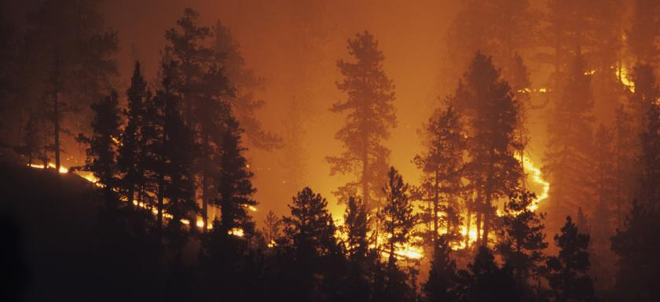
Cont.
Notes:
Wildfires are increasing and wildfire season is getting longer in the Western U.S. as temperatures rise. Higher spring and summer temperatures and earlier spring snow-melt result in forests that are hotter and drier for longer periods of time, priming conditions for wildfires to ignite and spread.

Slide 6
Impacts
Climate change as a result of global warming poses serious health implications on people.
Increased temperatures lead to rise in air pollution, long and more severe allergy seasons, transmission of insect borne illnesses, more regular and detrimental heat waves.
All the variations pose severe, and disastrous risks to health of the public (Zehr,2016).
Notes:
Dangerously hot weather is already occurring more frequently than it did 60 years ago - and scientists expect heat waves to become more frequent and severe as global warming intensifies. This increase in heat waves creates serious health risks, and can lead to heat exhaustion, heat stroke, and aggravate existing medical conditions.

Slide 7
Economics and Lifestyle
Personal lifestyles such as owning a personal car, and eating food that is less plant based increases the carbon footprint hence rising levels of global warming.
Increased population and economic development have for long been the major causes global warming as various industries are built to serve the population.
These industries produce most of the pollutants (CO2 and methane) that affect the ozone layer causing global warming.

Slide 8
Addressing the Issue
Most individuals, communities, and governments have collaborated in the fight against global warming.
Global leaders converge at the UN climate conference annually to devise strategies of fighting the environmental issue.
Individuals and communities have learned ways of saving energy, apply the car-less, recycling, making proper consumption choices, and engaging in family-planning to address the global warming issue(Hnordhaus, 2014).
Notes:
Although, individuals, societies, and governments are highly involved in fighting the issue of global warming, there is still more to be done to ensure that the situation does not worsen with time.
First, it is only a few countries across the globe that are working hard to handle the issue. More countries need to implement policies that encourage the application of the car-less strategy and individuals to make informed decisions when selecting what to consume.
Research and development on global warming should be well funded to establish more efficient ways of fighting global warming. People and communities need to be well enlightened about the issue and ways of curbing it in order to encourage their participation.

Slide 9
References
HNordhaus, W. D. (2014). A question of balance: Weighing the options on global warming policies. Yale University Press.
Baer, H., & Singer, M. (2016). Global warming and the political ecology of health: Emerging crises and systemic solutions. Routledge.
Zehr, S. C. (2016). Public representations of scientific uncertainty about global climate change. Public Understanding of Science.

