Slide 1
Key General Terminology
Mercy College Occupational Therapy Program
HLSC 210 – Overview of Occupational Therapy
Donna J. Roberto, MS, OTR/L; CEAS I; ATP

Slide 2
Occupation
Ordinary and familiar things that people do
Activities that have meaning and value…that have unique meaning and purpose in a person’s life
Bigger than “activity,” and assume a place of central importance in a person’s life

Slide 3
Occupation
Occupations are mediated by context and/or culture, and the values of and meanings to those who perform them (Dickie, 2014).
Occupations contribute to one’s health and well-being.
Engagement in meaningful occupations shape who we are, our self-concept and self-esteem
Occupations organize our time (day) and provide a sense of satisfaction

Slide 4
Occupation
Our quality of life is influenced by “engagement in meaningful activities.”
Helping a person who has a disability (acquired or otherwise) to gain new or return to old meaningful occupations – and accomplishing this through helping them “do” - is occupational therapy.

Slide 5
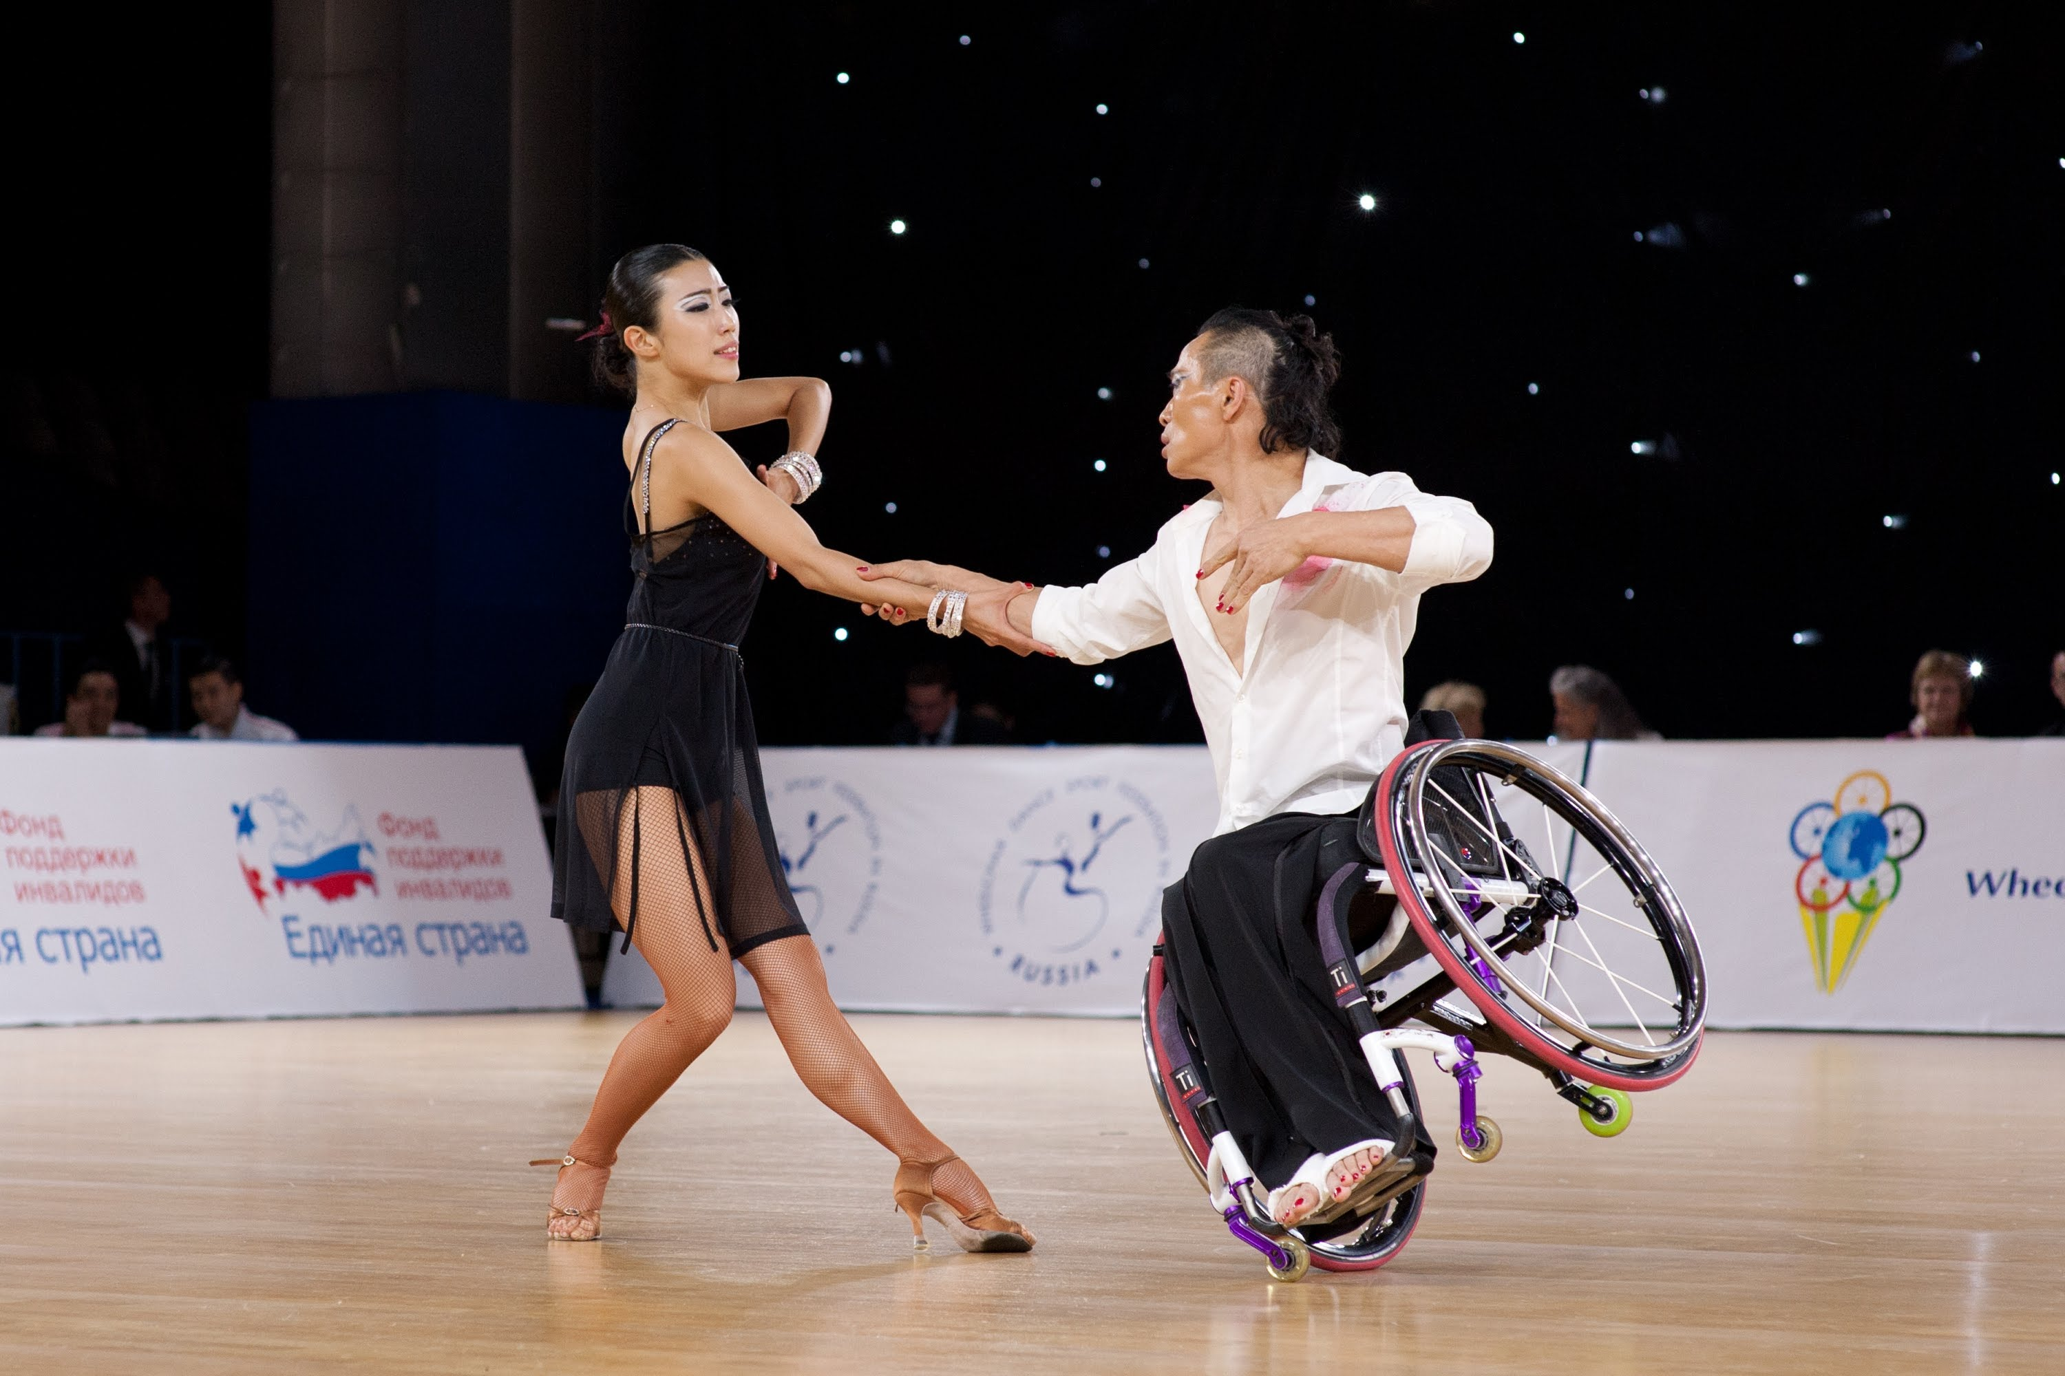
Areas of Occupation
Work
Play
Leisure
Social Participation

Slide 6
Occupational Performance
The ability to carry out activities of daily life
The occupational therapist’s word for “function.”
Occupational Performance emerges out of the interaction of three things:
Person
Activity
Context
Occupational
Performance

Slide 7
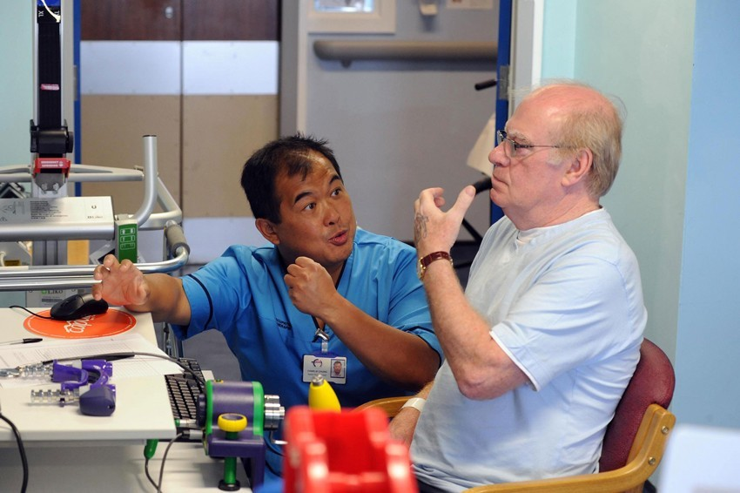
Two Important Beliefs
Client-Centered Care
An occupational therapist’s job is to provide care that is centered on the client.
Why would this be necessary, given what we’ve just learned about occupation?
What does this mean regarding the client’s engagement in the evaluation and treatment process?

Slide 8
Two Important Beliefs
Therapeutic Use of Self
Using one’s self – personality, insights, perceptions, judgements, actions – as part of the therapeutic process
We use ourselves in service during the client’s course of treatment

Slide 9
Types of Interventions
Group or Individual Interventions
Advocacy
Preparatory Methods and Tasks –
“Set Up”
Education and Training
Occupations & Activities

Slide 10
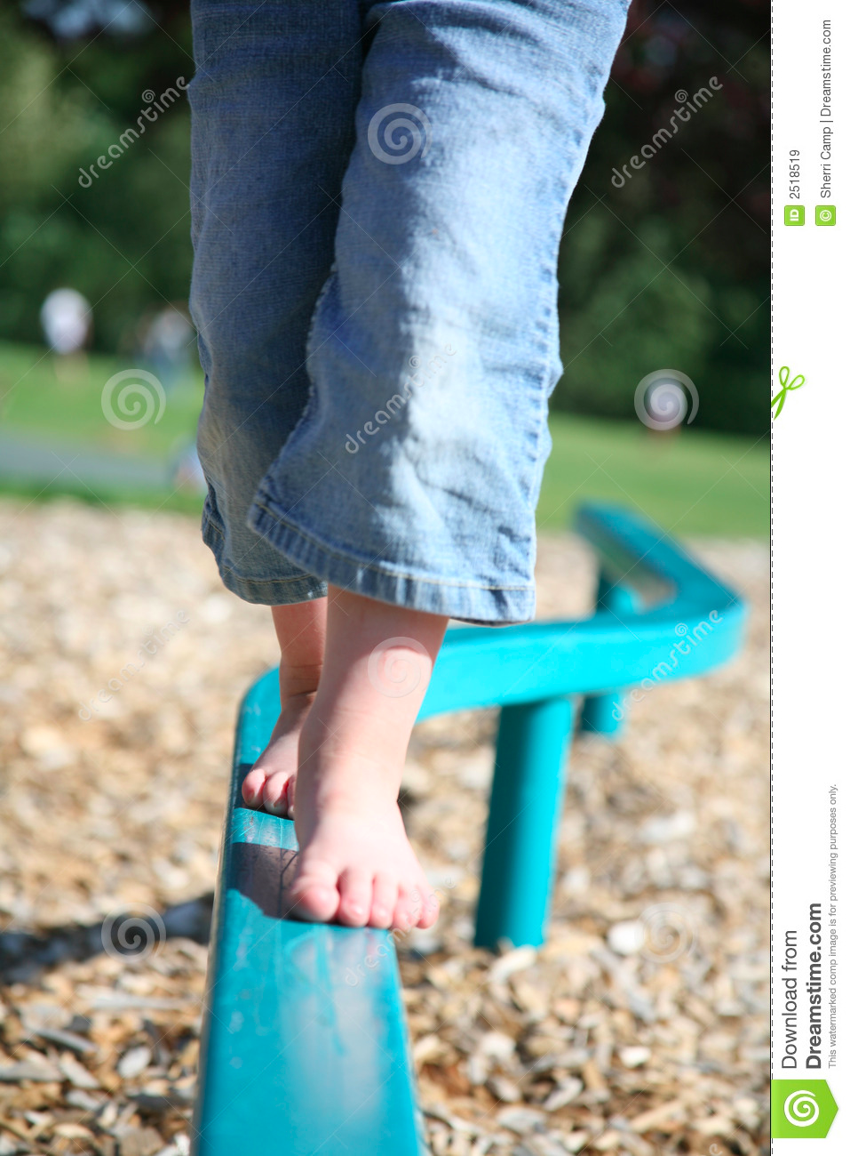
Types of Interventions: Occupations & Activities
Individualized
Specific
Meet particular goals and/or needs

Slide 11
Types of Interventions: Preparatory Methods and Tasks
Preparatory Methods
Might be done “to” the client
Get the client “ready” for occupational performance
Examples
Hot packs; cold packs; splinting; sensory strategies; muscle facilitation

Slide 12
Types of Interventions: Preparatory Methods and Tasks
Preparatory Tasks
Activities that will help the client attain their goals
Involve active participation by the client
Examples
Exercises; stretches; eye exercises
May not be meaningful to client

Slide 13
Types of Interventions: Education and Training
Education
share knowledge
Prevention
Examples: energy saving techniques; facts about disease process
Training
Teach skills to meet goals
Promotes increased engagement and independence
Examples: dressing with one hand; low vision techniques; tying one’s shoes

Slide 14
Types of Interventions: Advocacy
Empowering clients to seek out resources
Helping client learn to advocate for themselves
Educating others on behalf of the client
Examples: speaking with employers re: employee needs; speaking with village board about an accessible playground

Slide 15
Types of Interventions: Group Interventions
Groups are “mini-” reflections of social participation in society
Provide a place to learn and to practice skills needed for participation and engagement in society
Always will involve an activity
May involve a task
May involve learning and practicing a skill
May involve providing support to peers

Slide 16
Types of Approaches to Intervention
Modify
Create/Promote
“Health Promotion”
Maintain
Prevent
Establish, Restore, Remediate

Slide 17
Approaches to Interventions
Create and/or Promote Health – Health Promotion
Does not assume a disability is present
Designed to provide enriched experiences
Life-style Re-Design
Establish, Restore, Remediate
Help clients learn a skill that has not been developed
Restore an ability that client no longer has

Slide 18
Approaches to Interventions
Maintain
Preserve performance –
Client will not be able to participate to their fullest, and will not maintain health and quality of life if function is not maintained
Modify
Adapt
Teach compensatory ways of doing things
Change in the physical environment
Change in the method of completing a task
May be adapting for the client or caregiver

Slide 19
Approaches to Intervention
Prevent
Addresses needs of client with or without a disability
Aims at helping those who are at risk of developing problems with occupational performance
Helps to prevent barriers to performance
Example: joint preservation; stretching tight muscles; falls prevention; worksite injury protections (repetitive use injuries); home safety; splinting

Slide 20
Approaches to Intervention
Establish, Restore and Remediate
Focuses on impairments – or things that are wrong with our body or how we do things
Motor skills: Gross, Fine, Praxis, Bilateral Coordination, Laterality, Eye Skills
Visual perceptual skills: visual closure, figure ground, form constancy, depth perception
Sensory skills: arousal, attention, processing information for organization, touch, hearing, smelling, seeing, tasting – and two others: proprioception and vestibular
Cognitive skills: attention, memory, problem solving; metacognition, awareness, time management
Psychosocial skills: emotional regulation, social interaction, values, interests, interpersonal skills,

