Slide 1

Operations and Project Management
ELCBUS 340
16 April 2018

Slide 2
Today’s Agenda
Class Administration – Littlefield Launch, Team Projects
Quality
Statistical Process Control
Types of Variation
Control Charting
Continuous
Discrete
Process Capability Studies
Process Capability Ratio (Cp)
Process Capability Index (Cpk)

Slide 3
50,000 Feet Overview of OPM
Managing Value Chains
Managing Processes
Using Operations
to Compete
Supply Chain Strategy
Process Strategy
Location
Operations As a
Competitive Weapon
Process Analysis
Inventory Management
Process Analysis
Operations Strategy
Process Performance
& Quality
Forecasting
Project Management
Constraint Management
Sales & Operations
Planning
Process Layout
Resource Planning
Lean Systems
Scheduling
Notes:
Service vs. Manufacturing
Small vs. Medium vs. Large Firms
Industry type: hightech, healthcare, aerospace, IT, etc ….

Slide 4

Quality
A term used by customers to describe their general satisfaction with a service or product.

Slide 5
Costs of Quality
Many companies spend significant time, effort, and expense on systems, training, and organizational changes to improve quality and performance of their processes. It is estimated that COQ ranges from 20 to 30 percent of gross sales.
Four major categories:
  Prevention Costs
  Appraisal Costs
  Internal Failure Costs
  External Failure Costs

Slide 6
Costs of Quality
Prevention Costs are associated with preventing defects before they happen
Appraisal Costs are incurred when a firm assesses the level of performance of its processes
Internal Failure Costs result from defects that are discovered during the production of a service or product
External Failure Costs arise when a defect is discovered after the customer receives the product or service
Ethical Failure Costs are the societal and monetary costs associated with passing defective services or products to customers

Slide 7
TQM & Six Sigma

Slide 8
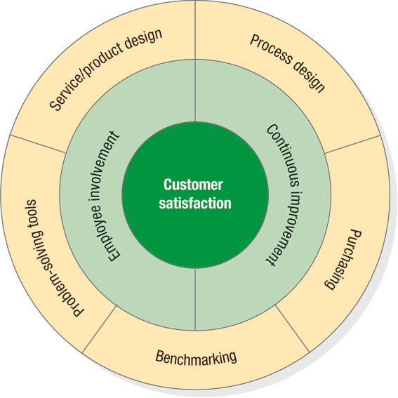
What is
Total Quality Management?
Total Quality Management (TQM)
Is a quality strategy that focuses on achieving high levels of process performance and quality by stressing three principles:
Customer Satisfaction
Employee Involvement
Continuous Improvement

Slide 9
Total Quality Management
Principles
Customer Satisfaction
  Conformance to Specifications
  Value
  Fitness for Use
  Support
  Psychological Impressions
Notes:
Customer satisfaction (internal or external): when customers’ expectations have been met or exceeded.
Conformance to specifications
It is the processes that produced the service or product that are really being judged.
Specifications may relate to consistent quality, on-time delivery, or delivery speed.
Value
How well the service or product serves its intended purpose at a price customers are willing to pay.
Fitness for use: customer may consider the convenience of a service or the mechanical features of a product.
Support: the service or product support may be as important to the customer as the service or product itself.
Psychological impressions: atmosphere, image, or aesthetics

Slide 10
Total Quality Management
Principles
Employee Involvement
  Cultural Change
    Quality at the Source
  Teams
    Employee Empowerment
      Problem-solving teams
      Special-purpose teams
      Self-managed teams
Notes:
Employee involvement
Cultural change
Challenge is to define customer for each employee
External customers buy the service or product.
Internal customers are employees in the firm who rely on output of other employees. An assembly line is a chain of internal customer-supplier relationships, with an external customer purchasing the finished goods.
Top management must motivate cultural change.
Everyone is expected to contribute and share the view that quality control is an end to itself
Quality at the source
Teams
Employee involvement is a key tactic for improving processes and quality
Small groups of people
Common purpose.
Set their own performance goals and approaches
Hold themselves accountable for success
Three employee-empowerment approaches to teamwork
Problem-solving teams (also called quality circles)
Special-purpose teams
Self-managing teams, the highest level of worker participation

Slide 11
Continuous Improvement
  Kaizen
  Problem-solving tools
  Plan-Do-Study-Act Cycle
Total Quality Management
Principles
Notes:
Based on the Japanese concept, kaizen
The philosophy of continually seeking ways to improve processes.
Not unique to quality. Applies to process improvement as well.
Getting started
SPC training
Make SPC a normal aspect of daily operations.
Build work teams and employee involvement.
Utilize problem-solving tools within the work teams.
Develop operator ownership in the process.

Slide 12
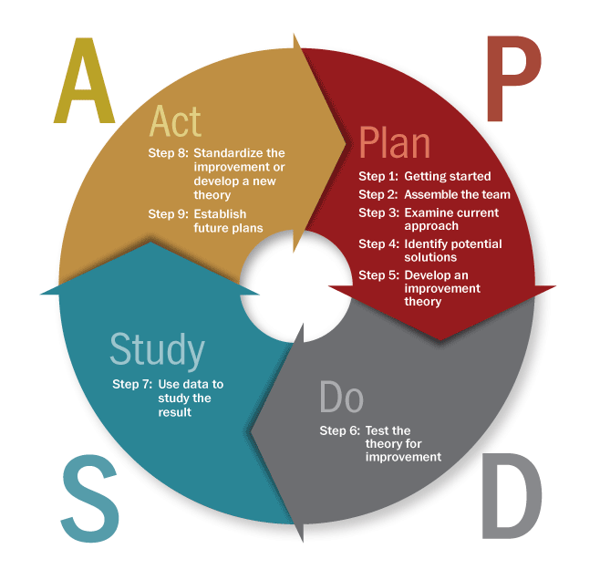
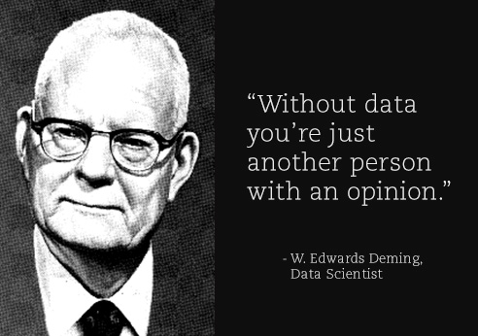
  Plan-Do-Study-Act Cycle
Total Quality Management
Principles
Notes:
Problem-solving process: The Deming Wheel
Plan—select a process needing improvement, document process, analyze data, set improvement goals, discuss alternatives, assess benefits and costs, develop a plan and improvement measures.
Do—implement plan, monitor improvements.
Study—analyze data to evaluate effectiveness of the plan.
Act—document and disseminate improved process as a standard procedure.

Slide 13

What is Six Sigma?
Six Sigma
A comprehensive and flexible system for achieving, sustaining, and maximizing business success by minimizing defects and reducing variation in processes.

Slide 14
Six Sigma
Project Frameworks
DMAIC
DFSS (Define for Six Sigma)
DMADV
IDOV

Slide 15
DMAIC
An improvement system for existing processes falling below specification and looking for incremental improvement
Define
Measure
Analyze
Improve
Control

Slide 16
DMADV
An improvement system used to develop new processes or products at Six Sigma quality levels
Define
Measure
Analyze
Design
Verify

Slide 17
IDOV
Used for designing a completely new product or business process to meet customer needs and specifications or to achieve Six Sigma quality levels
Identify
Design
Optimize
Verify

Slide 18
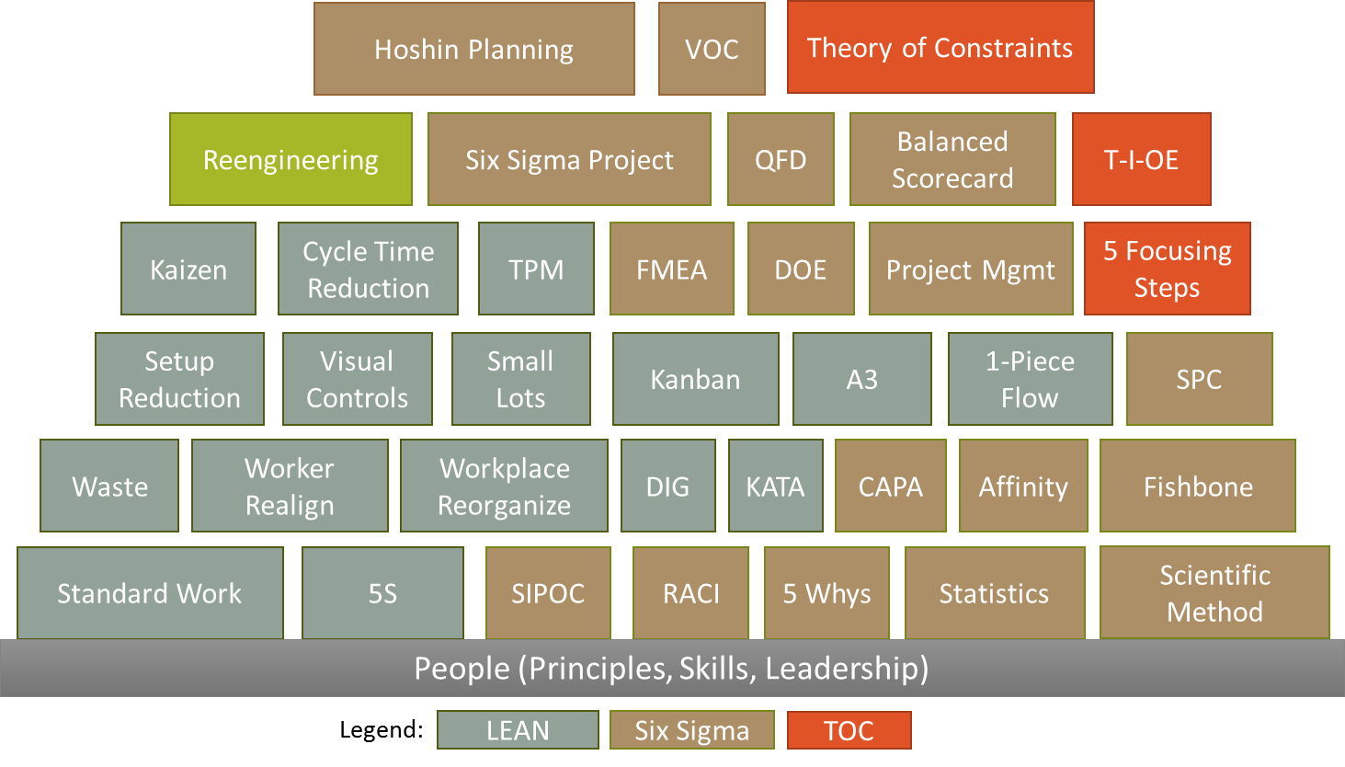
The Tools
Six Sigma Tools
Notes:
[Introduce the Tools]
Standard Work
The best combination of machines and people working together to produce a product or service at a particular point in time.
5S
5S is a workplace organization method used to assure work can be done effectively and efficiently.
SIPOC
SIPOC is a tool that summarizes the inputs, outputs and steps of one or more processes in table form.
RACI
RACI is a method to identify the roles and responsibilities of participants in a cross organizational team.
5Ys
Statistics
Waste
Worker Realignment
Workplace Reorganization
DIG
CAPA
Affinity
Fishbone
Setup Reduction
Visual Controls
Small Lots
Kanban
A3
1-Piece Flow
SPC
Kaizen
Cycle Time Reduction
TPM
FMEA
DOE
Project Management
Reengineering
Six Sigma Project
Balanced Scorecard
QFD
Hoshin Planning
VOC

Slide 19
Six Sigma Certifications
Master Black Belt
Black Belt
Green Belt
Yellow Belt
Certifying Organizations?

Slide 20
Acceptance Sampling
Acceptance Sampling
Acceptance Sampling
  The application of statistical techniques to determine if a quantity of material from a supplier should be accepted or rejected based on the inspection or test of one or more samples.
Acceptable Quality Level
  The quality level desired by the consumer.

Slide 21
Acceptance Sampling
Firm A uses TQM or Six
Sigma to achieve internal
process performance
Buyer
Manufactures furnaces
Fan motors
Supplier uses TQM or Six
Sigma to achieve internal
process performance
Firm A
Manufacturers
furnace fan motors
TARGET: Buyer’s specs
Motor sampling
Fan blades
Supplier
Manufactures
fan blades
TARGET: Firm A’s specs
Yes
Accept
motors?
No
Blade sampling
Yes
Accept
blades?
No

Slide 22
Six Sigma Approach
Process average OK;
too much variation
Process variability OK;
process off target
X
X
X
X
X
X
X
X
X
X
Process
on target with
low variability
X
X
X
X
X
X
X
X
Reduce
spread
Center
process
X
X
X
X
X
X
X
X

Slide 23
Statistical Process Control

Slide 24
Statistical Process Control (SPC)
SPC
  The application of statistical techniques to determine whether a process is delivering what the customer wants.
Performance Measurements
  Variables (Continuous) - Characteristics that can be measured.
  Attributes (Discrete) - Characteristics that can be counted.

Slide 25
A process that is in statistical control:
  Is stable and predictable
  Variation will be limited to an expected range
  But still may not be capable
A process that is out of statistical control:
  Is unstable and unpredictable
  Variation will not be limited to the expected range
  Variation may be extreme
Statistical Process Control (SPC)

Slide 26
Types of Variation
Common cause
Variation that is random, unidentifiable and unavoidable
Special cause
Variation that can be identified and eliminated

Slide 27
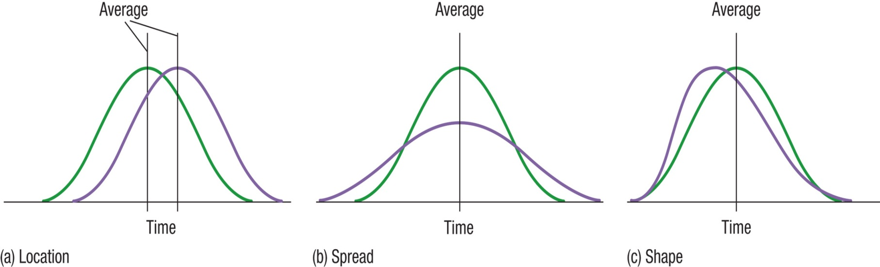
Effects of Special Cause Variation on the Process Distribution

Slide 28
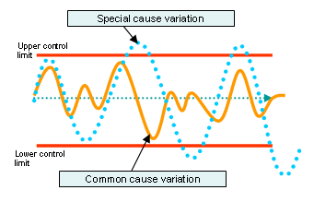
Control Charts
Time-ordered diagram used to determine whether observed variations are abnormal

Slide 29
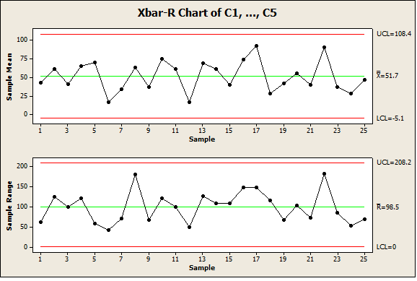
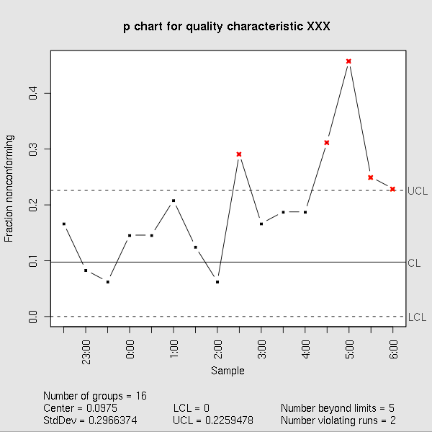
Control Charting
A control chart always has a central line for the average, an upper line for the upper control limit and a lower line for the lower control limit.
By comparing current data to these lines, one can make conclusions about whether the process variation is in control or out of control (special cause variation)
Variable data control charts use two charts with attribute data using one chart
Notes:
[Explain]
Describe the anatomy of a control chart – use the bullets as a guideline for your explanation.
[Draw this on the Board]
[Insert graphic from supplemental PPT, slide 7]
Remember the Galton box?
If you turn the SPC on its end and shook all of the points to the bottom, you would be a Probability Density Function (PDF) that would appear to be a normal distribution.
[Next Slide]
Control charting process

Slide 30
Types of
Control Charts
Variable Data Control Charts
X-bar Chart – Measures whether the process is generating output consistent with a target value.
R Chart – Measures the variability of the process.
S Chart – Measures the Standard Deviation of the process.
Attribute Data Control Charts
p-chart – Measures the proportion of defective services of products in a process.
c-chart – Measures the proportion of defects in one service or product.

Slide 31


Continuous Control Charts
$\overline{X }$Charts
R Charts
S Charts
Notes:
[Explain]
Describe the anatomy of a control chart – use the bullets as a guideline for your explanation.
[Draw this on the Board]
[Insert graphic from supplemental PPT, slide 7]
Remember the Galton box?
If you turn the SPC on its end and shook all of the points to the bottom, you would be a Probability Density Function (PDF) that would appear to be a normal distribution.
[Next Slide]
Control charting process

Slide 32
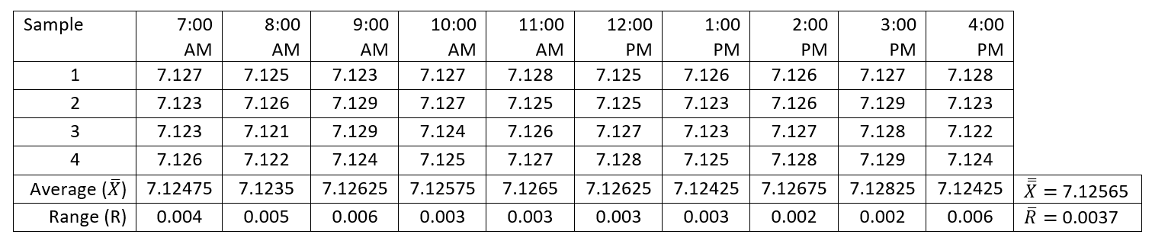

$\overline{X }$- Chart
Data are collected in a face-and-plunge operation done on a lathe. The dimension being measured is the groove inside diameter (ID), which has a tolerance of 7.125 ± 0.010. Four parts are measured every hour. These values have been entered in the table below.

Slide 33
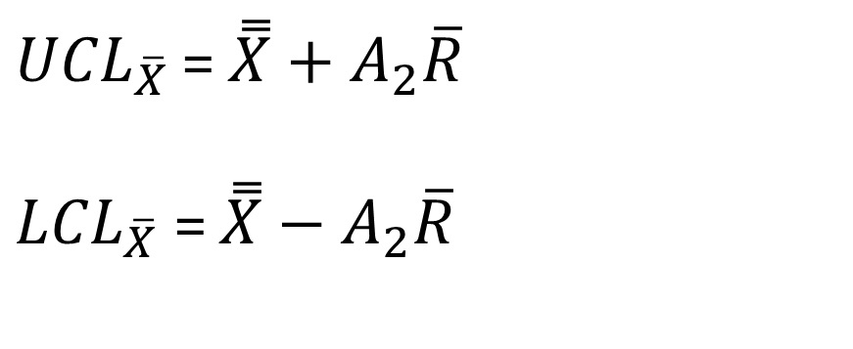

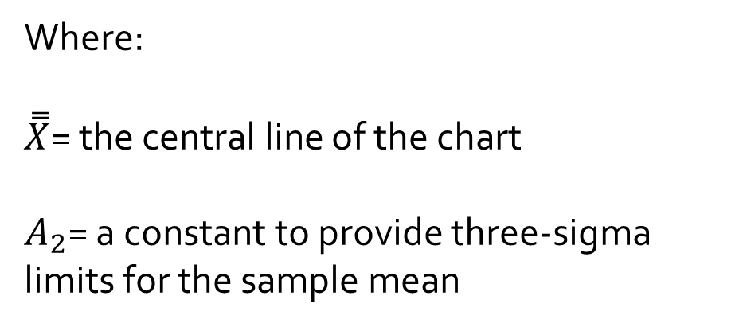
$\overline{X }$Chart
Control Limits
${UCL}_{\overline{X}}$ = $\overset{̿}{X}+A_{2}\overline{R}$
${LCL}_{\overline{X}}$= $\overset{̿}{X}−A_{2}\overline{R}$
Where:
$\overset{̿}{X}$= the central line of the chart
$A_{2}$= a constant to provide three-sigma limits for the sample mean

Slide 34
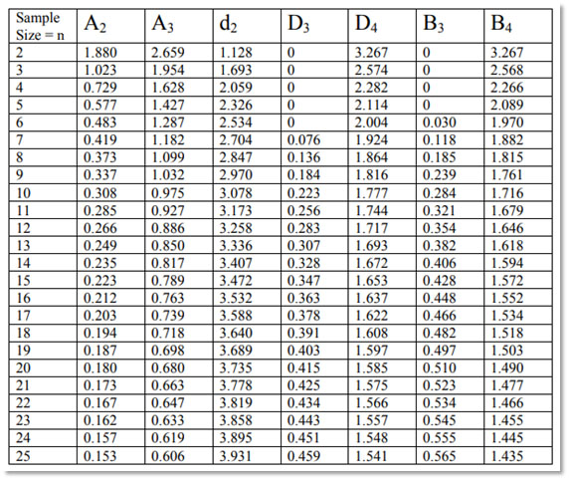
Calculating Control Chart Factors

Slide 35
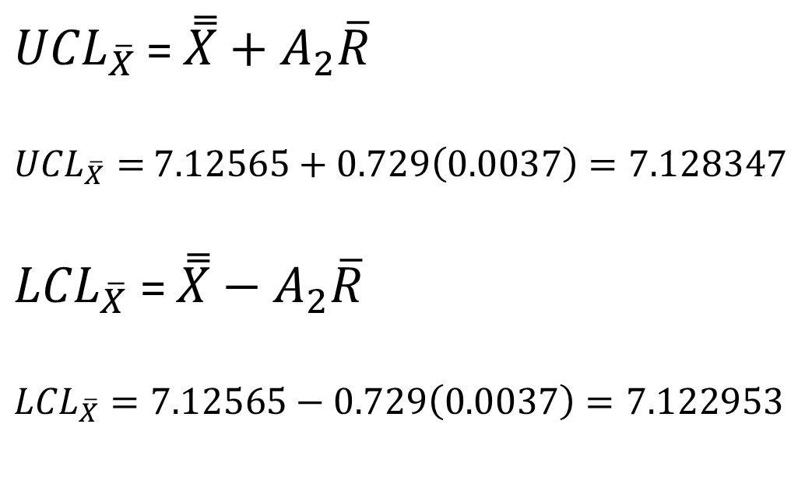
$\overline{X }$Chart
Control Limits
${UCL}_{\overline{X}}$ = $\overset{̿}{X}+A_{2}\overline{R}$
${UCL}_{\overline{X}}=$ $7.12565+0.729\left(0.0037\right)=7.128347$
${LCL}_{\overline{X}}$= $\overset{̿}{X}−A_{2}\overline{R}$
${LCL}_{\overline{X}}=7.12565−0.729\left(0.0037\right)=7.122953$

Slide 36
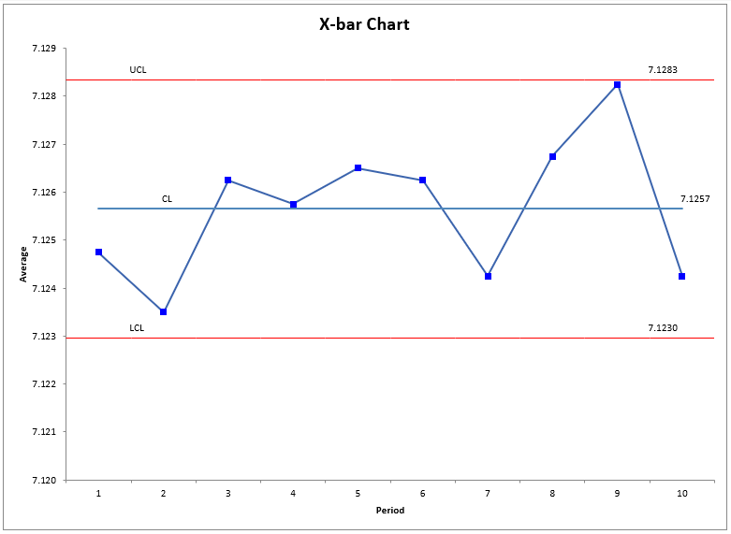


Plot $\overline{X}$ data over time
Centerline = $\overset{̿}{X}$

Slide 37
Upper and Lower Control Limits
LCL
UCL

Slide 38
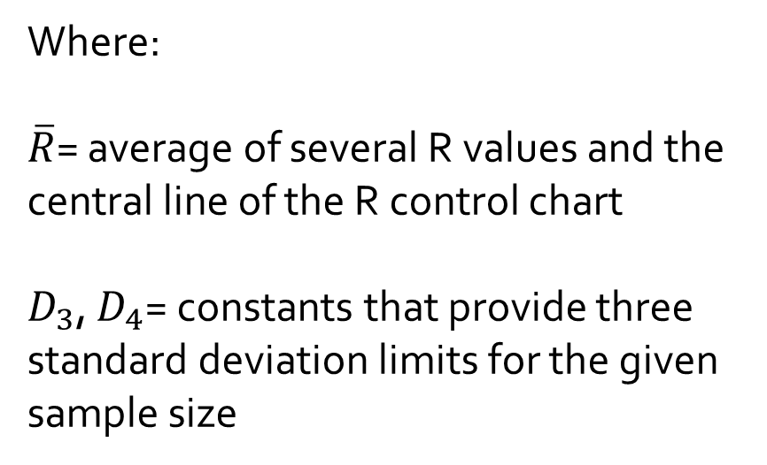
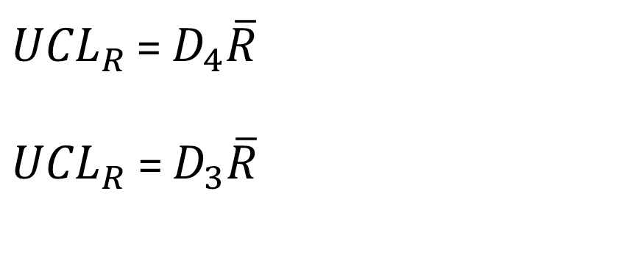
R-Chart
Control Limits
${UCL}_{R}$ = $D_{4}\overline{R}$
${UCL}_{R}$= $D_{3}\overline{R}$
Where:
$\overline{R}$= average of several R values and the central line of the R control chart
$D_{3}$, $D_{4}$= constants that provide three standard deviation limits for the given sample size

Slide 39
Calculating Control Chart Factors

Slide 40

R-Chart
Control Limits
${UCL}_{R}$ = $D_{4}\overline{R}$
${UCL}_{R}$ = 2.282(0.0037) = 0.008443
${UCL}_{R}$= $D_{3}\overline{R}$
${UCL}_{R}$= 0(0.0037) = 0

Slide 41
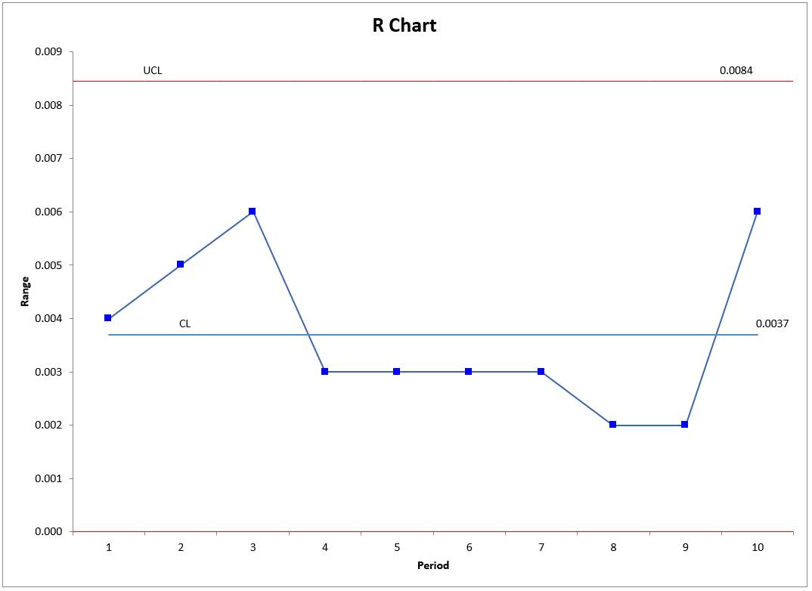
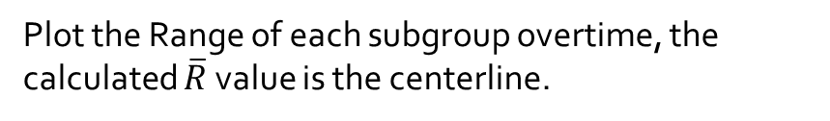
R-Chart
Plot the Range of each subgroup overtime, the calculated $\overline{R}$ value is the centerline.

Slide 42
Variation and out of control data points
Time plot of sequential process measurements
Common
Cause
Variation
Out-of-control point (Special Cause)

Slide 43

Example
The management of West Allis Industries is concerned about the production of a special metal screw used by several of the company’s largest customers. The diameter of the screw is critical to the customers. Data from five samples appear in the accompanying table. The sample size is 5. Is the process in statistical control?
Sample Number | 1 | 2 | 3 | 4 | 5
1 | 0.5014 | 0.5022 | 0.5009 | 0.5027 | 0.5045
2 | 0.5021 | 0.5041 | 0.5024 | 0.5020 | 0.5062
3 | 0.5018 | 0.5026 | 0.5035 | 0.5023 | 0.5054
4 | 0.5008 | 0.5034 | 0.5024 | 0.5015 | 0.5047
5 | 0.5041 | 0.5056 | 0.5034 | 0.5047 | 0.5043
 | 0.50204 | 0.50358 | 0.50252 | 0.50264 | 0.50502 |  | 0.50316
R | 0.0033 | 0.0034 | 0.0026 | 0.0032 | 0.0019 |  | 0.00288
$$\overline{X}$$
$$\overset{̿}{X}=$$
$$\overline{R}=$$

Slide 44
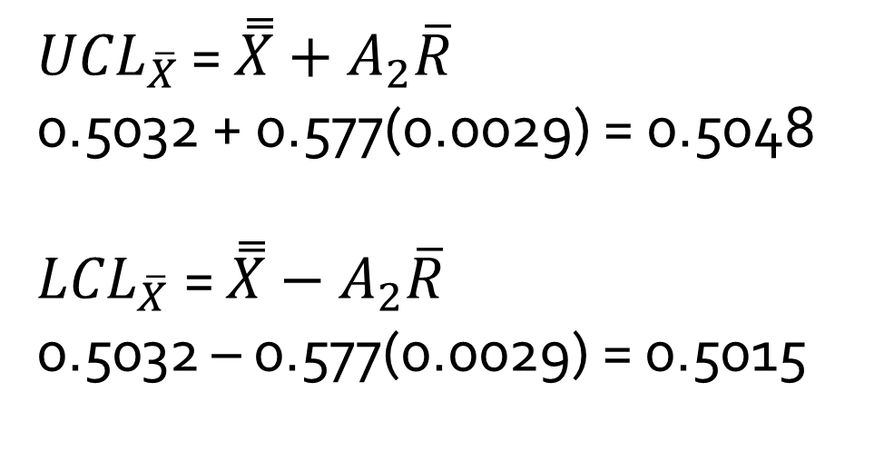
Compute the mean for each sample and the control limits.
Example
${UCL}_{\overline{X}}$ = $\overset{̿}{X}+A_{2}\overline{R}$
0.5032 + 0.577(0.0029) = 0.5048
${LCL}_{\overline{X}}$= $\overset{̿}{X}−A_{2}\overline{R}$
0.5032 – 0.577(0.0029) = 0.5015

Slide 45
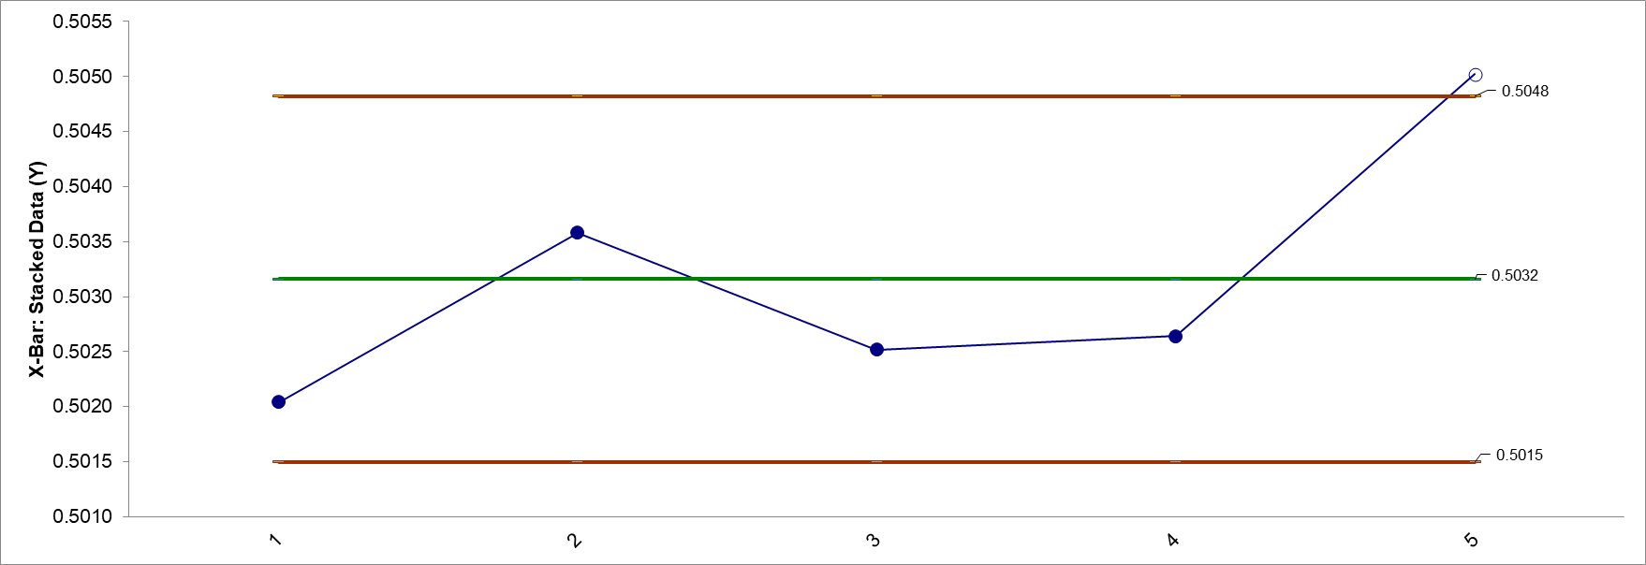
Example
Process average is NOT in statistical control.

Slide 46
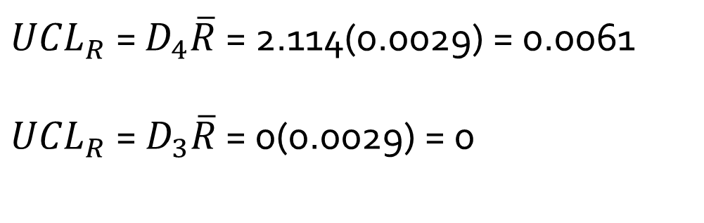
Example
  Compute the range for each sample and the control limits
${UCL}_{R}$ = $D_{4}\overline{R}$ = 2.114(0.0029) = 0.0061
${UCL}_{R}$= $D_{3}\overline{R}$ = 0(0.0029) = 0

Slide 47
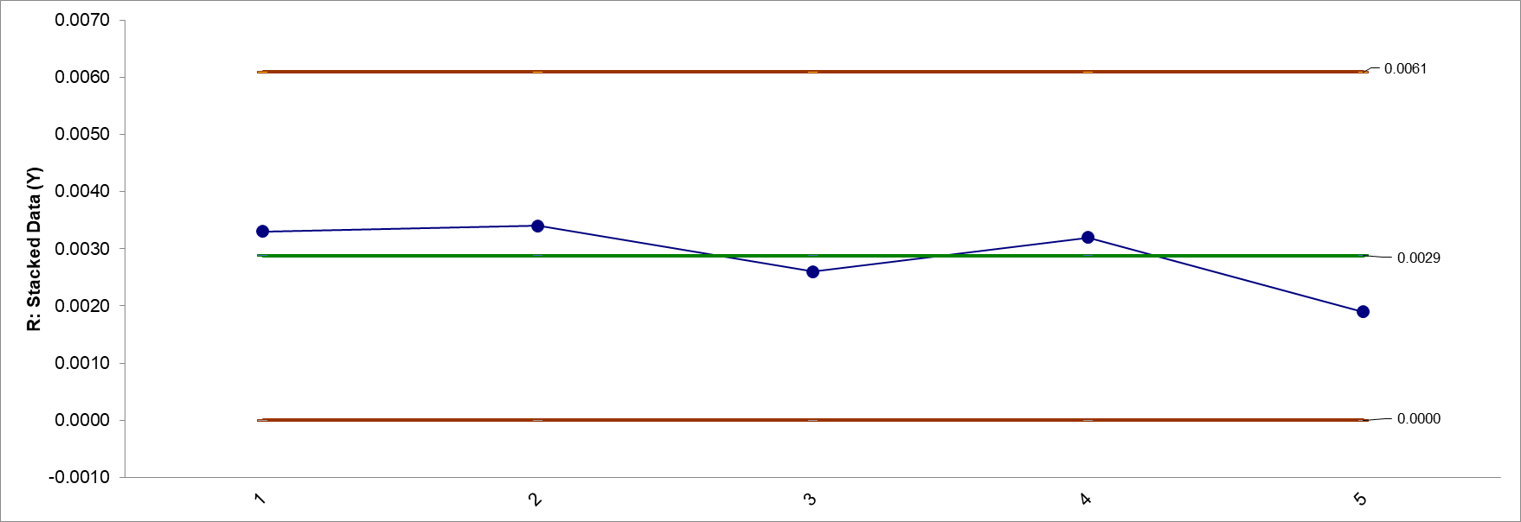
Example
Process variability is in statistical control.

Slide 48
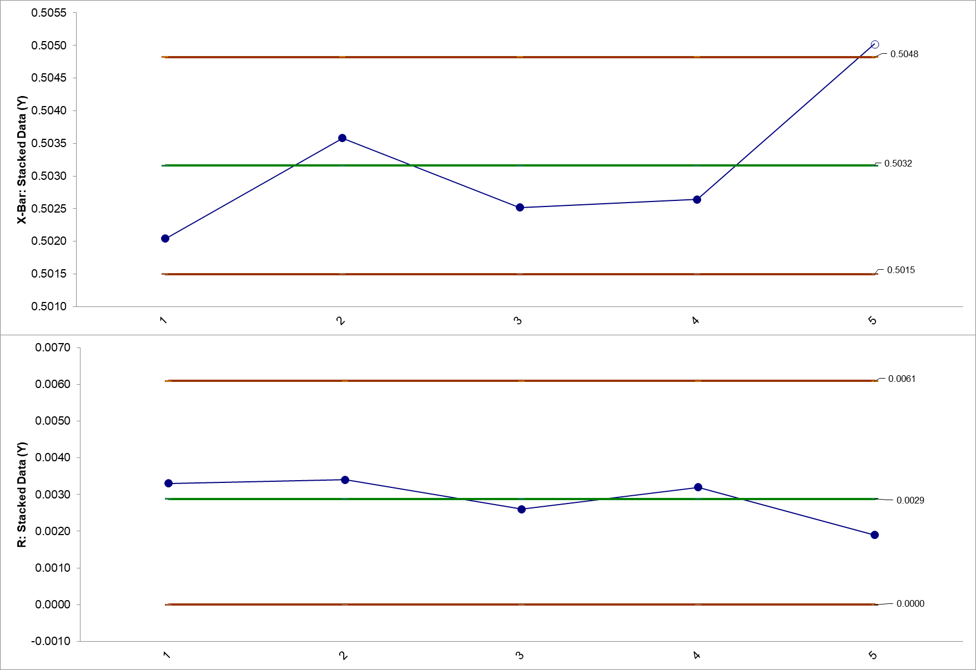

Slide 49
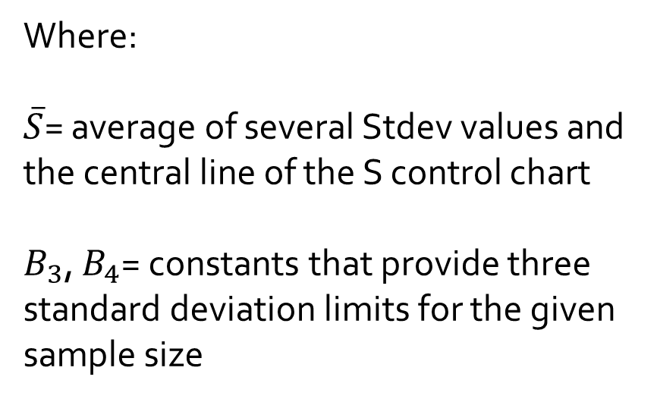
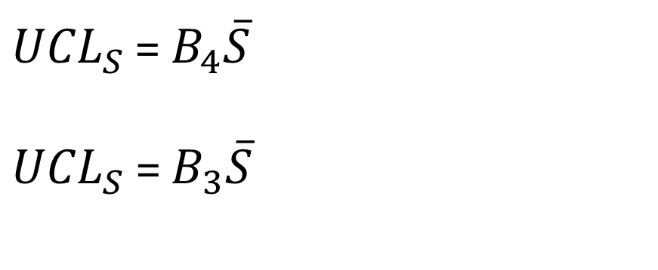
S-Chart
Control Limits
${UCL}_{S}$ = $B_{4}\overline{S}$
${UCL}_{S}$= $B_{3}\overline{S}$
Where:
$\overline{S}$= average of several Stdev values and the central line of the S control chart
$B_{3}$, $B_{4}$= constants that provide three standard deviation limits for the given sample size

Slide 50
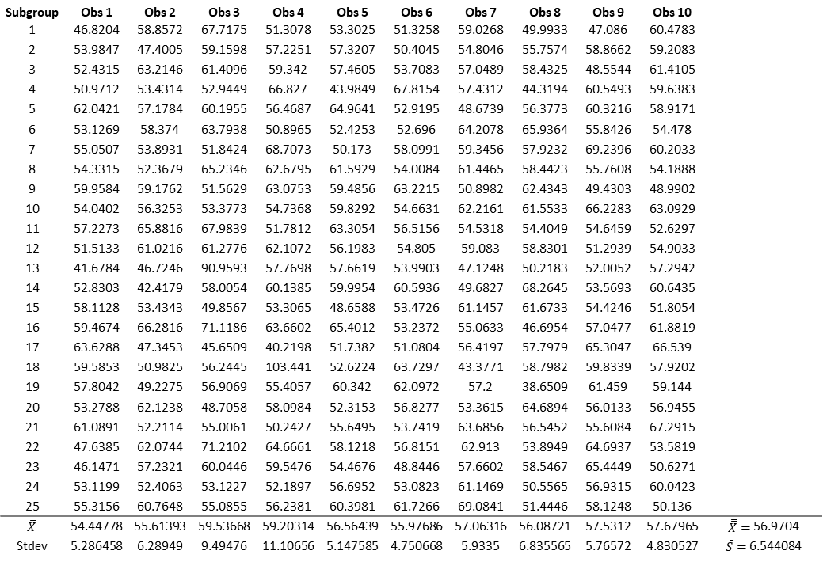
S - Chart
Subgroup | Obs 1 | Obs 2 | Obs 3 | Obs 4 | Obs 5 | Obs 6 | Obs 7 | Obs 8 | Obs 9 | Obs 10
1 | 46.8204 | 58.8572 | 67.7175 | 51.3078 | 53.3025 | 51.3258 | 59.0268 | 49.9933 | 47.086 | 60.4783
2 | 53.9847 | 47.4005 | 59.1598 | 57.2251 | 57.3207 | 50.4045 | 54.8046 | 55.7574 | 58.8662 | 59.2083
3 | 52.4315 | 63.2146 | 61.4096 | 59.342 | 57.4605 | 53.7083 | 57.0489 | 58.4325 | 48.5544 | 61.4105
4 | 50.9712 | 53.4314 | 52.9449 | 66.827 | 43.9849 | 67.8154 | 57.4312 | 44.3194 | 60.5493 | 59.6383
5 | 62.0421 | 57.1784 | 60.1955 | 56.4687 | 64.9641 | 52.9195 | 48.6739 | 56.3773 | 60.3216 | 58.9171
6 | 53.1269 | 58.374 | 63.7938 | 50.8965 | 52.4253 | 52.696 | 64.2078 | 65.9364 | 55.8426 | 54.478
7 | 55.0507 | 53.8931 | 51.8424 | 68.7073 | 50.173 | 58.0991 | 59.3456 | 57.9232 | 69.2396 | 60.2033
8 | 54.3315 | 52.3679 | 65.2346 | 62.6795 | 61.5929 | 54.0084 | 61.4465 | 58.4423 | 55.7608 | 54.1888
9 | 59.9584 | 59.1762 | 51.5629 | 63.0753 | 59.4856 | 63.2215 | 50.8982 | 62.4343 | 49.4303 | 48.9902
10 | 54.0402 | 56.3253 | 53.3773 | 54.7368 | 59.8292 | 54.6631 | 62.2161 | 61.5533 | 66.2283 | 63.0929
11 | 57.2273 | 65.8816 | 67.9839 | 51.7812 | 63.3054 | 56.5156 | 54.5318 | 54.4049 | 54.6459 | 52.6297
12 | 51.5133 | 61.0216 | 61.2776 | 62.1072 | 56.1983 | 54.805 | 59.083 | 58.8301 | 51.2939 | 54.9033
13 | 41.6784 | 46.7246 | 90.9593 | 57.7698 | 57.6619 | 53.9903 | 47.1248 | 50.2183 | 52.0052 | 57.2942
14 | 52.8303 | 42.4179 | 58.0054 | 60.1385 | 59.9954 | 60.5936 | 49.6827 | 68.2645 | 53.5693 | 60.6435
15 | 58.1128 | 53.4343 | 49.8567 | 53.3065 | 48.6588 | 53.4726 | 61.1457 | 61.6733 | 54.4246 | 51.8054
16 | 59.4674 | 66.2816 | 71.1186 | 63.6602 | 65.4012 | 53.2372 | 55.0633 | 46.6954 | 57.0477 | 61.8819
17 | 63.6288 | 47.3453 | 45.6509 | 40.2198 | 51.7382 | 51.0804 | 56.4197 | 57.7979 | 65.3047 | 66.539
18 | 59.5853 | 50.9825 | 56.2445 | 103.441 | 52.6224 | 63.7297 | 43.3771 | 58.7982 | 59.8339 | 57.9202
19 | 57.8042 | 49.2275 | 56.9069 | 55.4057 | 60.342 | 62.0972 | 57.2 | 38.6509 | 61.459 | 59.144
20 | 53.2788 | 62.1238 | 48.7058 | 58.0984 | 52.3153 | 56.8277 | 53.3615 | 64.6894 | 56.0133 | 56.9455
21 | 61.0891 | 52.2114 | 55.0061 | 50.2427 | 55.6495 | 53.7419 | 63.6856 | 56.5452 | 55.6084 | 67.2915
22 | 47.6385 | 62.0744 | 71.2102 | 64.6661 | 58.1218 | 56.8151 | 62.913 | 53.8949 | 64.6937 | 53.5819
23 | 46.1471 | 57.2321 | 60.0446 | 59.5476 | 54.4676 | 48.8446 | 57.6602 | 58.5467 | 65.4449 | 50.6271
24 | 53.1199 | 52.4063 | 53.1227 | 52.1897 | 56.6952 | 53.0823 | 61.1469 | 50.5565 | 56.9315 | 60.0423
25 | 55.3156 | 60.7648 | 55.0855 | 56.2381 | 60.3981 | 61.7266 | 69.0841 | 51.4446 | 58.1248 | 50.136
$$\overline{X}$$ | 54.44778 | 55.61393 | 59.53668 | 59.20314 | 56.56439 | 55.97686 | 57.06316 | 56.08721 | 57.5312 | 57.67965 | $\overset{̿}{X}=$56.9704
Stdev | 5.286458 | 6.28949 | 9.49476 | 11.10656 | 5.147585 | 4.750668 | 5.9335 | 6.835565 | 5.76572 | 4.830527 | $\overline{S}=$6.544084

Slide 51
Calculating Control Chart Factors

Slide 52
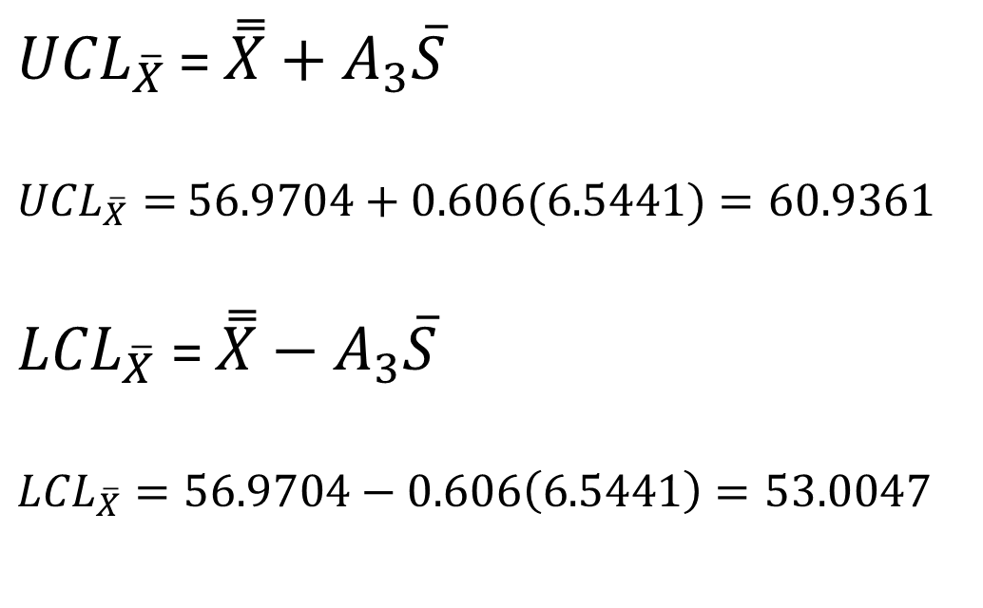

$\overline{X }$Chart
Control Limits when using large sample sizes (S Chart)
${UCL}_{\overline{X}}$ = $\overset{̿}{X}+A_{3}\overline{S}$
${UCL}_{\overline{X}}=$ $56.9704+0.606(6.5441)=60.9361$
${LCL}_{\overline{X}}$= $\overset{̿}{X}−A_{3}\overline{S}$
${LCL}_{\overline{X}}=56.9704−0.606\left(6.5441\right)=53.0047$

Slide 53

S-Chart
Control Limits
${UCL}_{S}$ = $B_{4}\overline{S}$
${UCL}_{S}$ = 1.436(6.5441) = 9.3973
${UCL}_{S}$= $B_{3}\overline{S}$
${UCL}_{S}$= 0.564(6.5441) = 3.6909

Slide 55
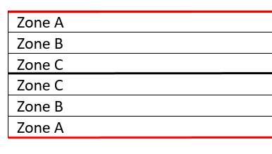

Control Chart Evaluation
Control Chart Rules
Rule Name | Out of Control Condition | Chart Type
 |  | Variables | Attributes
Beyond Limits | One or more points beyond the control limits | X | X
Zone C | 9 or more consecutive points on one side of the average (in Zone C or beyond) | X | X
Trend | 7 consecutive points trending up or trending down | X | X
Over-control | 14 consecutive points alternating up and down | X | X
Zone A | 2 out of 3 consecutive points in Zone A or beyond | X
Zone B | 4 out of 5 consecutive points in Zone B or beyond | X
Stratification | 15 consecutive points in Zone C | X
Mixture | 8 consecutive points with no points in Zone C | X
$$UCL$$
$$ctr$$
$$LCL$$

Slide 56

Discrete Control Charts c-charts np-charts

Slide 57
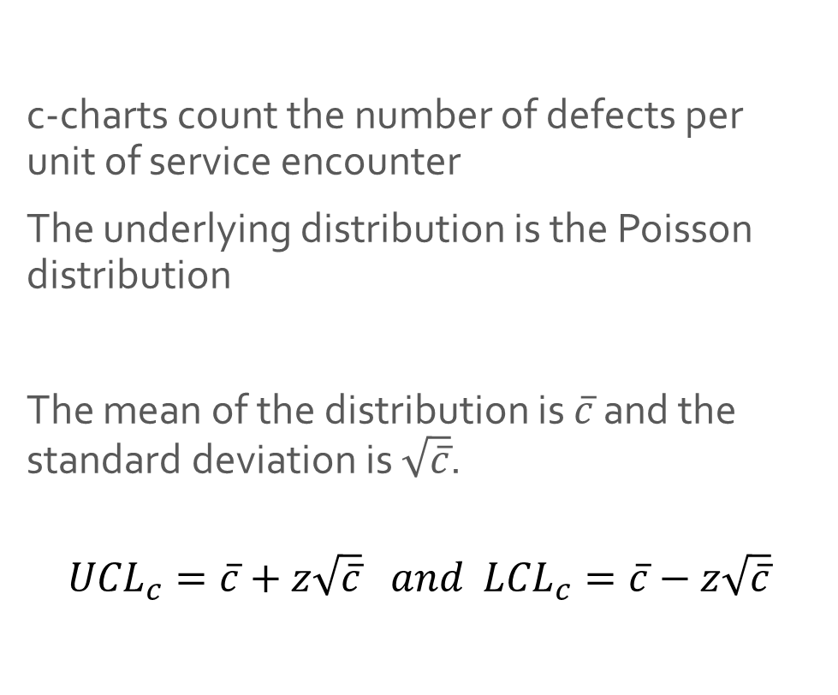
Control Charts for Attributes
Data c-chart
c-charts count the number of defects per unit of service encounter
The underlying distribution is the Poisson distribution
The mean of the distribution is $\overline{c}$and the standard deviation is $\sqrt{\overline{c}}$.
$${UCL}_{c}=\overline{c}+z\sqrt{\overline{c}} and{ LCL}_{c}=\overline{c}−z\sqrt{\overline{c}}$$

Slide 58
c-chart example
The Woodland Paper Company produces paper for the newspaper industry. As a final step in the process, the paper passes through a machine that measures various product quality characteristics. When the paper production process is in control, it averages 20 defects per roll.
a. Set up a control chart for the number of defects per roll. For this example, use two-sigma control limits.
b. Five rolls had the following number of defects: 16, 21, 17, 22, and 24, respectively. The sixth roll, using pulp from a different supplier, had 5 defects. Is the paper production process in control?

Slide 59
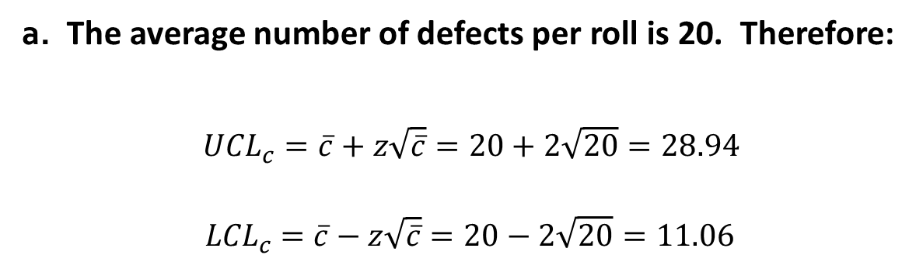
c-chart example
a. The average number of defects per roll is 20. Therefore:
${UCL}_{c}=\overline{c}+z\sqrt{\overline{c}}=20+2\sqrt{20}=28.94$
$${ LCL}_{c} =\overline{c}−z\sqrt{\overline{c}}=20−2\sqrt{20}=11.06$$

Slide 60
Example 5.4
c-chart example
The process is out of control due to Sample 6.
However, sample 6 is from a new supplier and results in a better product.

Slide 61
np-chart
np-charts are used to control the proportion defective
Sampling involves yes/no decisions so the underlying distribution is the binomial distribution

Slide 62

np-chart
$$D_{i}=number of defective \left(nonconforming\right) units in the{ i}^{th} subgroup$$
$$k=number of subgroups$$
$$n_{i}=sample size of the { i}^{th} subgroup$$
$$p_{i}=\frac{D_{i}}{n_{i}}=plot points$$
$$\overline{p}=\frac{\sum_{i=1}^{k}{D_{i}}}{\sum_{i=1}^{k}{n_{i}}}=center line for the p chart$$
$${LCL}_{p}=\overline{p}−3\sqrt{\frac{\overline{p}\left(1−\overline{p}\right)}{n_{i}}}$$
$${UCL}_{p}=\overline{p}+3\sqrt{\frac{\overline{p}\left(1−\overline{p}\right)}{n_{i}}}$$

Slide 63
np-chart example
A Test was conducted to determine the presence of the Rh factor in 13 samples of donated blood. The results of the test are given in the table on the next slide.
Using three-sigma control limits, is the accuracy of the blood testing process in statistical control?

Slide 64
np-chart example

Slide 65
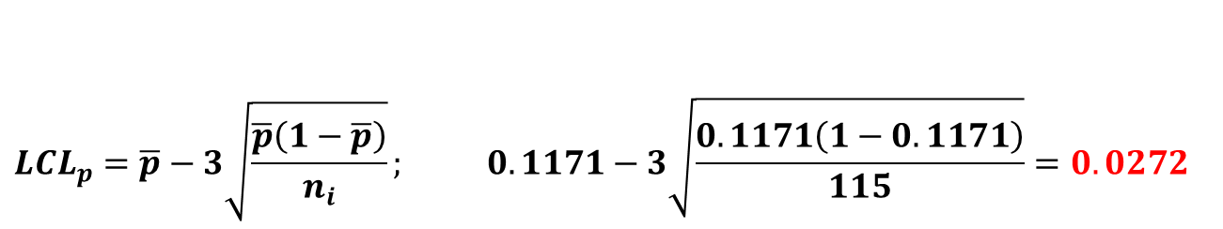
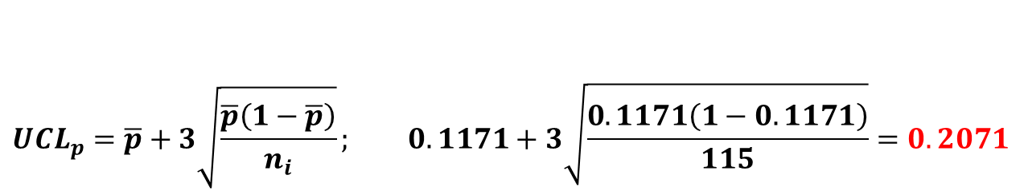
Example 5.3
np-chart example
Total defectives
Total number of observations
189
1614
p =
= = 0.1171
$${UCL}_{p}=\overline{p}+3\sqrt{\frac{\overline{p}\left(1−\overline{p}\right)}{n_{i}}}; 0.1171+3\sqrt{\frac{0.1171\left(1−0.1171\right)}{115}}=0.2071$$
$${LCL}_{p}=\overline{p}−3\sqrt{\frac{\overline{p}\left(1−\overline{p}\right)}{n_{i}}}; 0.1171−3\sqrt{\frac{0.1171\left(1−0.1171\right)}{115}}=0.0272$$
Calculate the sample proportion defective and plot each sample proportion defective on the chart.

Slide 66
np-chart example

Slide 67
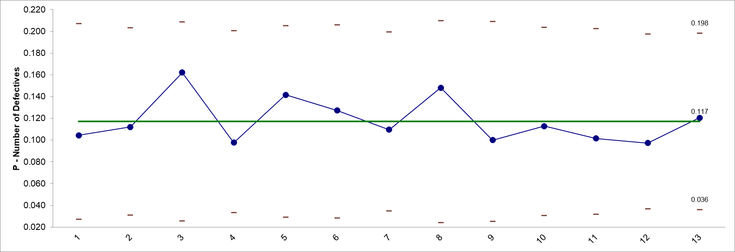
np-chart example
The process is in statistical control.

Slide 68
Control Chart Evaluation
Control Chart Rules
Rule Name | Out of Control Condition | Chart Type
 |  | Variables | Attributes
Beyond Limits | One or more points beyond the control limits | X | X
Zone C | 9 or more consecutive points on one side of the average (in Zone C or beyond) | X | X
Trend | 7 consecutive points trending up or trending down | X | X
Over-control | 14 consecutive points alternating up and down | X | X
Zone A | 2 out of 3 consecutive points in Zone A or beyond | X
Zone B | 4 out of 5 consecutive points in Zone B or beyond | X
Stratification | 15 consecutive points in Zone C | X
Mixture | 8 consecutive points with no points in Zone C | X
$$UCL$$
$$ctr$$
$$LCL$$

Slide 69
Basic Control Charting Decision Tree
Type of Data
Continuous
Discrete
Subgroup Size
Defectives or Defects
Defects
Defectives
Constant Sample Size
Constant Sample Size
n = 1 n = 2 to 9 n = 10+
Yes No
Yes No
I-MR
chart
Xbar-R chart
Xbar-S chart
c chart
u chart
np chart
p chart

Slide 70
Process Capability
Process Capability – The ability of the process to meet the design specification for a service or product

Slide 71
Process Capability
Nominal
value
Process distribution
Lower
specification
Upper
specification
20
25
30
Minutes
(a) Process is capable

Slide 72
Process Capability
Nominal
value
Process distribution
Lower
specification
Upper
specification
20
25
30
Minutes
(b) Process is not capable

Slide 73
Process Capability
Process Capability
Nominal value
Six sigma
Four sigma
Two sigma
Lower
specification
Upper
specification
Mean

Slide 74

Process Capability Ratio
Process Capability Ratio $C_{p}$
A test to see if the process variability is capable of producing output within a product’s specifications.
Upper specification – Lower specification
6σ
C_{p} =

Slide 75
Example 5.5
Process Capability Ratio $C_{p}$
The intensive care unit lab process has an average turnaround time of 26.2 minutes and a standard deviation of 1.53 minutes.
The nominal value for this service is 25 minutes ± 5 minutes.
Is the lab process capable of four sigma-level performance?
Upper specification = 30 minutes
Lower specification = 20 minutes
Average service = 26.2 minutes
σ = 1.53 minutes

Slide 76

Example 5.5
Process Capability Ratio $C_{p}$
$$C_{p}=\frac{Upper Specification −Lower Specification}{6σ}$$
$C_{p}=\frac{30−20}{6\left(1.53\right)}=1.09$
Process did not meet 4-sigma level of 1.33

Slide 77

Process Capability Index
Process Capability Index $C_{pk}$
Measures how well a process is centered and whether the variability is acceptable
x – Lower specification
3σ
Upper specification – x
3σ
C_{pk} = Minimum of ,
where
σ = standard deviation of the process distribution

Slide 78
Example 5.5
Process Capability Index $C_{pk}$
The intensive care unit lab process has an average turnaround time of 26.2 minutes and a standard deviation of 1.53 minutes.
The nominal value for this service is 25 minutes ± 5 minutes.
Is the lab process capable of four sigma-level performance?
Upper specification = 30 minutes
Lower specification = 20 minutes
Average service = 26.2 minutes
σ = 1.53 minutes

Slide 79
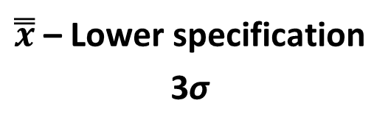
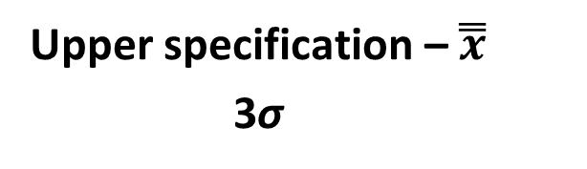
Example 5.5
Process Capability Index $C_{pk}$
C_{pk} = Minimum of ,
C_{pk} = Minimum of 26.2 – 20 , 30 – 26.2
3 ( 1.53) 3( 1.53)
C_{pk} = Minimum of 1.35, 0.83
C_{pk} = 0.83
Process does not meets 4-sigma level of 1.33

Slide 80
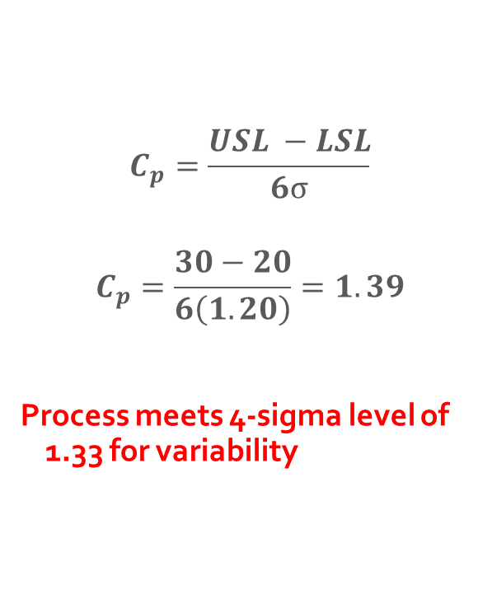
Example 5.5
Process Capability Ratio $C_{p}$
New Data is collected:
Upper specification = 30 minutes
Lower specification = 20 minutes
Average service = 26.1 minutes
σ = 1.20 minutes
$$C_{p}=\frac{USL −LSL}{6σ}$$
$$C_{p}=\frac{30−20}{6\left(1.20\right)}=1.39$$
Process meets 4-sigma level of 1.33 for variability

Slide 81
Example 5.5
Process Capability Index $C_{pk}$
x – Lower specification
3σ
Upper specification – x
3σ
C_{pk} = Minimum of ,
C_{pk} = Minimum of 26.1 – 20 , 30 – 26.1
3 ( 1.20) 3 ( 1.20)
C_{pk} = Minimum of 0.59 1.08
C_{pk} = 0.59
Process does not meets 4-sigma level of 1.33

Slide 82
Example 5.5
Process Capability Failure Rates

